Slide 1
Status of the WHO measles and rubella laboratory manual
Accelerating progress towards measles and rubella elimination
Geneva, Switzerland 21-23 June 2016
Jenny Rota, WHO consultant

Slide 2
Goal is to update information to reflect current responsibilities of the network, provide best practices, resources and guidelines
Five new chapters primarily focus on support for elimination of measles and rubella:
Laboratory’s role and responsibility in verification of elimination
Planning serosurveys and determination of population immunity
Case ascertainment in elimination setting
Expanding use of RT-PCR for diagnostic purposes
Emphasis on molecular epidemiology, analysis using MeaNS, RUBeNS
2

Slide 3
Features of the new edition of the lab manual:
Chapters of manual available as web pages with hyperlinks to annexes*,
and to related material in other chapters
Information in annexes can be comprehensive without lengthening core manual
Easy navigation to related topics and information in other sections or other chapters
Pdf format facilitates updating and printer friendly without need to download entire manual
*Annexes to consist of protocols, supplemental information, instructions
3

Slide 4

Initial efforts directed toward drafting 5 new chapters
Drafted in collaboration with members of lab manual working group
Generating first draft is a process… a reasonably complete first draft
of new chapters is nearly complete
Other chapters of manual with significant updating or expanded content
are well underway:
Data management and reporting of laboratory results
Quality assurance and quality control in network laboratories
Antibody assays for measles and rubella diagnosis
4

Slide 5

WHO Measles and Rubella Laboratory Manual
Chapter 1: Measles and Rubella: Overview
Chapter 7: Molecular epidemiology of
measles and rubella
Lab Manual home
Cover page
Introduction
Chapters
List of abbreviations
Annexes
Chapter 8: Measles and rubella diagnosis
and surveillance in low prevalence and
post-elimination settings
Chapter 2: The measles and rubella global
laboratory network
Chapter 3: Clinical samples for measles
and rubella antibody and molecular testing
Chapter 9: Determination of individual
and population immune status
Chapter 4: Antibody assays for measles
and rubella diagnosis
Chapter 10: Laboratory support for the
verification of elimination of measles and rubella
Chapter 5: Virus isolation and identification
of measles and rubella in cell culture
Chapter 11: Data management and reporting
of laboratory results
Chapter 6: Nucleic acid detection (RT-PCR)
for the molecular diagnosis of measles
Chapter 12: Quality assurance and quality
control in network laboratories
5

Slide 6
To do:
Complete first draft of chapters
Identify material needed for annexes and organize the drafts of the annexes
Determine which tables and figures to include with the chapters
Continue to review literature and other resources (especially WHO and regional publications) to assure that information is aligned with WHO recommendations
6

Slide 7
Timeline to be discussed in working group meeting Friday 24 June
Provisional timeline:
Review and revise (in progress) to complete first drafts of chapters with working
group members through 15 August
Request review and input from regional laboratory coordinators 15 August – 30 September
Preliminary advance drafts of chapters with annexes available 15 October
Solicit feedback from GMRLN 15 October-15 November
Full draft with annexes completed prior to 31 December 2016
7

Slide 8
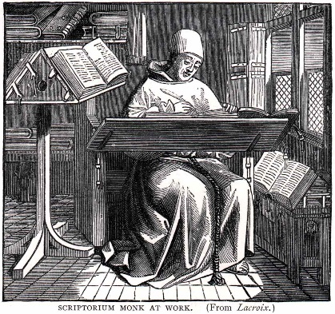
Thank you!
Lab manual working group: Mick Mulders, David Featherstone, Kevin Brown, David Brown,
Paul Rota, Marilda Siquiera, Joe Icenogle

