Slide 1
Next generation and Extended sequencing Working group (NEW) for measles and rubella
Alberto Severini on behalf of the N.E.W working group
National Microbiology Laboratory
Public Health Agency of Canada
alberto.severini@phac-aspc.gc.ca
Accelerating Progress towards Measles and Rubella Elimination, WHO Geneva, June 21-23, 2016

Slide 2
Background
The current genotyping approaches (N450 and the H gene for measles) is adequate for routine genotyping
However, as we are getting closer to the elimination of measles and rubella the diversity of their genomes diminishes
Standardised genotyping targets are often insufficient to distinguish repeated importations from local transmission
We need to develop an extended, practical, genotyping target to help document elimination and to rule out endemic transmission

Slide 3
The Next generation and Extended sequencing Working group (NEW) for measles and rubella
NEW was created in response to discussions on the need for more discriminating methods for the genotyping of measles and rubella.
The creation of NEW was one of the recommendation stemming form the 12th Global LabNet meeting in Istanbul.

Slide 4
Summary of NEW’s objectives
(formal terms of reference available)
To evaluate and share methods and applications for
  whole genome sequencing (WGS),
  next generation sequencing (NGS)
  extended genome sequencing for measles and rubella
To evaluate the utility of these methods for molecular surveillance
To establish a catalogue of WGS and extended sequencing
  collecting data on the rate of measles and rubella genomic change during outbreaks
  defining the variability of measles and rubella genomes.

Slide 5
To report to and advise the WHO measles and rubella laboratory network.
NEW met in Berlin on March 16-17, 2016
We developed a set of recommendations for GRMLN
We developed a set of standards for obtaining and depositing measles sequences

Slide 6
Utility
Extended and WGS are not meant to replace standard genotyping by N-450 for measles and 739 from the E1 gene for rubella
WGS or sequencing of the MF-NCR region of measles has proven its utility in low incidence setting, when standard genotyping fails
Extensive and uniform sampling of outbreaks, plus a prior knowledge of related sequences, are needed to make the results interpretable
It is recommended to obtain as many measles and rubella genomic sequences as possible to develop a database that will aid in outbreak investigations

Slide 7
Collaborations and data collection
It is recommended to obtain as many measles and rubella genomic sequences as possible to develop a database that will aid in outbreak investigations.
  NLs are encouraged to collect and store specimens (suited for culture isolation, if possible) for extended sequencing and to collaborate with GSLs and RRLs that have capacity for whole genome and/or extended sequencing.
MeaNS and RubeNS eventually be able accept measles and rubella whole genome sequences and measles MF-NCR sequences.

Slide 8
Standards (in brief)
At this time, there are no recommendations regarding standard protocols for obtaining sequences.
WGS-t - Whole genome excluding termini
MF-NCR sequence – From the stop codon of the M gene to the start codon of the F gene.
Next generation sequencing coverage minimum 10 reads
Sanger sequencing minimum bidirectional
No unsequenced bases

Slide 9
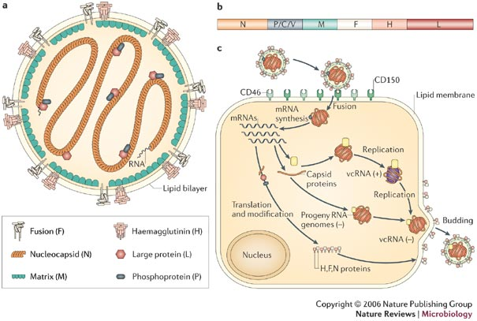
Measles genome
WHO genotyping N target 450 nt
MF-NCR target
1018 nt
Alternate genotyping target:
H ORF, 1854 nt
Moss & Griffin, 2006
WGS-t
15,875 nt

Slide 10
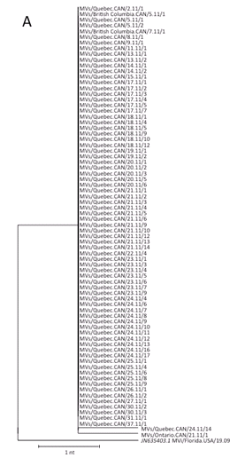
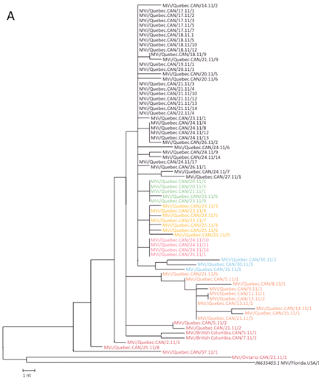
WGS resolves the chains of transmission
N450
Whole genome

Slide 11
D8 (Taunton) imported from the Netherlands in 2014
13-0338) MVs/Ontario.CAN/30.13
14-0492)MVs/BC.CAN/13.14/5
13-0340) MVs/British Columbia.CAN/31.13
14-0557)MVs/SK.CAN/16.14
14-0345) MVs/British Columbia.CAN/11.14/3
66
14-0558)MVs/SK.CAN/16.14/2
14-0407) MVs/Alberta.CAN/12.14/2
14-0309)MVs/BC.CAN/10.14/6
13-0599) MVs/Alberta.CAN/44.13/5
14-0560)MVs/SK.CAN/16.14/3
14-0436) MVs/British Columbia.CAN/13.14/3
14-0559)MVs/SK.CAN/17.14
14-0384) MVs/British Columbia.CAN/12.14/2
58
14-0573)MVs/SK.CAN/16.14/4
H gene
14-0298) MVs/British Columbia.CAN/09.14/4
MF UTR
14-0343)MVs/BC.CAN/11.14/2
13-0597) MVs/Alberta.CAN/44.13/3
14-0388)MVs/BC.CAN/12.14/6
14-0435) MVs/British Columbia.CAN/13.14/2
14-0391)MVS/BC.CAN/12.14/8
14-0349) MVs/British Columbia.CAN/11.14/7
14-0298)MVs/BC.CAN/09.14/4
14-0275) MVs/British Columbia.CAN/09.14/3
14-0435)MVs/BC.CAN/13.14/2
13-0596) MVs/Alberta.CAN/44.13/2
14-0349)MVs/BC.CAN/11.14/7
14-0433) MVs/British Columbia.CAN/13.14
14-0275)MVs/BC.CAN/09.14/3
14-0348) MVs/British Columbia.CAN/11.14/6
14-0433)MVs/BC.CAN/13.14
14-0273) MVs/British Columbia.CAN/09.14/2
52
14-0348)MVs/BC.CAN/11.14/6
13-0578) MVs/Alberta.CAN/44.13
14-0273)MVs/BC.CAN/09.14/2
14-0347) MVs/British Columbia.CAN/11.14/5
14-0407)MVs/AB.CAN/12.14/2
14-0271) MVs/British Columbia.CAN/09.14
14-0347)MVs/BC.CAN/11.14/5
13-0554) MVs/Alberta.CAN/43.1
14-0271)MVs/BC.CAN/09.14
14-0573) MVs/Saskatchewan.CAN/16.14/4
14-0346)MVs/BC.CAN/11.14/4
14-0391) MVs/British Columbia.CAN/12.14/8
14-0390)MVs/BC.CAN/12.14/7
99
14-0346) MVs/British Columbia.CAN/11.14/4
14-0345)MVs/BC.CAN/11.14/3
14-0002) MVs/Alberta.CAN/43.13/3
14-0387)MVs/BC.CAN/12.14/5
13-0528) MVs/Alberta.CAN/42.13/2
14-0311)MVs/BC.CAN/11.14
14-0560) MVs/Saskatchewan.CAN/16.14/3
14-0386)MVs/BC.CAN/12.14/4
14-0389) MVs/British Columbia.CAN/12.14/7
14-0437)MVs/BC.CAN/13.14/4
14-0001) MVs/Alberta.CAN/46.13/3
14-0385)MVs/BC.CAN/12.14/3
13-0527) MVs/Alberta.CAN/42.13
36
14-0301)MVs/BC.CAN/10.14/3
14-0559) MVs/Saskatchewan.CAN/17.14
14-0436)MVs/BC.CAN/13.14/3
14-0388) MVs/British Columbia.CAN/12.14/6
14-0384)MVs/BC.CAN/12.14/2
13-0554)MVs/AB.CAN/43.13
14-0343) MVs/British Columbia.CAN/11.14/2
13-0596)MVs/AB.CAN/44.13/2
13-0643) MVs/British Columbia.CAN/46.13
13-0597)MVs/AB.CAN/44.13/3
13-0498) MVs/Alberta.CAN/41.13
13-0599)MVs/AB.CAN/44.13/5
14-0558) MVs/Saskatchewan.CAN/16.14/2
13-0339)MVs/ON.CAN/30.13
14-0387) MVs/British Columbia.CAN/12.14/5
100
13-0600)MVs/AB.CAN/44.13/6
14-0311) MVs/British Columbia.CAN/11.14
13-0601)MVs/AB.CAN/44.13/7
13-0601) MVs/Alberta.CAN/44.13/7
13-0498)MVs/AB.CAN/41.13
14-0557) MVs/Saskatchewan.CAN/16.14
13-0527)MVs/AB.CAN/42.13
14-0386) MVs/British Columbia.CAN/12.14/4
14-0001)MVs/AB.CAN/46.13/3
14-0309) MVs/British Columbia.CAN/10.14/6
13-0528)MVs/AB.CAN/42.13/2
13-0600) MVs/Alberta.CAN/44.13/6
13-0578)MVs/AB.CAN/44.13
14-0437) MVs/British Columbia.CAN/13.14/4
14-0002)MVs/AB.CAN/43.13/3
14-0385) MVs/British Columbia.CAN/12.14/3
13-0340)MVs/BC.CAN/31.13
14-0301) MVs/British Columbia.CAN/10.14/3
13-0643)MVs/BC.CAN/46.13
D8 MVi/Manchester.GBR/30.94 U29285
JN635407.1 MVi/Texas.USA/4.07
14-0599)MVs/AB.CAN/16.14/5
14-0599) MVs/Alberta.CAN/16.14/5
100
JN635404.1 MVi/Virginia.USA/15.09
2
5

Slide 12
NEW current membership
WHO Mick Mulders
US CDC Bettina Benkamp
Min-hsin Chen
Joe Icenogle
Paul Rota
Public Health England Kevin Brown
Ana Penedos
Luxemburg Institute of Health Judith Huebschen
Claude Muller
RKI Germany Annette Mankertz
Sabine Santibanez
GIE - Russian Federation Sergey Shulga
NML Canada Joanne Hiebert
Alberto Severini

Slide 13
New members welcome
Laboratories with an interest in extended sequencing should consider joining NEW
Next NEW meeting will be on Friday, June 24 at !3:30 at HQ Rm M105 (open to all plenary meeting participants)

