Slide 1
Vaccine specific RT-PCR for measles (MeVA)
Accelerating Progress towards Measles and Rubella Elimination, WHO Geneva, June 21-23, 2016
Alberto Severini
National Microbiology Laboratory
Public Health Agency of Canada
alberto.severini@phac-aspc.gc.ca

Slide 2
Background
Approximately 5% of recently vaccinated individuals develop a rash about 10-12 days after vaccination
These vaccine reactions are clinically indistinguishable from measles.
These cases are measles IgM positive and MeV positive by PCR.
With the ubiquitous presence of recently vaccinated children, Vaccine MeV may be detected in unrelated rash diseases.
Genotyping is the only way to identify cases associated with MeV vaccine (genotype A) and avoid unnecessary public health responses.
But genotyping may take several days
Rapid confirmation of vaccine reaction is needed during outbreaks in which recently vaccinated individuals may also have been exposed to measles

Slide 3
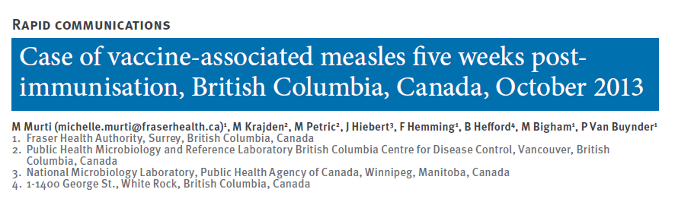
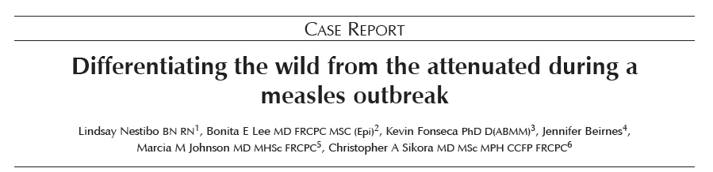

Slide 4
Objectives
Provincial laboratories in Canada kept asking us to confirm MeV vaccine presence on an urgent basis.
We developed a rapid RT PCR method to detect specifically MeV Genotype A (MevA)
Vaccine/wild type result can be obtained in a few hours
Platforms:
Roche 480 LightCycler (Canada NML)
Roche 480 LightCycler (Germany RKI)
ABI 7500 (US CDC)

Slide 5
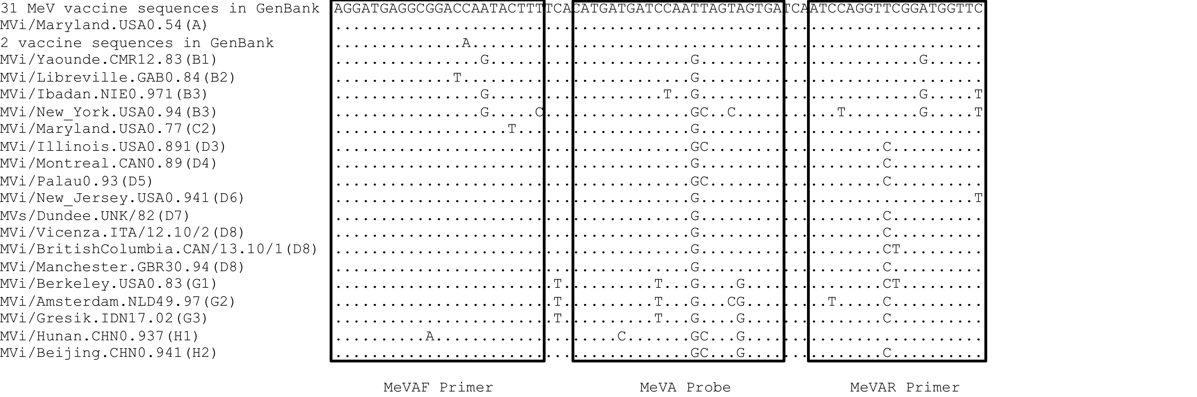
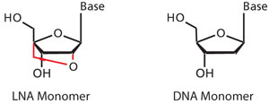
Target - N gene nt 478 to nt 548
Contains 4 “locked” nucleotides

Slide 6
Limit of detection
 | Copy # | Tested/positive | % positive
MeVA qPCR | 10³ | 18/18 | 100
 | 10² | 18/18 | 100
 | 10¹ | 13/20 | 65
 | 10⁰ | 1/18 | 6
 | 10⁻¹ | 0/3 | 0
MeV qPCR | 10³ | 18/18 | 100
 | 10² | 18/18 | 100
 | 10¹ | 18/18 | 100
 | 10⁰ | 4/18 | 22
 | 10⁻¹ | 0/3 | 0

Slide 7
Cp Correlation
Slope = 0.88 (0.82-0.94, 95% CI)

Slide 8
Sensitivity and Specificity
Centre | n | Sensitivity (95% CI) | Specificity (95% CI) | Genotypes
NML | 184 | 0.97 (0.90-0.99) | 1.00 (0.95-1.00) | B3, B2, C1, D2, C2, D3, D4, D5 D6, D7, D8, D9, D10, G1, G2, E, H1, H2
CDC | 28 | 0.94 (0.68 – 1.00) | 1.00 (0.70-1.00) | B3, D4, D8, D9, G3, H1 AIK, CAM-70, Edmonston-Zagreb, Moraten
RKI | 158 | 0.95 (0.83- 0.99) | 0.99 (0.95- 1.00) | B3 , D4 , D5, D6, D8, D9, D10, G2, H1

Slide 9
Testing algorithm at the NML
We routinely test with MeVA :
suspected vaccine cases, on request by the client laboratory
Every suspected case from children of vaccination age.
We have detected about 60 vaccine-associated cases so far
Always test in parallel with the routine MeV RT-PCR
report vaccine positive cases immediately
confirm by routine sequencing
We have developed a multiplex test (in validation phase)

Slide 10
In conclusion
MeVA RT-PCR is specific for MeV genotype A
The clinical sensitivity is 97% of the MeV RT-PCR
The lower limit of detection is about 1 log higher that the MeV RT-PCR
MeVA RT-PCR shows similar performance on Roche LightCycler 4800 at the NML and RKI and on ABI 7500 at the CDC
It works only with the Qiagen QuantiTect Kit but not with the Invitrogen SS3 kit
A D5 strain tested false positive for vaccine strain

Slide 11
Caveats and limitations
The sensitivity of MeVA RT-PCR is slightly lower that the MeV general methods
the occasional vaccine mistaken for wild type does not jeopardise measles surveillance
It is conceivable that there are still unreported variants which are identical to genotype A in the MeVA PCR target.
we genotype all the MeVA positive specimens, and we withhold the official report in cases in which measles vaccine is unlikely.
one false positive D5 at RKI

Slide 12
Acknowledgments
At the NML
Felicia Roy
Lillian Mendoza
Joanne Hiebert
At the CDC
Rebecca McNall
Bettina Bankamp
Paul Rota
At the RKI
Amy Lüdde
Nicole Friedrich
Annette Mankertz

