Slide 1


Accelerating Progress towards Measles and Rubella Elimination
Hotel Royal, Geneva, Switzerland, 21-23 June 2016
Laboratory session LS5: Polio containment and Global Health Security
Salon Voltaire
Poliovirus containment:
Explaining the process

Slide 2
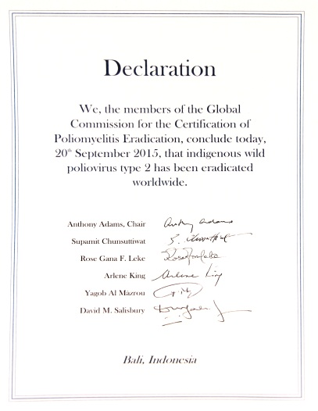
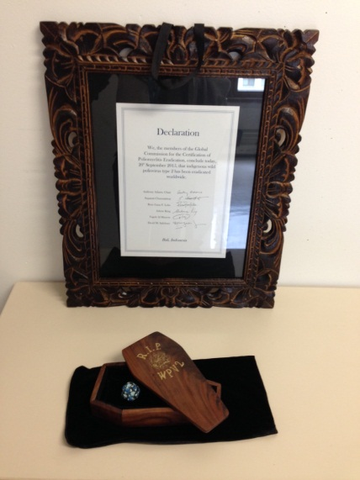
Global eradication of WPV2
September 2015
GCC declaration:
WPV2 is an eradicated agent!

Slide 3
Rationale for switching from tOPV to bOPV
  Today:
  No circulating WPV2, but type 2-cases (VDPV2)
  The risks associated with the use of tOPV outweigh the benefits
  Therefore: switch from tOPV to bOPV.

Slide 4
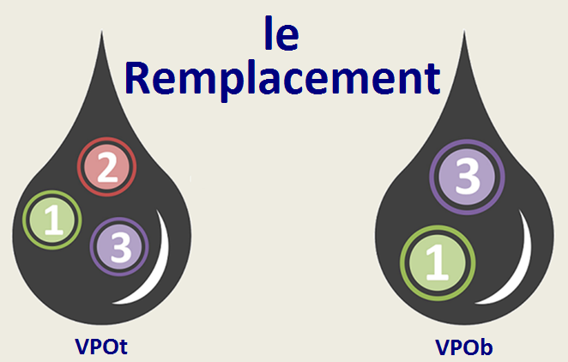
The switch from tOPV to bOPV
tOPV
bOPV
Organized in all 155 tOPV-using countries in April 2016

Slide 5
Where are Sabin2 and Sabin2-like viruses now?
Specimens of human origin collected where Sabin2 was circulating
Stool collections, respiratory sample collections
Research, surveillance, diagnostic facilities
Vaccine vials (tOPV, mOPV2)
Vaccine manufacturing plants (s-IPV)
Materials associated with clinical trials
…
Wherever it needs to be, we want it to stay!

Slide 6
Containment of type 2 poliovirus (PV2)
Goal: prevent inadvertent or malicious release from facilities and transmission of PV2 to people
Phase I: Reduce the number of facilities containing PV2:
Countries: identify and destroy unneeded PV2
  WPV2 by end-2015
  OPV2/Sabin2 by July 2016 (draft guidance developed!)
Countries: designate poliovirus-essential facilities for needed PV2
Phase II: Reduce risk in remaining facilities:
Countries and facilities: ensure appropriate containment of PV2 in designated poliovirus-essential facilities

Slide 7
Risk of transmission of poliovirus from facilities
Poliovirus transmission risk = Likelihood of release x Consequences of release
Very
High
Number of facilities
High
Likelihood of release
Moderate
Low
Very
Low
Population immunity
Environment & location
Consequences of release

Slide 8
Phase I: Reduce number of facilities
The current relative risk of release is decreasing as the number of facilities holding PV2 is decreasing. Destruction of stocks is reducing the number of facilities and the risk of release.
Consequences of release depend on immunization coverage of population and location of facilities.
Risk of reintroduction (Oct 2015)
Risk of reintroduction at end of Phase I
Very
High
Very
High
High
destruction
High
Likelihood of release
Moderate
Likelihood of release
Moderate
Low
Low
Very
Low
Very
Low
Consequences of release
Consequences of release
Facilities with PV2 materials

Slide 9
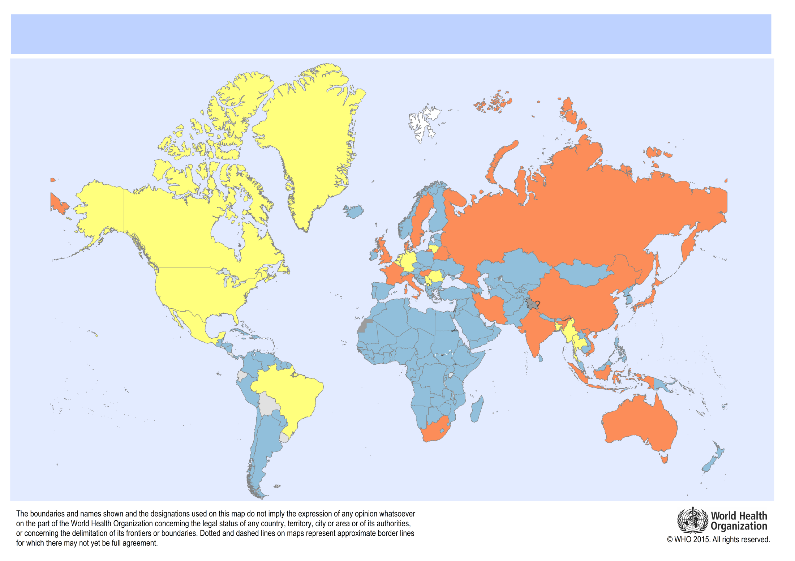
Reported progress on completion of GAPIII Phase I
Target 1: Complete Phase I (WPV2/VDPV2) by 31 Dec 2015
20 countries reported hosting 55 designated PEFs
No WPV2 or VDPV2 retained (N=170)
Countries with designated poliovirus-
essential facilities for containment of WPV2 or OPV2/Sabin2 materials (N=17)
Reports pending completion (N=13)
Report not received in WHO/HQ
Data source: WHO Database ; Last updated 24 May2016
Data source: WHO Database ; Last updated 13 April 2016

Slide 10
Strategies to ensure timely completion of Phase I
Target 2: Complete Phase I (Sabin2) by 31 July 2016
Communications:
  Awareness raising & engagement of non-polio networks
Provision of technical support:
  Establishment of Containment advisory Group (CAG) to address concerns (1st mtg: May 2016)
  Development of guidance for the identification, storage and handling, or disposal of materials potentially infected with Sabin or Sabin-like poliovirus type 2 (shared with CAG for comments by 24 June)

Slide 11
Guidance for the completion of Phase I of GAPIII (OPV2/Sabin2)
The term ‘polio-essential facilities’ includes laboratories not specifically working on polio, but holding materials contaminated or potentially contaminated with polioviruses (e.g. rotavirus labs)
Non-polio labs may qualify as PEFs by meeting GAPIII requirements
Equally, the certificate of participation in the poliovirus containment certification scheme (CP) and the interim containment certificate (ICC) of the GAPIII Containment Certification Scheme (CCS) are available to non-polio labs during Phase II of GAPIII
Inactivated extracts of full length PV2 RNA or cDNA are not considered infectious or subject to containment, provided appropriate assurance is provided that NO PV2 is reconstructed in facilities based on genetic engineering, synthetic biology or other technologies that make use of genetic material.
For operational reasons, the target date for completion of the second part of GAP III Phase I (OPV2/Sabin2) is extended from end-July to 31 December 2016.
All facilities holding poliovirus contaminated or potentially contaminated clinical specimens collected before end-July 2016 are requested to complete the inventory and submit to NPCC/NCC/WHO by 31 October 2016
Inventories are expected to support national decisions for PEF designations by December 2016

Slide 12
Phase II: Ensure appropriate containment of PV2 in poliovirus-essential facilities
Poliovirus-essential facilities:
Poliovirus vaccine production facilities
Research facilities
Facilities housing repositories

Slide 13
Phase II: Ensure appropriate containment
Risk of reintroduction as Phase II progresses
Facility safeguards
Very
High
2015
High
Likelihood of release
Moderate
Low
Very
Low
Population immunity
Environment & location
Consequences of release
Facilities with PV2 materials before implementation of GAPIII
Implementation of GAPIII with time
Facilities with PV2 materials after implementation of GAPIII

Slide 14
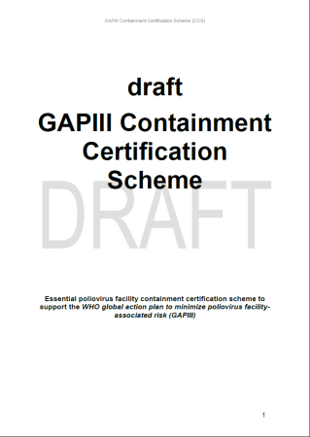
Phase II: Implement containment measures
Finalizing the Containment Certification Scheme (CCS) to ensure that GAPIII:
Is appropriately and timely implemented in all PV-essential facilities, and that
Robust, transparent and equitable mechanisms are applied for containment certification across sectors and geographies
  Certificate of containment CC
  Interim certificate of containment ICC
  Certificate of participation CP

Slide 15
Strategies to support implementation of Phase II
Target 3: Implement Phase II of GAPIII
Support to stakeholders
  Containment Certification Scheme (CCS)
  Interim containment certification options available in preparation for full implementation of GAPIII requirements in Phase III
  GCC to ensure international oversight through globally harmonized containment certification procedures following CCS
  Regional GAPIII Implementation and certification trainings for national containment authorities and poliovirus-essential facilities
  Development of pool of GAPIII containment auditors to support countries' containment certification efforts

Slide 16
Conclusions
Poliovirus containment is a major global endeavour
Destruction of polioviruses eliminates risk of release from facilities
Global oversight of containment is necessary
Countries and facilities are key to poliovirus containment
      We count on your help to engage them…

Slide 17
Thank you
For any questions or suggestions on poliovirus containment, GAPIII and CCS
please contact:
previsanin@who.int
GAPIII is available at:
http://www.polioeradication.org/Portals/0/Document/Resources/PostEradication/GAPIII_2014.pdf

Slide 18
For all materials described in Module B collected BEFORE 31.7.16
B1
The facility DOES NOT possess any PV2 infectious or potentially infectious materials
B2
PV2 infectious or potentially infectious materials collected BEFORE 31 Jul 2016 will NOT be retained beyond 31 Dec 2016
B3
PV2 infectious or potentially infectious materials collected BEFORE 31 Jul 2016 are planned to be retained BEYOND 31 Dec 2016 in a form where all present PV2 is inactivated
B4
Planned retention, in their native form, of PV2 infectious or potentially infectious materials collected before 31 Jul 2016
must be in agreement with the responsible national authority
Responsible national authority
designates poliovirus-essential facility (dPEF)
Full length PV2 RNA no longer present by 31 Dec 2016
Full length PV2 RNA still present
by 31 Dec 2016 and responsible national authority AGREES to their retention outside of containment
Full length PV2 RNA still present
by 31 Dec 2016 and responsible national authority DOES NOT agree to their retention outside of containment
dPEF
engages in certification process against Annex 2 of GAPIII⁺ (WPV2/VDPV2)
dPEF for engages in certification process against Annex 3 of GAPIII⁺ (OPV2/Sabin2)
Transfer or Destroy
before 31 Dec 2016
National authority for containment (NAC)
delivers CP to dPEF
National authority for containment (NAC)
delivers CP to dPEF
Transfer or destroy
before 31 Dec 2016
dPEF demonstrates implementation of Annex 2 of GAPIII⁺ (WPV2/VDPV2)
dPEF demonstrates implementation of Annex 3 of GAPIII⁺ (OPV2/Sabin2)
dPEF not
ICC-certified
NAC inspects dPEF
NAC certifies dPEF (ICC) following CCS
Transfer or Destroy
No further containment measures required with these materials for the purpose of PV eradication
Continue retention of WPV2/VDPV2
Continue retention of OPV2/Sabin2
Retention of WPV/VDPV materials beyond Global Certification of the Eradication of Poliomyelitis
(expected 2019) will only be allowed if full compliance against Annex 2 of GAPIII requirements is certified
Retention of OPV/Sabin materials three months after bOPV cessation (expected 1 year after Global Certification of the Eradication of Poliomyelitis) will only be allowed if full compliance against Annex 3 of GAPIII requirements is certified
_____________________________________
⁺ Global Action Plan (GAPIII) http://www.polioeradication.org/Portals/0/Document/Resources/PostEradication/GAPIII_2014.pdf
PV: Poliovirus; NAC: National authority for containment; CP: Certificate of Participation; ICC: Interim Certificate of Containment; CC: Certificate of Containment; CPE: Cytopathic effect

Slide 19
For all materials described in Module B collected AFTER 31.7.16
C1
PV2 infectious materials collected AFTER 31 July 2016 (new faecal or respiratory specimens originating from recent OPV-using countries) will ONLY be used under the defined conditions.
Facilities should implement Annex 6 of GAPIII.
Inoculation of polio-permissive cells (Annex 3) with extracts of specimens listed in Module B
Inoculation of polio non-permissive cells with extracts of specimens listed in Module B
CPE is observed or
Absence of CPE is not confirmed
CPE is not observed
No further containment measures required with these materials for the purpose of PV eradication
Such materials should no longer be handled but be safely and securely stored until and NOT beyond confirmation of presence of PV2 (signed non-retention policy)⁺
In situations where and when mOPV2 stockpiles were deployed to respond to WPV2/VDPV2 outbreaks after 31 Jul 2016, the handling and storage of materials collected from such a time and place should follow the algorithm “For all materials described in Module B collected before 31 Jul 2016” until 3 months after the last use of mOPV2 in that area.
Presence of PV2 confirmed
Presence of PV2 not confirmed
Transfer to a
dPEF holding a CP
Destroy
_____________________________________
⁺ as described in the Global Action Plan (GAPIII) http://www.polioeradication.org/Portals/0/Document/Resources/PostEradication/GAPIII_2014.pdf
PV, Poliovirus; NAC, National authority for containment; CP, Certificate of Participation; ICC, Interim Certificate of Containment; CC, Certificate of Containment; CPE, Cytopathic effect

