Slide 1


Measles Rubella surveillance in India
Dr. Pradeep Haldar
Deputy Commissioner (Immunization)
Ministry of Health & Family Welfare
Government of India

Slide 2
Lab supported MR surveillance India (2005-2016)
Lab supported MR Surveillance started in (2005)
Outbreak reduced from 10 to 5 cases per week (2014)
Outbreak reduced from 20 to 10 cases per week (2012)
Outbreak reduced to 5 cases per 4 weeks (2015)
Modified cases based surveillance started (2016)
Expanded to entire country
Outbreak threshold reduction triggered by outbreak size

Slide 3
Laboratory supported MR-surveillance in the country
  Established on AFP surveillance platform
  Community reach enhanced through >41,000 reporting network
    Government health facilities, Private sector, non-formal sector, temples etc
    Active case search in community - preliminary/detailed investigation
Aggregate surveillance
  Unique ID for each outbreak with line-list of core variables
  Active case search & management integral part of investigation
Transitioning to modified case-based surveillance
  Started from Karnataka, 2016
  In process of expansion

Slide 4
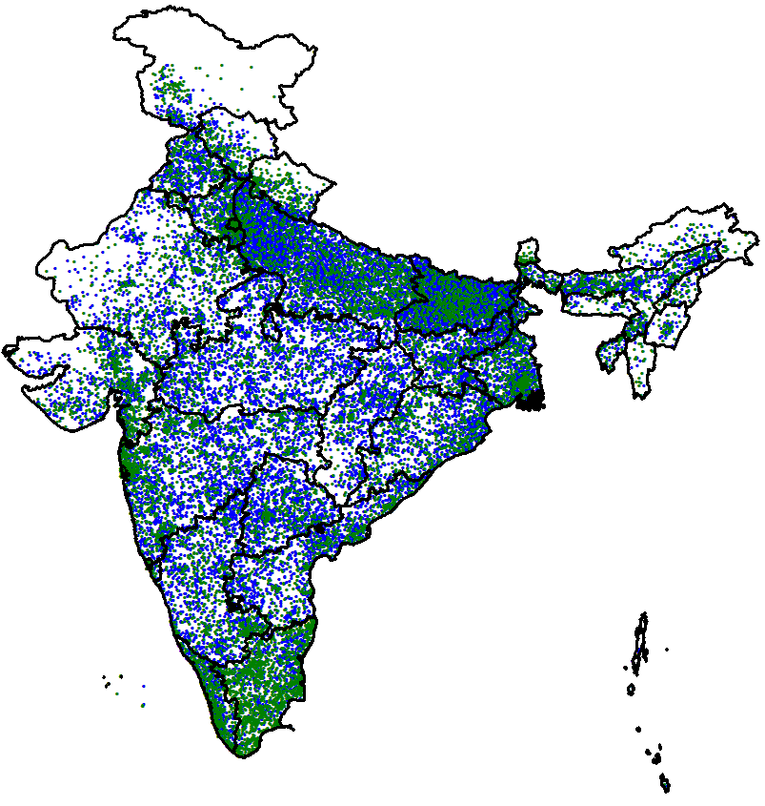
AFP-MR reporting network across the country
*Indian System of Medicine
Reporting Units (11,557): Send a report of AFP / suspected Measles cases, weekly
Informing Units (29,826): Inform as and when they see AFP/suspected Measles case

Slide 5
WHO accredited Measles-Rubella laboratory network
Map showing geographical spread of MR Laboratory network Net
12 - National laboratories
2 - National reference laboratories
7 out of 14 lab tests throat swabs/urine specimens for genotype characterization

Slide 6
Case-definition of suspected/clinical Measles
Any person with fever and maculo-papular rash
with either cough/ coryza / conjunctivitis
or
Any person where clinician suspects
measles infection/death
For field epidemiological investigation, suspected measles would be a case within last 3 – months of onset
Future plans - rash and fever surveillance

Slide 7
MR outbreak investigation algorithm
Weekly desk review of measles data at district
> 5 cases in a block/planning unit
A death in a block/planning unit
Suspected outbreak flagged with Measles Outbreak - ID
Preliminary case search in community to look for minimum 5 cases-clustering
If yes, Epidemic Response Team mobilized to conduct detailed outbreak investigation with H to H case search
Case management and line listing of all cases with core variables & unique ID

Slide 8
Outbreaks investigated, India, 2012-2017*
Number of outbreaks
*as on 16th Aug 2017
Surveillance sensitivity enhanced and expanded to entire India by 2015

Slide 9
MR outbreak cases (2016)
2016
N = 32,934
Cases detected in community - active case search
Cases reported from reporting network
Active case search triggered from outbreak investigation adds ~ 50% of cases which would be otherwise missed
*: as on 16th Aug 2017

Slide 10
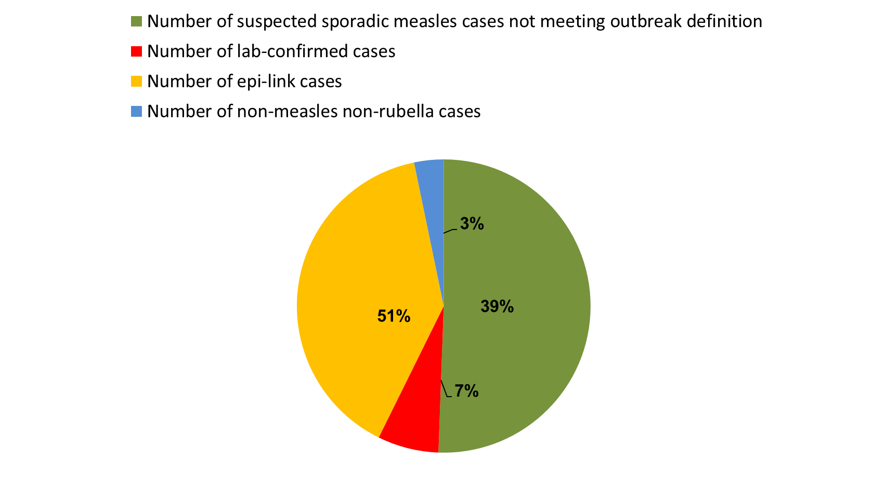
Status of MR cases reported - investigated - classified
Jan to Jul 2016
Jan to Jul 2017*
Overall: cases declining
Outbreaks: reducing Sporadic cases: increasing
Switch to modified case base provide better epidemiological data
N = 55,350
N = 34,024
Sporadic suspected measles cases
Lab confirmed cases
EPI link cases
Non measles non rubella cases
Outbreak
*: as on 16th Aug 2017

Slide 11
Transitioning to modified case-based
MR Surveillance in India

Slide 12
Modified case-based MR Surveillance algorithm
Suspected MR case reported
Collect Serum samples and throat swab/urine samples
Each sporadic case investigated
Every Tuesday district review based on Weekly Reporting
> 5 cases clustered or a death in 4 weeks period in a contiguous area
Outbreak flagged with ID
No
No outbreak Investigation;
Yes
Conduct outbreak investigation as per protocols i.e. house to house cases search and line listing, samples for serology & virology. Case management with referral services under medical officer supervision.

Slide 13
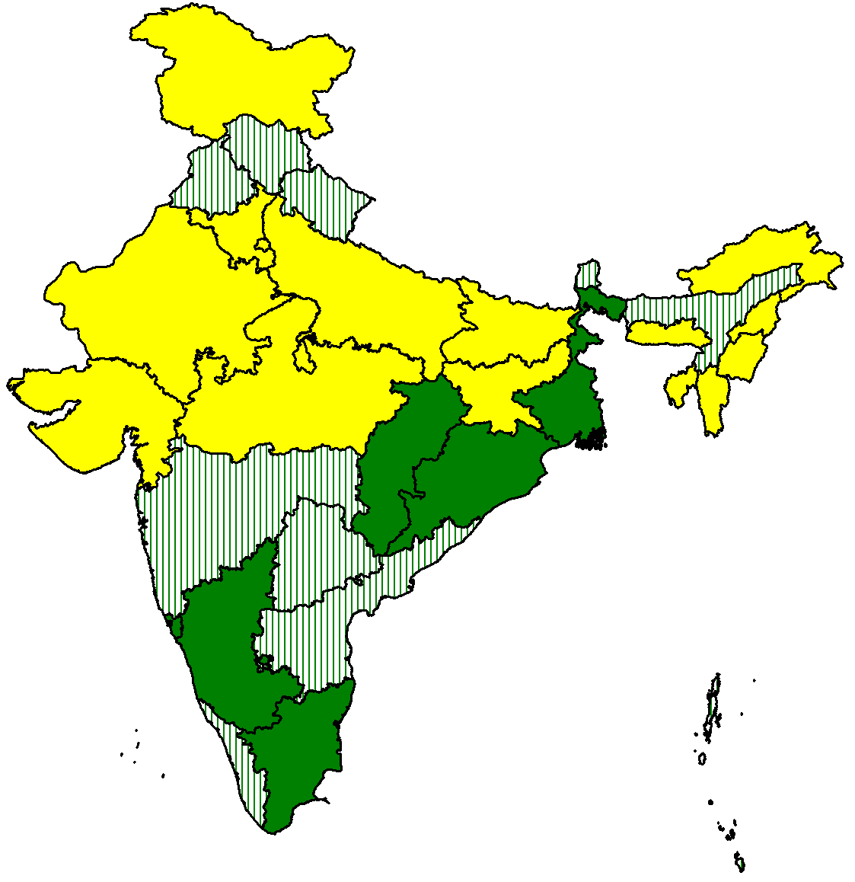
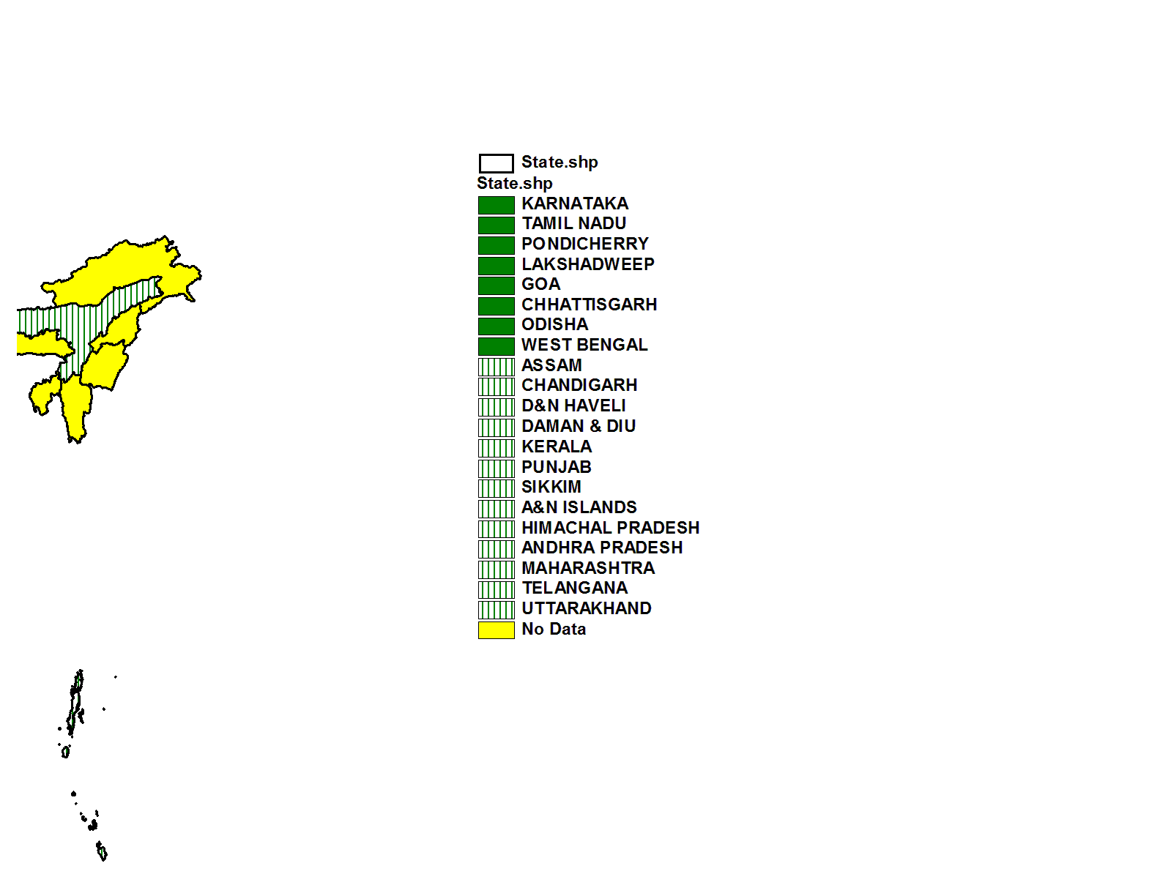
Case-based MR surveillance expansion plan - India
State | Year
KARNATAKA | Case based in place from quarter-4 2016 to quarter-3 2017
GOA
LAKSHADWEEP
PONDICHERRY
TAMIL NADU
CHHATTISGARH
ODISHA
WEST BENGAL
ASSAM | 2017
CHANDIGARH
D&N HAVELI
DAMAN & DIU
KERALA
PUNJAB
SIKKIM
A&N ISLANDS
ANDHRA PRADESH
HIMACHAL PRADESH
MAHARASHTRA
TELANGANA
UTTARAKHAND
ARUNACHAL PR. | 2018
BIHAR
DELHI
JAMMU & KASHMIR
MANIPUR
MEGHALAYA
MIZORAM
NAGALAND
TRIPURA
HARYANA
JHARKHAND
UTTAR PRADESH
GUJARAT
MADHYA PRADESH
RAJASTHAN
2017
Case based surveillance
(Introduced Qtr-4 2016 to Qtr-3 2017)
2017
2018

Slide 14
Trend of Measles and Rubella cases in Karnataka, 2005-2017*
MCV2 Introduced
cases
Switched to case-based
*: as on 16th Aug 2017

Slide 15
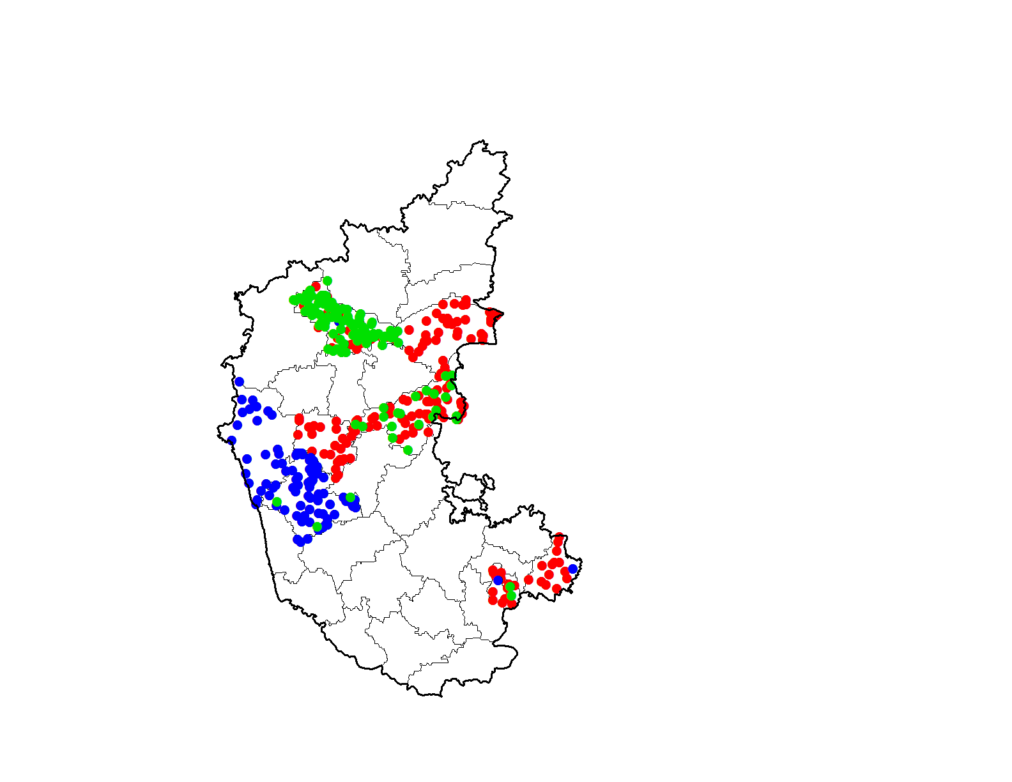
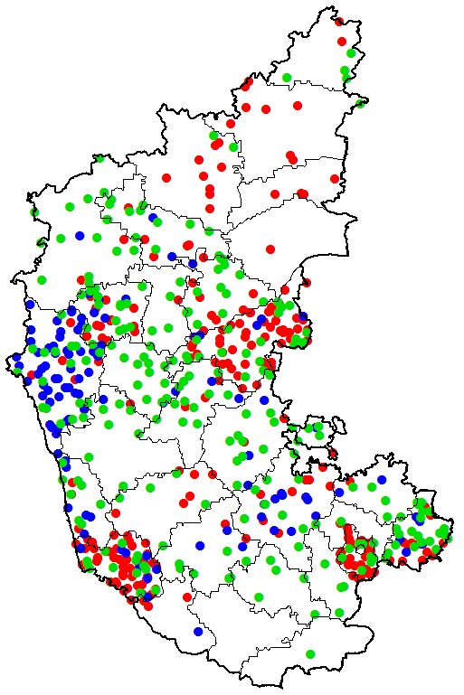
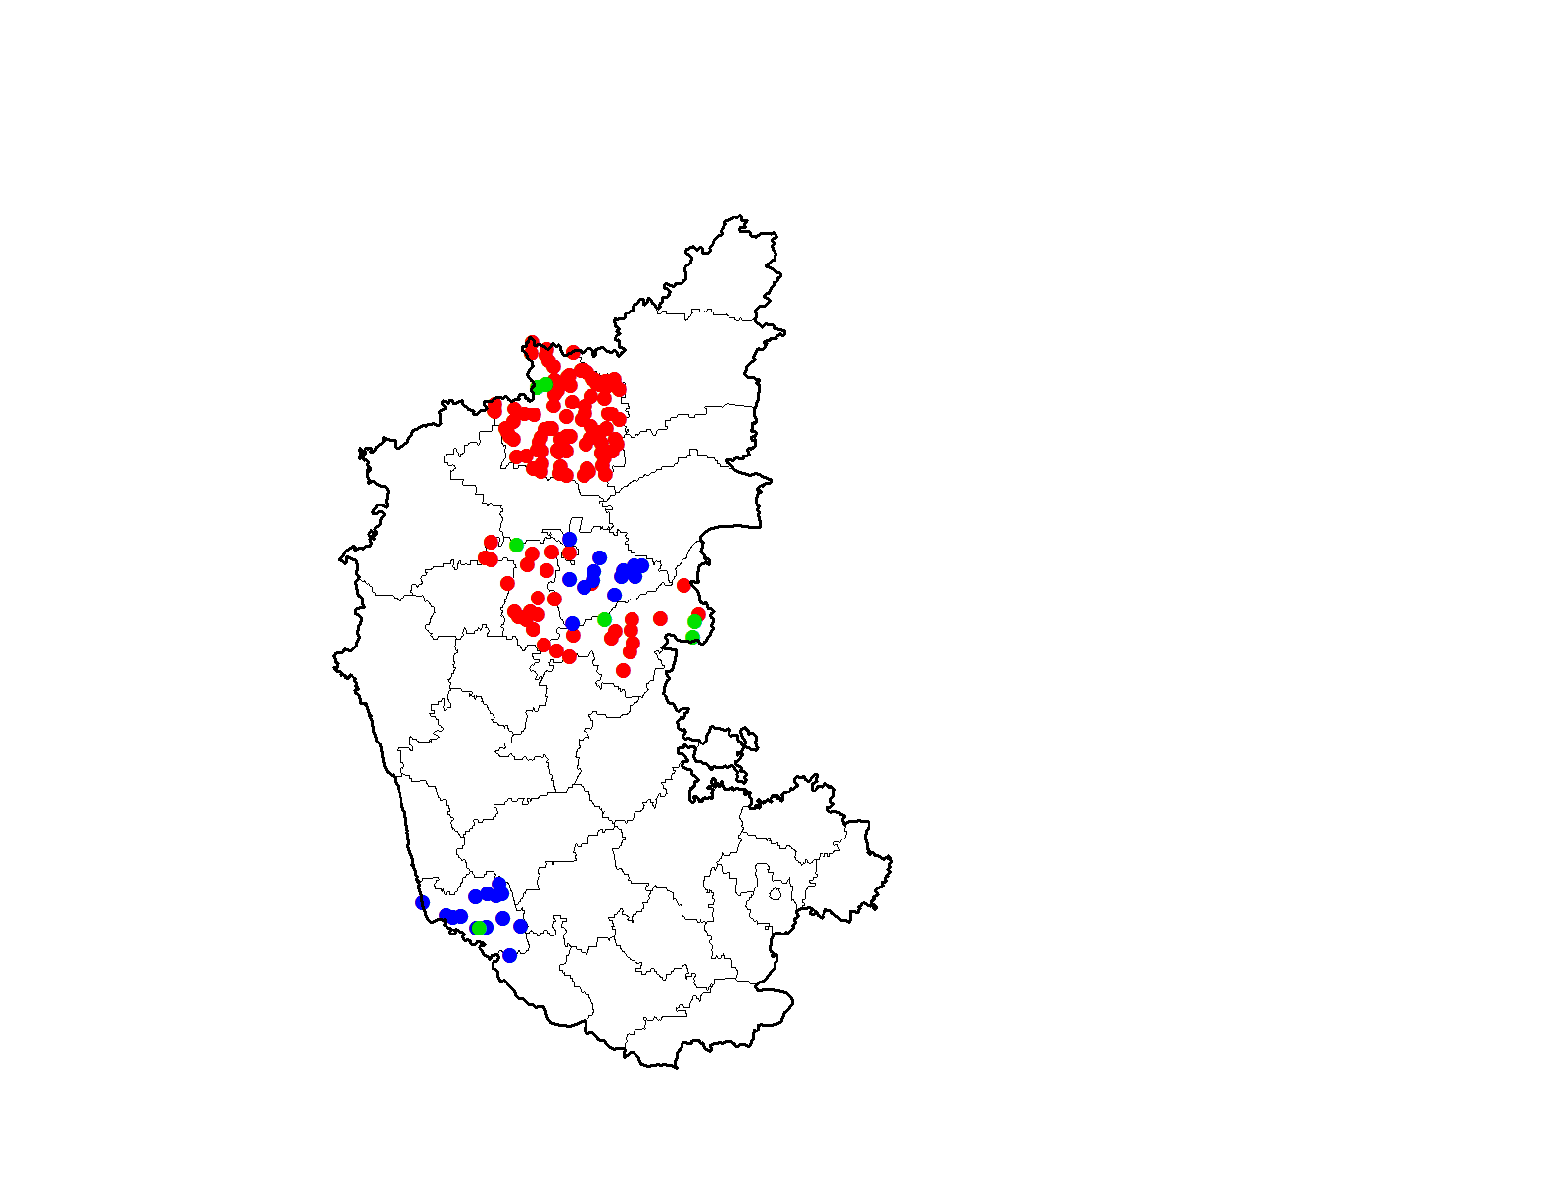
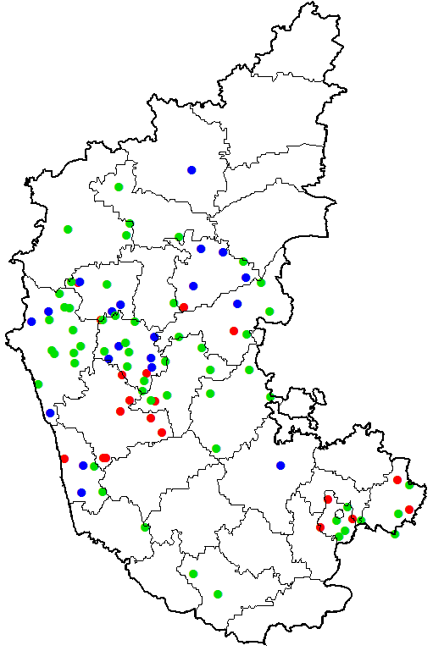
MR cases classified (Lab-confirmed & Epi-linked), Karnataka
In earlier Outbreak-based
surveillance model
After transitioning to
Case-based surveillance
Sep 2015 – Feb 2016
Sep 2016 – Feb 2017
(Before MR campaign)
 | Sep15 – Feb16 | Sep16 – Feb17
Measles cases | 170 | 233
Rubella cases | 88 | 110
Negative cases | 111 | 242
After SIA
Mar 2016 – Jul 2016
Mar 2017 – Jul 2017
(After MR campaign)
 | Mar16 – Jul16 | Mar17 – Jul17
Measles cases | 120 | 19
Rubella cases | 27 | 20
Negative cases | 7 | 55
*: as on 16th Aug 2017

Slide 16
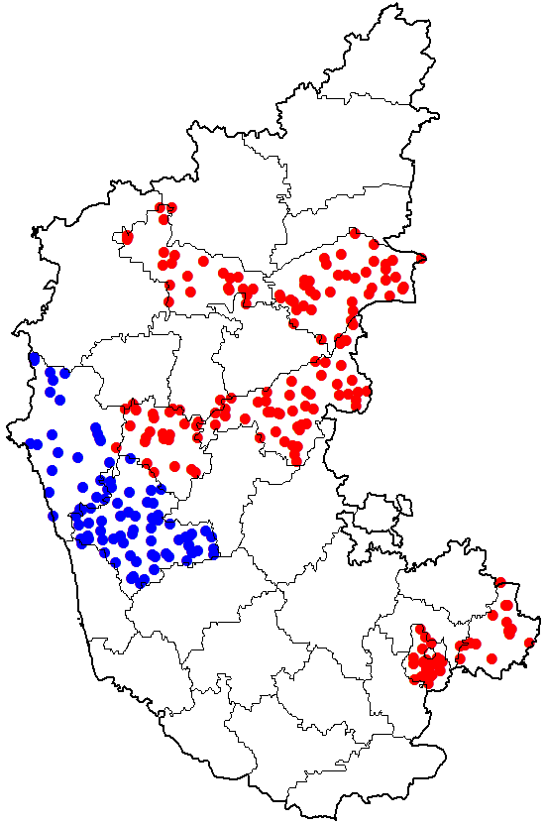
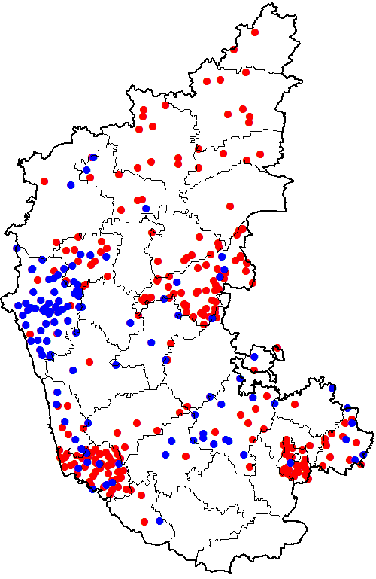
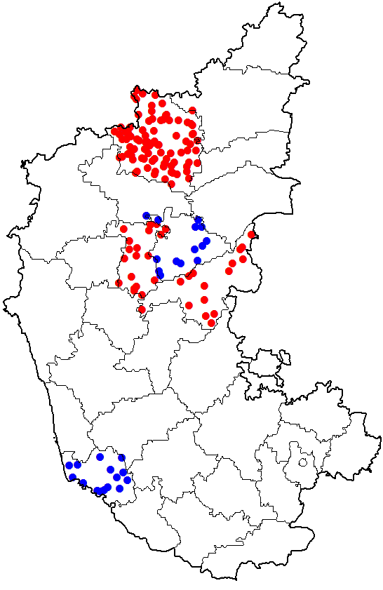
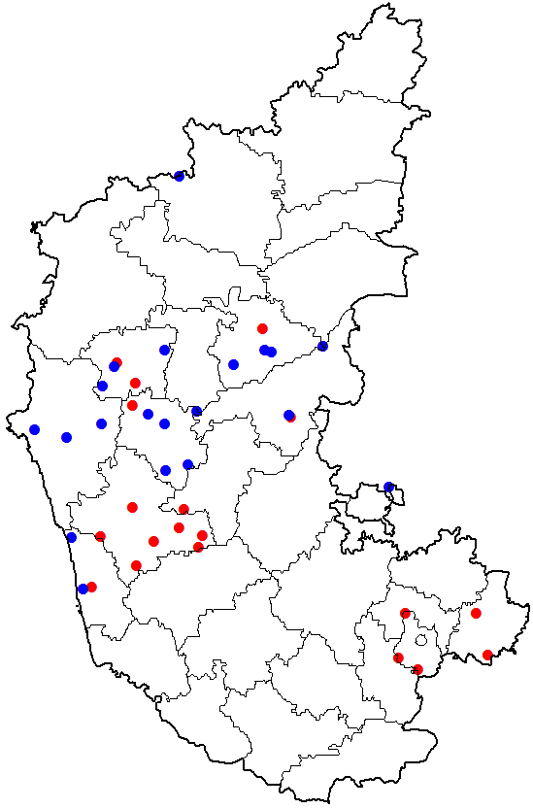

MR cases classified (Lab-confirmed & Epi-linked), Karnataka
In earlier Outbreak-based
surveillance model
After transitioning to
Case-based surveillance
Sep 2015 – Feb 2016
Sep 2016 – Feb 2017
(before MR campaign)
 | Sep15 – Feb16 | Sep16 – Feb17
Measles cases | 170 | 233
Rubella cases | 88 | 110
After SIA
Mar 2016 – Jul 2016
Mar 2017 – Jul 2017
(after MR campaign)
 | Mar16 – Jul16 | Mar17 – Jul17
Measles cases | 120 | 19
Rubella cases | 27 | 20
*: as on 16th Aug 2017

Slide 17

Country’s measles/rubella virus genotypes, 2014-2017*
2017*
2016
B3 (n=0)
D4(n=7)
D8(n=83)
2B(n=8)
B3 (n=2)
D4(n=15)
D8(n=202)
2B(n=3)
2014
2015
B3 (n=1)
D4(n=19)
D8(n=127)
B3 (n=1)
D4(n=15)
D8(n=129)
2B(n=1)
*: MR surveillance data updated till June- 2017

Slide 18
Sentinel site CRS Surveillance

Slide 19
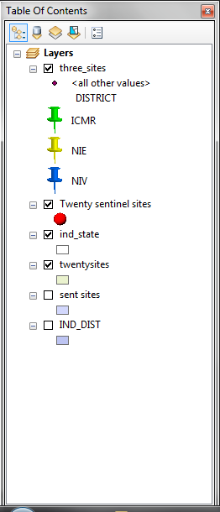
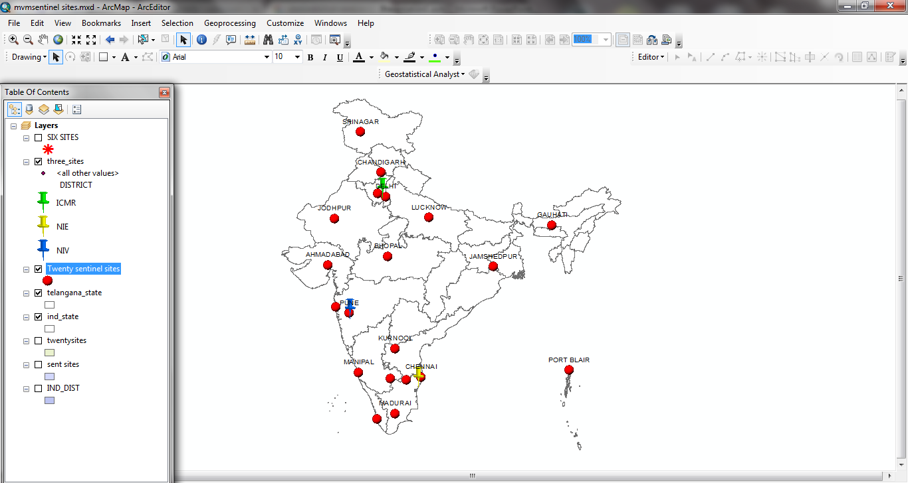
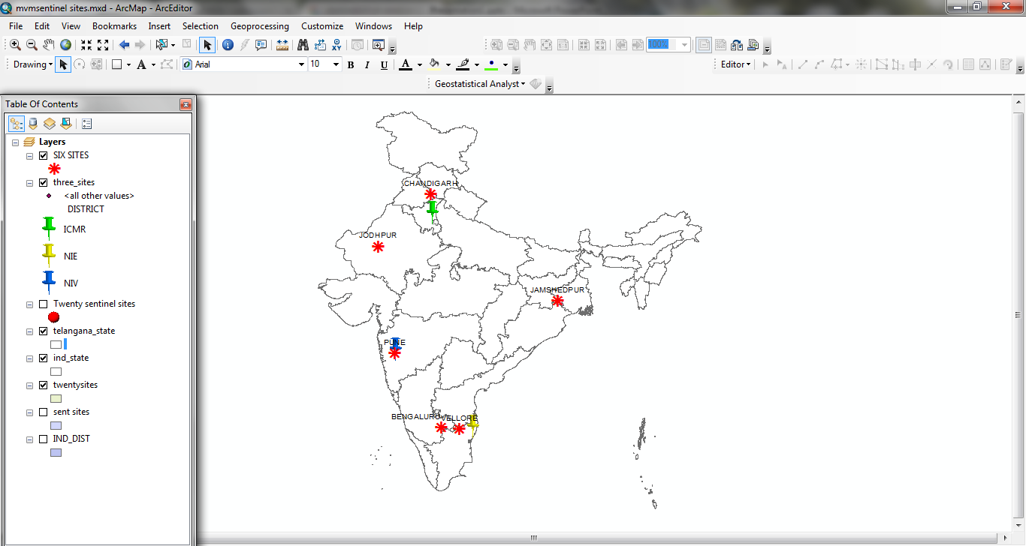
CRS sentinel surveillance sites
Six sites operational:
AIIMS, Jodhpur
CMC, Vellore
IGICH, Bengaluru
KEM, Pune
PGIMER, Chandigarh
TMH, Jamshedpur
ICMR, DELHI
NIE, CHENNAI
NIV, PUNE
Proposed 20 surveillance sites

Slide 20
Summary and Way Forward
MR surveillance sensitivity is being enhanced through phased transitioning to modified case-based surveillance
Expand modified case-based surveillance in entire country by 2018
Modified case base has advantage of active case search in community and also focuses on sporadic case.
Proficient MR laboratory network established for all states
  Quality assurance by WHO
Genotyping of circulating MR viruses are being strengthened to augment genetic data base
Changing to Fever-Rash (more-sensitive) surveillance eventually

Slide 21
Advantages of Modified case-based MR surveillance
Sensitivity increases
  as sporadic cases lab confirmed
  Community search associated with outbreak captures additional cases not capture through reporting system
If cases are below threshold of outbreak will capture all cases
No additional burden on lab or human resource
Line-list generated from sporadic case and or outbreak investigation has data core-variables for all

Slide 22
Thank You

