Slide 1
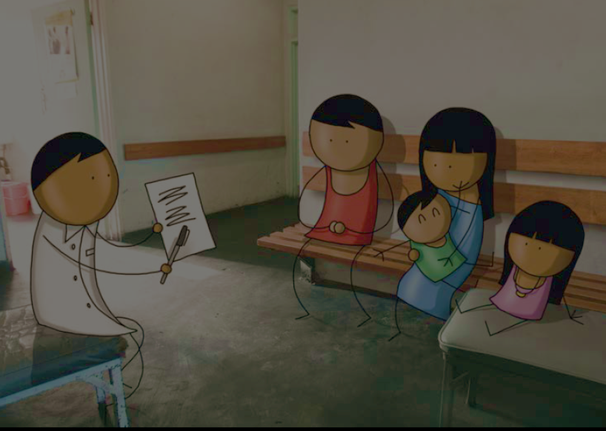
Stakeholder Consultation
15 September 2015
M&RI Annual Meeting

Slide 2
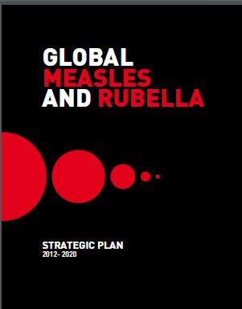
Measles and Rubella Update
Stakeholder Consultation
Global strategic plan’s five strategies
    Achieve & maintain high levels of population immunity by providing high vaccine coverage with 2 doses of measles- and rubella-containing vaccines
    Monitor disease using effective surveillance and evaluate programmatic efforts to ensure progress
    Develop & maintain outbreak preparedness and respond rapidly to outbreaks & manage cases
    Communicate & engage to build public confidence and demand for immunization
    Perform research & development needed to support cost-effective operations & improve vaccination & diagnostic tools
Global strategic plan’s four principles
    Country ownership & sustainability
    Routine immunization & health systems strengthening
    Equity
    Linkages
Financial stability
Red Cross National Society Roundtable
14 September 2015

