Slide 1

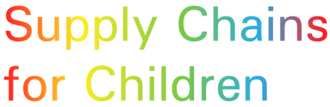

Measles Containing Vaccines
Overview of Supply through UNICEF
2017 Measles & Rubella Initiative Partners’ Meeting
7-8 September 2017

Slide 2
MCV Demand through UNICEF 1/2
UNICEF procures MCV on behalf of on average 75 countries per year
Total value of vaccines procured: US$ 143 million (2016) with GAVI, Government funding, UNICEF Programmes and MRI funding
Demand for Measles and MR vaccine is heavily driven by requirements for supplementary activities, with 75% of MR and 60% of Measles vaccine supplied for supplementary activities
Between 2014 and present, estimated 44 million children in humanitarian situations were reached with measles vaccine procured through UNICEF
Multi-year tender covering supply requirements through UNICEF for 2018-2020 will be finalized shortly

Slide 3
MCV Demand through UNICEF 2/2
Number of SIAs supplied:
Note for 2017: number based on actual & remaining forecast

Slide 4
MCV Supply Market
Currently, there are two manufacturers producing WHO pre-qualified Measles vaccine, one manufacturer with MR vaccine and three manufacturers with MMR vaccine.
Pipeline manufacturers are in development of Measles, MR and MMR vaccines.
UNICEF’s market update detailing market situation for MCV is available on UNICEF’s website https://www.unicef.org/supply/index_71360.html. Updated version is currently in development and will be published in Q4/2017.
UNICEF also publishes markets dashboard monitoring market dynamics of more than 50 essential commodities, among them being Measles, MR and MMR https://www.unicef.org/supply/files/UNICEF_SD_Market_Dashboard_Table_March_2017_-_Final.pdf.

Slide 5
CHALLENGES
Forecasting (in)accuracy
Short term fluctuations of demand:
      Require flexibility from the manufacturers to react to large increases/decreases in demand at short notice.
      Due to long production cycle, postponements of campaigns impact manufacturers’ predictability of production and thereby cost. This may translate into higher offered price.
    Long term fluctuation vs. tender forecast:
      Impacts reliability of signaling of trends to the industry
      Production scale influences cost and thereby offered price
When planning a campaign, countries may not realize the Gavi approval timelines and vaccine delivery lead time.
Changes within countries’ regulatory requirements, countries’ procurement policies and increasing complexities in country specific import requirements impact delivery timelines.

Slide 6
PROGRESS
Sufficiency of supply for planned activities. Availability of MCV vaccines enables supply to catch up campaigns (including India and Indonesia) while maintaining supply to other activities, if planned and forecasted with suppliers
GAVI’s new Measles and MR Strategy provides greater visibility into countries’ long-term immunization plans which allows for enhanced visibility into long-term supply requirements
UNICEF intends to establish access to 5 dose vial presentation of Measles and MR if and when countries’ demand materializes

Slide 7
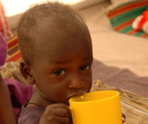

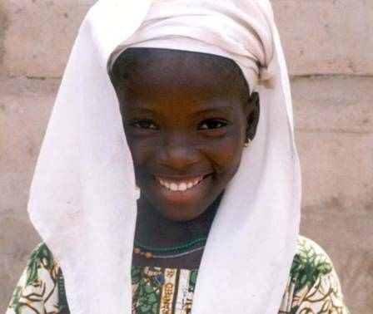
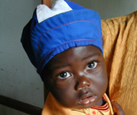


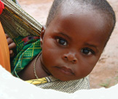
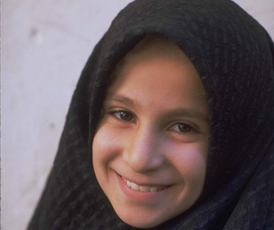
Thank you

