Slide 1

MINISTRY OF HEALTH
Measles and Rubella Surveillance Experience from NPHL-Tanzania
Presenter: Medard Beyanga
Date: March 6th - 7th 2024

Slide 2
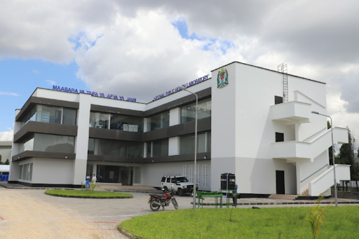
History of NPHL
Established in 2008, formerly called NHLQATC
  Occupying the 3rd and 4th floor of the NIMR building
  ISO15189:2022 Accredited with certification number MED001 since 2014
Built a new laboratory BSL 3 to expand the diagnosing capacity
In 2020, changed to National Public Health Laboratory (NPHL)
The COVID-19 pandemic contributed to its reforms
The NPHL is under the Ministry of Health (MoH)

Slide 3
Core functions
Disease surveillance e.g. Measles, influenza, rubella, rotavirus etc
Outbreak Response of Emerging and Re-emerging diseases
Quality assurance programs (EQA production and distribution)
Centre of training of Biosafety and biosecurity, QMS, and medical diagnosis (malaria microscope, bacteria culture etc.)
Calibration of laboratory equipment and certification of BSc

Slide 4
TESTING CAPACITY AND TECHNOLOGY
Molecular Biology
Genomic sequencing
Serological tests
Microbiology

Slide 5
Measles and Rubella Surveillance
NPHL employs a total of 132 staff, with 7 working in the serology section and 5 in the molecular section.
The lab has been performing measles and rubella serological tests since 2013

Slide 6
Measles and Rubella Serology testing
Due to a shortage of staff involved in COVID-19 testing, measles and rubella testing were suspended during the pandemic
New staff were added at NPHL by MoH & trained by WHO with its network partners - on Serological testing for measles and rubella, quality control & data management
Testing operations were resumed in September 2021 after the NPHL received all reagents from IRR
From 2021 to 2024, the NPHL consistently achieved outstanding results in the External Quality Assessment (EQA) both in serology IgM and molecular testing

Slide 7
Measles and Rubella Samples Received NPHL from Sept2021- Dec 2023 for Serological testing

Slide 8
Measles and Rubella serology IgM PT Results
Year | Measles PT results (%) | Rubella PT results (%)
2021 | 100 | 100
2022 | 100 | 100
2023 | 100 | 100

Slide 9
Measles and Rubella Molecular testing
In November 2022, a scientist from NPHL received WHO/CDC/UVRI facilitated training on molecular testing, including RT-PCR and sequencing alongside several other countries
After training Practice panel was given to all participants
Reagents were order through IRR and then received
The Practice panel was tested within a month, and then the Proficiency panel was also tested- again in short spell of time
The score was a perfect 100% for both the practice and mEQA panels

Slide 10
Measles and Rubella Molecular testing
The laboratory was approved by WHO to start testing by June 2023 and reporting in the Global MeaNS2 database
5 more staff were given on- job training to competency level
SoPs were developed
The laboratory has continued to exhibit excellent performance by passing the 2024 External Quality Assessment (EQA)
The lab successfully submitted 63 sequences to MeaNS2
The submitted sequences were ALL B3

Slide 11
Measles and Rubella Samples Received NPHL from Nov 2022 to Dec 2023 for molecular testing
Year | Total number of samples received | Number of samples tested
2022 | 10 | 10
2023 | 112 | 112

Slide 12
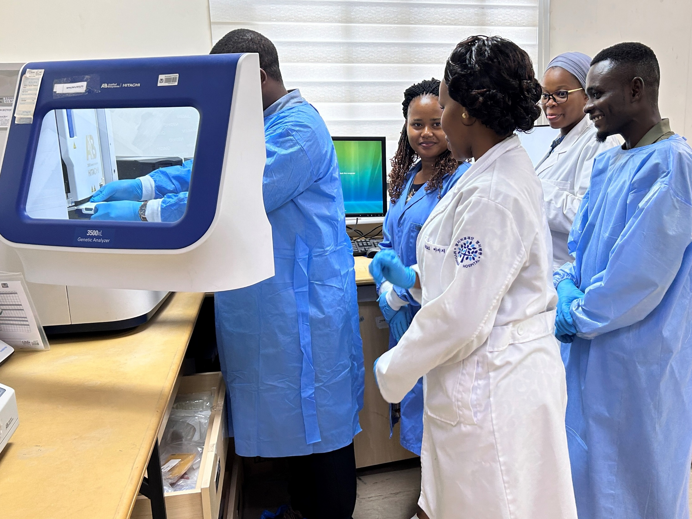
NPHL staff trained to conduct Measles and Rubella genotyping and sequencing

Slide 13
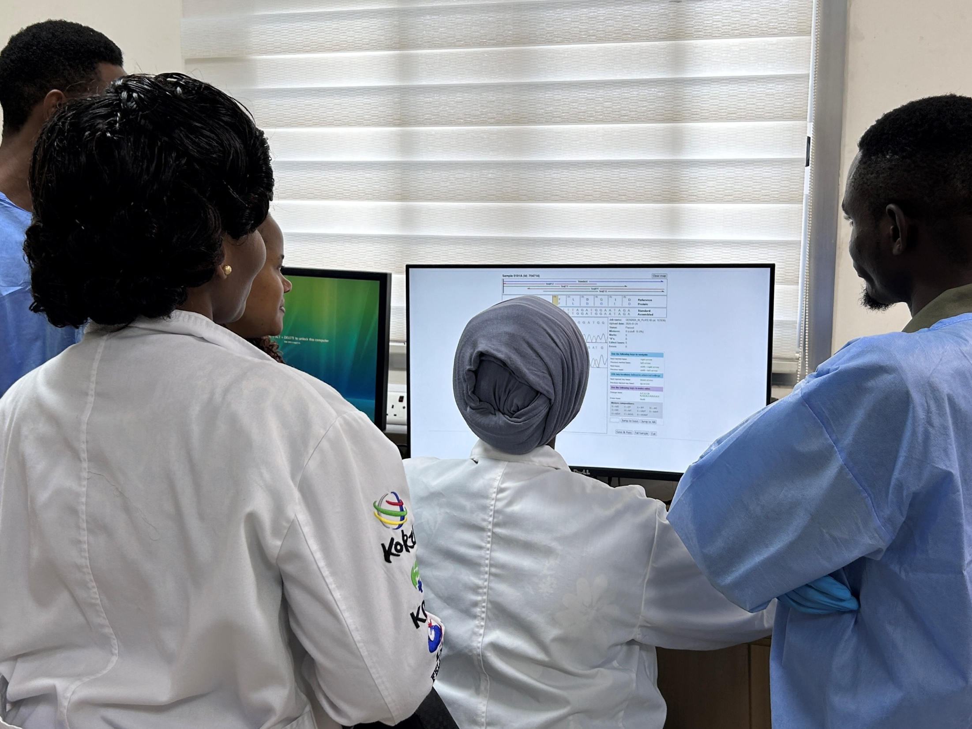
Sequencing editing by using Recall software

Slide 14
Conclusion
The robustness of measles and rubella laboratory surveillance is intricately tied to the effective functioning of the laboratory
Enhancing the NPHL through the integration of cutting-edge technology and collaboration between pillars (epidemiology, coordination) is anticipated to significantly elevate the synergy between surveillance efforts and laboratory capabilities
NPHL has demonstrated capability to locally generate the needed laboratory evidence for documenting Tanzania national progress towards measles/rubella elimination

Slide 15
Acknowledgment
The National Public Health Laboratory (NPHL) expresses its gratitude to the following organizations for their ongoing support. We appreciate their commitment to sustaining the assistance they provide to the NPHL.
  WHO
  US-CDC, UVRI, VIDRL, UK-HSA
  MoH
  The Global Measles and Rubella Partnership

Slide 16


Asante Sana

