Slide 1
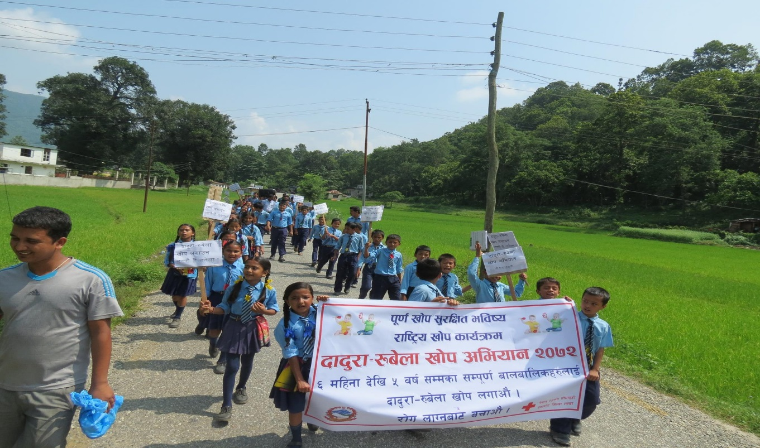
14th Measles and Rubella Initiative Meeting
Nepal Red Cross Society’s Initiative
Mona Aryal
HOD, Health Service Department
Nepal Red Cross Society
National Headquarter

Slide 2
Nepal Red Cross Society
At a glance
The largest humanitarian organizational with its network in all the 75 districts of Nepal with its million plus members, 90,000 volunteers and hundreds of staff.
Vision: to provide immediate relief to human suffering and reduce vulnerability, under the Fundamental Principles of the Red Cross,
Mission: relieve human suffering and to reduce vulnerability

Slide 3
Key Program and services
Disaster Management
Water Sanitation and Hygiene Promotion (WASH) Program
First Aid
National Blood Transfusion Service
Community Resilience Program(CPR)
Health Sector
Partner and development(HV and Communication)
Gender and Inclusion
Organizational Development
Junior and Youth Activities
PMER Capacity and Enhancement Program
Finance Development and Resource Mobilization
Community Eye Care and Health Promotion Program
Eye Hospital and Community Eye Care Centers
Nepal Blood Transfusion Service
Emergency Transportation (Ambulance Service)
Capacity Building in Emergency Health
Maternal and Child Health

Slide 4
Disease Burden
Year | Total no. of reported suspected measles cases | Number of suspected measles outbreak investigated | Number (%) of outbreak confirmed as measles outbreaks | Number (%) of outbreak confirmed as rubella cases | Number(%) of outbreak confirmed as mixed measles and rubella outbreaks
2003 | 13,344 | 67** | 41(61) | ** | ***
2004 | 12,047 | 197 | 138(70) | 13(7) | 11(6)
2005 | 2,023 | 46 | 1(2) | 36(78) | 2(4)
2006 | 2,838 | 31 | 2(6.5) | 24(77) | 1(3)
2007 | 1,415 | 21+ | 3(14) | 11(52) | 1(5)
2008 | 2,089 | 39 | 6(15) | 27(69) | 1(2.5)
2009 | 4,340 | 66 | 2(3) | 57(89) | -
2010 | 2,550 | 33 | 7(21) | 19(58) | 2(6)
2011 | 734 | 64 | 22(35) | 31(49) | 4(6)
2012 | 791 | 68 | 16(24) | 32(48) | 7(11)
2013 | 335 | 3 | 0(0) | - | -
2014 | 353 | 2 | 0(0) | - | -
Source: JRF WHO-UNICEF/WHO-IPD, HMIS/DoHS/MoHP,**Outbreak investigation and laboratory testing started in March 2003;***Lab-confirmed for rubella specific IgM did not started until January 2004;”+* Samples QNS from 2 outbreaks

Slide 5
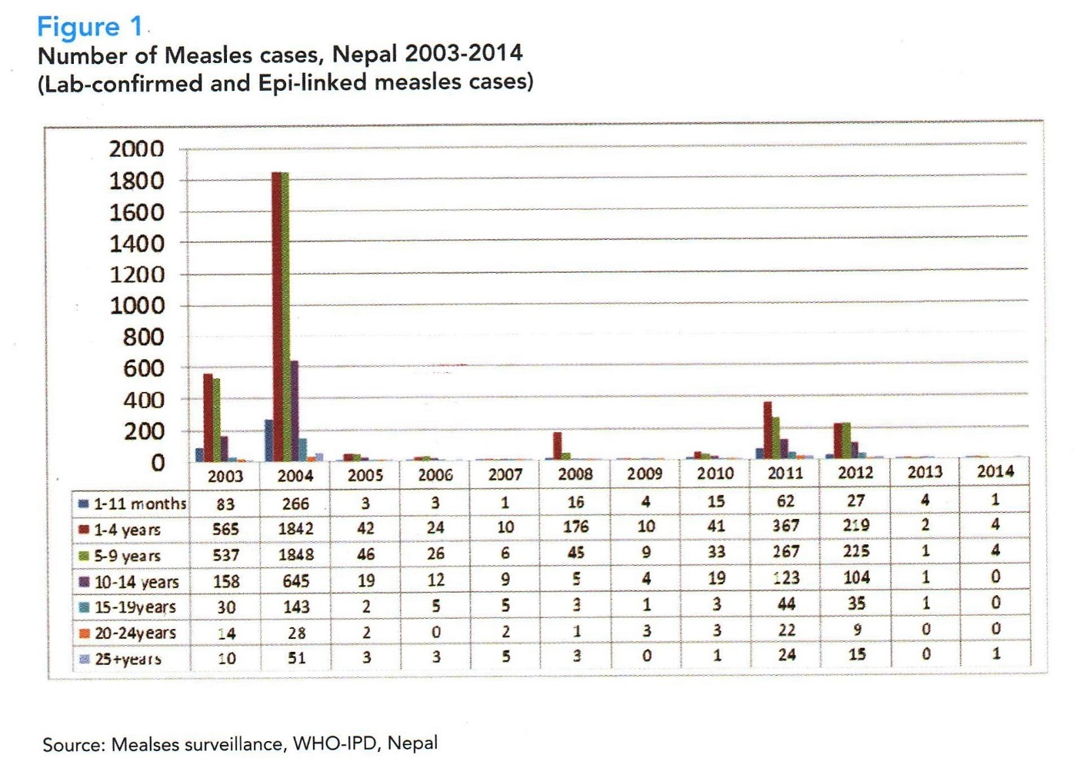

Slide 6
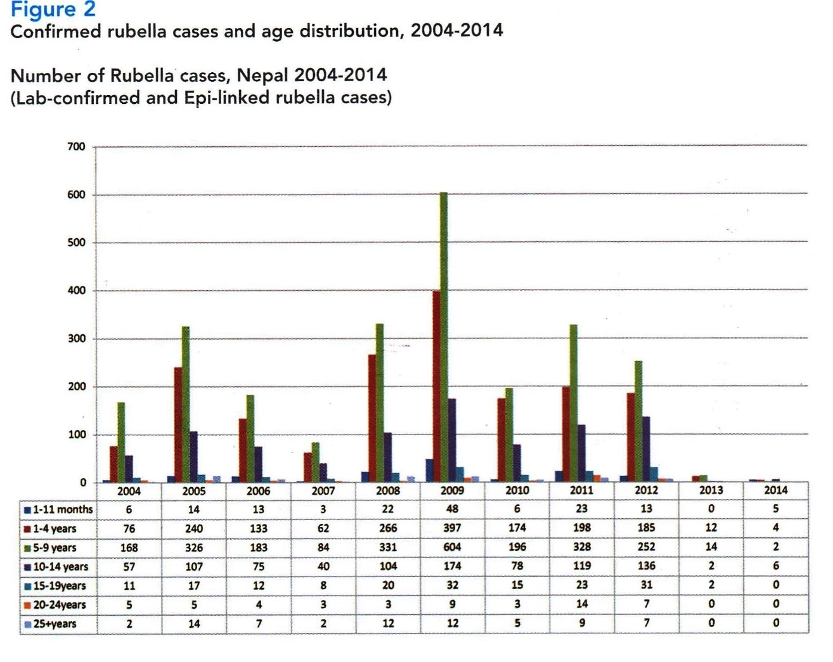
Source: Measles surveillance, WHO-IPD, Nepal

Slide 7
Working in partnership
NRCS headquarters coordinates with Ministry of Health and Population (MoHP), World Health Organization (WHO) and UNICEF at the national level and their sub ordinate units at the district level
NRCS district chapters works in close coordination with district public health office (DPHO)/ district health office (DHO), municipality office and district education office in the programme districts.
At community level, NRCS volunteers work closely with female community health volunteer (FCHV) of Government, Junior/Youth Red Cross Circle, Mothers Group, Teacher Sponsors, Community Leaders

Slide 8
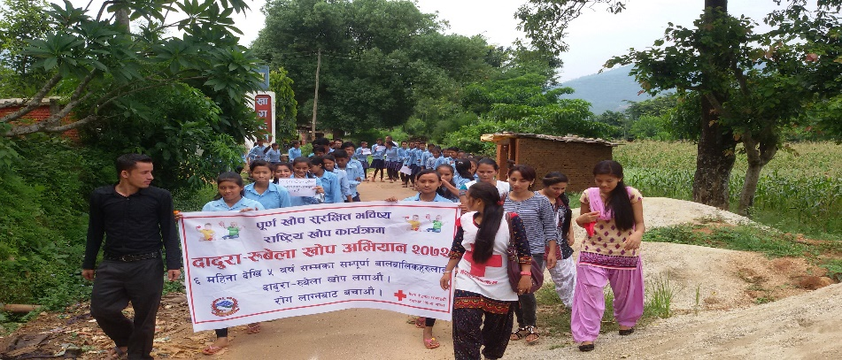
Immunization Campaigns
Past Campaigns
Nepal Red Cross Social Mobilization for Measles/Polio/Integrated Campaign in 2008 in 17 districts (1258 volunteers mobilized)
Social Mobilization for Measles Campaign in 2009 in 11 districts (over 700 volunteers mobilized)
Social Mobilization for National Immunization Day in 2011 in 14 districts (595 volunteers mobilized)
Measles Rubella Social Mobilization Campaign 2012 in 30 municipalities of 22 districts (over 1000 volunteers and supervisors oriented and mobilized)
Social Mobilization for Total Immunization 2015 in 2 districts (405 volunteers and 8 supervisors mobilized)
Current Campaign
Social mobilization for Measles Rubella Campaign in 14 most earthquake affected districts of Nepal, 2015 (435 volunteers mobilized)

Slide 9
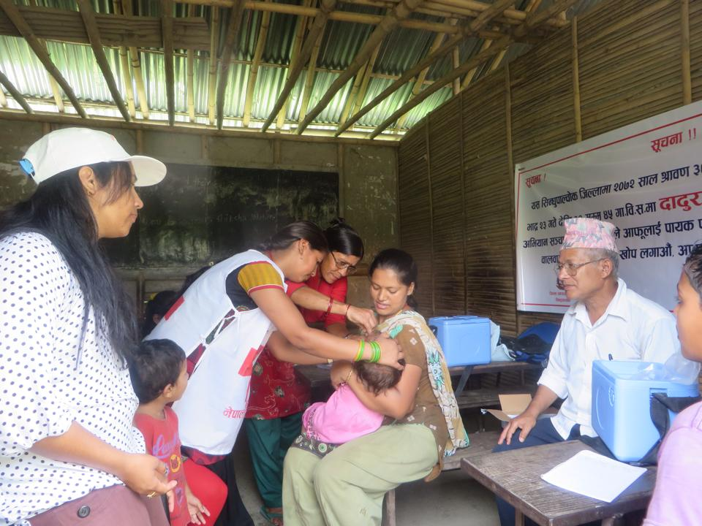
Immunization Campaigns
Role of NRCS in the campaigns
As an auxiliary to government NRCS took part in in the campaigns through social mobilization activities.
Activities such as door to door visits, mass awareness rallies, distribution of IEC materials, display of banners with campaign messages at strategic locations
Future Campaigns
NRCS is planning to support Ministry of Health and Population in achieving country targets of Measles Elimination and Rubella/Congenital Rubella Syndrome(CRS) control in Nepal (Strategy 2015-2019)
Discussions with various Partner National Societies to support NRCS program plan

Slide 10
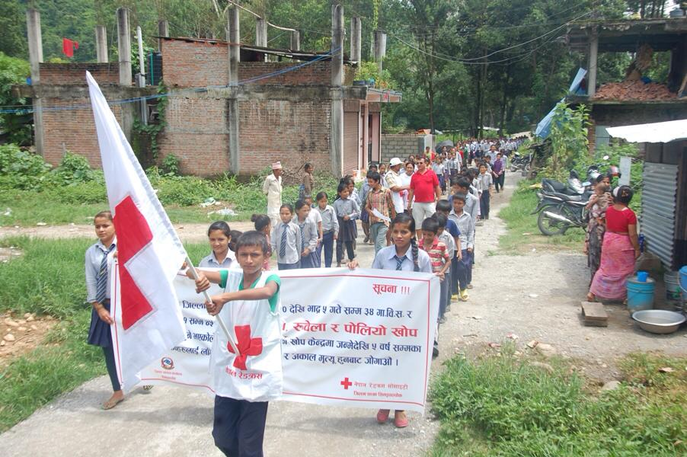
Routine Immunization
Besides the involvement in program activities during the implementation period, NRCS volunteers support Female Community Health Volunteers and District Public Health Office to disseminate messages on immunization/schedule/venue regularly.
NRCS Junior Circle volunteers also actively participate (as volunteers) in various immunization campaigns routinely.

Slide 11
Other activities to support measles and rubella
NRCS shows active presence in the immunization working group meetings at the Central Level
At the district level, NRCS is also a member of District Immunization Service Committee
Discussions with various Partner National Societies to support NRCS program plan in achieving country targets of Measles Elimination and Rubella/Congenital Rubella Syndrome(CRS) control in Nepal (Strategy 2015-2019)
Immunization is one of the key component in NRCS health strategy and plan

Slide 12
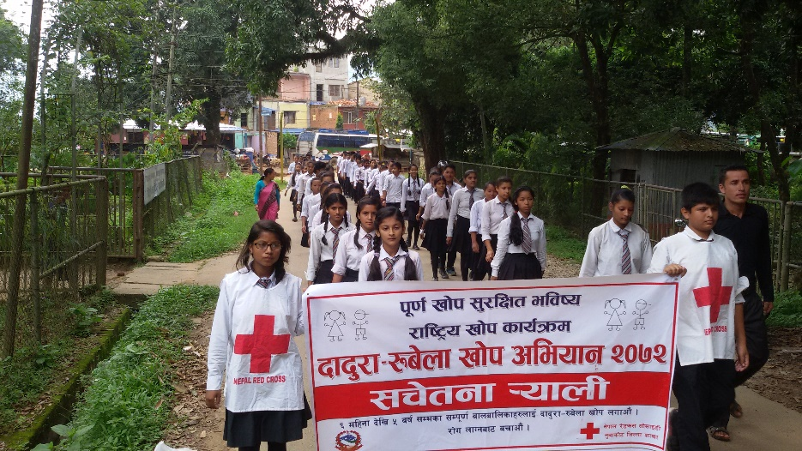
Key Challenges
Differences in capacity of District Health System in various districts(leadership, administration, stakeholders presence and involvement in the immunization program)
Differences in capacity of NRCS district Chapters and Sub Chapters
Geographical constraints
Internal migration
Hard to reach/vulnerable population: rural and urban
Funds
Recurring disaster/Current disaster (earthquake)

Slide 13
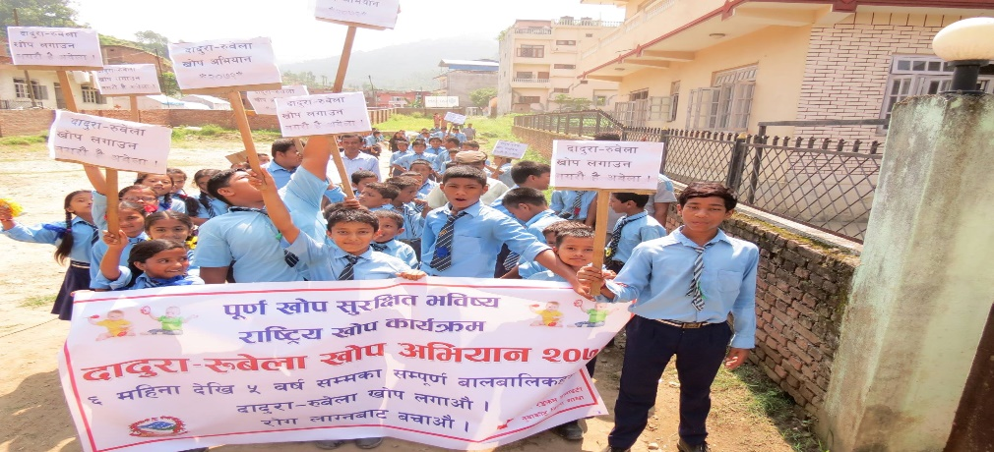
Key learning
Key learning points
NRCS can play a supportive role in the coordination at both district and community level
Participation of Junior/Youth Red Cross volunteers can support the social mobilization program
Dissemination of message in local language is more effective in reaching the target population
It is important to involve the community, local stakeholders as well in the program planning process
Involvement of FCHVs and women/mother’s group in the local community show greater impacts

Slide 14
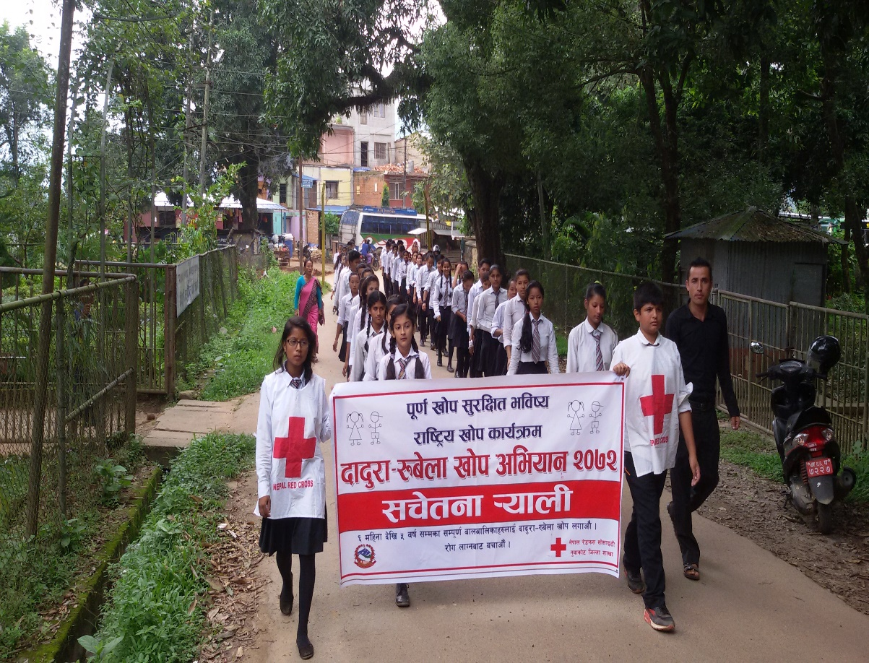
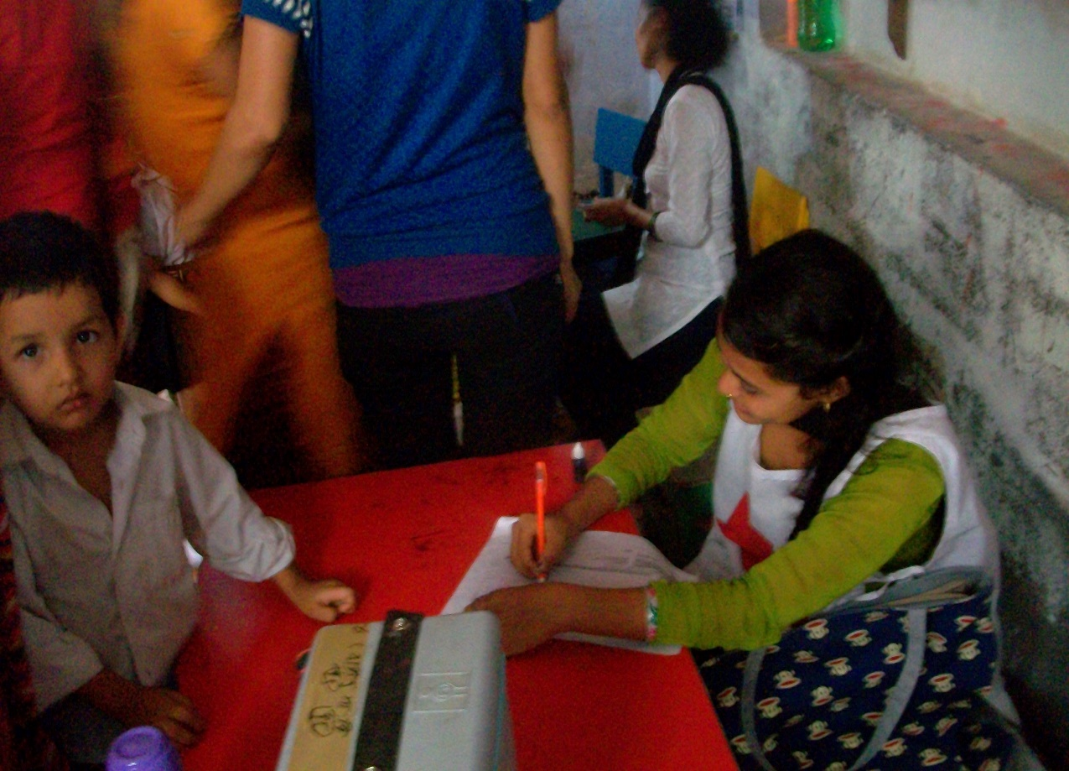
Thank You

