Slide 1

“How Individuals Can Make a Difference”
M&RI Annual Meeting
Erin Hohlfelder @Global_ErinH
Global Health Policy Director

Slide 2

4 Key Questions: USG Advocacy
Who is our target?
What is our ask? / What does success look like?
What are our messages?
What are our tactics?

Slide 3
Case study: 2014 Gavi/vaccines

Slide 4
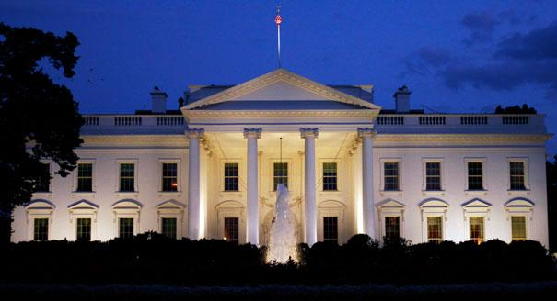
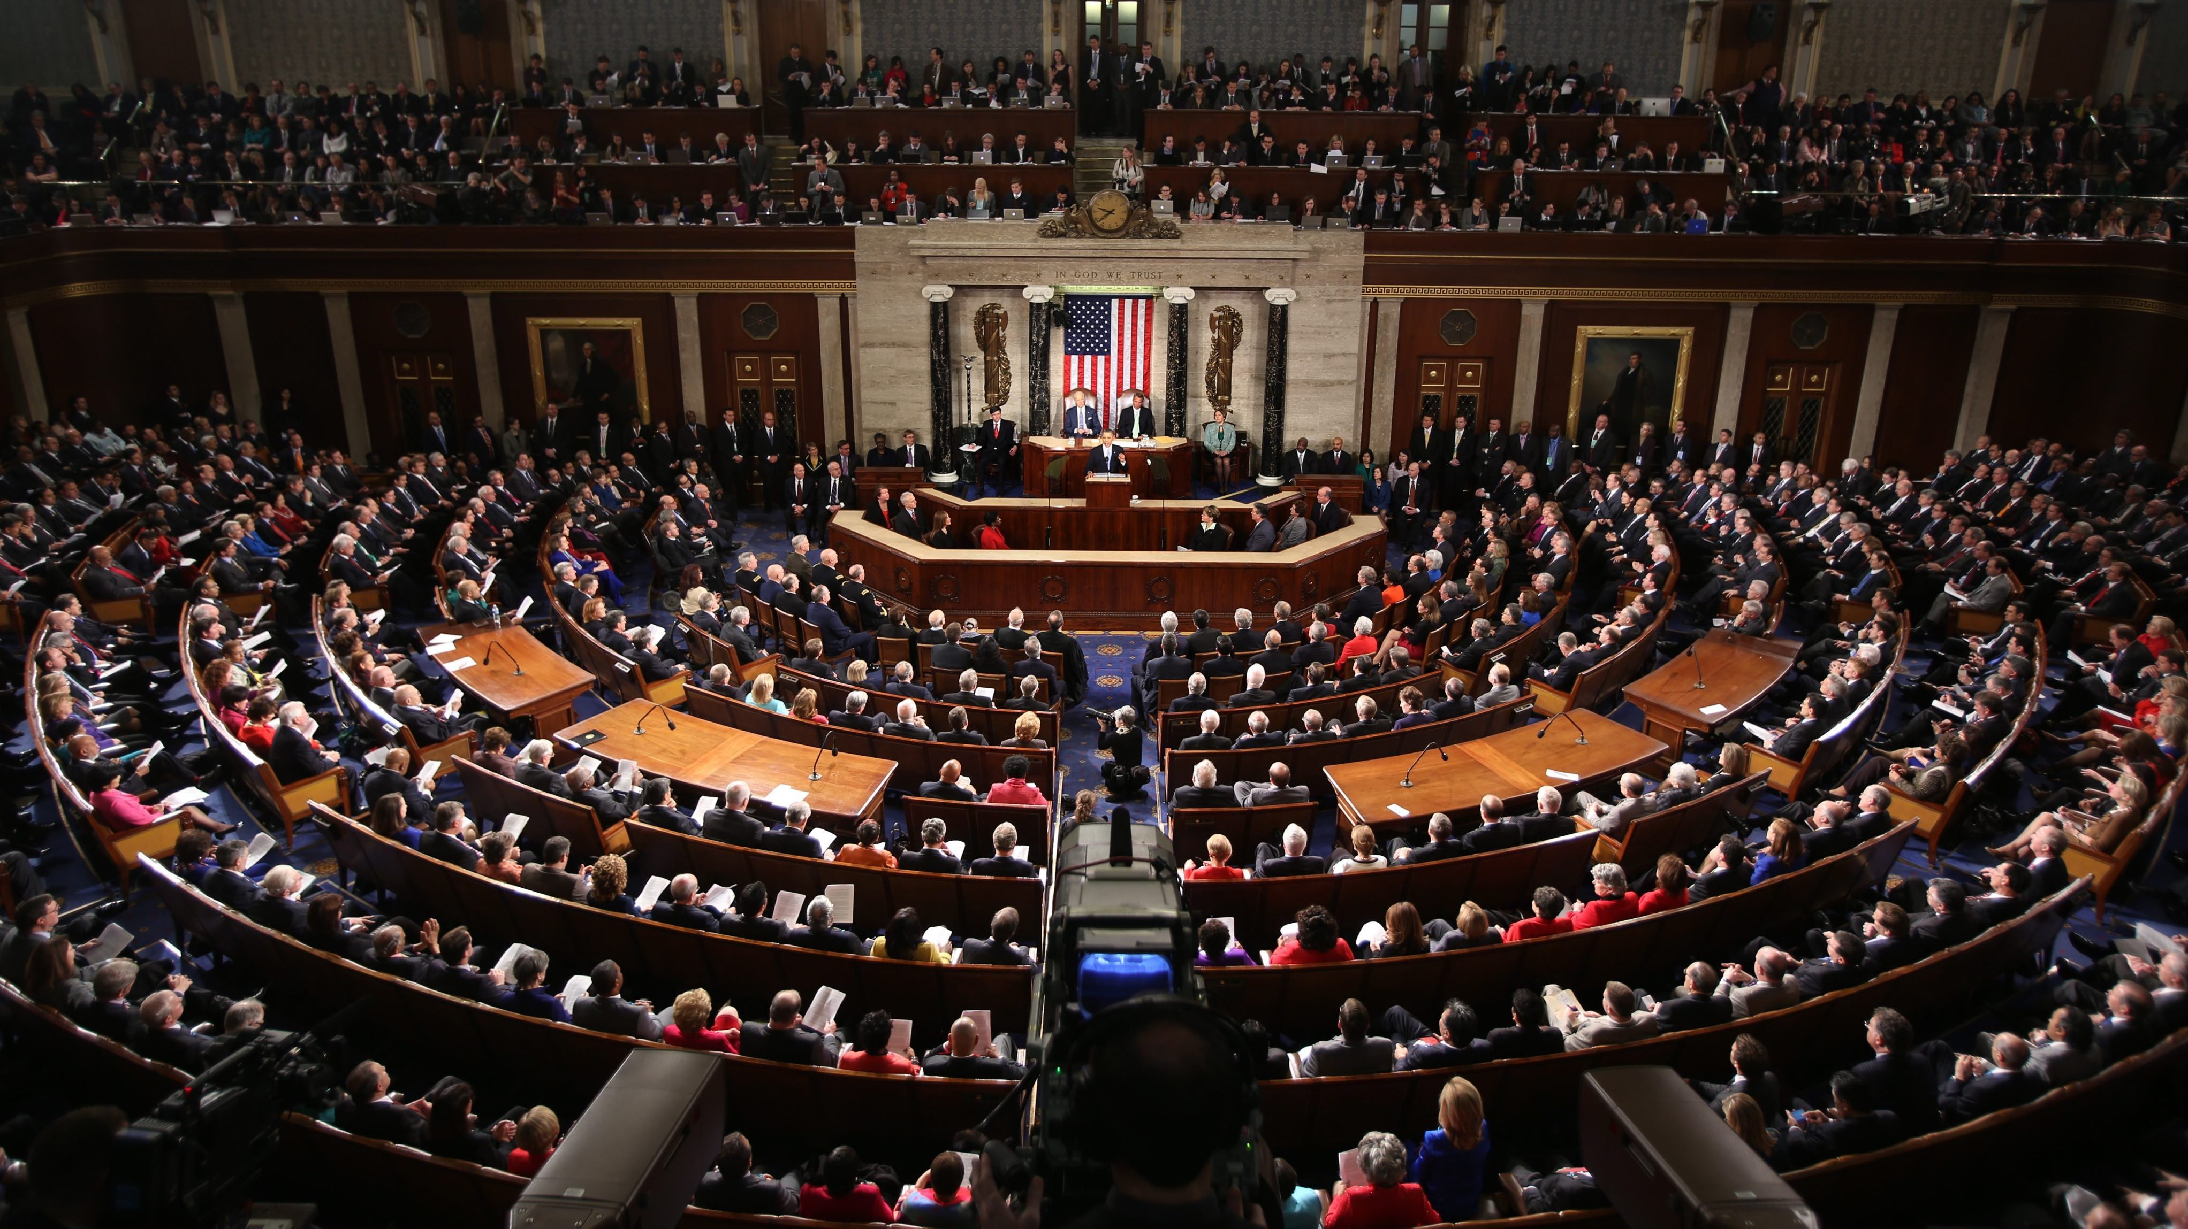
Who is our target?

Slide 5
What is our ask?
Previous US contributions
Wider US budget constraints/considerations
Gavi’s overall ambition and need
Political “sell-ability”
$1 billion/4 years + MNCH protection

Slide 6
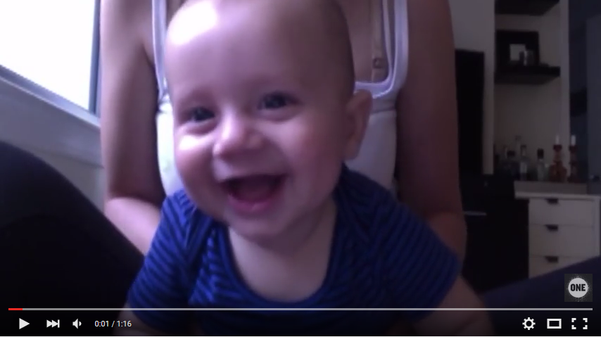
What are our messages? (1/2)
https://www.youtube.com/watch?v=K0InE83pM6s
#everyparent

Slide 7
What are our messages? (2/2)
White House/Congress:
  Links with EPCMD strategy
  Moral case
  Economic case
  Clear, measurable impact

Slide 8
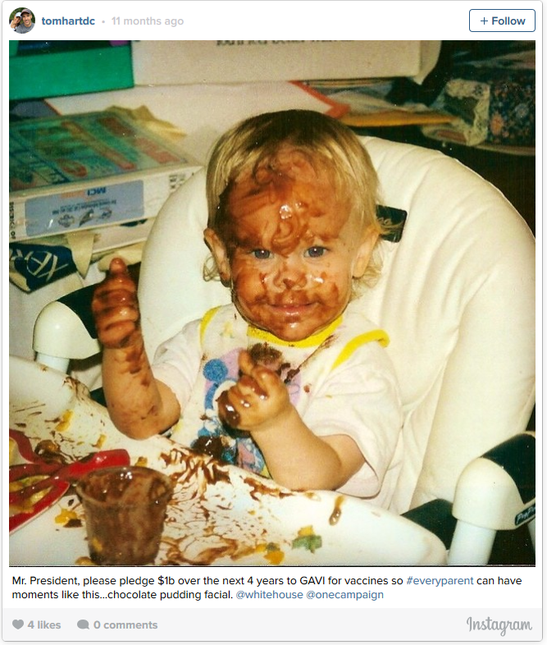
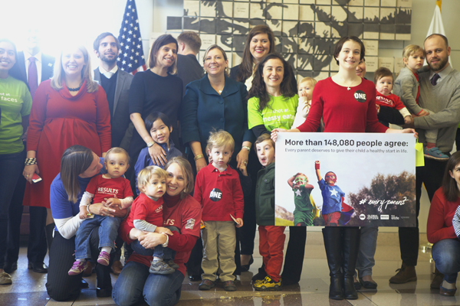
What are our tactics?
Traditional petition + creative delivery with partners
Call and tweet @WhiteHouse
Inaugural Instagram campaign
Grasstops strategy (including Mom Blogger summit)
Insider advocacy

Slide 9
Lessons Learned
Individual actions matter (especially when they go beyond the petition)
Most Americans can separate personal views on vaccines and support for global campaigns (but don’t engage the trolls!)
“Feel good” campaigns can still work if done right
Partnerships matter
Can’t divorce specific campaign from wider advocacy efforts on related issues
Saying thank you matters

