Slide 1
“Measles as a tracer”: developing an Operational Framework for Measles and Rubella Elimination in the WHO European Region
Jose Hagan, M.D., M.S.
Team Leader, Disease Control and Elimination
Vaccine-preventable diseases and immunization unit

Slide 2
MR Elimination Operational framework – Regional and global context
  Regional commitment. WHO European Region adopted a goal for all 53 Member States to achieve and sustain measles and rubella elimination as part of the European Vaccine Action Plan 2015—2020.
  Regional status. Despite progress, targets have not been met, and a new target date has not been set.
  Global strategic focus on maximizing overall impact of vaccines. IA2030 is a shift from GVAP towards broader health objectives around health security and equity, but with measles elimination as a key indicator of immunization system performance and a prerequisite for achieving other immunization goals.
  A strategy refresh. A fresh approach is required to secure political commitment and renew efforts to achieve the goal of measles and rubella elimination in a way that maximizes its sustainability and broader impact.

Slide 3
Using measles as tracer

Slide 4
Measles virus is highly contagious: Even small pockets of susceptible individuals can lead to outbreaks
Immunization programme must have strategies and programs that effectively reach and deliver two doses to 95% or more of each birth cohort to sustain herd immunity.
Generic strategies are rarely sufficient; thoughtfully designed strategies and investment is often needed to reach special groups, often involving collaborative planning with multiple areas of government and society.
High and equitable coverage must be sustained in order to maintain measles elimination; requires long-term planning and sustainability of the immunization programme.
These special strategies may often be leveraged for other immunization and preventive health service delivery.

Slide 5
Measles vaccine is highly effective: cases rarely occur in fully-vaccinated individuals.
Cases and outbreaks almost always signal individuals and groups for whom the routine immunization programme’s strategies and activities are not well tailored, resourced or implemented.
Purposeful approach to investigation and route cause analysis may provide insight into unique challenges or issues regarding a sub-population, or systematic issues with broad impact.
Groups for whom routine immunization strategies are ineffective may often be underserved with other health services.

Slide 6
Measles cases are highly visible: few infections are asymptomatic in unvaccinated persons
Cases meeting the suspect case definition are highly likely to lead to contact with the healthcare and surveillance systems.
Sensitive and representative surveillance systems, and capacity to manage, analyze, interpret and use public health data are needed, which has broad public health application.
  Maintaining measles elimination-standard laboratory surveillance capacity ensures that infrastructure, skills, and processes are in place for generic potential future respiratory pandemic “disease X”
Outbreaks that are not rapidly detected signal surveillance system gaps.

Slide 7
Measles and rubella elimination as a path to broader health goals
To mobilize and sustain political support for the elimination goals, planning for measles and rubella elimination activities must be explicit in their linkage to the broad strategic objectives of EIA2030 related to health systems strengthening and equity.
Resources for achieving the needed high level of health system contact with communities and for other aspects of MR elimination should have a dual purpose - maximizing the contribution to other health gains.

Slide 8

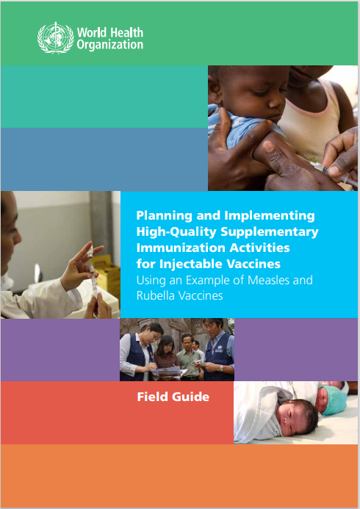
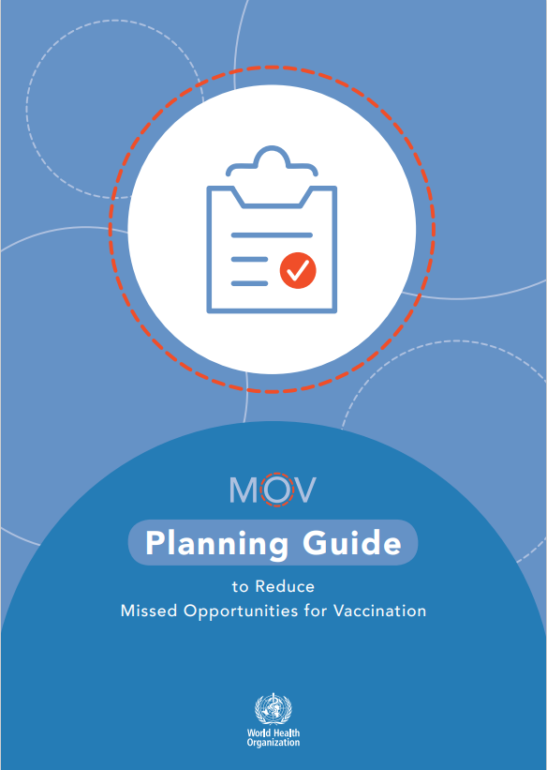
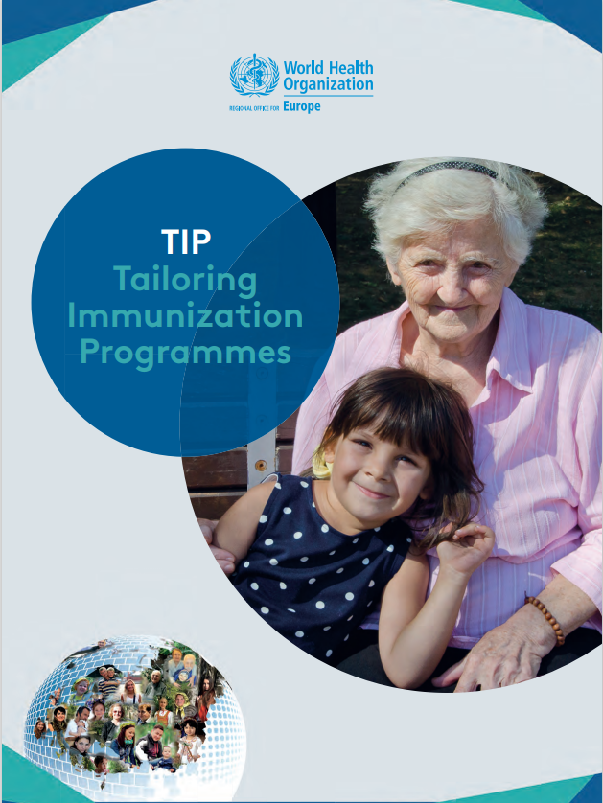

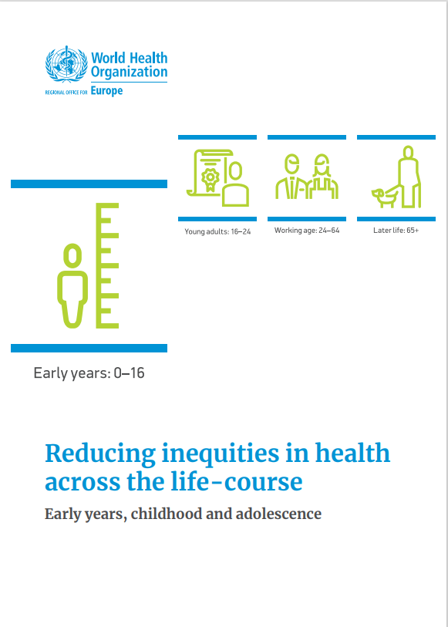

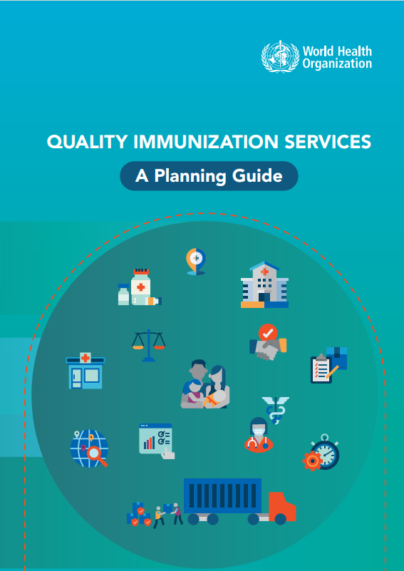
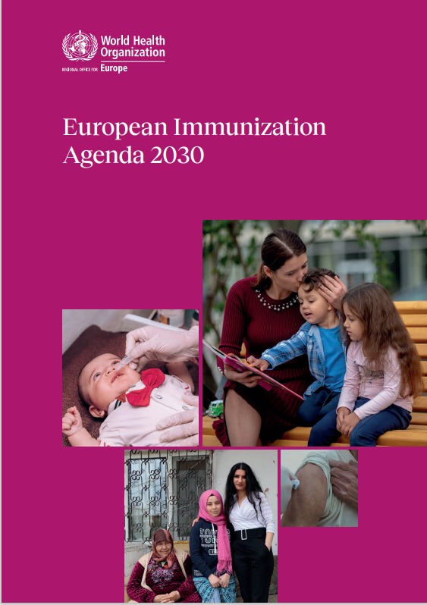
“Measles as a tracer” is a targeted integration of key cross-cutting concepts and initiatives in immunization
Data triangulation and data use for action
Supplemental immunization and intensification of routine immunization
Tailoring Immunization Programmes
Behavioral insights research
Second year of life platform
Immunization across the life-course
Reducing missed opportunities for vaccination
Immunization inequity

Slide 9
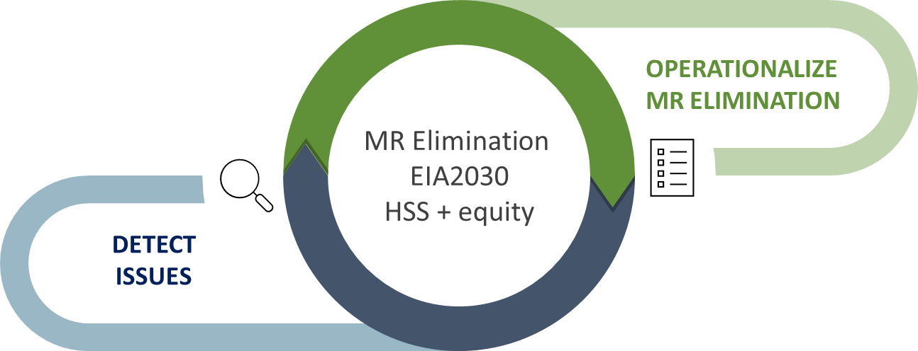
Operational framework for measles and rubella elimination in the WHO European Region
using measles as a tracer to advance progress to immunization equity and the strategic priorities of European Immunization Agenda 2030

Slide 10
Working definition of measles as a tracer in the European Region
Using measles cases and outbreaks to better tailor and implement activities towards measles and rubella elimination
Using measles cases and outbreaks and as a diagnostic tool for identifying gaps in equity, strategy, and implementation of the immunization and primary health services
Using measles and rubella elimination as a target to focus investment in broader public health system strengthening.

Slide 11

MR Elimination operational framework – key attributes
Build on and align with existing guidance (e.g., immunization equity, EIA2030, MRSF 2021—2030) - opportunity to compile, reinforce, contextualize existing guidance.
Focus on operationalizing measles and rubella elimination strategies to maximize use of measles as a tracer for identifying inequities, and for strengthening routine immunization and targeted aspects of health systems
Tailor for countries, considering the diverse health infrastructures, service delivery modes, and implementation status, by providing a range of options or activities to address a particular gap.

Slide 12
MR Elimination operational framework
MR Elimination
Vaccination
Surveillance & Laboratory
Outbreak Investigation & Response
THREE
Strategic Pillars
Communication, ​advocacy, ​political commitment​
Governance, ​planning
Cross-cutting
operational Elements
Resource mobilization, partnerships, ​coordination ​
Monitoring, ​program review, ​risk assessment, verification

Slide 13
Formal process of developing an operational framework for MR Elimination
Q4 2024
“Think Tank” consultations
Concept
Surveillance
Draft framework
Final product
Outbreaks
Vaccination
Background paper
Stakeholder consultation
Review of existing guidance
Articulation of concept
Socialization with stakeholders
In-person expert workshop
Q3 2024
Q3 2023 – Q2 2024
Q1 2023

Slide 14
Think tank consultations
Surveys sent to national subject-matter focal points from all Member States related to vaccination service delivery, surveillance, and outbreak preparedness and response to identify key challenges and issues to be addressed
Think tank participants invited from measles and rubella subject matter experts from WHO, Unicef, CDC, ECDC, ETAGE, and national experts.
Brainstorm and discuss how ‘measles as a tracer’ may apply to action areas, and how to focus and implement these actions for advancing and sustaining MRE while maximising the collateral impact on strengthening the overall immunisation system and achieving broader health objectives

Slide 15
Example output from think tanks
Surveillance: Detecting cases
Issue or challenge | Activities | Cross-sector engagement or impact
Cases do not access the health care system. populations disconnected from mainstream HC transient populations | Outreach initiatives and mobile health units Collaboration with non-traditional healthcare providers, pharmacists, “Health mediators”, etc. Ensuring specific populations (e.g. Roma, migrant workers) are registered in the healthcare system Establish intersectoral cooperation to detect and report cases (not always health system detecting cases). E.g. school health nurses, occupational health physicians, etc. | Use every opportunity to connect populations to other preventive and primary health interventions Engage other sectors to link populations to public health system (education, labor, immigration, etc) Understand barriers for populations to access the healthcare system, including during outbreak investigations (interview of unvaccinated cases/contacts)

Slide 16
Challenges
Need for greater specificity in the operational guidance for actions that involve sectors outside of the immunization programme
Lack of sufficient input from health systems strengthening focal points to date
Balancing focus of the document as a practical and operational guide to measles elimination while retaining sufficient discussion of the linkage to health systems strengthening

Slide 17
Next steps
Completion of final Think Tank (vaccination service delivery) on March 22nd.
First draft of document to define the structure and broad content
In-person expert consultation including health systems strengthening focal points in WHO and other partners to expand and refine the content
Member State and other stakeholder consultation on the document content before finalization
Socialization of the final document to stakeholders

Slide 18
Thank you

