Slide 1
Opportunities in the Second Year of Life (2YL)
Karen Hennessey, WHO HQ
Measles & Rubella Initiative Partner’s Meeting
Washington DC,
7-8 September 2017

Slide 2
Overview
Measles vaccination coverage in the second year of life (2YL)
Challenges with achieving high coverage in 2YL
Reasons & opportunities for strengthening 2YL platforms

Slide 3
1.
Measles vaccination in the second year of life

Slide 4
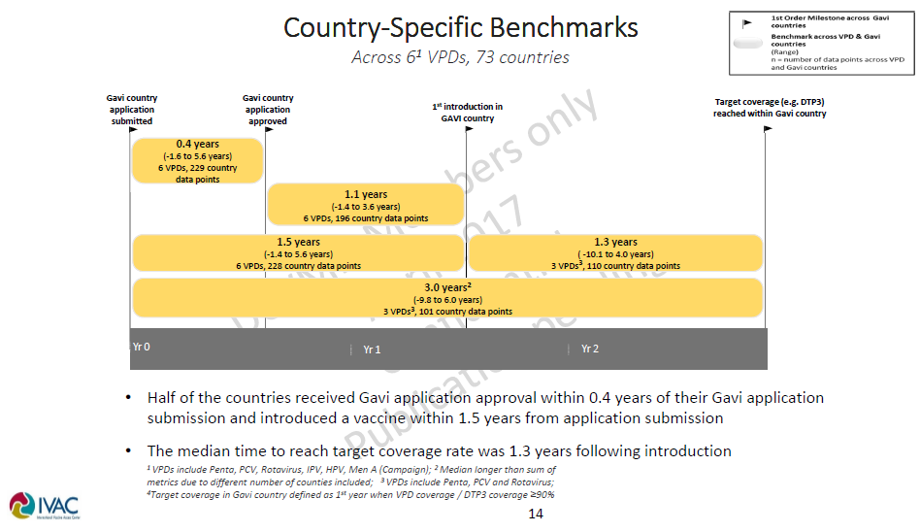
Experience with new vaccines introduced during infancy

Slide 5
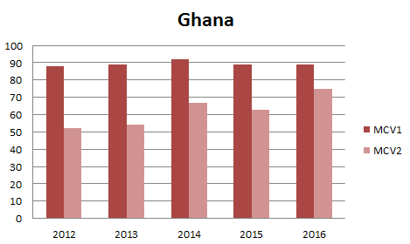
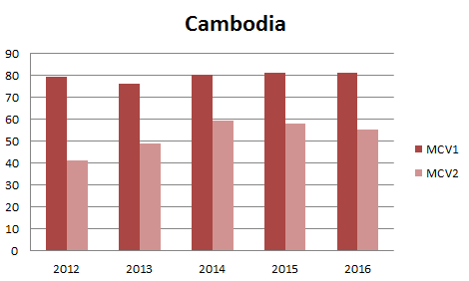
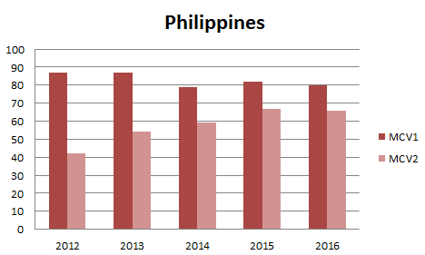
Countries that introduced a second dose of measles containing vaccine (MCV2) more than 5 years ago
PIE
14%
After 5 years they have not reached coverage targets – MCV1 v MCV2 diff of over 10%
PIE
26%
14%

Slide 6
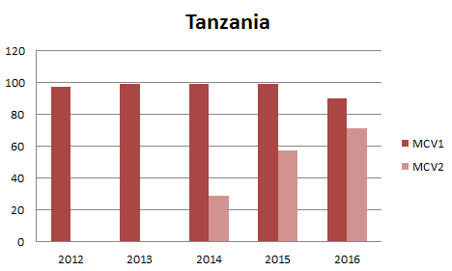
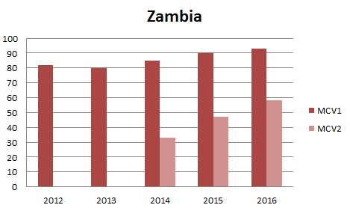
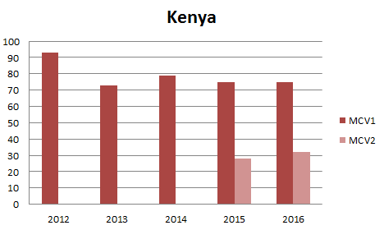
Countries that introduced MCV2 more recently
PIE
PIE
19%
35%
We have not yet harnessed the lessons from the countries that introduced earlier
43%

Slide 7
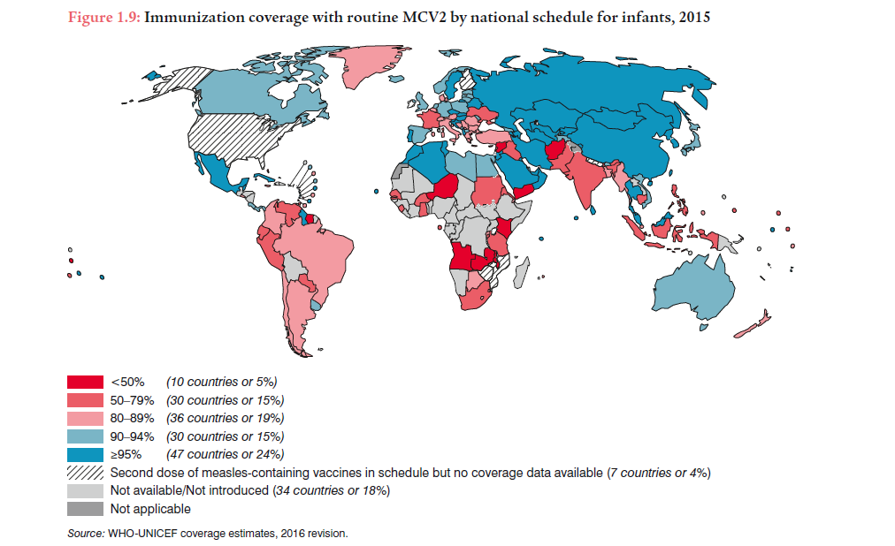
In 2016, 5 countries introduced, 7 planning, 22 TBD

Slide 8
2.
Challenges with achieving high coverage in 2YL – what have learned from PIEs & Pilots

Slide 9
Some reasons for low 2YL/MCV2 coverage
Findings from PIEs & Pilots
  Overall – most countries did not treat MCV2 as a new vaccine introduction because MCV already in schedule
  Lower demand:
  Low awareness of vaccination beyond infancy
  Prioritizing infants over young children
  Insufficient policies and guidance - manifests at service delivery as:
  Count late MCV1 as MCV2 (don’t give the 2nd dose)
  Consider late MCV2 as too late (don’t give 2nd dose)
  Do not open 10-dose vial because not enough children in session (don’t give the 1st or 2nd dose)
  Data collection and reporting forms not updated
  Requires updating paper forms & programming of broader health information systems – not easy to modify!
  Forms impact knowledge & behaviour

Slide 10
From Cambodia PIE – July 2014
‘Many health center staff administered M18 but were not reporting (due to lack of column in monthly report); some were recording M18 administered in the observation column, while others were not recording at all.‘ | ‘The format of the vaccination card may affect the correct understanding on M18 among mothers’

Slide 11
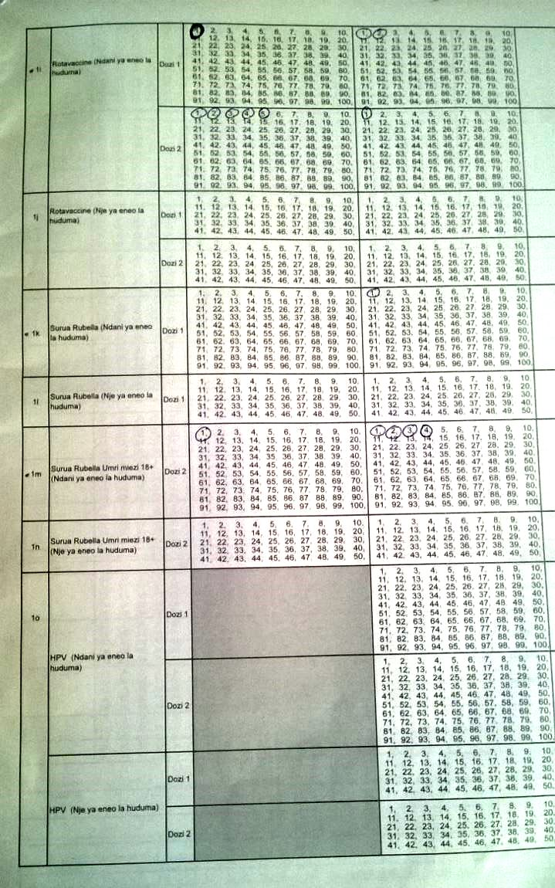
Tanzania tally sheet
Male
Female
MR 1, <1 year, WITHIN the service area
MR 1, <1 year, OUTSIDE the service area
MR 2, 18+ months, WITHIN the service area
MR 2, 18+ months , OUTSIDE the service area
No place to record MR1 given after 12 months of age

Slide 12
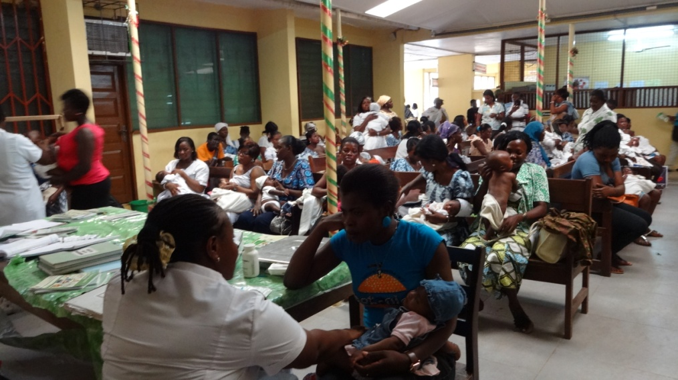
From Ghana PIE – Aug 2013
Vaccinating at 18 months is challenging and requires innovative strategies: Importance of an effective communication strategy Integration with other programs critical

Slide 13
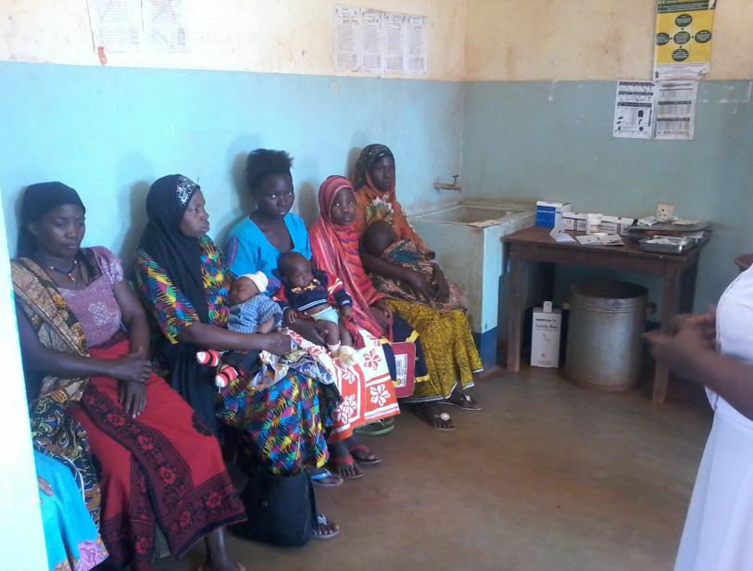
From Tanzania MCV2 PIE – July 2015
…reports of some caregivers being turned away due to insufficient number of children to open MR vial.

Slide 14
From Cambodia PIE – July 2014
‘The necessity for children to be vaccinated after the 1st birthday was not well known by many mothers in most villages visited.’ | ‘While the relationship and communication between HC staff and mothers seemed to be very good in the villages visited, the messages from health workers were not always sufficient to motivate mothers or caretakers to seek M18 vaccination for their children.’

Slide 15
3.
Reasons & opportunities for strengthening 2YL platforms

Slide 16

Why are strong 2YL platforms are needed?
  REASON 1: To accelerate measles and rubella elimination
  Currently, many of the countries with the highest measles endemicity do not have routine MCV2 or have low MCV2.
  For countries that will soon introduce MCV2 means strengthening platforms at the most opportune time – when a country has committed to introducing a 2YL vaccine.
  In addition, Gavi countries will be eligible for new vaccine introduction grants. However, these grants alone will not be enough to implement activities needed – they will need to be optimized & supplemented to take full advantage of modifying systems & increasing demand.

Slide 17
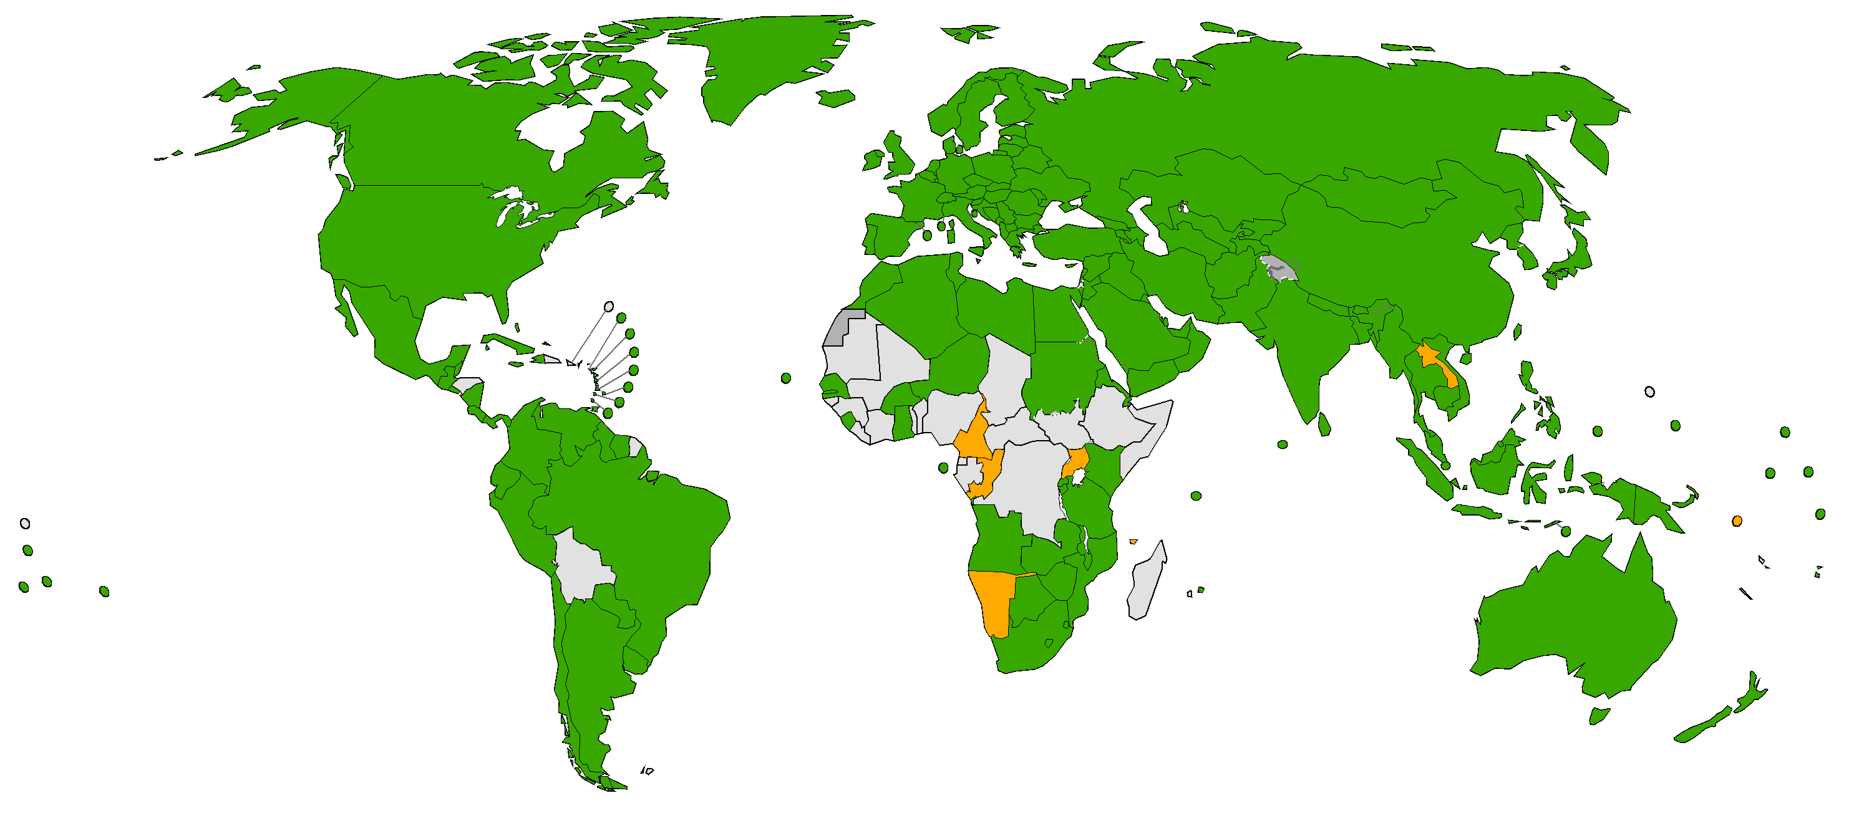


MCV2 Introduction Status
OPPORTUNITY: strengthen 2YL platforms as part of preparing to introduce MCV2
Introduced to date
(165 countries or 85.1%)
Planned introductions in 2017
(7 countries or 3.6%): Cameroon, Comoros, Congo, Laos, Namibia, Sol Islands, Uganda
Not Introduced/No Plans
(22 countries or 11.3%) – including ETHIOPIA, NIGERIA , DRC
Not applicable
Data source: WHO/IVB Database, as of 09 August 2017
Map production Immunization Vaccines and Biologicals (IVB),
World Health Organization
The boundaries and names shown and the designations used on this map do not imply the expression of any opinion whatsoever on the part of the World Health Organization concerning the legal status of any country, territory, city or area or of its authorities, or concerning the delimitation of its frontiers or boundaries. Dotted lines on maps represent approximate border lines for which there may not yet be full agreement. ©WHO 2017. All rights reserved.

Slide 18
  REASON 2: To accommodate the increasing number of vaccines recently recommended to be scheduled in 2YL
Vaccine | Age & Scope of Recommendation
MCV2 or MR2 (2016 recommendation) | Second dose at 15-18 months All countries
Tetanus (and diphtheria) (2017 recommendation) | Three primary + 3 booster doses (one of the boosters in 2YL) All countries
DTP4 | Booster at 1-6 years; pertussis- tetanus-containing booster in 2YL All countries
PCV | Alternative 2+1 schedule for PCV; 3rd dose 9 and 15 months Schedule option
Meningitis A - routine | Single dose at 9–18 months Based on programmatic and epidemiologic considerations
Japanese encephalitis | One or two doses, starting from six months of age, Based on local epidemiology and type of vaccine
Seasonal influenza | Starting from 6 months & extending to 23 or 59 months

Slide 19
  REASON 3: To help us reach our Global target of 90% DTP3 coverage through improving catch-up practices and ensuring catch-up @ 2YL visit
  Currently, few countries have clear policies or consistent practice to catch-up vaccination beyond 12 months
  A 2014 DHS/MICs analysis showed that countries could potentially improve DTP3 coverage by as much as 10% if all eligible children who came into contact with a health facility were vaccinated, ie, prevented missed opportunities to vaccinate (MOV).

Slide 20
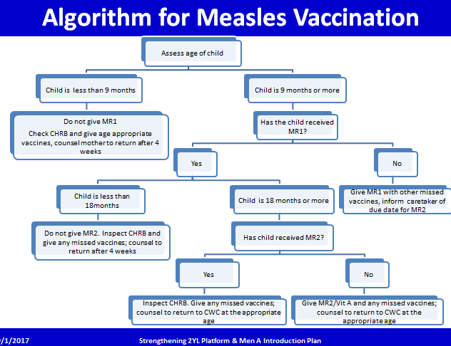
  Why is ‘catch-up’ so hard?
  Policies – can be complicated
  Many countries lack catch-up policies or they are unclear, confusing, have passive approach.
  Practice – changing behaviours
  HCW may not look for missed doses –they may see a 9m old and think measles vaccine and not look for missed doses.
  HCW may find children with missed doses but not vaccinated them because he/she is afraid of running out of vaccine → Requires forecasting & assurance to HCW that they have adequate supplies for catch-up

Slide 21

REASON 4: Opportunity optimize immunization schedules & integrate other interventions
  Introduction of a 2YL vaccine is an opportunity for optimizing the immunization schedule and consider integrating other health interventions relevant to this age. For example in Zambia important aspects of 2YL platform included another opportunity to check/refer on nutritional needs because of the high prevalence of malnutrition; and to check/refer completeness of early detection of HIV in infants and children.
  Addition of interventions at a 2YL vaccination contact requires building new partnerships or re-framing existing ones.

Slide 22
2YL Activities & Plans
Develop resources: Global Guidance document, ‘How to’ guide, Training materials
Build a cadre of expert consultants: conduct a consultant training, with emphasis on national capacity building
Support countries introducing MCV2: For example Laos MCV2 intro planning taking place this month with joint support 2YL/NV introduction
2YL costing tool - to help with country decision making & help understand the funds that will be needed to support at the global level
Demand – we need to learn more about the role demand plays in low coverage we are observing & how to increase demand – understanding that the response may be highly country specific.

Slide 23
  Conclusions
Strengthening 2YL platforms will:
Accelerate measles & rubella elimination by improving routine administration of measles vaccine – esp MCV2. We need to support countries introducing MCV2 including optimizing/ supplementing the Gavi introduction grants to reverse the current trend and ensure high MCV2 coverage.
Help achieve the 90% DTP3 coverage target by improving catch-up practices & ensuring that catch-up vaccination happens at the 2YL contact
Allow us to be prepared for other 2YL introductions – including for vaccines in the pipeline.

Slide 24









Thank You!
Acknowledgment to the
M&RI RI Workgroup members & 2YL donors

