Slide 1
M&RP Communications
Sara Veltkamp, Partner and VP at Minerva Strategies
Sara@minervastrategies.com

Slide 2
Communications Team
Partner representatives:
  Tiffany Smith, U.S. CDC
  James Noe, American Red Cross
Program support unit members:
  Andy Gill, Camber Collective
  Lamine Barry, Camber Collective
  Sara Veltkamp, Minerva Strategies
  Dori Valerio, Minerva Strategies
  Caroline Hall, Minerva Strategies

Slide 3
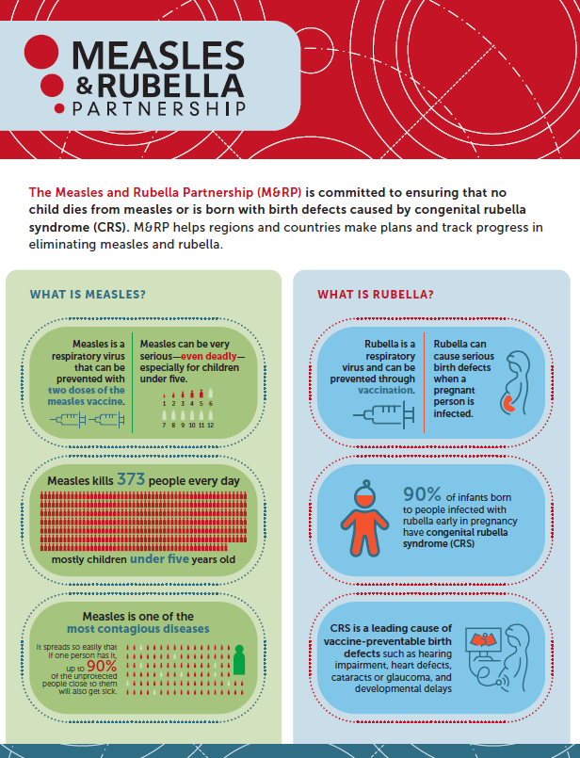
Communication Strategy to Support Priorities
Strategies:
  Create a centralized information hub for information and tools
  Coordinate communication and media efforts across partners at key moments
  Align with and support other immunization efforts and campaigns

Slide 4
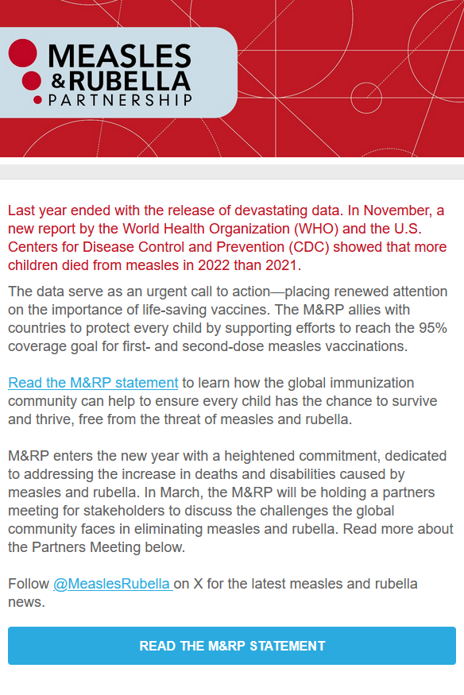
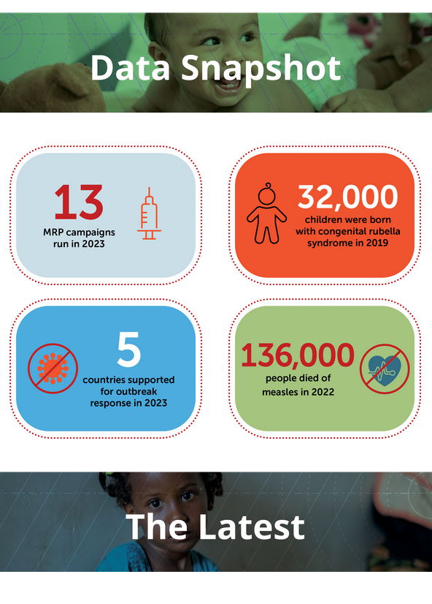

Communication Tools: M&RP Newsletter
Scan to sign up for the M&RP newsletter!
MeaslesRubellaPartnership.org/newsletter-sign-up

Slide 5
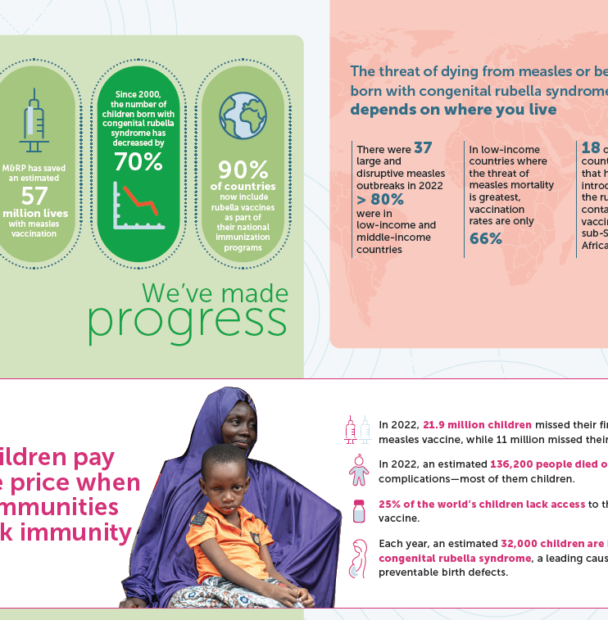
Communications Tools:
Website Resources
M&RP stories and updates
2022 annual summary coming soon
Latest fact sheet
Draft of the 2022 Annual Summary

Slide 6
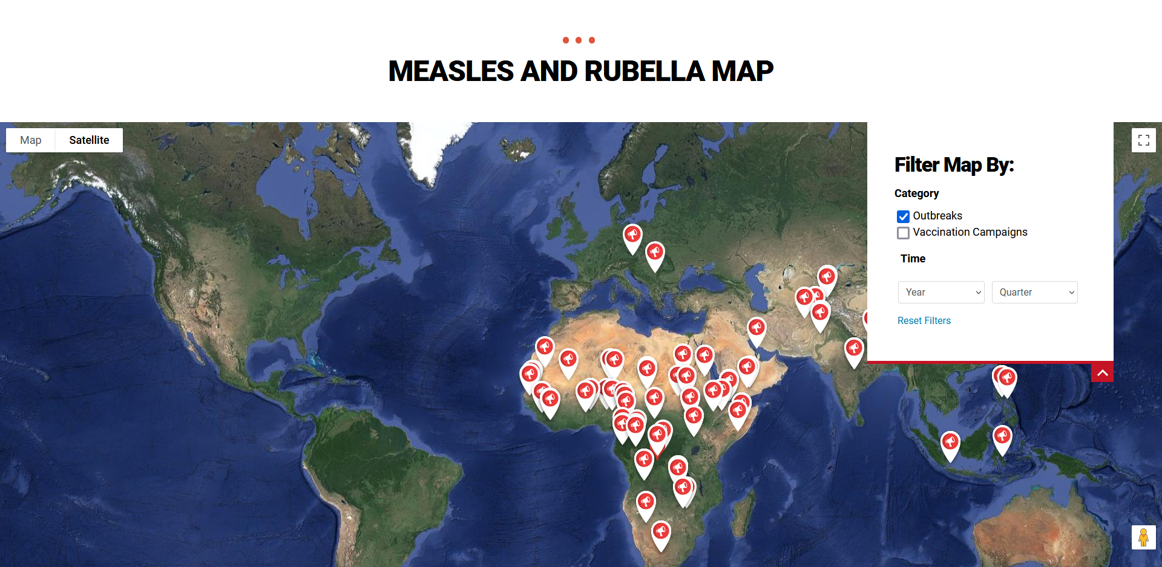
Communication Tools: Outbreak & Campaign Tracker

Slide 7
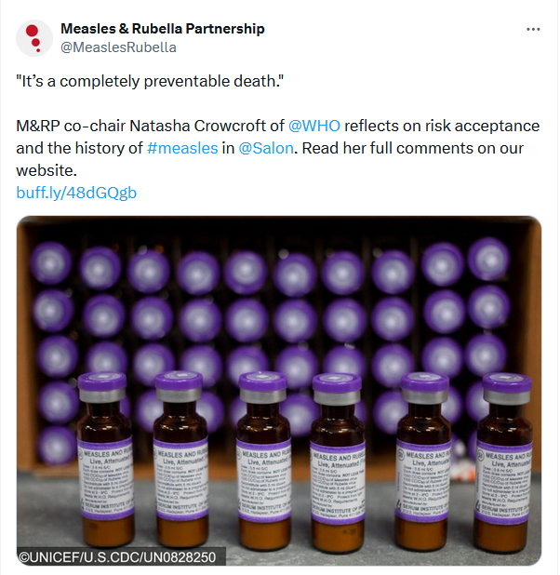
Communication Tools: Social Media
Follow @MeaslesRubella on X/Twitter

Slide 8

Social Media: We Need Your Thoughts!
Which social media platform do you find most helpful in your immunization work?

Slide 9
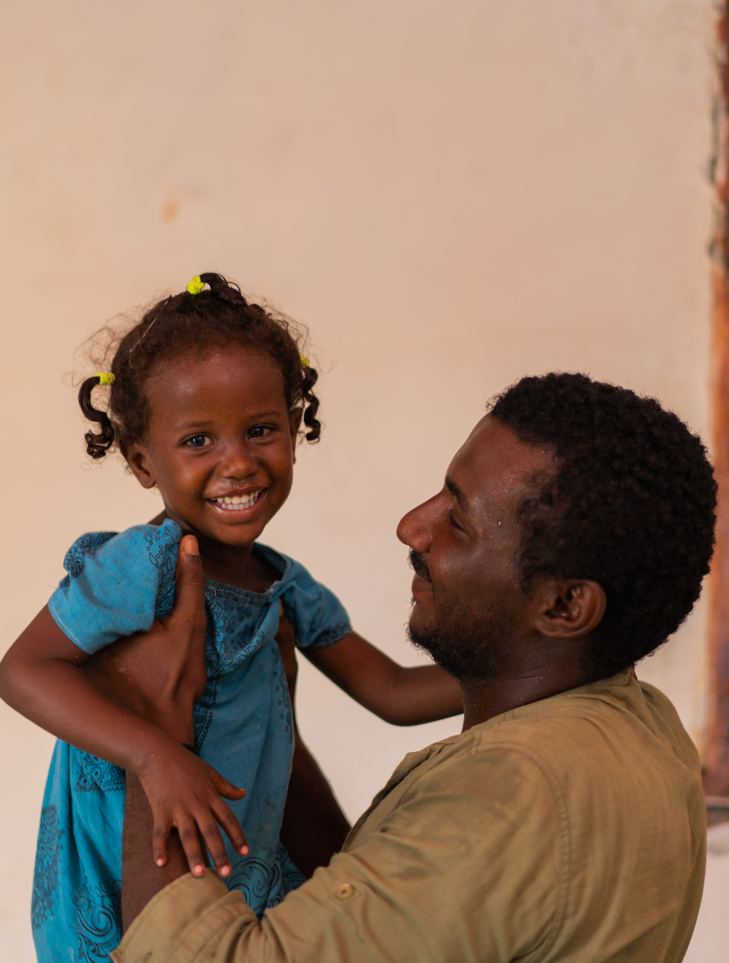
What You Can Do
Sign up for our newsletter to stay up to date on the latest M&RP stories, activities, and progress toward a measles and rubella-free world.
Follow us on Twitter/X to see and share curated content from our partners.
Share our fact sheet, annual summary, and our digital content with others creating pathways to vaccine access and equity.
Finally, join us in supporting “Humanly Possible.” Learn more about this unbranded campaign led by UNICEF and WHO in the next session.
©UNICEF/U.S.CDC

Slide 10
Thank you!
For questions or access to key M&RP messages and other tools, email Sara@MinervaStrategies.com

