Slide 1


Federal Ministry of Health
Primary Health Care
Maternal and Child Health
Expanded Program on Immunization
Sudan EPI Benefits From Polio Eradication Program
M&RI Annual Partners Meetings
Washington D.C
September 2015
Dr. Nada Ahmed

Slide 2

  Background.........
_{Total pop. =} 41,149,153
_{< 1 pop. =} 1,402,511
_{< 5 pop. =} 6,490,062
_{States =} 18
_{Localities =} 187

Slide 3
EPI Organogram
PHC
NITAG
NEC
COLD CHAIN
SIAs
Planning &
M&E
Surveillance and information)
Operation
MCH
EPI Manager
Zonal Coordinators (6)
State operation Officers (18)
Locality Operation Officers (187)

Slide 4
Surveillance Organogram
National EPI Manager
Surveillance technical committee
Surveillance Unit
Information surveillance focal persons
Zonal coordinator
State Surveillance technical committee
National medical officers
State EPI-Manager
State IVPDs surveillance & response officer
Locality operation officer
Reporting site

Slide 5
Measles Situation in EMR
      The Regional Committee for the Eastern Mediterranean Region resolution in 1997 to eliminate measles from the region by 2010.
      EMR countries were divided into a measles control and a measles elimination group according to their measles epidemiology and control status.

Slide 6
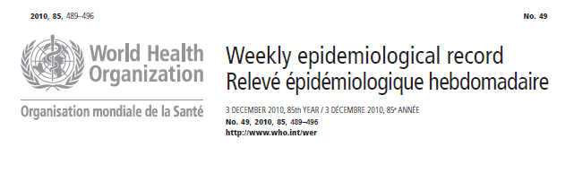
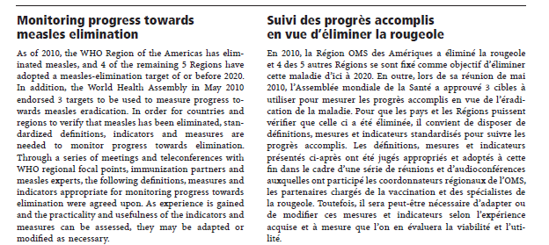

Slide 7
Measles Situation in Sudan
      Before 2004 Sudan was among the control group.
      Since 2004, measles elimination adopted in Sudan
      Catch up campaign in 2004 – 2005
      In 2006 case based surveillance started integrated with AFP surveillance
Several follow up campaigns in the period 2007 -2011 were conducted.
In 2013 Sudan implemented another catch-up campaign
Notes:
These series of campaigns have had a substantial impact on the reduction of measles morbidity,

Slide 8
Measles Cases Vs Measles Campaigns 2000 – 2014
Catch up campaign
Follow up campaign

Slide 9
Adoption of Elimination Strategies since 2004
Raising Immunity
Provide 2nd opportunity through catch up and follow up campaigns
Strengthen Routine measles immunization
Introduction of MCV2 in routine immunization services 2012
Establishing & Strengthen Case based surveillance
Case Management
Outbreak investigation and response
Notes:
Strategies of elimination +
3- case management
4- outbreak investigation and response

Slide 10
Measles Activities Integrated with AFP Surveillance
Weekly report (Zero reports)
Weekly surveillance report
Measles news are published in the AFP Surveillance newsletter
Active search forms

Slide 11
  Programmatic Benefits Contributed by Polio
Management
Measles and Rubella Surveillance integrated with AFP in Infrastructures(Staff, data management, transport,
communications, premises and technical committee as The Certification/Validation committee)
Community surveillance cross Border coordination's meeting and preparedness for importations.
Notes:
Consider ways to improve program performance for and benefit from AFP surveillance in IVPDs

Slide 12
  Programmatic Benefits Contributed by Polio
Management
Polio staffing regarding recruitment procedures, training are used in Measles and Rubella Surveillance and also work as senior staff to ensuring that best practices, knowledge and capacities for Integrated vaccine Preventable Diseases Surveillance (IVPDs) at all levels
Monitoring and supervision activities for AFP Surveillance are also used for IVPDs surveillance.
Notes:
Consider ways to improve program performance for and benefit from AFP surveillance in IVPDs

Slide 13
  Programmatic Benefits Contributed by Polio
Management
NIDs for polio provided experience in planning, implementation and control of other disease initiatives and campaigns (measles, MNT, Meningitis A, yellow fever …)
Active search during polio NIDs for guinea worm and measles provided very useful information that facilitated proper replanning of control measures.

Slide 14
Programmatic Benefits Contributed by Polio
Acceleration of other preventive initiatives during SIAs eg. Accelerated child survival initiatives including vitamin A distribution, basic health education messages, soil- transmitted worm’s prevention, distribution of impregnated mosquito bed nets, distribution of folic acid for pregnant women

Slide 15
  Focus in High Risk
Polio eradication initiative served all special group of population including refugees, displaced, nomads , security compromised areas, border population and hard to reach population through:
Special arrangement to cover them by vaccination, surveillance,
Provide information about them for other programs (eg MCH)
Adoption of ways for reaching under served and hard to reach populations.
Provide baseline information to mobilize the donor interest and resource allocation.

Slide 16
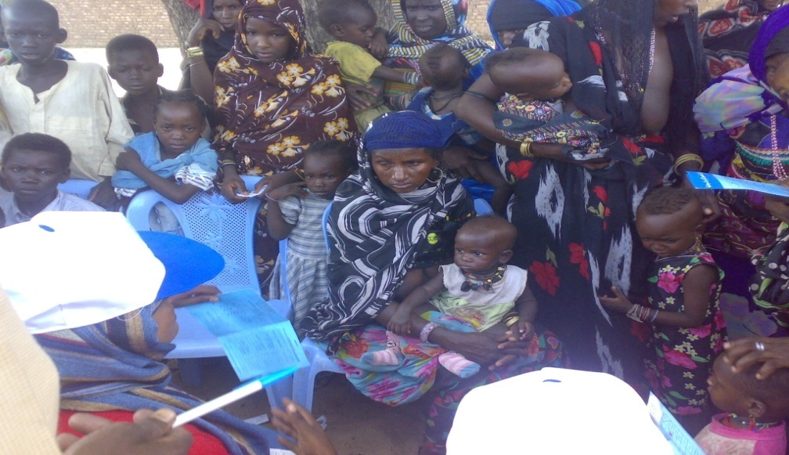
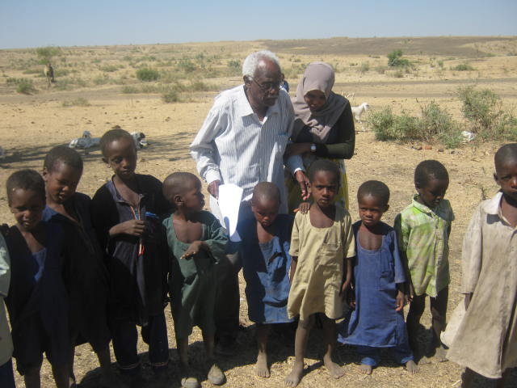
  Immunizations Among Nomads in Sudan

Slide 17
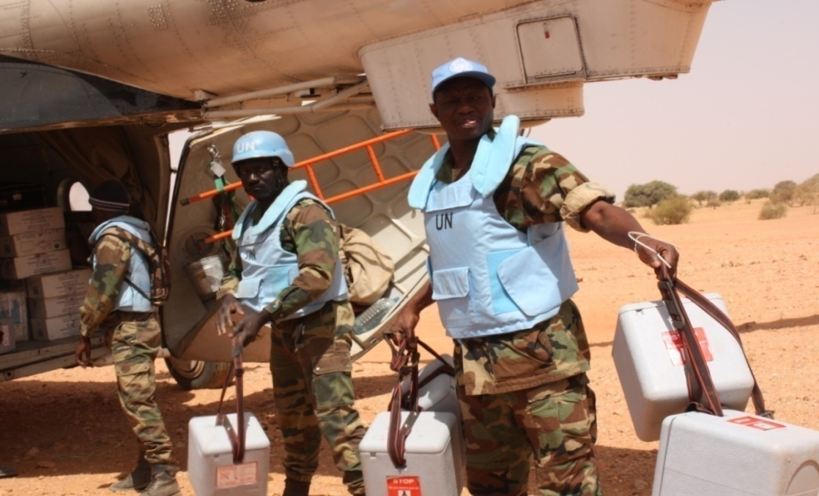
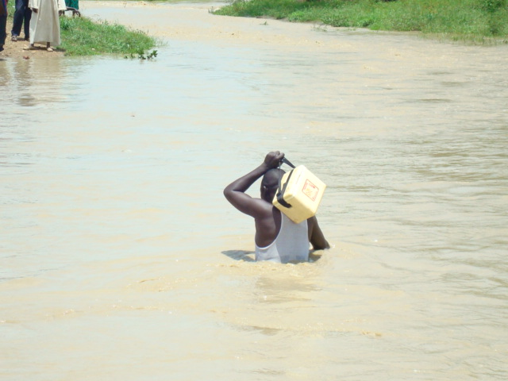
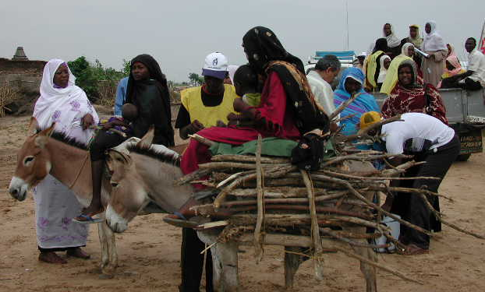

Slide 18
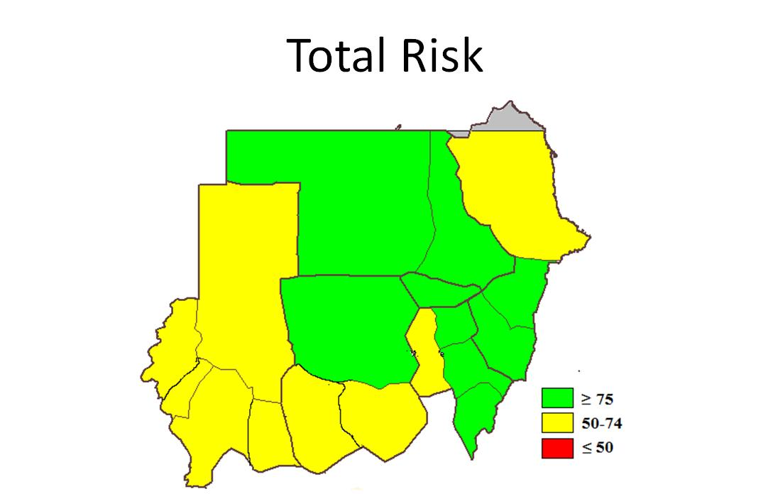
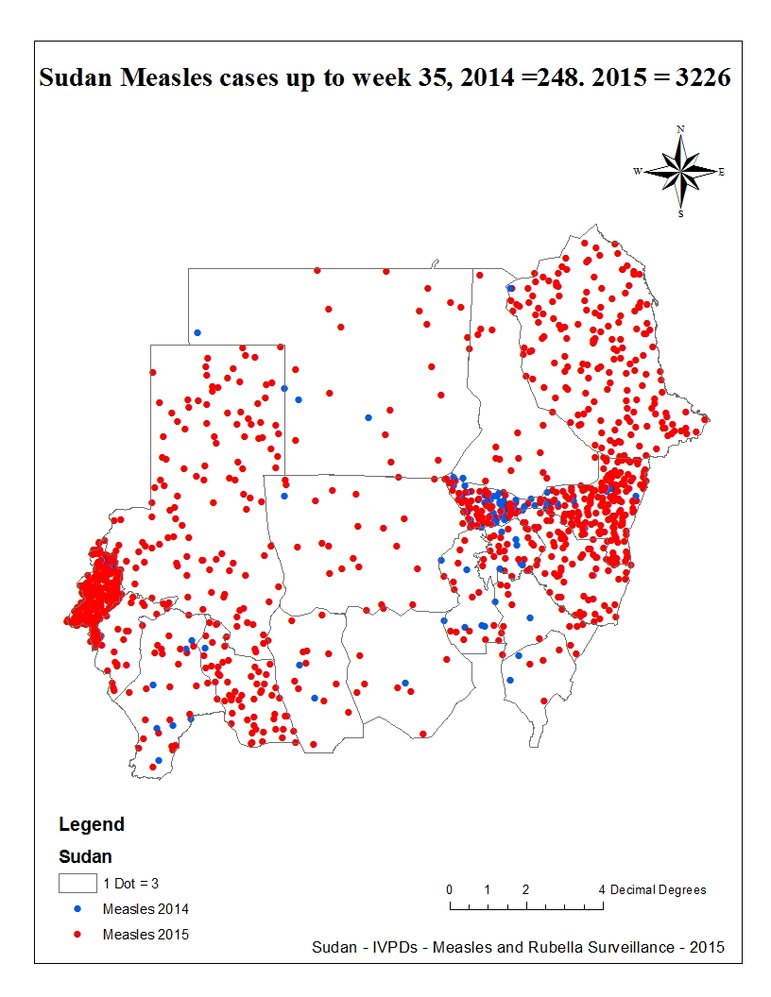
  Risk Map for AFP &Measles Outbreak

Slide 19
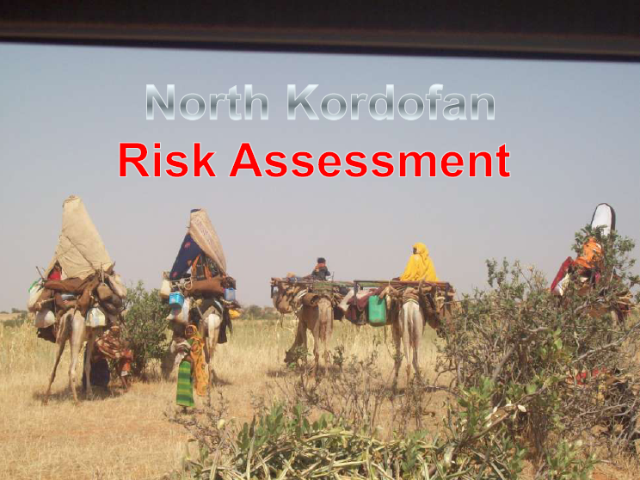

Slide 20
  Programmatic Benefits Contributed By Polio
Advocacy & Social Mobilization
polio eradication success promotes and sensitizes the politician and community leaders for the importance of prevention and control activities in the field of communicable diseases.
Using mobilized and trained volunteers as social mobilizer and health workers to AFP surveillance and polio SIAs to attain measles elimination

Slide 21
  Programmatic Benefits Contributed By Polio
Advocacy & Social Mobilization
Using Social map for special population (e.g. Nomads) Communications and community engagement developed to achieve polio eradication in measles surveillance and SIAs

Slide 22
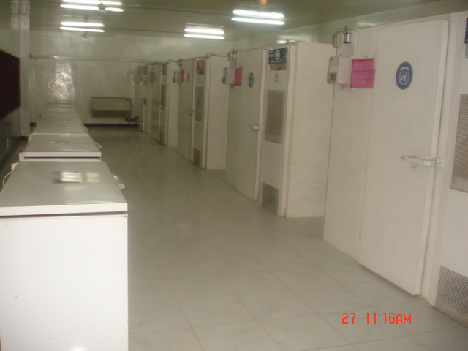
  Programmatic Benefits Contributed By Polio
Cold Chain:
Equipment inventory update and repairs and maintenance for polio lead to Strengthening the cold chain
Vaccine management forms, wastage and logistics started with polio eradication initiative .

Slide 23
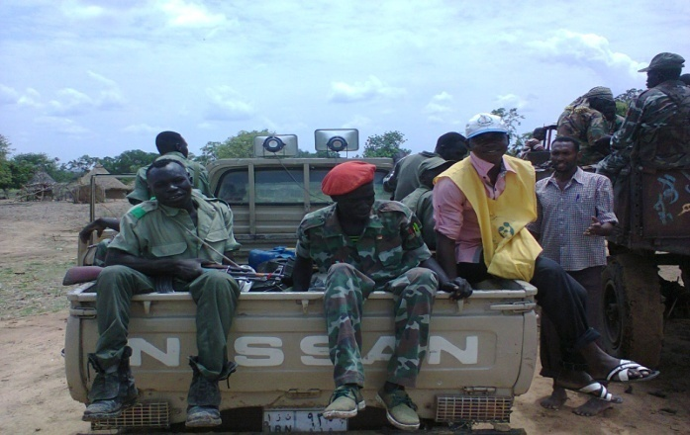
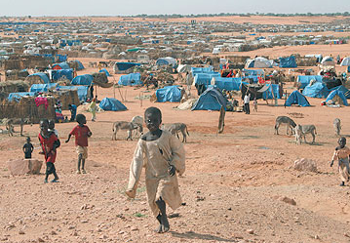
  Examples of Use of Polio’s Infrastructure to Support Measles and Rubella in Sudan
Allocate the capacities, processes and assets created by the program to support &strengthening Measles and Rubella Surveillance.
Use all Strategies to reach vulnerable and hard to reach population to support measles immunization and surveillance

Slide 24
  Examples of Use of Polio’s Infrastructure to Support Measles and Rubella in Sudan
Measles and Rubella laboratory
accredited polio lab and the qualified personnel, transport, and shipping of samples are currently utilized for measles and other vaccine preventable diseases surveillance
The existing polio lab will be upgraded and used for all other viral diseases in the country.
Rubella surveillance is integrated with measles surveillance.

Slide 25
  Likelihood That Infrastructure Will Be Maintained & Ability to Support Immunizations & Measles / Rubella
Volunteers, assistant, secretaries, drivers, supporting staff (e.g. IT) work in Measles and Rubella Surveillance.
Polio program resource support functions for IVPDs surveillance and contribute in RI activities.
Built capacity for polio programs provide the actual capacity for IVPDs surveillance and in emergency response to outbreaks .

Slide 26
  Likelihood That Infrastructure Will Be Maintained & Ability to Support Immunizations & Measles / Rubella
Measles surveillance integrated with AFP surveillance in reporting sites, cases investigation, staff at all level (Medical Officers and Field Volunteers), infrastructures and work plans
Actually polio eradication infrastructure is being utilized by routine immunization personnel and also other programme such as emergency programme during the time of outbreaks (Yellow fever) or mass vaccination campaigns (meningitis).

Slide 27
  Potential negative impact on measles, rubella and other health programs when GPEI no longer provides infrastructure
If no other resources are allocated then this may lead to collapse in Measles and rubella surveillance system in Management and operations, Planning,
Implementation Monitoring and data management,
social mobilization and advocacy, Capacity building, Partnerships and coordination.

Slide 28

شكرا

