Slide 1
Progress in creating a world free of measles, rubella and congenital rubella syndrome
12th Annual Meeting of the Measles and Rubella Initiative
10 September 2013
Dr. Robert Perry, WHO / EPI

Slide 2
Overview
Global and regional targets
Scorecard on progress
  Coverage steady for 1st dose; more countries introducing 2nd dose in routine
  Cases/incidence dropped over 90% since 1980
  Estimated deaths (through 2011) dropped 71% since 2000
Regional updates
Opportunities to accelerate progress
  Rubella roll-out
  New tools on the horizon for vaccination, surveillance and monitoring
Remarkable progress on the road to eradication, but need to accelerate progress towards global and regional goals

Slide 3
Measles and Rubella Targets
WHA 2015 Global Control Targets:
  Measles mortality reduction of 95% vs. 2000
  Measles reported incidence <5 cases per million
  Measles vaccination coverage ≥90% nationally, ≥80% in every district
Regional Measles and Rubella Elimination Goals:
  2000 AMRO measles (rubella elimination by 2010)
  2012 WPRO measles
  2015 EMRO (measles) and EURO (measles + rubella)
  2020 AFRO (measles) and SEARO (measles, this week?!?)
GVAP Goals:
  2015: measles elimination in 4 and rubella elimination in 2 regions
  2010: measles and rubella elimination in 5 regions

Slide 4
94% Reduction in reported measles cases
Measles global annual reported cases and MCV1 coverage*, 1980-2012
* MCV1 coverage: coverage with first dose of measles-containing vaccine as estimated by WHO and UNICEF

Slide 5
Global coverage has levelled off
Measles containing vaccine coverage by WHO region, 1980-2012
Source: WHO/UNICEF coverage estimates 2012 revision. July 2013; Immunization Vaccines and Biologicals, (IVB), World Health Organization.
194 WHO Member States. Date of slide: 17 July 2013

Slide 6
Proportion of Countries Reaching 90% MCV1
By WHO Region

Slide 7
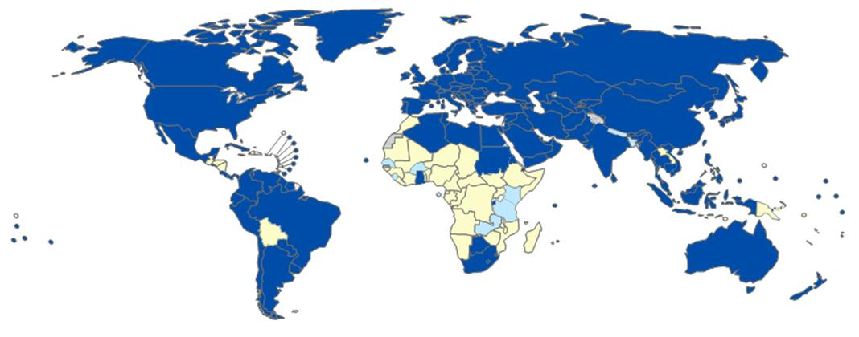
Measles 2nd dose introductions planned in 9 more countries during 2013-14
Data in HQ as of 6 September 2013
Introduced prior to 2013 (147 member states or 75%)
2013: Kenya, Rwanda, Sao Tome e Principe, Zambia
2014: Burkina Faso, Nepal, Senegal, Sierra Leone, Tanzania
Introduced or planned 2013-2014 (9 member states or 5%)
No (39 member states or 20%)
Not available
Not applicable

Slide 8
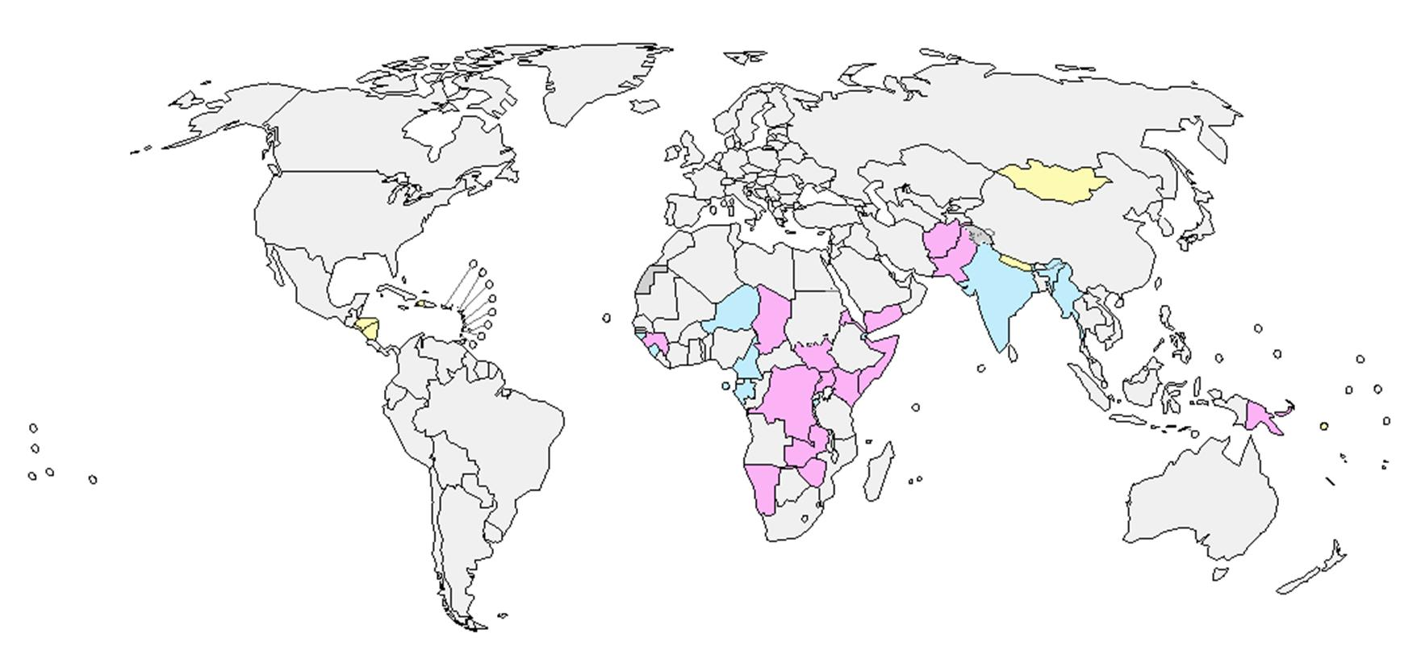
Measles campaigns in 32 countries in 2012
112 million children reached
20 (63%) attained 95% coverage
14 (44%) with coverage survey
26 of 32 SIAs integrated 1 or more other interventions
Measles (10)
Measles and OPV (15)
Vitamin A – 18
De-worming – 11
Bed nets – 1
OPV – 18
Other interventions -8
Measles and Rubella (7)
Not Available
Not Applicable

Slide 9
Reported cases increased in 2010 and 2011, but
provisional total lower for 2012*
Reported measles cases by WHO Region, 2000-2012
*2012 data are provisional, includes reports from 181/194 countries

Slide 10
Reduction in estimated measles deaths, 1985 - 2011
86% drop from 1985-2011
71% drop from 2000-2011
Source: WER 2013; 88(3):29-36

Slide 11
Response to measles resurgence in AFRO
Plans to address recent resurgence
  Routine strengthening
  Improving campaign funding and quality
  Widening target age range if needed
  Post-campaign coverage surveys
GAVI supported SIAs in 2013:
  M in DRC, Ethiopia, and Nigeria
  MR in Rwanda, Cape Verde, Ghana, Senegal
MR Initiative supported M and MR SIAs in 11 other countries
Data source: surveillance DEF file
Data in HQ as of 5 Aug 2013

Slide 12
Response to outbreaks and humanitarian emergency in EMRO
Large outbreaks affecting Pakistan, Somalia
  GAVI and MRI outbreak funds supporting Pakistan campaign
Sudan holding measles campaign targeting <15y with UNICEF, MR Initiative support
Humanitarian emergency in Syria and neighbors
Challenge of supporting MIC such as MR campaigns in Jordan, Lebanon, Morocco
Data source: surveillance DEF file
Data in HQ as of 5 Aug 2013

Slide 13
Responding to measles and rubella resurgence in EURO
New Accelerated Plan for Action for the region
Large outbreaks in Ukraine (ending), Turkey and Georgia (ongoing)
Smaller outbreaks in Azerbaijan, Germany, the Netherlands and United Kingdom
1st round of status reports to Regional Verification Committee in July
Data source: surveillance DEF file
Data in HQ as of 5 Aug 2013

Slide 14
Measles elimination goal in SEARO?
India completes measles SIAs this month
  139 M children so far
Routine MCV1 up from 61% to 79%
MR SIAs: Nepal in 2012, Bangladesh in 2013
Expect this week regional goal of measles elimination by 2020
*India is not included in this graph.
Data source: surveillance DEF file
Data in HQ as of 5 Aug 2013

Slide 15
Final push to eliminate measles in WPRO
Region making remarkable progress towards elimination
Regional TAG reaffirmed elimination goal, recommends rubella elimination
Resurgence in China, outbreaks in Lao PDR and Viet Nam
MR SIAs in Cambodia, Viet Nam
Data source: surveillance DEF file
Data in HQ as of 5 Aug 2013

Slide 16

Measles and rubella in PAHO
Measles and rubella elimination achieved maintained
Outbreak after importations
  Ecuador
  Brazil
  USA
Big events in 2014 in Brazil: Olympics, World Cup, others
Data source: surveillance DEF file
Data in HQ as of 5 Aug 2013

Slide 17
Reported Measles Incidence Rate* (Jul 2012 – Jun 2013)
Reported Measles Cases in 15 Large Outbreaks since Jan 2012
Ukraine: 12,744 in 2012
1,821 in 2013
Georgia: 31 in 2012
5,783 in 2013
Romania: 4,271 in 2012
1,026 in 2013
Pakistan†: 14,984 in 2012
>25,000 in 2013
Turkey: 57 in 2012
5,710 in 2013
China†: 6,183 in 2012
22,950 in 2013
Sudan: 8,523 in 2012
2,156 in 2013
Thailand: 3,694 in 2012
1,282 in 2013
Nigeria†: 19,062 in 2012
48,619 in 2013
Dem Rep Congo†: 73,794 in 2012
63,426 in 2013
Ethiopia†: 4,347 in 2012
1,997 in 2013
Angola: 4,442 in 2012
1,736 in 2013
<1
Indonesia: 9,429 in 2012
1,917 in 2013
(91 countries or 47%)
*Rate per 1'000'000 population
Reported cases through end
Mar 2013 except where noted †:
China conf + comp thru 20 Aug 2013
DRC through end Aug 2013
Ethiopia through July 2013
Nigeria through Aug 2013
Pakistan through end May 2013
Somalia through end July 2013
≥1 - <5
(31 countries or 16%)
≥5 - <10
(14 countries or 7%)
India: 18,668 in 2012
≥10 - <50
(33 countries or 17%)
Somalia†: 9,983 in 2012
1,593 in 2013
≥50
(13 countries or 7%)
No data reported to WHO HQ
The boundaries and names shown and the designations used on this map do not imply the expression of any opinion whatsoever on the part of the World Health Organization concerning the legal status of any country, territory, city or area or of its authorities, or concerning the delimitation of its frontiers or boundaries. Dotted lines on maps represent approximate border lines for which there may not yet be full agreement. ©WHO 2013. All rights reserved.
(12 countries or 6%)
Data in WHO HQ as of 5 August 2013
Not applicable

Slide 18
MR Initiative Outbreak Response Fund
Purpose: enable countries to rapidly respond to measles outbreaks while small and localized, preventing progression to larger and more widespread epidemics
$55 million support from GAVI over 5 years
Standard operation procedures developed
  Managed by MR Initiative Management Team
  GAVI eligible country
  Documented outbreak and need for funding
  Rapid turn-around: requests (48hr), funding (7d), vaccines (10d)
  Country required to report on activities and results
$5,179,000 disbursed to date to 4 countries
Web site link for application and more information:
http://www.measlesrubellainitiative.org/wp-content/uploads/2013/06/SOP-Funding-Request.pdf

Slide 19
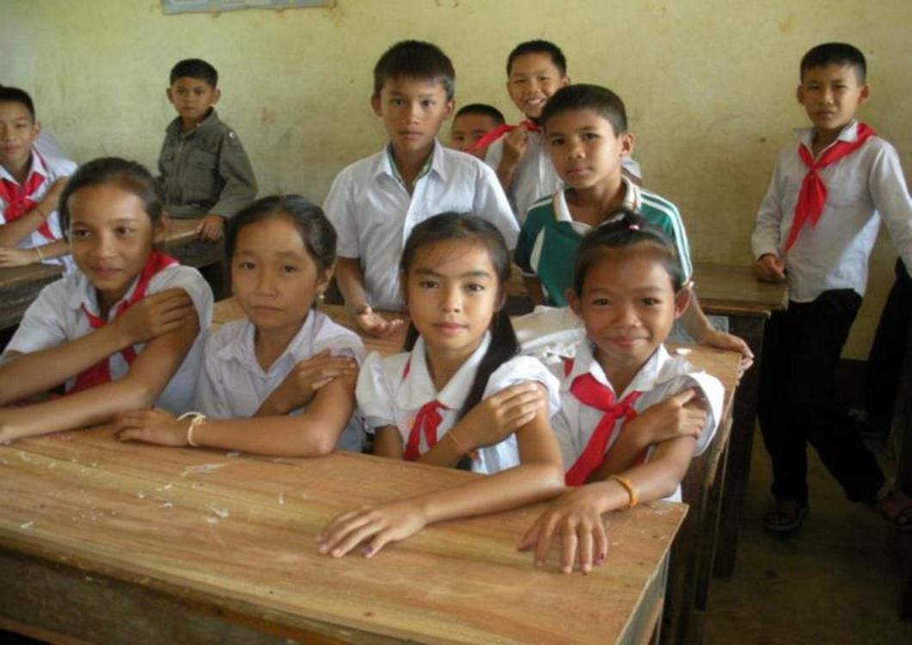
Rubella

Slide 20
Rubella as the "game changer”
Over 800 million children projected to receive MR by 2020
"WHO recommends that countries take the opportunity offered by accelerated measles control and elimination activities to introduce RCVs."
  Preferred approach: begin with MR vaccine in a wide-age range campaign followed by introduction in routine
  Countries introducing RCV should achieve and maintain immunization coverage of ≥80% delivered through routine and/or regular SIAs
GAVI support ($554 million) for MR vaccine introduction will shift market away from M to MR
Need ensure highest-quality campaign preparations and implementation, improved monitoring, and post-campaign surveys
Another 800 million children projected to receive MR in the following decade
Wkly Epid Rec, 15 July 2011, vol 86:301-316

Slide 21
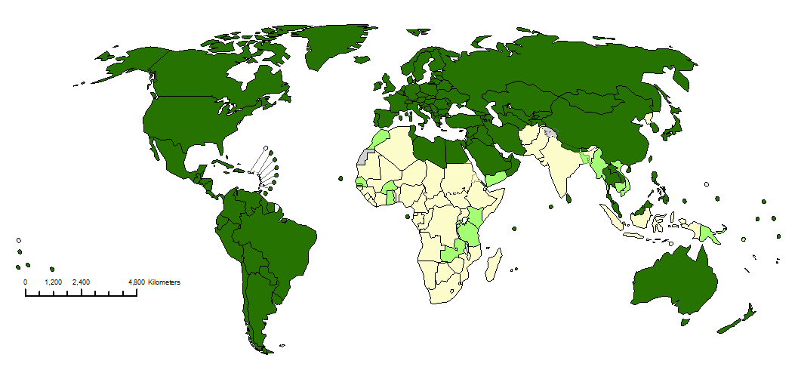
Rubella in catch up SIAs in 20 countries during 2013-2015
2013: Bangladesh, Cambodia, Cape
Verde, Ghana, Morocco, Rwanda, Senegal
2014: Burkina Faso, United Republic
of Tanzania, Viet Nam, Yemen
2015: Burundi, Eritrea, Gambia, Kenya, Myanmar, Papua New Guinea, Sao Tome e Principe, Solomon Islands and Zambia
Introduced prior to 2013 (131 member states or 67%)
SIA conducted or planned 2013-2015 (20 member states or 10%)
No (43* member states or 22%)
Not available
Not applicable
Data in HQ as of 14 June 2013

Slide 22
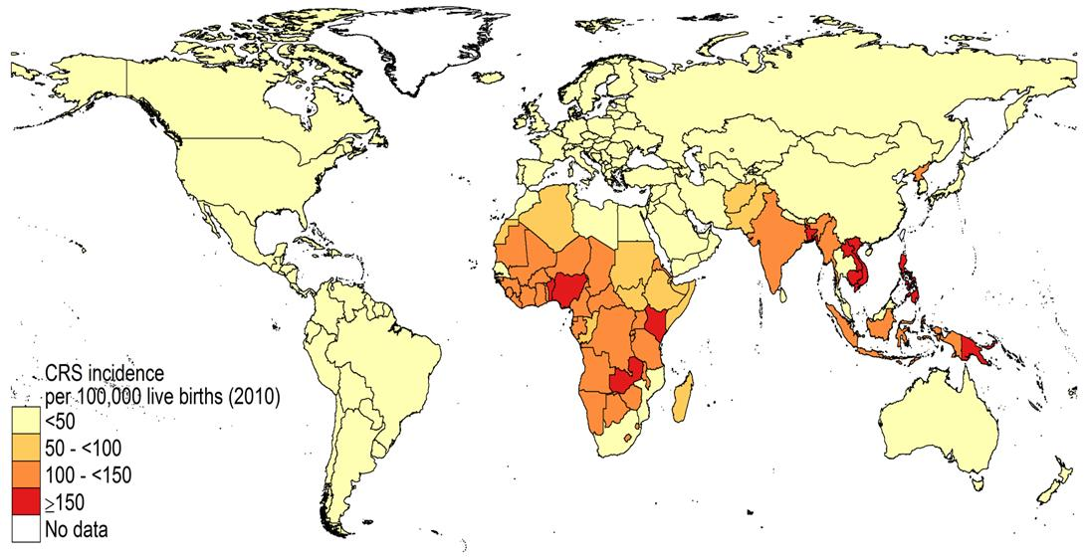
Estimated average incidence of CRS per 100,000 live births, 2010
Source: Vynnycky, Adams, HPA, et al (in preparation)

Slide 23
SAGE, November 2012
SAGE welcomed recent GAVI investments in measles and rubella control which provide significant additional resources for increasing routine coverage, measles-rubella and measles supplementary immunization activities and timely outbreak response vaccination. SAGE recommends that countries seize this unique opportunity and commit additional national resources to ensure programme planning and implementation is of the highest quality. Each campaign should follow established “best practices” and be independently evaluated to ensure homogeneous vaccination coverage of >95%.
SAGE commended countries and regions for the remarkable progress made in reducing measles mortality globally during last three decades, contributing significantly to the fourth Millennium Development Goal.
Despite this progress, a careful assessment of the comprehensive reports presented indicates that based on current trends and programme performance, the 2015 global targets as well as regional elimination targets in EUR (2015), EMR (2015) and AFR (2020) will not be achieved on time.
SAGE urged countries and partners to raise the visibility of measles and rubella elimination activities and to ensure that they receive adequate priority and resources as a central component of the GVAP.

Slide 24
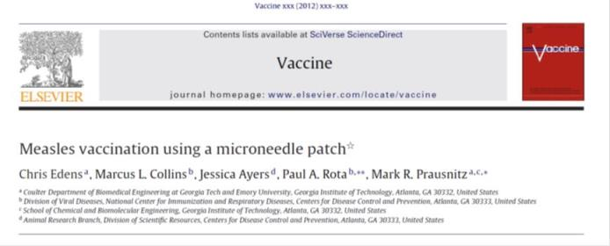
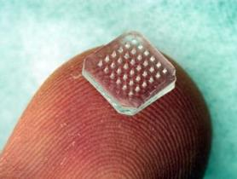
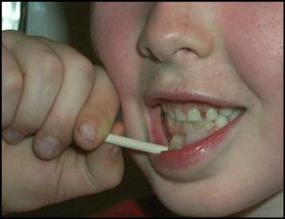
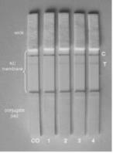
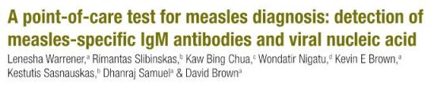
New tools
Microneedle patch
Bull World Health Org 2011; 89:675-82.
Point of care diagnostic test

Slide 25
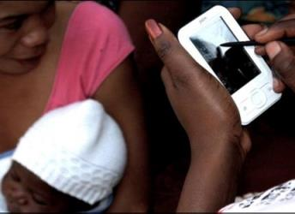
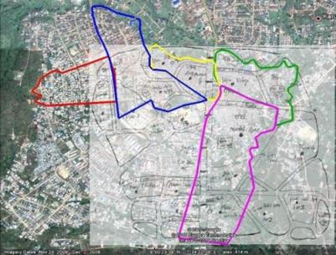
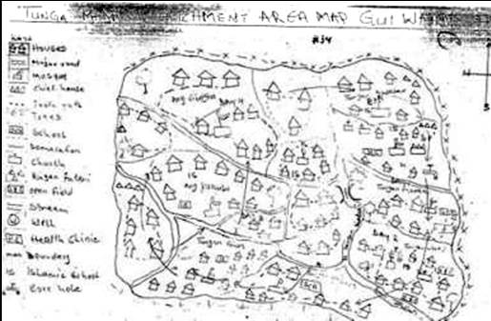
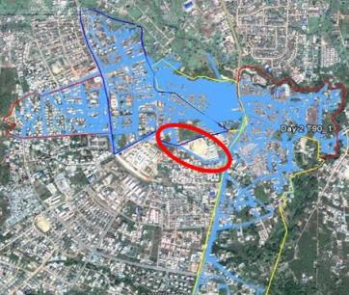

Innovation in the field
Using mobile phones for data collection and transmission
Coverage during SIAs
Surveillance data
Micoplanning using satellite imaging and GPS
Monitor movement of vaccination teams with GPS device
Use SMS messages to stimulate active surveillance
  Can we expedite data transmission using mobile phones?
  Can we expedite the transmission by using mobile phone?

Slide 26
Summary
Score card shows remarkable progress
  50 years of measles vaccine led to >90% reduction in global cases and deaths
  Over 40 years of rubella vaccine with rubella elimination in PAHO
Each region demonstrates progress and challenges
  PAHO maintaining elimination
  Progress in AFRO and WPRO
  On-going outbreaks in EMRO and EURO
  SEARO RC to decide on 2020 elimination target on Friday 13th Sep
Opportunities to accelerate progress
  Rubella roll-out – two birds with one stone!!
  New outbreak response fund
  Alignment of policy (SAGE in November) and funding (GAVI) – get ducks in row!!
On the road to eradication but need to accelerate progress towards regional goals

Slide 27
