Slide 1
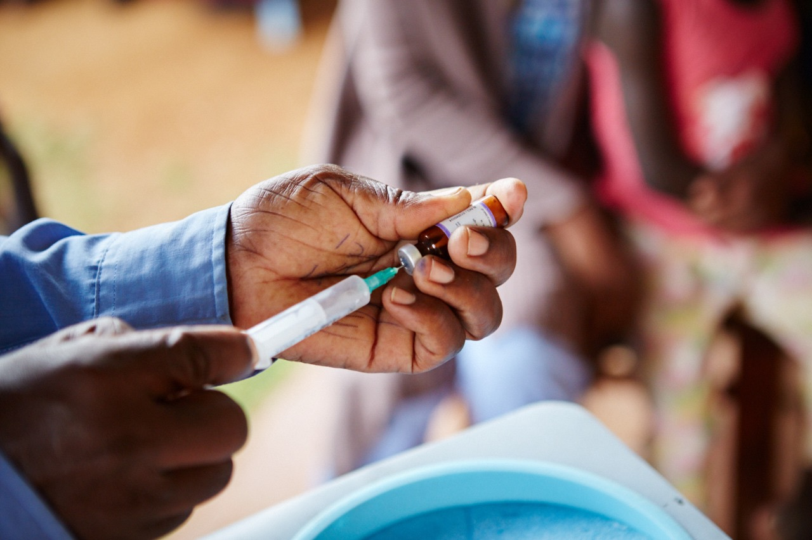
Individuals Making a Difference in Eliminating Measles & Rubella
Ms. Kathy Flynn & Ms. Sara Horein
September 7, 2017
Notes:
Opening slide (0 min)

Slide 2
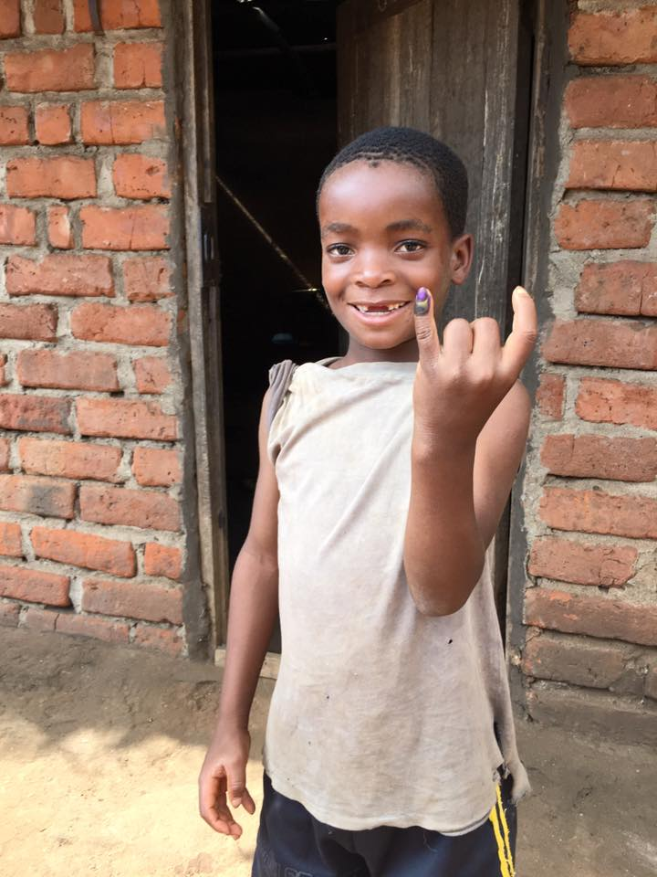
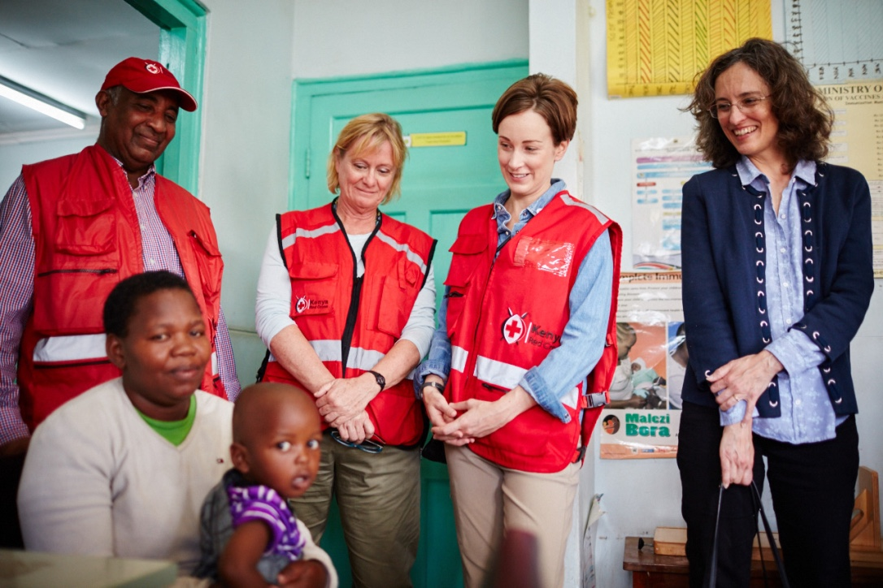
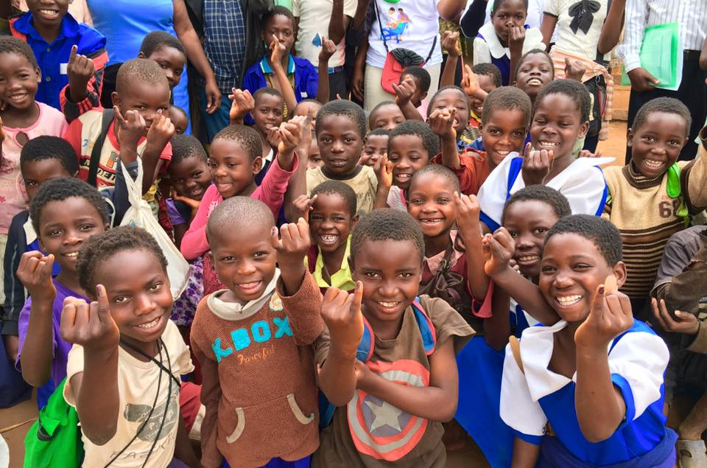

Volunteer Impact
Notes:
Kathy
Introduce us
Explain our role as Independent Monitors for M&RI
Share how we are making a difference (5 mins)

Slide 3
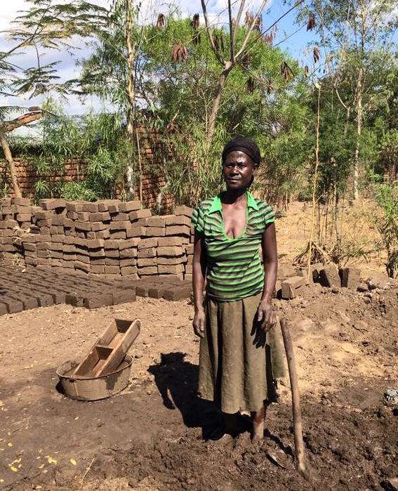
Meet Chimwala
Notes:
Sara
Share story of Chimwala. (5 mins)

Slide 4
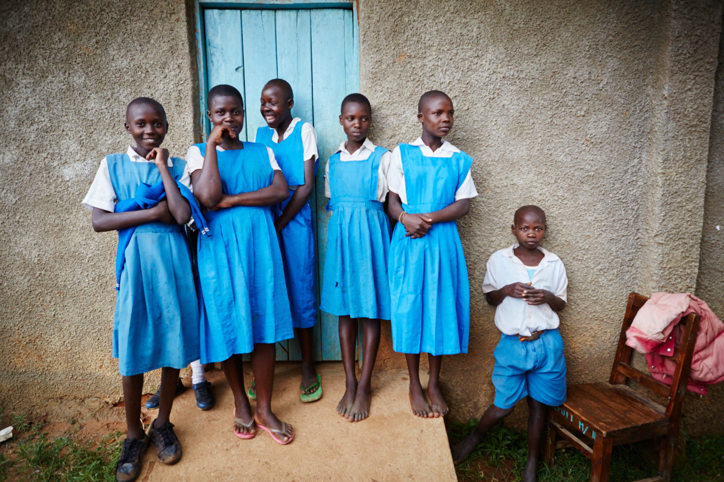
Questions
Notes:
Kathy
Closing remarks: power of the individual volunteer and donor. (1 min)

