Slide 1
Polio Transition Planning:
Risks and opportunities of transitioning polio resources to support Measles-Rubella Elimination
Measles & Rubella Initiative Partners meeting
September 7-8, 2017

Slide 2
Underlying premise:
Transition to other health goals risk -- and opportunity
There is a RISK to other health goals (such as Measles-Rubella) when GPEI funding stops, as the polio infrastructure is already helping to support other health programmes
There is an OPPORTUNITY for current GPEI staff, assets and knowledge to further contribute to other health goals
2

Slide 3
Measles & Rubella Global Strategic Plan Midterm Review (2016)
“All stakeholders involved in control and elimination of measles and rubella as well as those involved in immunization system strengthening should engage in polio transition planning (at all levels) to leverage the opportunity and avoid the risks of the end of the GPEI”

Slide 4
Most Obvious Candidates for
Transitioning of Polio Assets*
Measles and rubella elimination
Immunization system strengthening
Vaccine preventable-communicable disease surveillance & lab networks
* adapted from WHO draft report on Polio Transition Planning
to the 70th WHA, April 2017

Slide 5
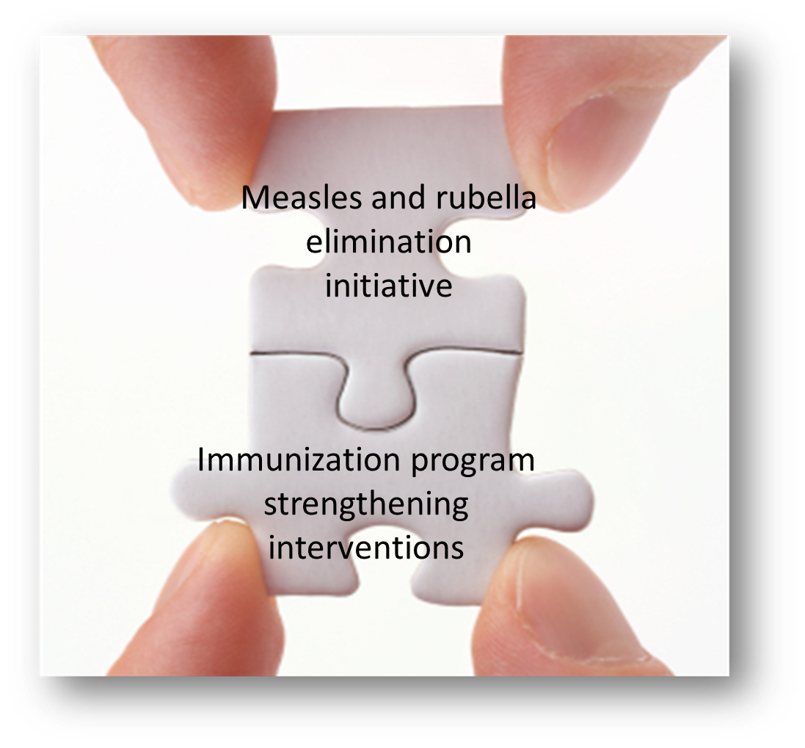


KEY STEP to build immunization program capacity is to strategically link:
1. disease-specific efforts
2. health system strengthening efforts
GVAP
measles and rubella elimination targets
GVAP
national and subnational vaccination coverage targets
Orenstein W.A. & Seib K (2016) Beyond vertical and horizontal programs: a diagonal approach to building national immunization programs through measles elimination, Expert Review of Vaccines, 15:7, 791-793
Sepúlveda J et al. Improvement of child survival in Mexico: the diagonal approach. Lancet 2006; 368: 2017–27

Slide 6

GPEI presence in over 70 countries, but 95% of personnel footprint in 16 countries
>1000 personnel
>100 personnel
>40 personnel
>10 personnel
1+ personnel
M&RI – 6 Gavi priority
Includes social mobilizers. Does not include national government staff, vaccinators or regional/headquarters personnel.
Note: Philippines, Haiti also have between 1-10 polio funded personnel but are not displayed; no headquarters staff displayed
Source: GPEI partner HR databases, 2014

Slide 7
Characteristics of the 16 Priority
“Polio Transition” Countries
Most of the world’s unvaccinated and under-vaccinated children
    (53% of 20.8 million infants who did not receive measles vaccine in 2015 are in the Big 6 priority measles countries)
Most of the world’s measles cases and deaths (88% of deaths)
Most of the world’s rubella and congenital rubella syndrome
    (100,000 CRS cases)
Consequences of losing polio assets – risk that EPI progress in these countries and globally will be reversed !!

Slide 8
86% of WHO immunization personnel in Africa are polio-funded
40% of WHO AFRO’s workforce is polio-funded
Polio funding plays a significant role in overall partner capacity in many regions
and countries
Example: Polio funds 70% of
WHO staff in DR Congo¹
38
126
3
88
Provinces
Kinshasa
# polio-funded personnel
Other
Total staff¹
1. 2013 DRC FRR data; excluding consultants
Source: GPEI FRR, WHO, UNICEF, BCG analysis

Slide 9
Why It Makes Sense to Pivot from
Polio Eradication to Measles-Rubella Elimination
Strategies are similar
  Surveillance and lab network
  Outbreak preparedness and response
  Importance of achieving/maintaining high routine coverage
  Need for periodic SIAs to reach inaccessible children
  Use of communications/social mobilization network
Polio infrastructure concentrated in the lowest-performing countries with highest measles-rubella disease burden
Polio and measles-rubella already working together and interconnected including human resources
Measles still major cause of <5 child deaths
Rubella is the leading infectious cause of birth defects

Slide 10
GPEI Lessons Learned That Can Be Applied to Measles-Rubella Elimination
Using a targeted disease initiative for broader health communication
Value of advanced state-of-the-art global lab network and real-time disease surveillance
Experience with reaching every child
Outstanding program monitoring and use of accountability frameworks for performance assessment
Partnership coordination, advocacy, resource mobilization

Slide 11

Polio-Funded Surveillance Officer Responsibilities
Polio
Other VPDs:
Measles/Rubella
Yellow Fever
Neonatal tetanus
Meningitis
Acute encephalitis syndrome
Diphtheria
Cholera
Pertussis
…and so on
Other Communicable Diseases:
Bloody diarrhea
Neglected tropical diseases
Dengue
Viral hemorrhagic fevers
Rabies
Malaria
….and so on
Other VPDs

Slide 12
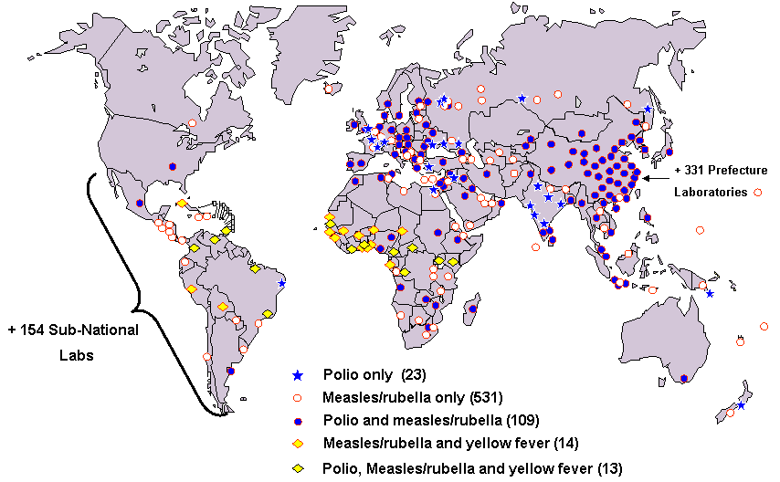
Health Emergency and IHR Capacity: Building on the
Polio/MR Lab and Surveillance Network (>700 labs)
12
Notes:
The GMRLN started in 2000, and is now the largest globally-coordinated laboratory network supporting surveillance in 191 countries
723 GMRLN labs in 165 countries include:
506 subnational
180 national
14 regional reference
3 global specialized laboratories

Slide 13
Resource Dependence of MR on Polio
Financial
  Polio FRR: surveillance/lab costs $102 million, excluding technical support like NPSP (2016)
  $111 million annually needed for MR surveillance to be maintained at status quo (excluding operational costs at country level)
    $77 million (70%) coming from polio $$
Human
  Over 2500 polio-funded staff are supporting MR surveillance

Slide 14
Key Messages– Polio/MR/VPD Surveillance
Polio is the foundation for much of VPD surveillance in many developing countries
Polio funds a significant amount of the VPD surveillance -- human resources and infrastructure
  Even with polio support, insufficient to achieve various global/regional goals
Careful planning and consideration needs to be undertaken to ensure all the gains in VPD surveillance are not destroyed during polio transition
Polio needs VPD surveillance as much as
VPD surveillance needs polio
Notes:
Not as vertical as previously accused

