Slide 1



5-Point Plan Pilot to
Strengthen Routine Immunization by
- Identifying Unvaccinated Children
- Determining the Reasons, and
- Rectifying the Barriers
American Red Cross & Zambia Red Cross Society
Notes:
Mary

Slide 2
5-Point Plan Objectives
Mobilize Community-Based Volunteers (CBVs) & communities in a district to identify clusters of children who do not have a vaccination record and/or are zero-dose or under-vaccinated and determine the reasons why; and to engage partners to rectify the reasons in a sustainable manner for future generations.
Notes:
Mary

Slide 3
5-Point Plan Overview
Point 1.
Find clusters of unvaccinated children
Point 2.
Ask mothers & frontline health workers why
Point 3. Share information with MoH & partners and act to overcome barriers
Point 4. Social mobilization once barriers are removed
Point 5. Evaluate
~2 weeks for 1 district
May 2023
October 2023
May 2024
May 2025
Notes:
Mary

Slide 4
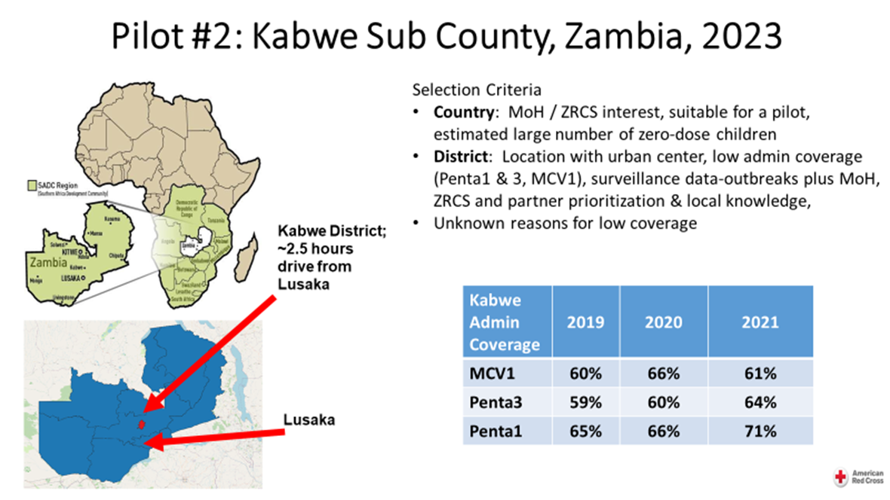
Planning: Selection of Targeted Area
Zambia: natural fit
MoH consultations: Feb 2023
DHIS2 Data:
  Coverage (MCV1)
    Low reported coverage of ~61%
  Coverage (Penta1 & 3)
    Low reported coverage of ~65%
  <2-year-old population
  Unknown reasons for low or stagnating coverage
  Geographical scale
Kabwe District, Central Province ~3-hour drive from Lusaka

Slide 5
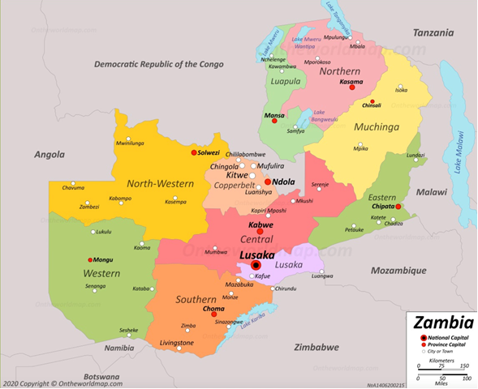
Kabwe District , within
Central Province Zambia
Lusaka
Notes:
James

Slide 6
Building the Partnership
Zambia: (Zambia Red Cross Society)
  Ministry of Health:
    National, Provincial, District
  Zambia Statistics Agency
  WHO
  IFRC
  GRID 3
  AKROSS
National & International Consultants:
  Zambia Broadcasting Corporation; Mr. Graham Sale; Biostat
AmRC Volunteers: Ms. Kathy Flynn
Notes:
James

Slide 7
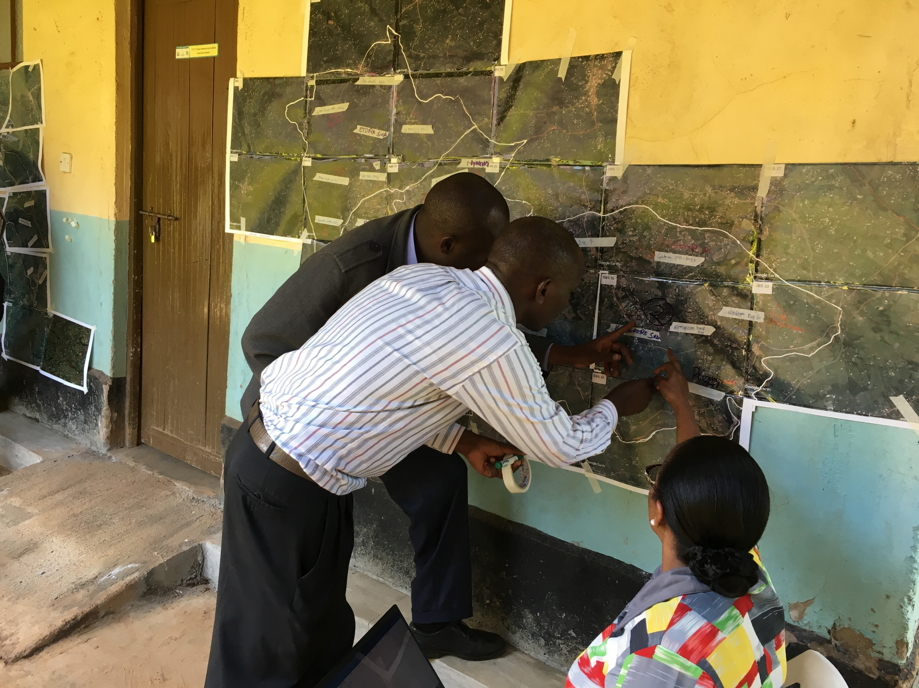
Satellite Maps, ‘Micro-mapping’,
Volunteers & Real-Time Data Collection
Satellite mapping
Est. 63,200 households
‘Micro-mapping’
>45 houses/volunteer/day
Recruit: 330 volunteers; 33 supervisors
  MoH & RC volunteers & partners
Notes:
James

Slide 8
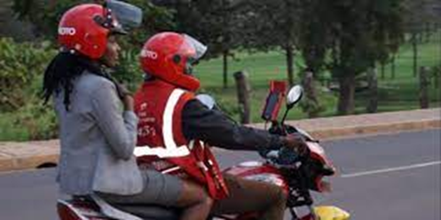
Supervisor and Volunteer movement logistics
Size and terrain
Motorbike/bicycle used
Number needed for Supervisors and Volunteers was determined
Notes:
Ruth

Slide 9
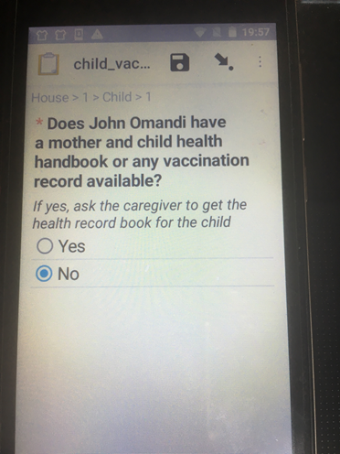
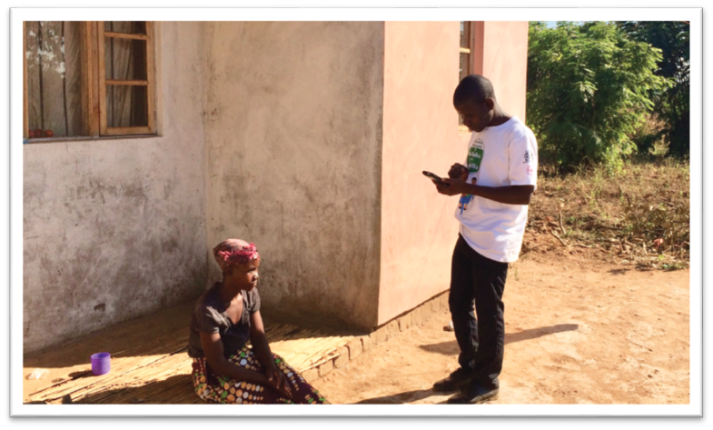
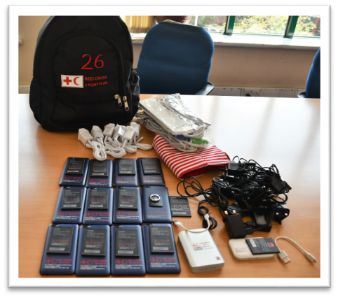
Real-Time Electronic Data Collection
Mobile data collection(each volunteer had a mobile phone)
Visit all buildings
Census of all residences with consent
Children <2 years, review home-based health records for Penta1, Penta3 and MCV1
Notes:
Ruth

Slide 10
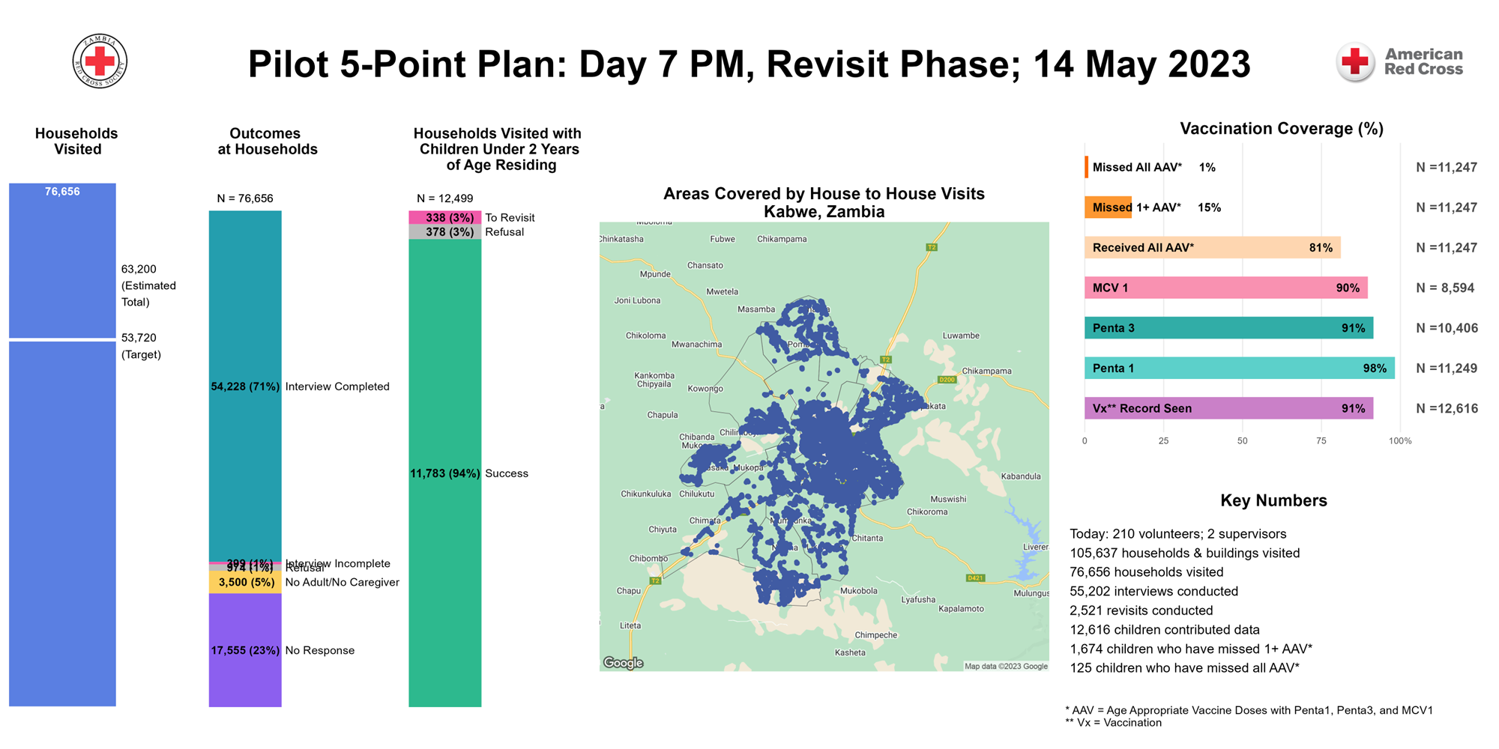
Monitoring Point 1: High-Level
Email mary.agocs@redcross.org for link to live view

Slide 11

Monitoring Point 1: High-Level

Slide 12
Monitoring Point 1: High-Level

Slide 13
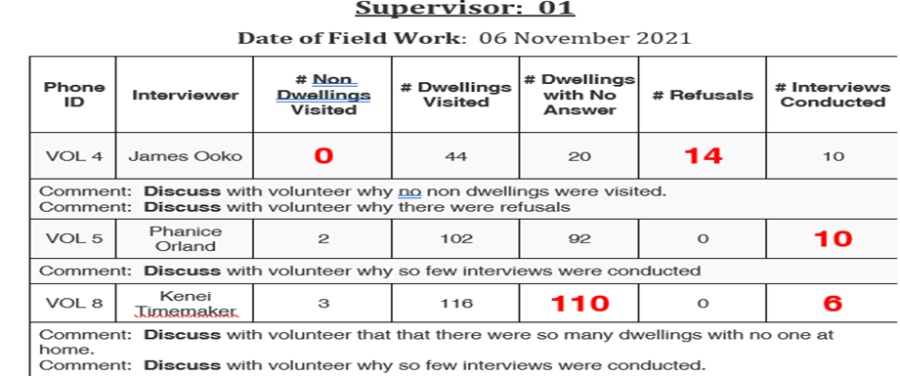
Monitoring Point 1: Situation Reports
Identify missed areas
Identify teams & volunteers not meeting targets
Track and return to houses: ‘Revisit’
  Houses with children <2 years of age; no interview
  No one at home

Slide 14
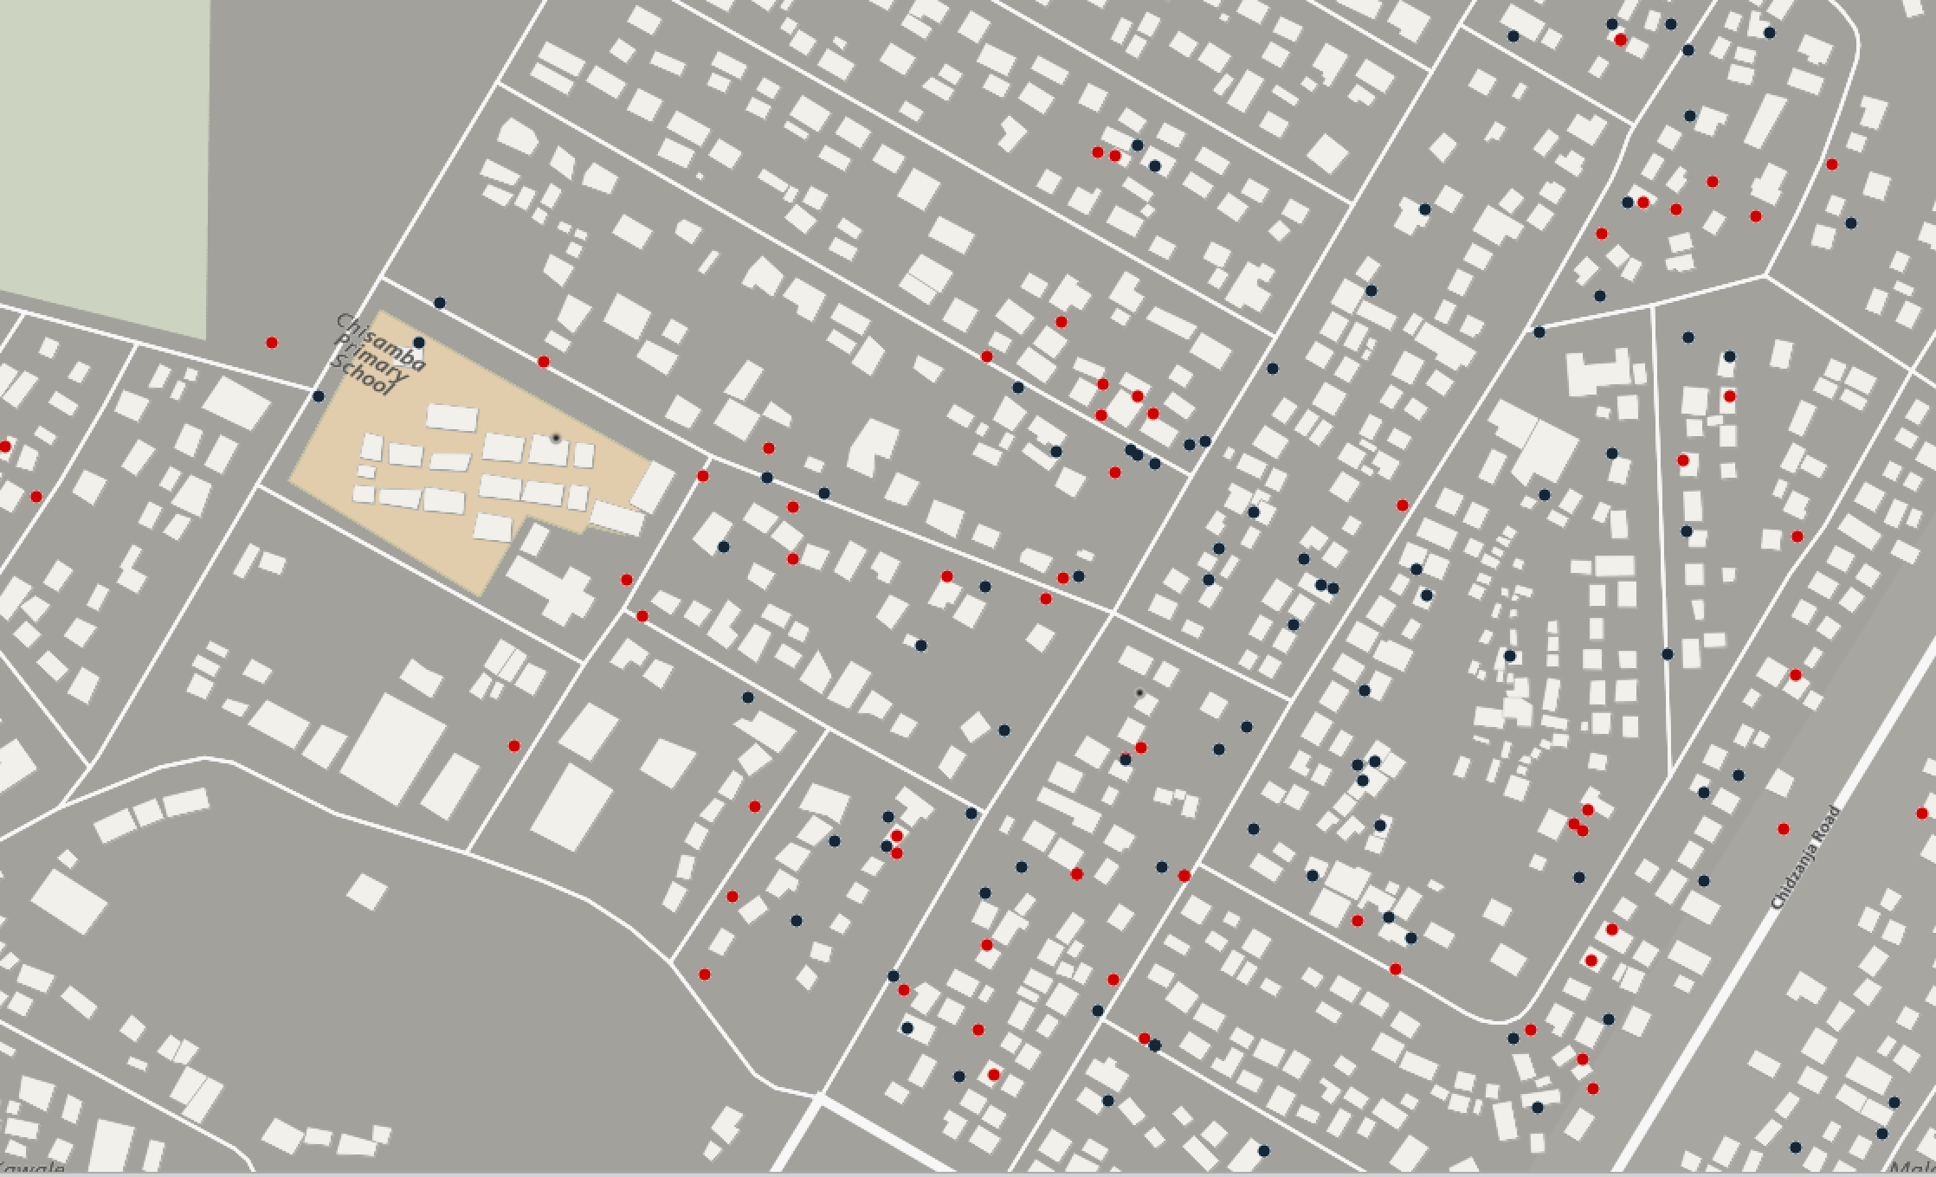

Defining a Cluster: A Work in Progress
Urban Africa: Mobile Phone GPS, Residence of Missed Child, 2023
Red dot: missed child; Blue dot: vaccinated child
Building-level data crowdsourced by volunteers, available through OpenStreetMap (OSM)

Slide 15
Validation of Data Accuracy Summary
During Implementation of 5PP in Kabwe, 1,190 cards (~10%) were randomly selected to be Photographed during Point 1 and 2 data collection for validation.
For the 1,190 cards, the AmCross team graded the accuracy of the date of birth and Penta1, 3 & MCV1 data collected by volunteers .
Out of the 1,190 cards,
    846 (71%) were official HF documents
    253 (21%) were improvised cards e.g., Notebooks, papers etc.
    91 (8%) were not photographed either due to lack of consent or other errors

Slide 16
Accuracy of Vaccination Information
Official card review results
Improvised card review results

Slide 17
5-Point Plan Overview
Point 1.
Find clusters of unvaccinated children
Point 2.
Ask mothers & frontline health workers why
Point 3. Share information with MoH & partners and act to overcome barriers
Point 4. Social mobilization once barriers are removed
Point 5. Evaluate
~2 weeks for 1 district
May 2023
October 2023

Slide 18
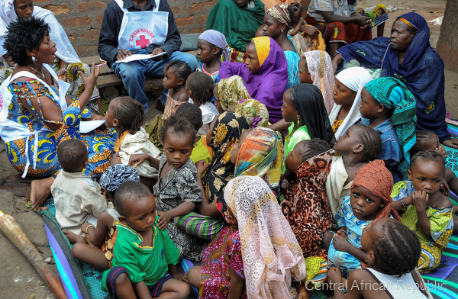
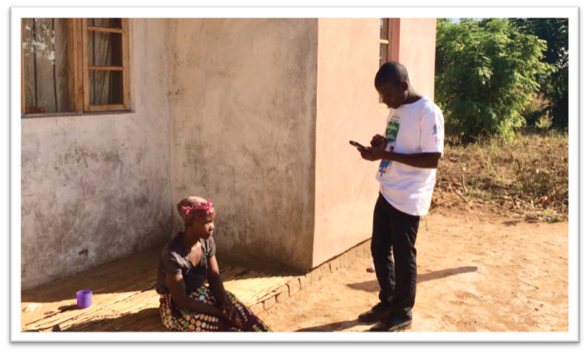
Barriers to Vaccination from the Mother/Caregiver Perspective
Point 2 of the 5 Point Plan
Focused group discussion
  FGDs were conducted in 6 clusters
  Led by Community Development Assistants: in a trusted setting
  Methodology melds with WHO/UNICEF MOV guidelines
Survey of mothers
  Total of 20 interviewers were used
  Senior Red Cross volunteers and Teachers

Slide 19
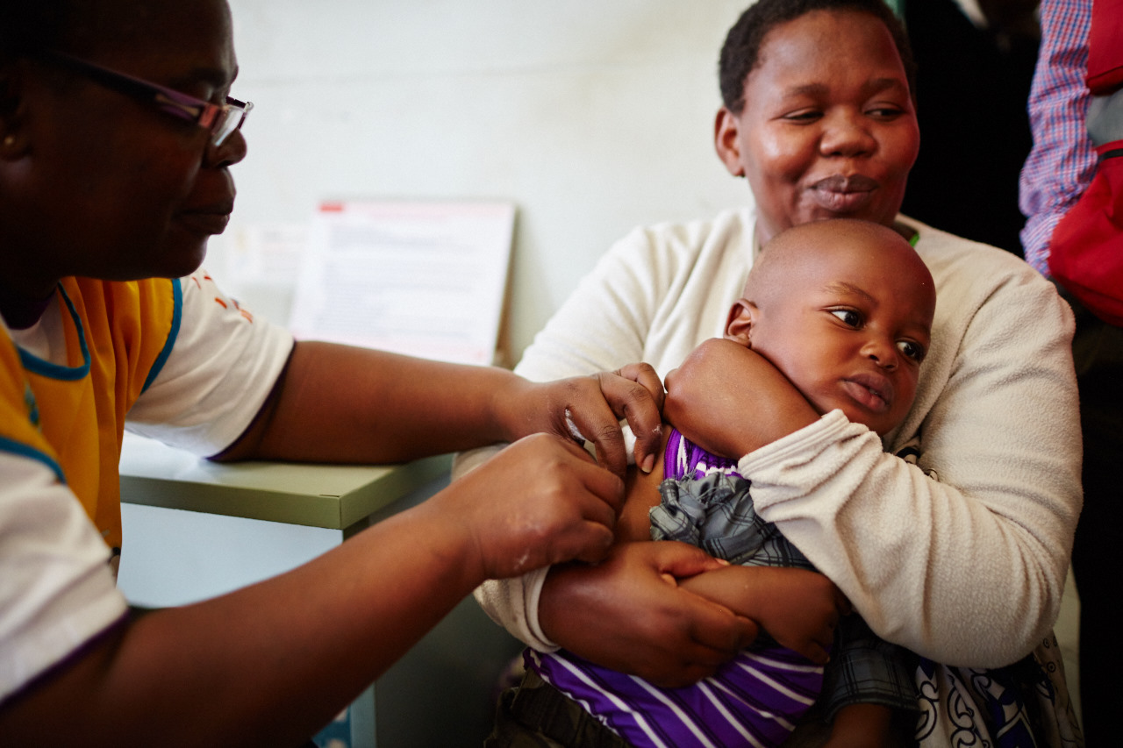
Barriers to vaccination from the health worker/mother/caregiver perspective
Point 2: Key queries in the Health Facility Interview
Health Facility-related Barriers
Long wait times
Stock-outs
Fixed sites – not convenient or consistent
Outreach - not convenient or consistent
Poor defaulter tracking
Do not vaccinate older (eligible) child
Do not vaccinate because of wastage associated with multi-dose vials
Do not vaccinate mildly ill or missing card
Missed opportunity – do not check for missed vaccines or refer eligible child to EPI clinic
Costs - charges a fee
Mother/Caregiver-related Barriers
Not aware of vaccine/services
Hesitant/afraid of vaccine side effects
Lack of trust in HF /do not feel welcome or comfortable at facility
Social or political barriers
Costs – transportation, missing work

Slide 20
5-Point Plan Overview
Point 1.
Find clusters of unvaccinated children
Point 2.
Ask mothers & frontline health workers why
Point 3. Share information with MoH & partners and act to overcome barriers
Point 4. Social mobilization once barriers are removed
Point 5. Evaluate
~2 weeks for 1 district
May 2023
October 2023

Slide 21
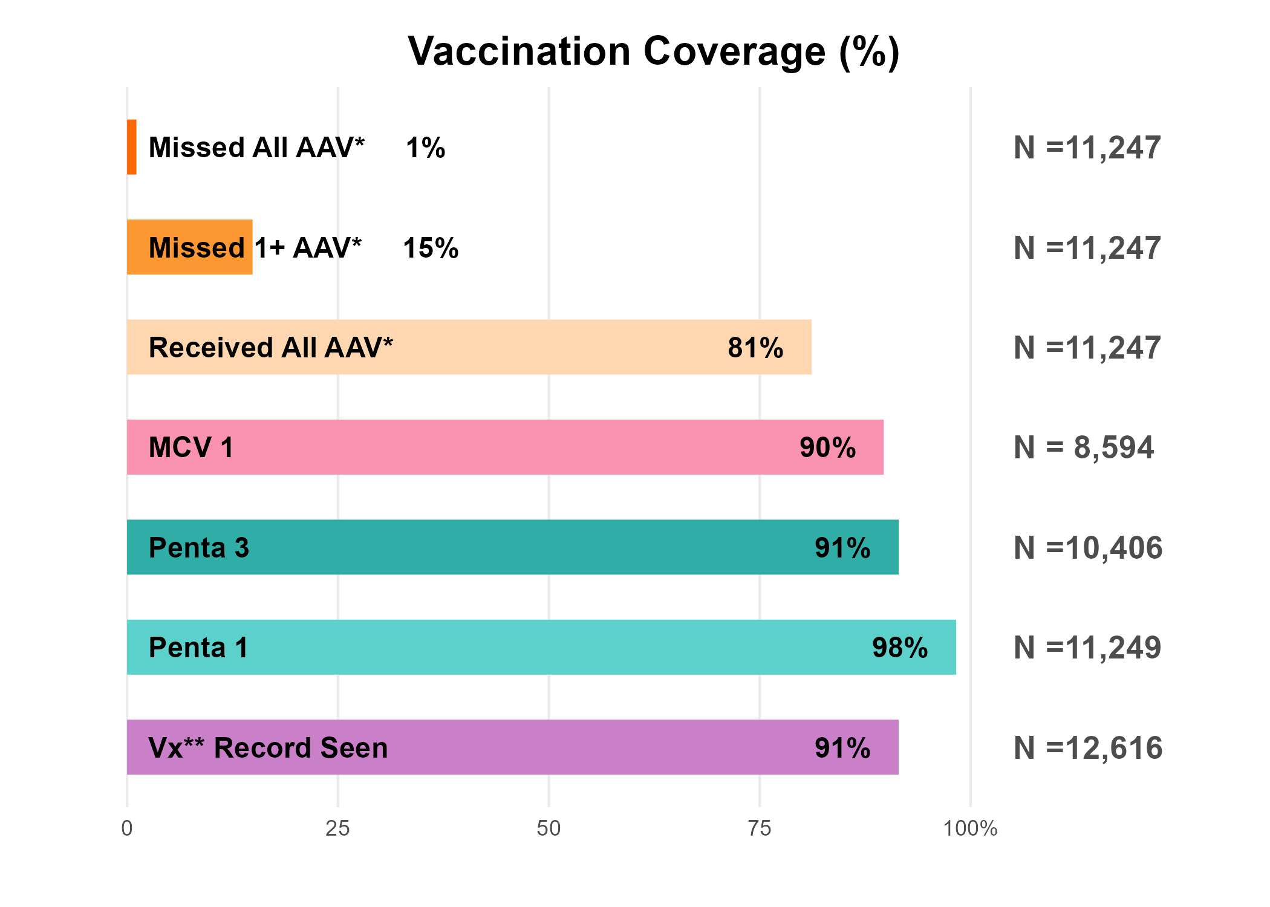
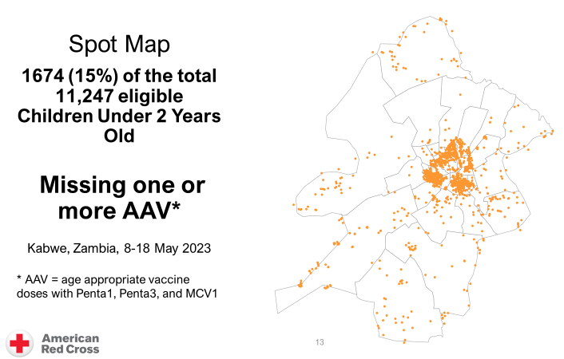
Summary of Barriers
Point 1
Point 2
Mother/Father/Caregiver Reasons |  | Health Care Worker Reasons
One on One Interviews | Focus Group Discussion | Service Delivery Practices that Lead to Unvaccinated Children
1. Too busy to take child 2. Forgot child needed vaccination 3. Long wait time for vaccination 4. Bad staff attitude | Vaccine stock-outs/unavailability Caregiver too busy Confusion over when vaccines are due Distance to clinic Myths and misconceptions Caregiver complacency | 1. Vaccine stock-outs (100%) 2. Do not vaccinate up to maximum age for Penta (86%) 3. Inadequate defaulter tracing (71%) 4. Do not always open multi-dose vials (55%) 5. Wait times over 20 minutes (50%)
Lack of training on RI
Lack of Home-based Health Records

Slide 22
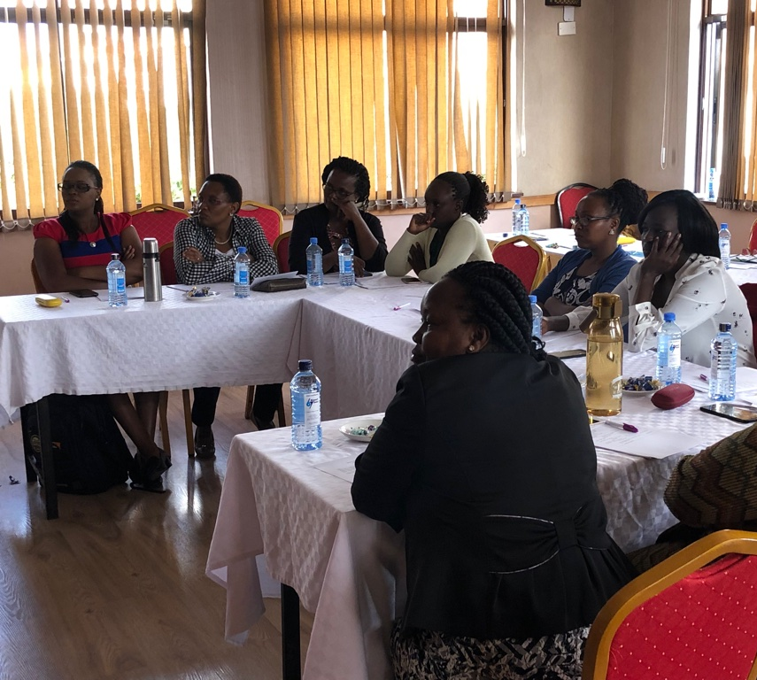
Coordination Meeting
Point 3: RC relays collated information to MoH and Partners, who act to rectify problems
MoH, WHO, UNICEF, GAVI, USAID, CIDRZ, CHAZ, & other Partners to take
ACTION

Slide 23
Actions to rectify the barriers
USAID Momentum committed to support delivery of vaccines and outreaches to the hard-to-reach HFs.
Jesus Care Ministries committed to train the Health Care workers in 17 poorly performing HFs.
Zambia Red Cross and SUNTAI committed to provide a total of 30,000 and 3,200 immunization cards respectively
Creation of WhatsApp group by MoH for weekly vaccines stock taking and reporting

Slide 24
5-Point Plan Overview
Point 1.
Find clusters of unvaccinated children
Point 2.
Ask mothers & frontline health workers why
Point 3. Share information with MoH & partners and act to overcome barriers
Point 4. Social mobilization once barriers are removed
Point 5. Evaluate
~2 weeks for 1 district
May 2023
Oct 2023
May 2024

Slide 25
Thank you!

