Slide 1


Measles & Rubella Microarray Patches for Vaccine Equity
First trial results from The Gambia
Ed Clarke
Professor of Paediatric Infection, Immunity and Global Health | Vaccines & Immunity Theme Lead
Measles & Rubella Partnership Meeting
06 March 2024

Slide 2
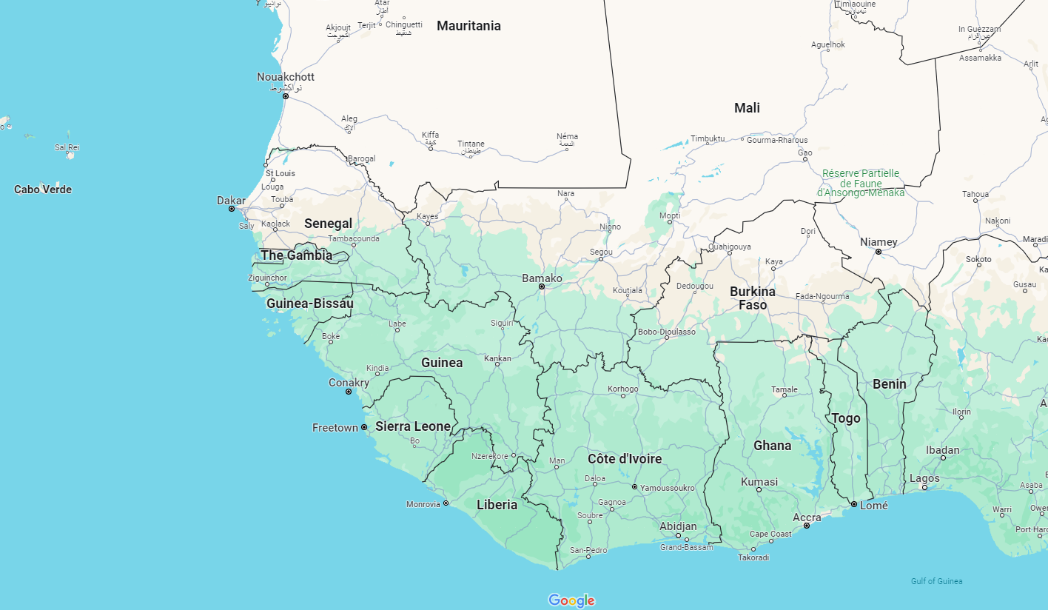
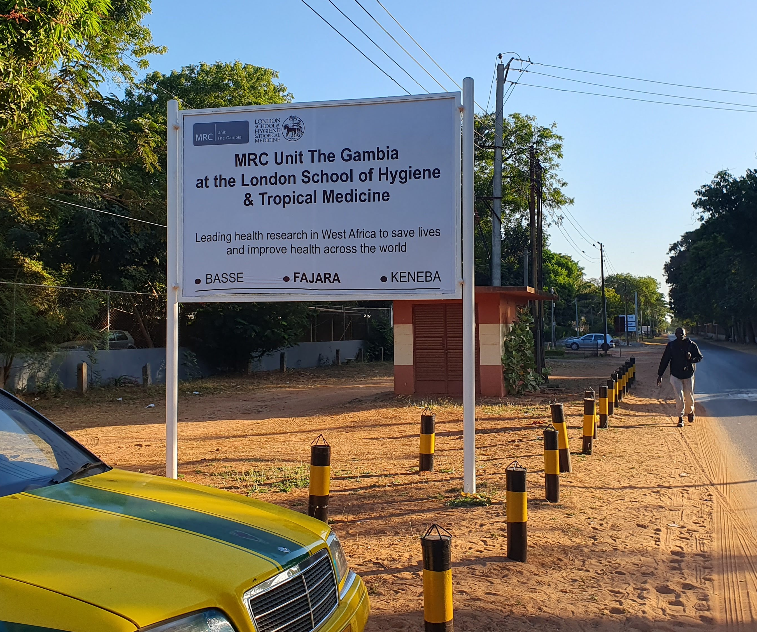

The Gambia & The MRC Unit
Low-income
Population ~2.4 M
75th anniversary 2022
>1500 staff

Slide 3
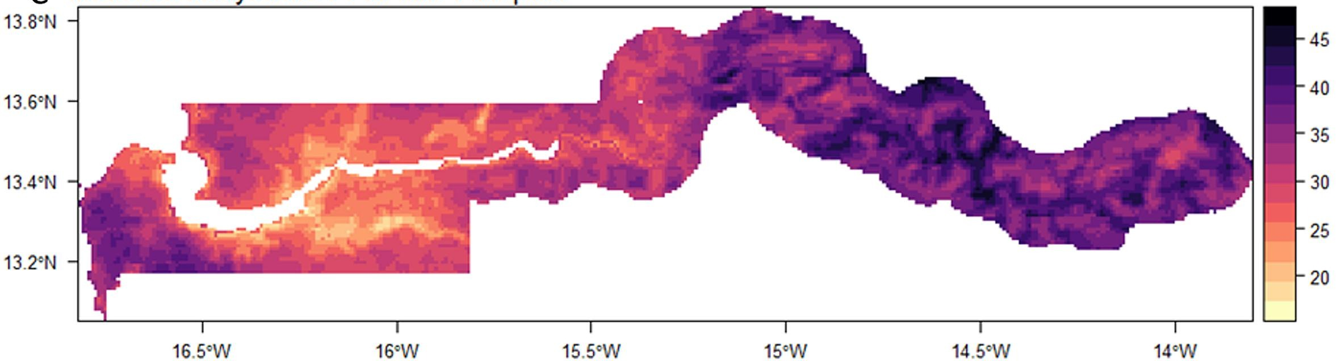
Measles containing vaccine coverage in West Africa
Elimination target
Delayed MCV1 coverage, The Gambia
Microarray patch-based MCV administration offers a potential approach to closing the immunity gap
Wariri O, et al. Vaccine 2023; 41(39): 5696-705.
Wariri O, et al. The Lancet Global Health 2021; 9(3): e280-e90.

Slide 4
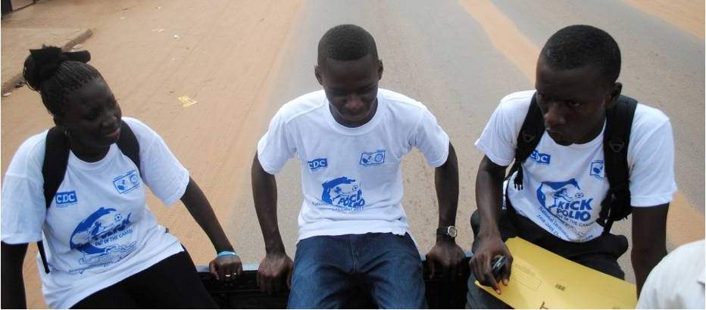
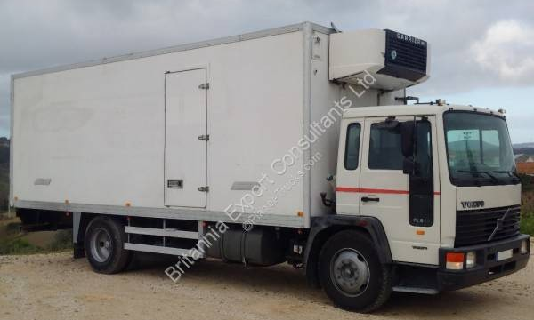
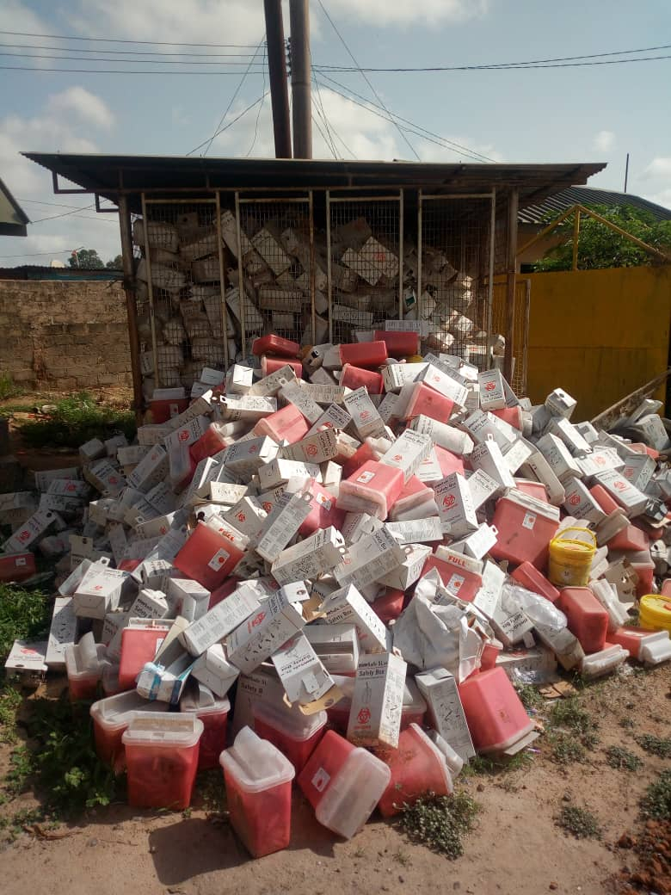
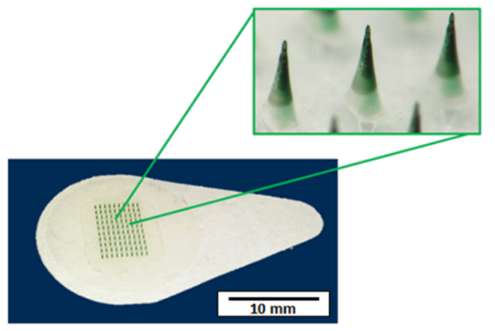
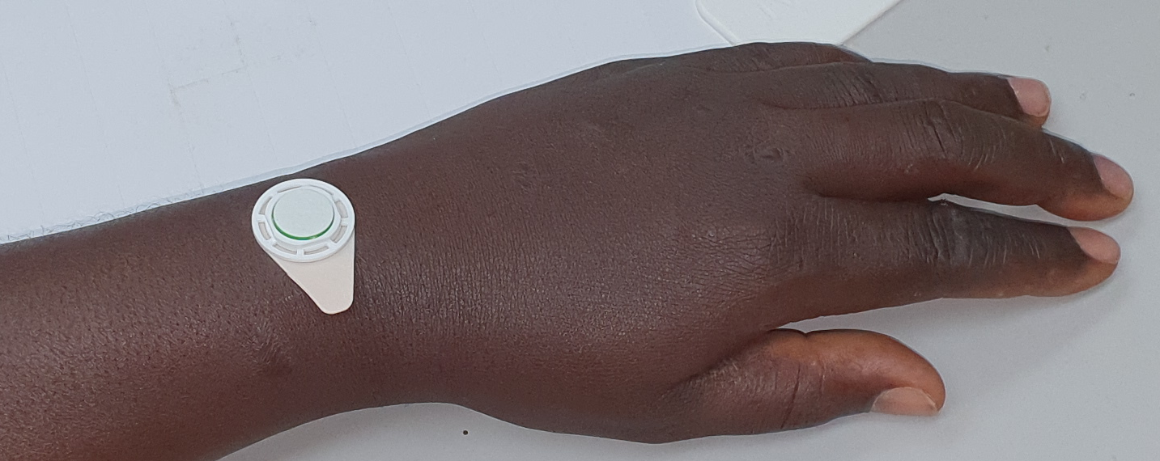
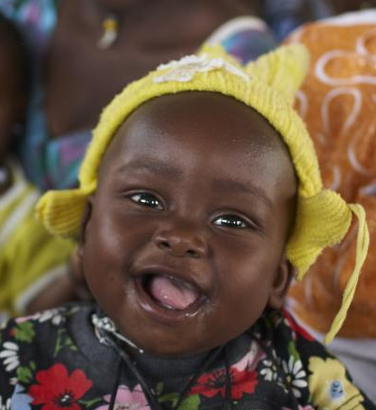
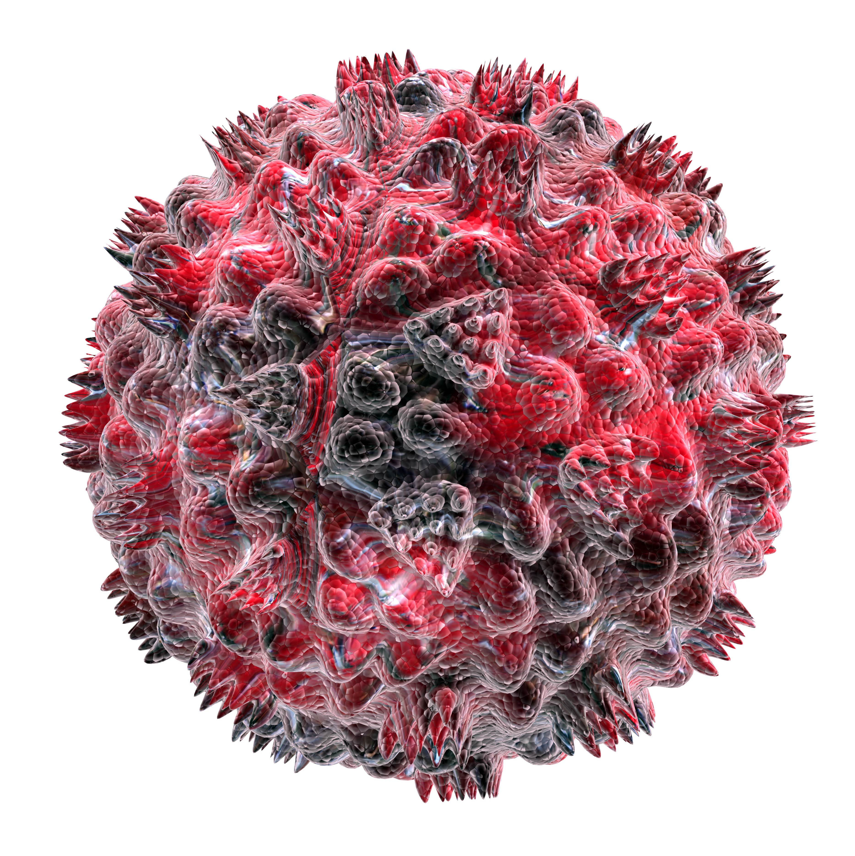



Microarray patches
Ease of administration
⇒ minimal training
Thermostable ⇒
↓ cold chain
No sharps
waste
“Highest priority, transformational innovation for
overcoming immunization barriers in LMICs”
Pain-free
No sharps
injuries
Reduced cost
Single dose
preparation

Slide 5
Trial design
Adults
n=45
 | MRV-MNP Placebo SC injection* | Placebo MNP MRV SC injection
Adults | N = 30 | N = 15
Toddlers | N = 60 | N = 60
Infants | N = 60 | N = 60
Data Monitoring
Committee
Toddlers
n=120
MRV primed
15 to 18 months
Data Monitoring
Committee
Infants
n=120
MRV naive
9 to 10 months
*0.9% sodium chloride
Adigweme I, et al. Trials 2022; 23(1): 775.

Slide 6
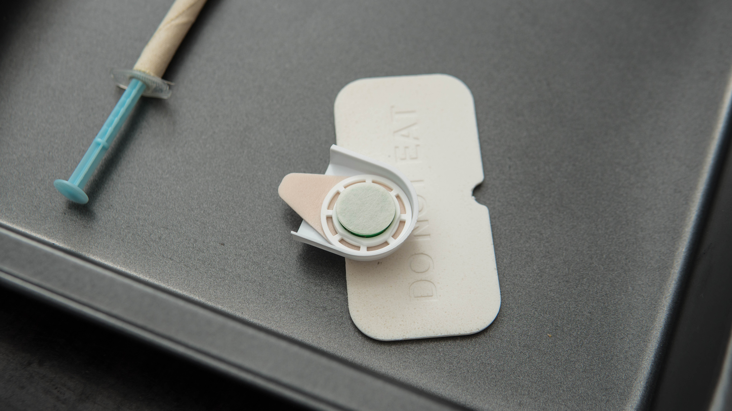
Serum Institute of India Pvt. Ltd. Measles & Rubella Vaccine

Slide 7
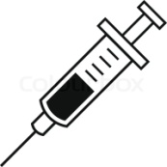
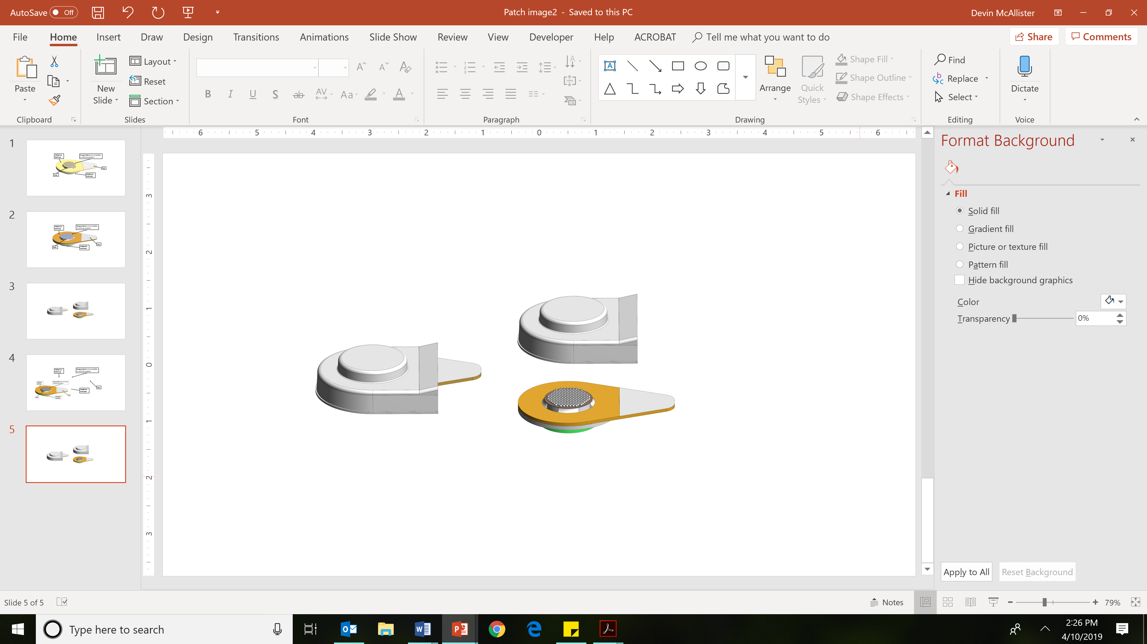

Trial schedule – toddlers & infants
Visit 0
Screening
Visit 1
Randomization & Vaccination
Visit 2
Day 7 safety
Visit 3
Day 14 safety
Visit 4
Primary immunogenicity
Visit 5
End of study
S,I
S
I
I
-14
0
7
14
42
180
Solicited events
Unsolicited adverse events
Safety (S) & Immunogenicity (I)
blood sample
S,I

Slide 8
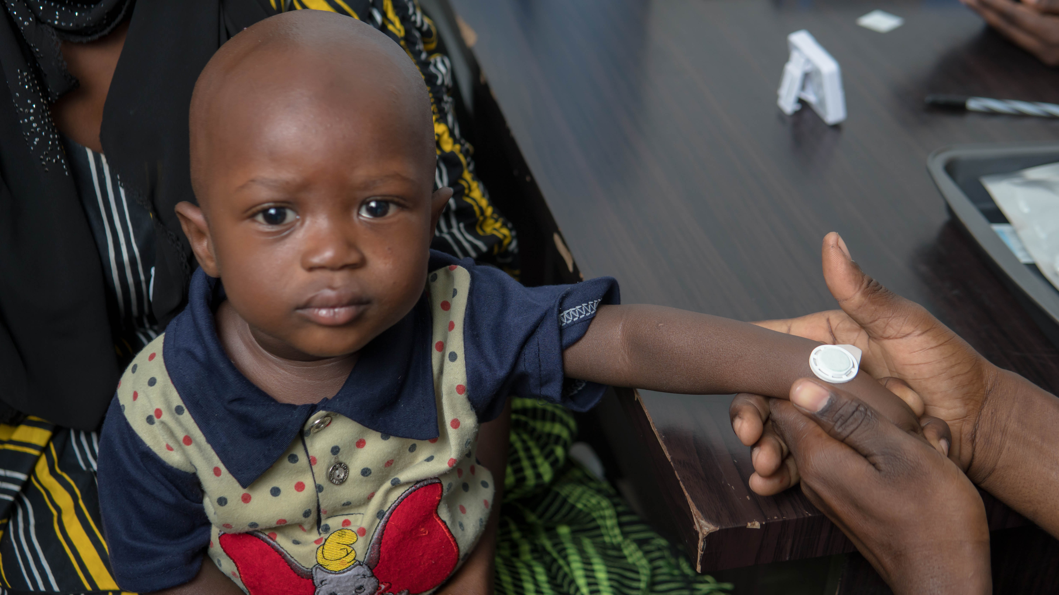

Slide 9
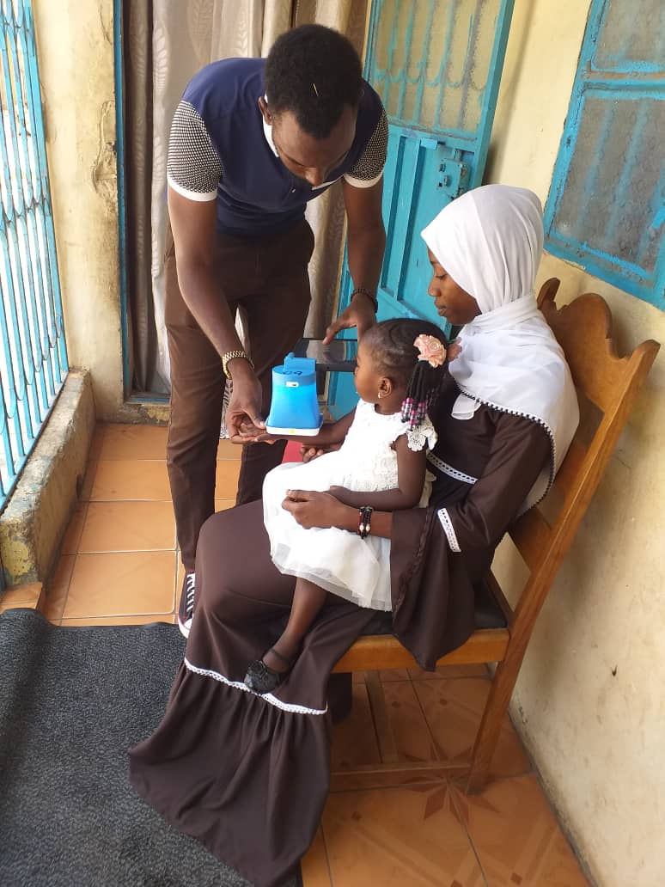
Safety endpoints
Solicited local and systemic adverse events - day 0 to 13
  Local: tenderness, redness, swelling
  Systemic: fever, vomiting, diarrhoea, irritability, drowsiness, reduced feeding, rash
Unsolicited adverse events – day 0 to 180
Safety laboratories – day 7
Severity graded based on Division of AIDS Tables (V2.1. Jul 2017)
Assessed for relatedness and expectedness

Slide 10
Immunogenicity endpoints
Serum neutralizing antibody concentrations
  Gold standard correlate of protection

Slide 11
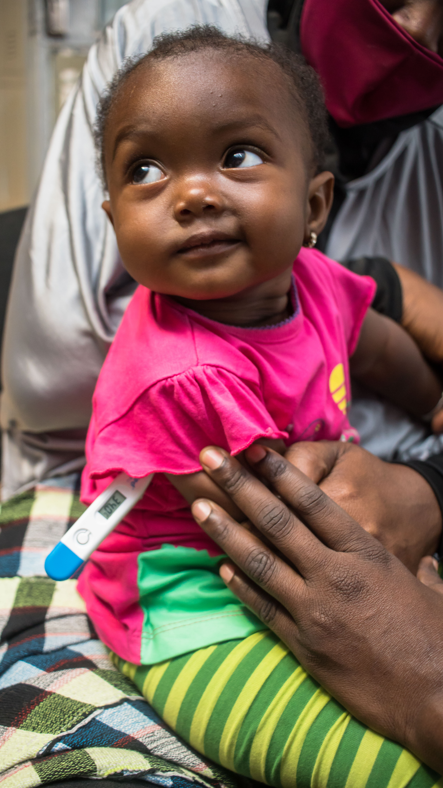
Infant Disposition
Consented & Screened
n = 161
Screen failure
n = 38 (23.6% of screened)
Moderate malnutrition: 12 (31.6%)
Unable to attend follow-up: 11 (28.9%)
Abnormal screening labs: 9 (23.7%)
Other: 6 (15.8%)
Eligible but not vaccinated: 3
Randomized & Vaccinated
n = 120
Safety population
n = 120 (100%)
Receipt of non-study vaccine (n = 1)
Withdrawal of parental consent (n = 1)
Primary immunogenicity population (day 42)
n = 118 (98.3%)

Slide 12
Infant demographics & growth data
 |  | Measles and Rubella Vaccine MNP N = 60 | Placebo MNP N = 60
Age (Months)
 | Median (Range) | 9 (9 to 10) | 9 (9 to 10)
Sex, n(%)
 | Male | 26 (43.3) | 25 (41.7)
 | Female | 34 (56.7) | 35 (58.3)
Race, n(%)
 | African | 60 (100) | 60 (100)
Tribe, n(%)
 | Mandinka | 35 (58.3) | 28 (46.7)
 | Wolof | 4 (6.7) | 7 (11.7)
 | Fula | 6 (10.0) | 3 (5.0)
 | Jola | 10 (16.7) | 7 (11.7)
 | Other | 5 (3.3) | 15 (13.3)
Weight for length z-score
 | Median (Range) | -0.3 (-1.8 to 2.9) | 0.0 (-1.8 to 1.9)

Slide 13
Infant safety
Solicited adverse events

Slide 14
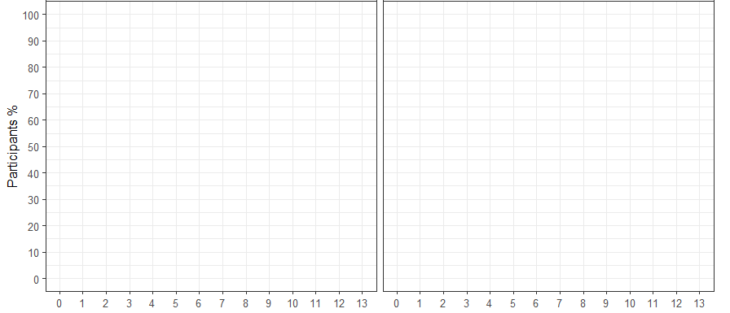
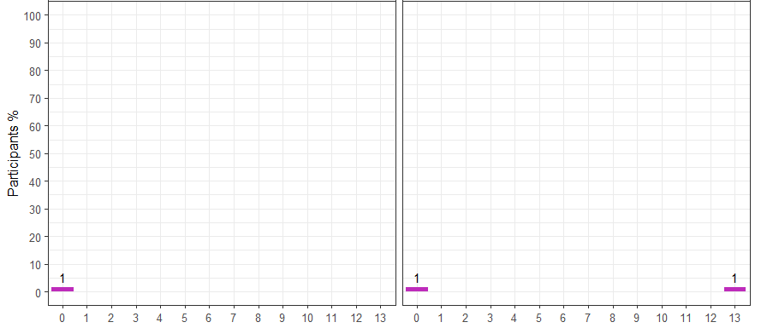
Infant tenderness
Measles & Rubella Vaccine
Placebo
No reaction
Grade 1
Microneedle Patch
Subcutaneous injection
Day post-vaccination (day 0)

Slide 15
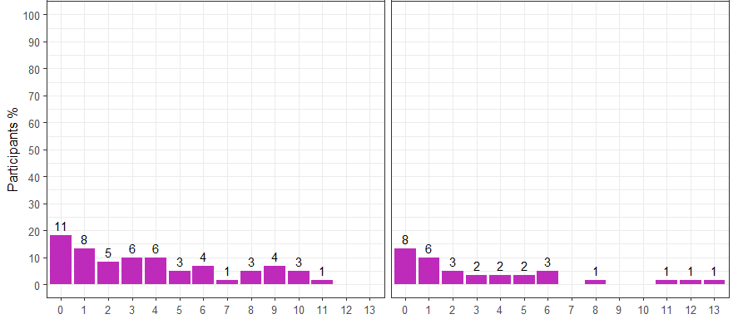
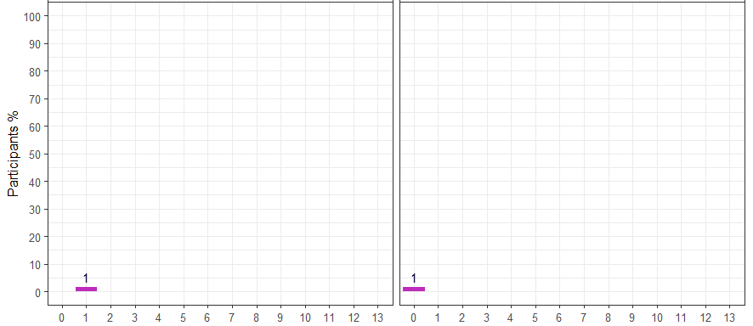
Infant redness
Measles & Rubella Vaccine
Placebo
No reaction
Grade 1
Microneedle Patch
Subcutaneous injection
Day post-vaccination (day 0)

Slide 16
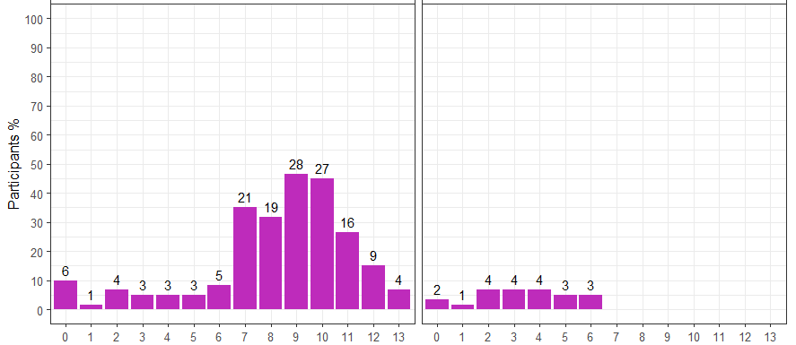
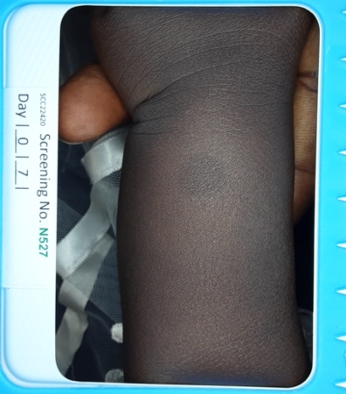
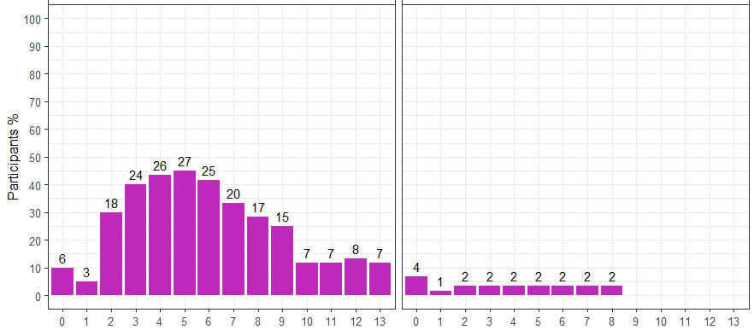
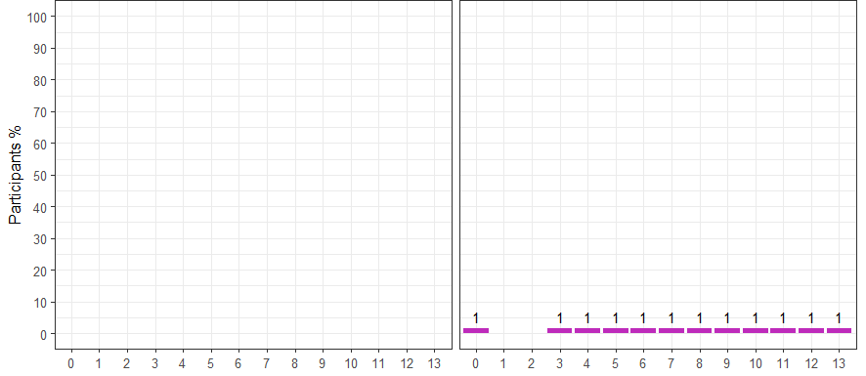
Infant swelling
Measles & Rubella Vaccine
Placebo
No reaction
Grade 1
Microneedle Patch
Infants
Subcutaneous injection
Toddlers
Day post-vaccination (day 0)

Slide 17
Infant systemic solicited adverse events
Low levels of predominantly mild (grade 1) systemic events
No severe (grade > 3) systemic adverse events in either group
No clinically significant differences between groups

Slide 18
Infant safety
Unsolicited adverse events

Slide 19
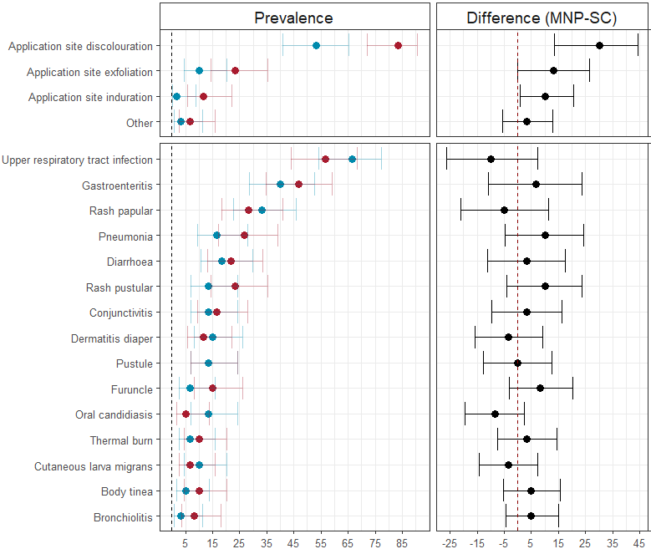
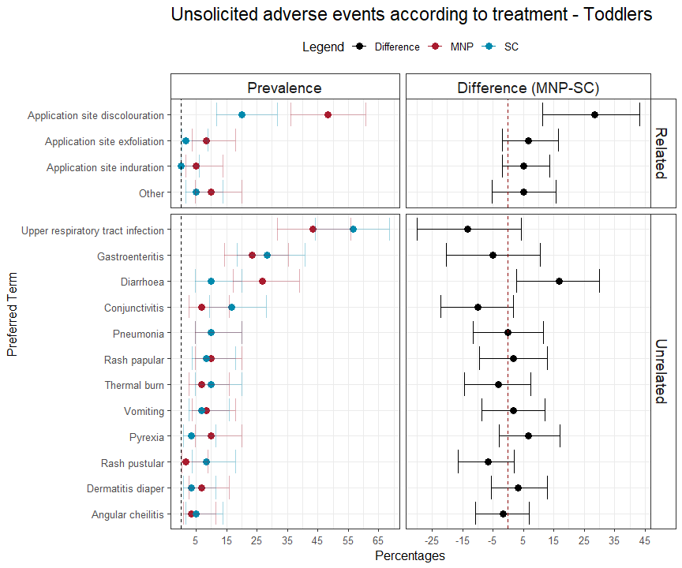
Infant unsolicited adverse events
Prevalence (%)
MRV-MNP – Placebo-MNP
Related
All related events mild (grade 1)
99.8% mild or moderate severity
Two unrelated serious adverse events
No related serious or severe adverse events
Un-related *
(%)
MRV-MNP
Placebo-MNP
* Includes events which occurred in at least 5 participants

Slide 20
Infant immune responses

Slide 21
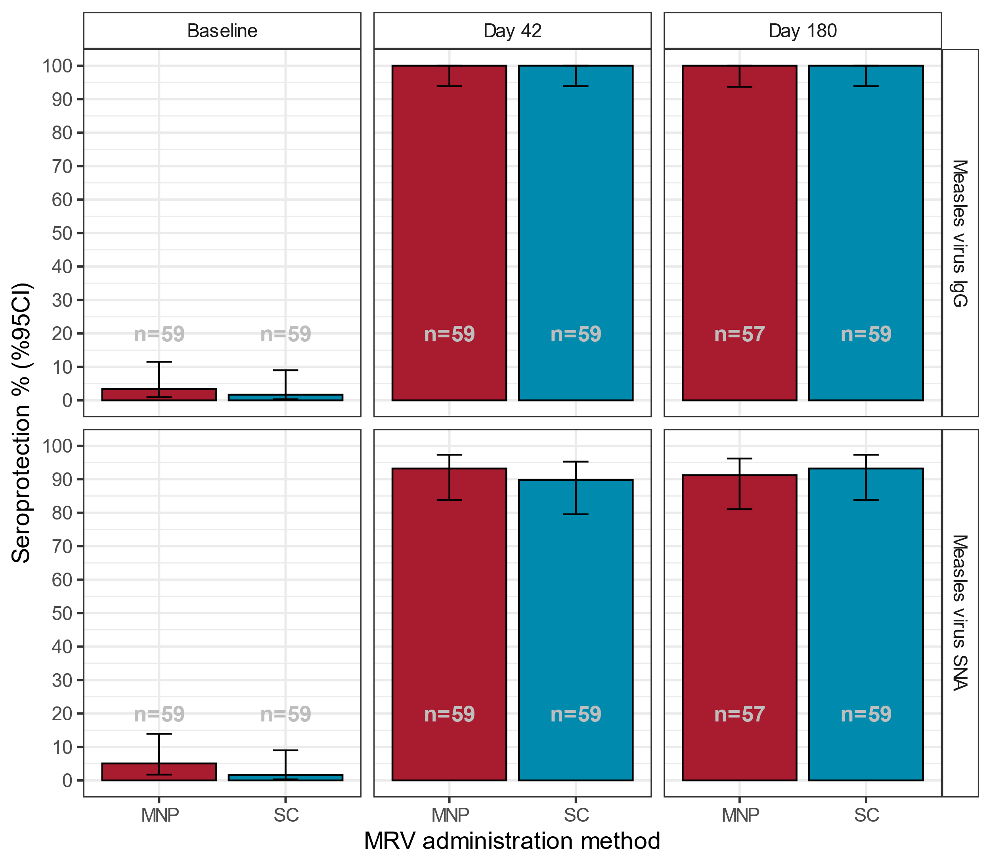
Infant measles protection (%)
Baseline
Day 42
Day 180
93.2%
89.8%
91.2%
93.2%
Seroprotection (% [95% CI])*
MRV administration method
* % with measles SNA concentration > 200 mIU/mL

Slide 22
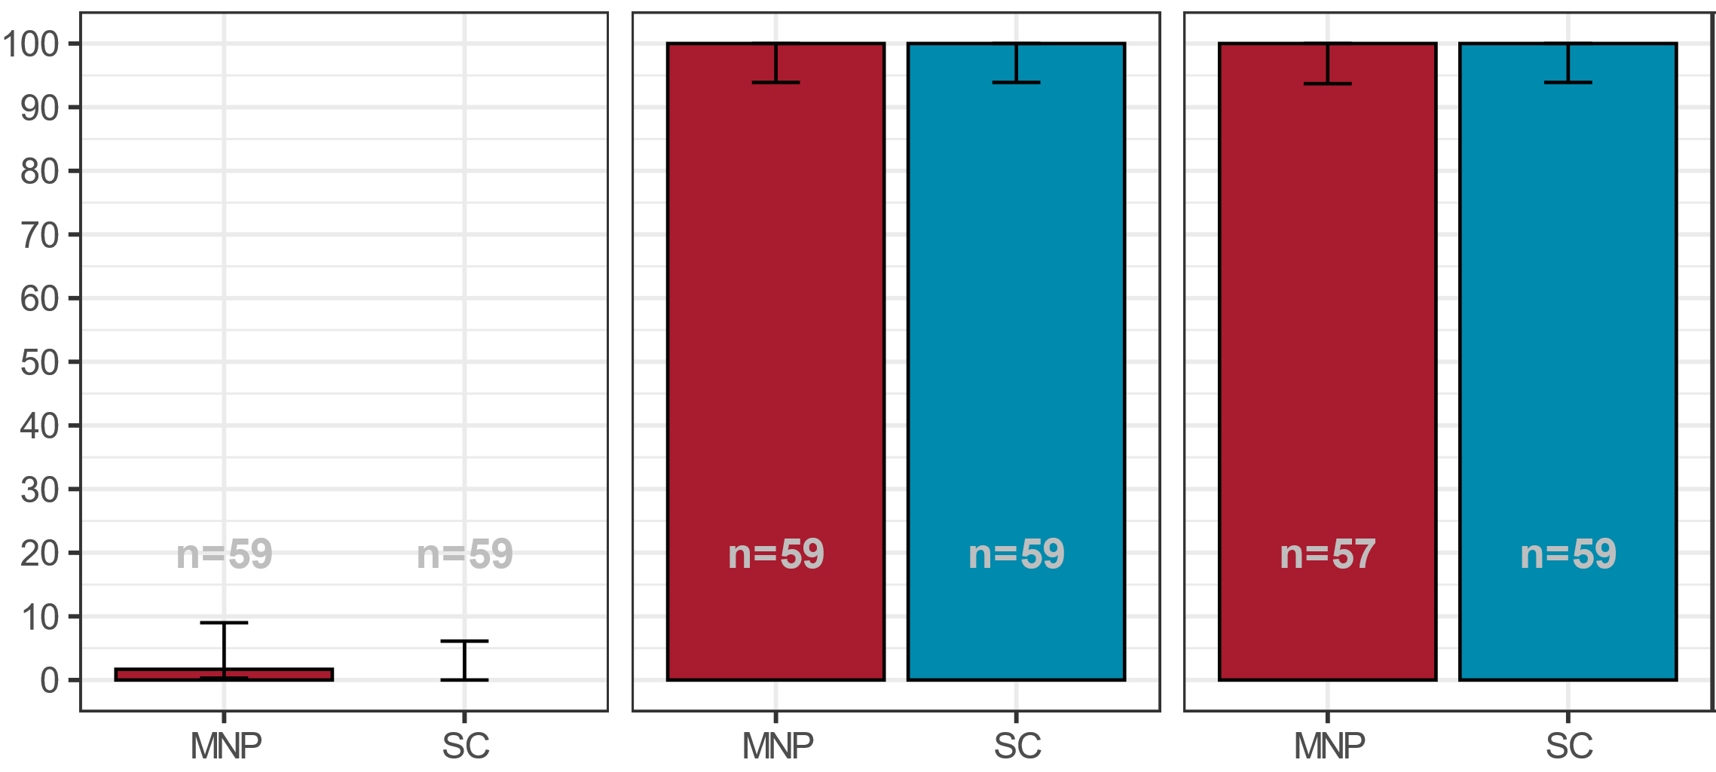
Infant rubella protection (%)
Baseline
Day 42
Day 180
100%
100%
100%
100%
Seroprotection (% [95% CI])*
MRV administration method
* % with rubella SNA concentration > 10 IU/mL

Slide 23
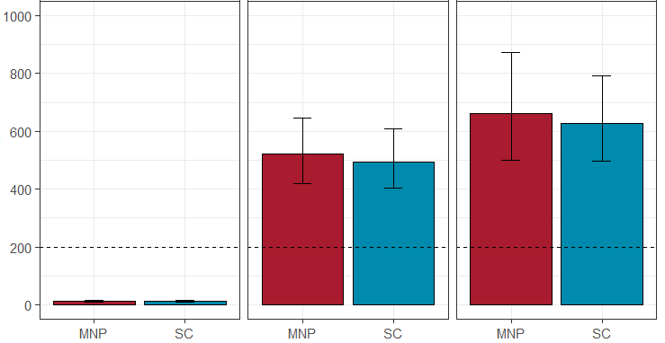
Infant measles antibody levels (GMC)
Baseline
Day 42
Day 180
Geometric mean concentration
([95% CI]) mIU/mL
Protective level
MRV administration method

Slide 24
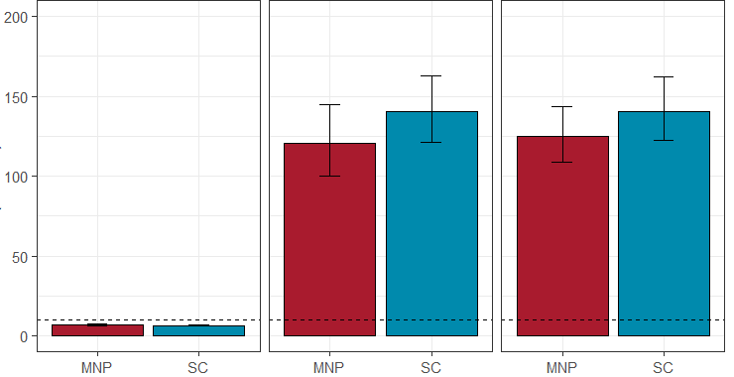
Infant rubella antibody levels (GMC)
Baseline
Day 42
Day 180
Geometric mean concentration
([95% CI]) IU/mL
Protective level
MRV administration method

Slide 25
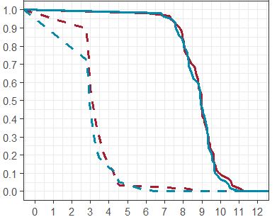
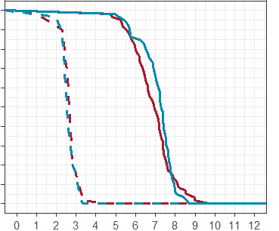
Infant reverse cumulative distributions
Measles
Rubella
MRV administration
MNP
SC
Baseline
Day 42
% of participants
> concentration
Log₂ antibody concentration
(mIU/mL [measles])
IU/mL [rubella])

Slide 26
Toddler results

Slide 27
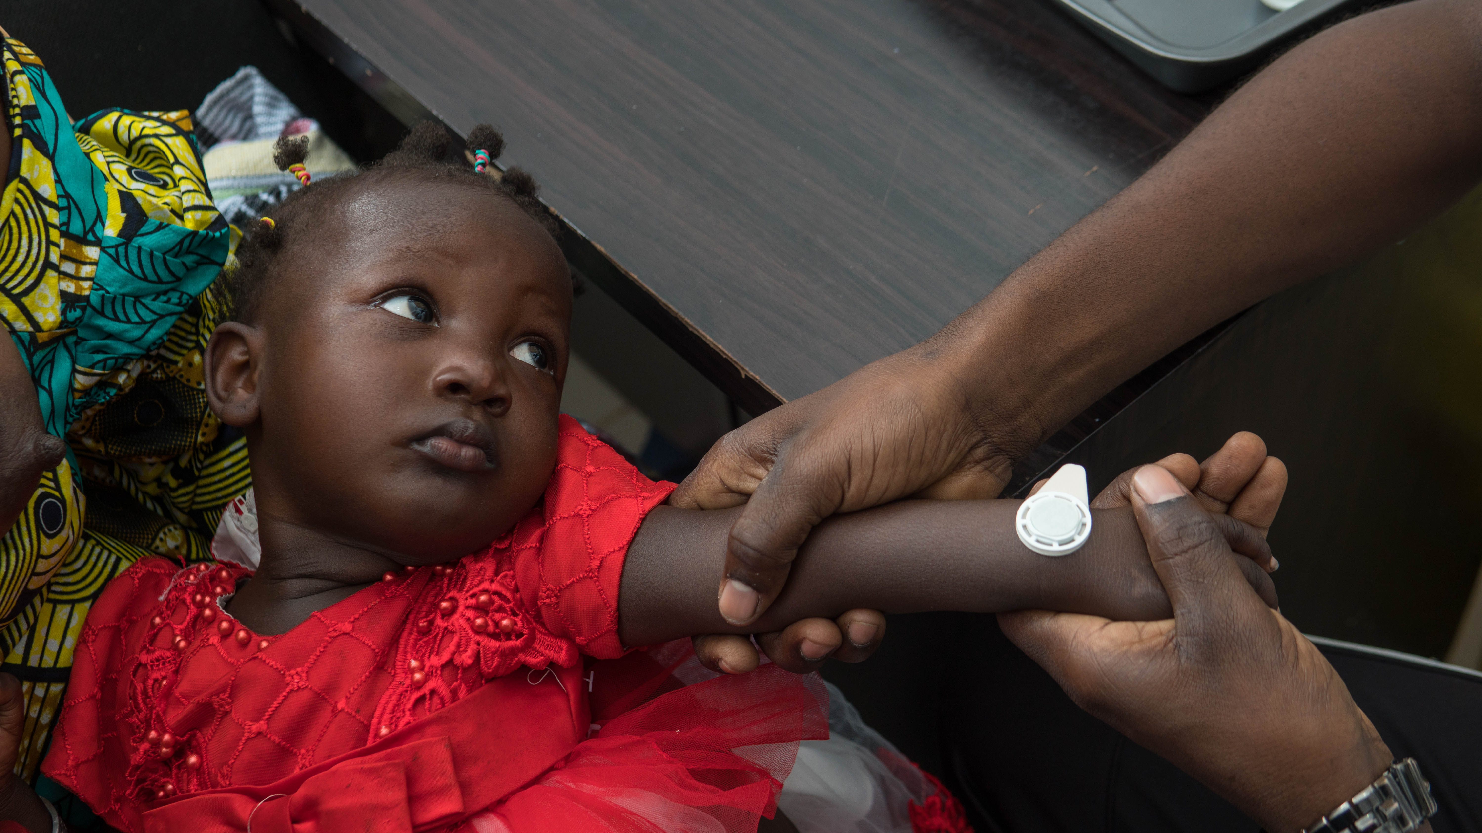
Toddler safety
Safety and tolerability comparable to the infants

Slide 28
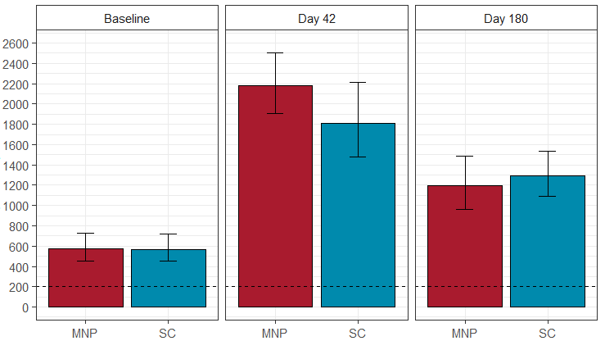
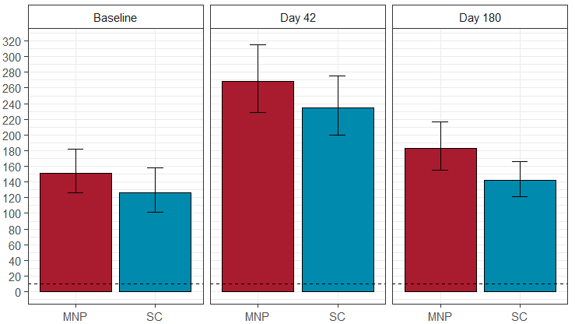
Toddler antibody levels (GMC)
Measles
Rubella
Geometric mean concentration
([95% CI]) mIU/mL
Geometric mean concentration
([95% CI]) IU/mL
Protective level
MRV administration method
MRV administration method

Slide 29
Parental perceptions & acceptability
Questionnaire completed with parents
  Before vaccination (pre-vacc)
  Immediately following vaccination (post-vacc)
  Day 14
  Day 42

Slide 30
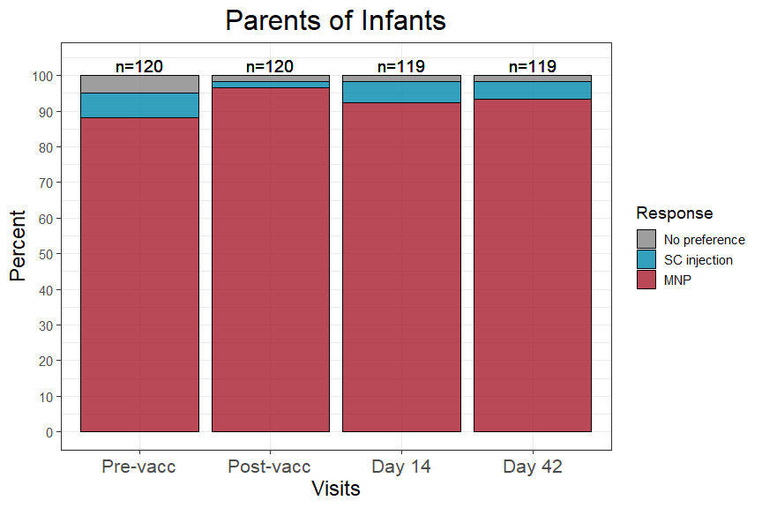
Parental perceptions & acceptability
Which of the two methods would be better to give vaccines to children?

Slide 31
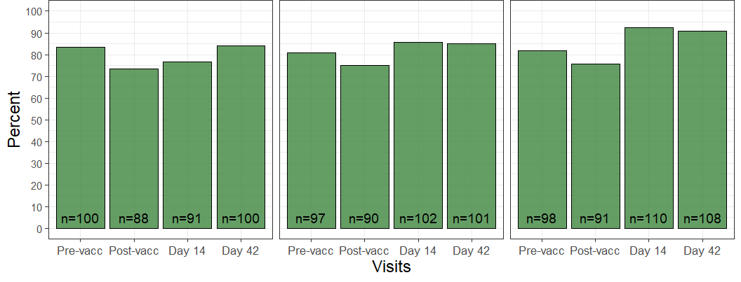
Parental perceptions & acceptability
What are the good things about having a vaccine with the patch?
It will keep them healthy It’s not painful There are no ill effects

Slide 32
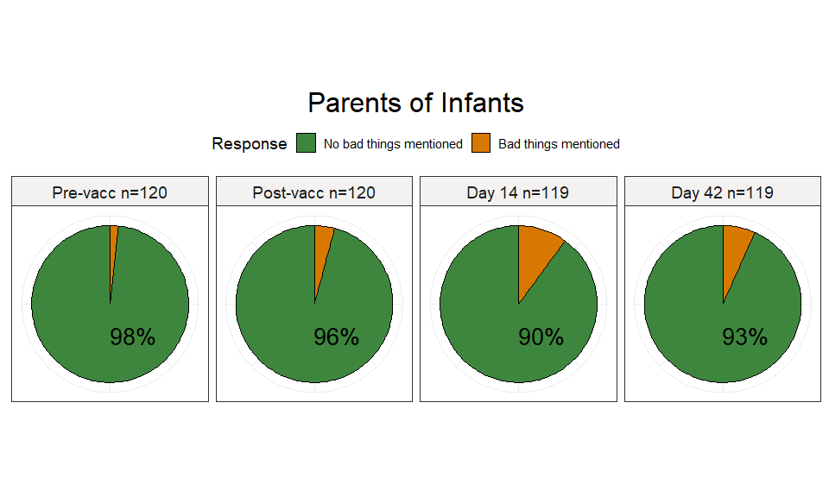
Parental perceptions & acceptability
What are the bad things about having a vaccine with the patch?

Slide 33
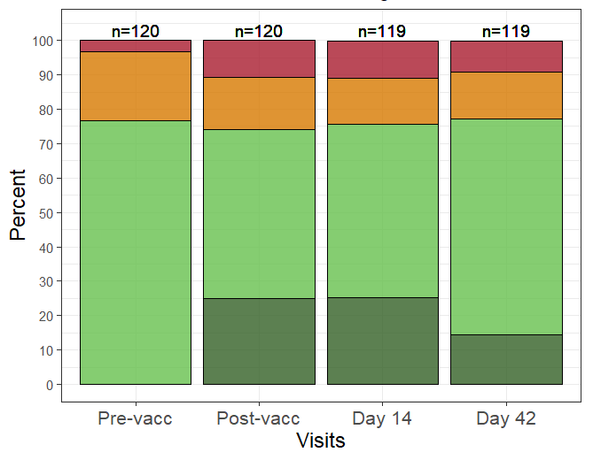
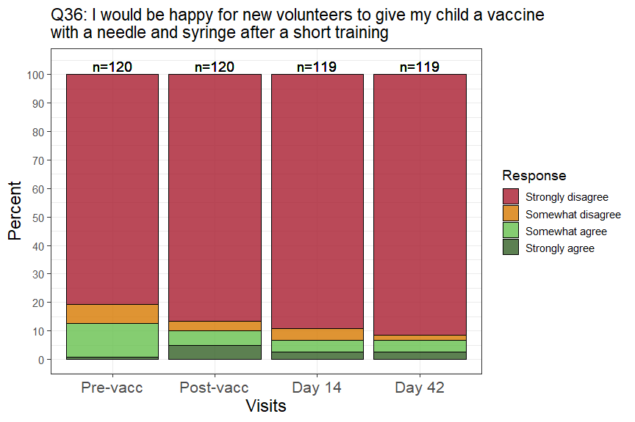
Parental perceptions & acceptability
I would be happy for a new volunteer to vaccinate my child after a short training.
Microneedle Patch
SC injection

Slide 34
Summary
In adults, toddlers and infants the measles and rubella patch was well tolerated and safe.
Mild local reactions at the patch site were common but resolved and were of no safety concern.
Immune responses to measles and rubella were robust and comparable to those generated by subcutaneous injection.
Patches were generally received positively by parents.
These are the 1st data on the use of microarray patches to deliver vaccines to children and strongly support their further development.

Slide 35
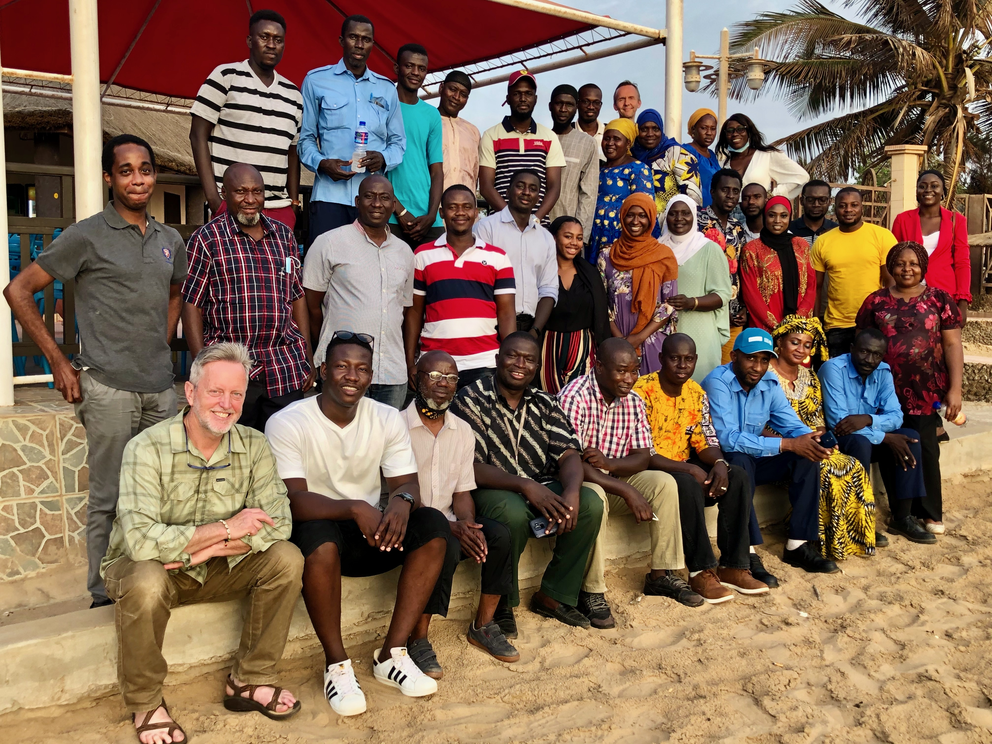

Slide 36

Clinical and Field Team
  Dr Ikechukwu Adigweme
  Anthony Mendy
  Baba Danso
  Lamin B Jarju
Data Management
  Simon Donkor
Statistics
  Michael Ooko and Dr David Jeffries
Laboratory
  Abdoulie Njie
Monitoring
  Dr Armel Zemsi
Micron Biomedical Inc
Medical Monitoring
  Dr Hilary Johnstone
CDC
  Dr Paul Rota
  Dr James Goodson
  Dr Elina El-Badry
  Dr Stephen Crooke
Serum Institute of India Pvt.Ltd
  Ravi Menon
Study participants, families and communities

Slide 37
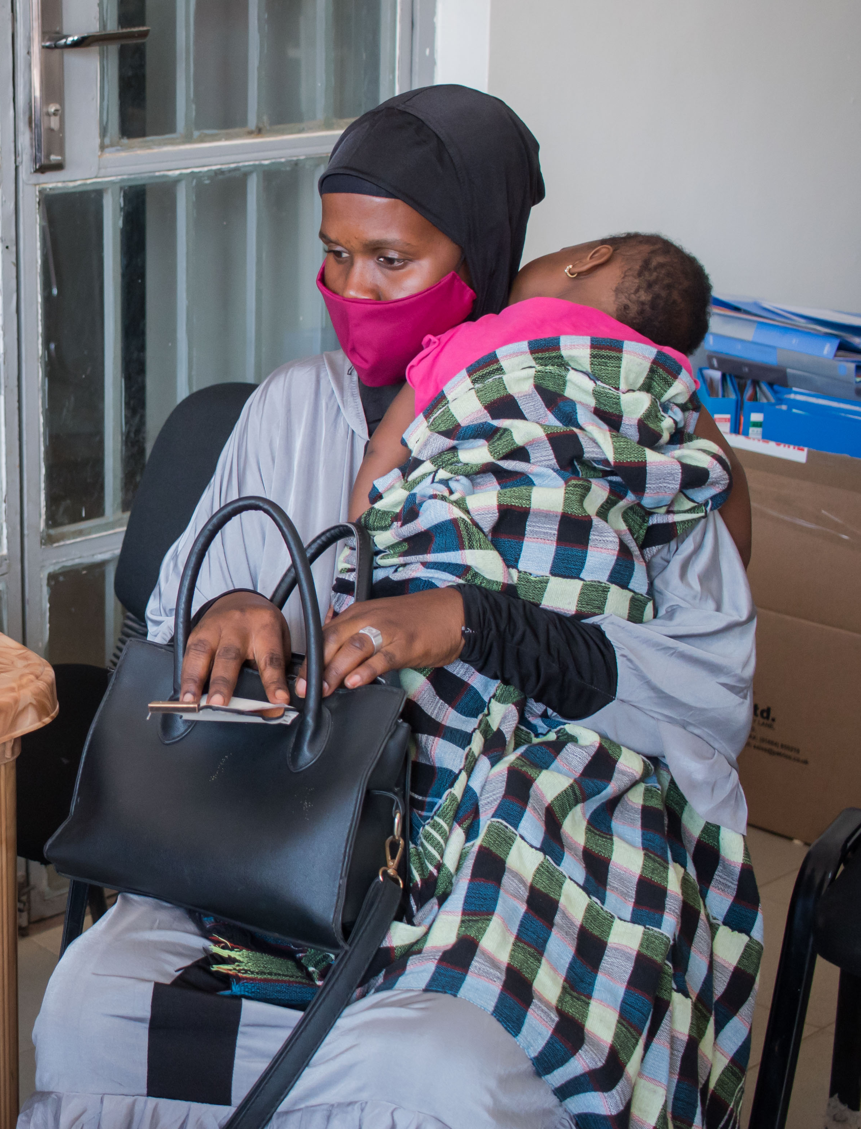

Thank you for listening
Questions welcome
Ed.Clarke@lshtm.ac.uk
@mrcgambia, @EdClarkeVaccine

Slide 38


