Slide 1
Communication strategies to reach Zero dose children in India
Sanjay Bhardwaj
Measles and Rubella Partnership Meeting
Washington DC
07 March 2024

Slide 2



Management of VPD Outbreaks - Current Practice
  VPD outbreak, followed by disease specific response
  Recurrent outbreaks and undermined EPI
  Underlying system insufficiencies not identified

Slide 3
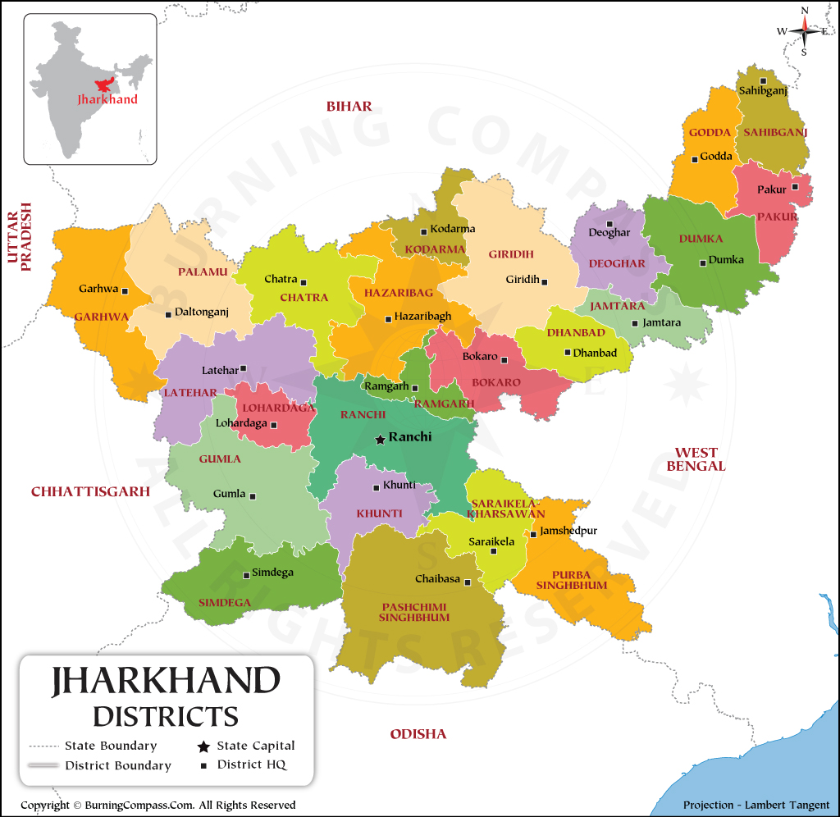
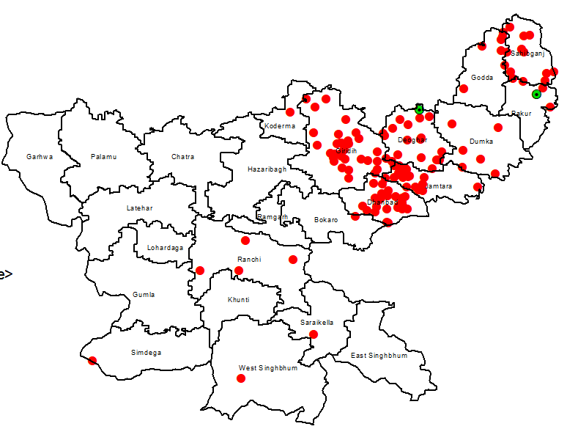
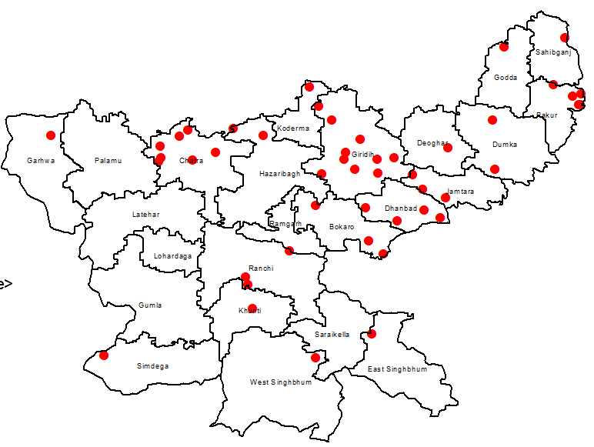
India - Jharkhand
Situated in eastern India; > 25% tribal population
More than 40 million people in 24 districts
MCV1 86.7; MCV2 32.3
2022
2023
3,436
Measles cases
39
Rubella cases
1,616
Measles cases
33
Rubella cases

Slide 4




Pre-Appraisal Activities
Working Group Formation
Desk Review
Budgeting
Coordination & National Planning
Background Information
Funds
Appraisal Activities
National Sensitization Workshop
Sensitization of Teams & Development of Field Assessment plan
Methodology
Key Informant Interview
Assessment
Focus Group Discussion
Field Work
National
Provincial
District
Health Facility
Session
Community
Data Collection & Analysis
Post Appraisal Activities
54 Focus Group Discussions
National Action Plan Workshop
Multi-Year Costed Action Plan
Review (Every 6 months)

Slide 5
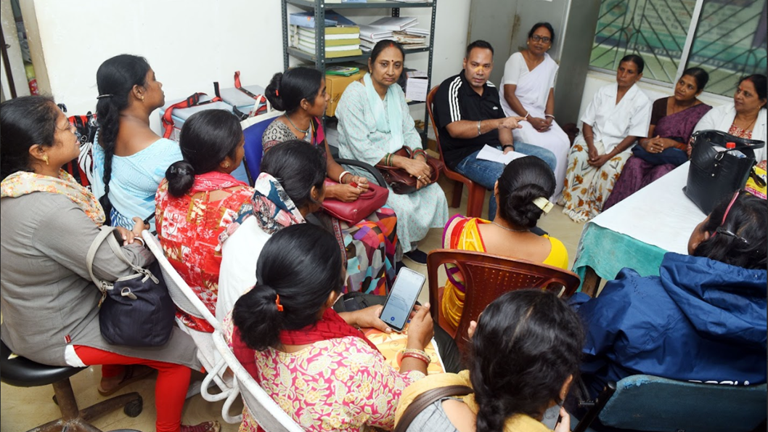
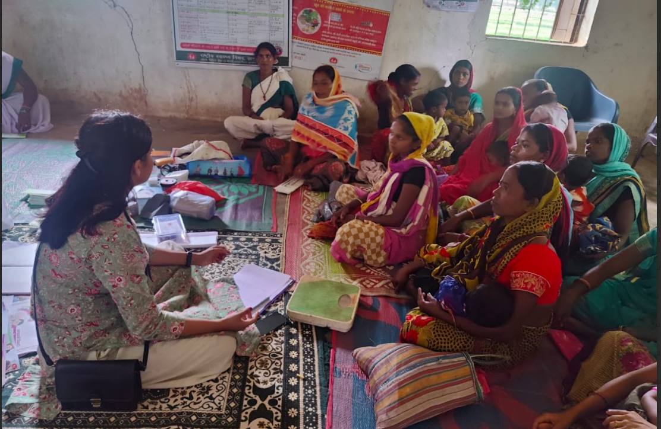
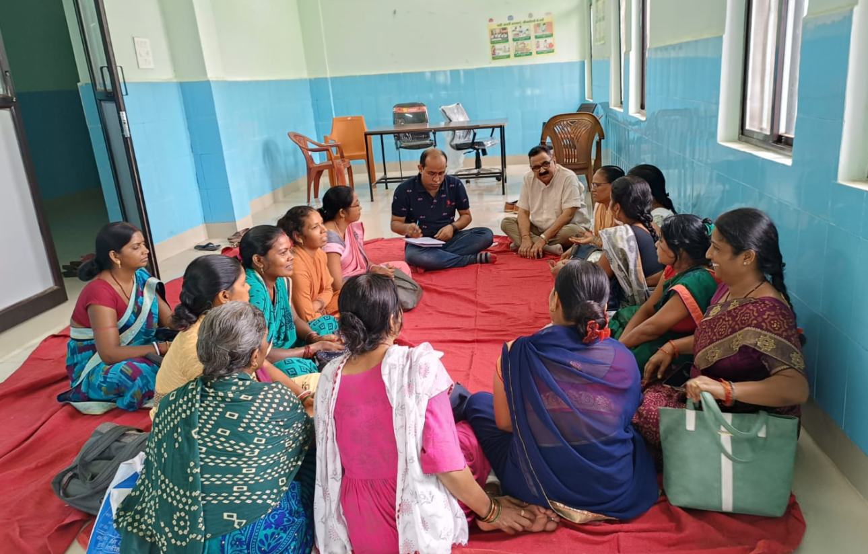
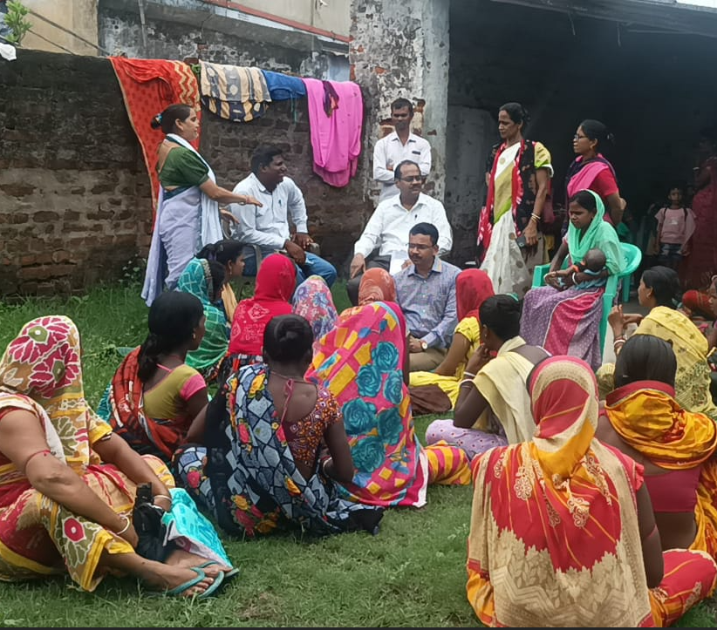

Slide 6
Demand Side Issues
Myths and Misconceptions
Considered as divine wrath seeking treatment from local healers like Bhagats. Perform “Mata ka Geet”.
Vaccination may lead to measles, inability to reproduce and esp. harmful for malnourished children.
Poor Care Seeking
Measles not considered as medical condition, child usually taken care at home using home remedies like application of goat milk, ghee, coconut oil, etc., use of neem leaves, no bathing and isolation for 5–7 days.
Poor community engagement in EPI microplanning
Vaccine hesitancy/refusal
  Low importance for vaccination
  Lack of trust
  Misperceptions
Poor IPC skills of health workers
Family's compulsions for livelihood
Importance of vaccination
Unvaccinated children also grow well. What is the importance of vaccination?
Poor Care Seeking
Families hide infections and don’t take children to health facilities.
Decision Making
Fathers often dissuade mothers due to which mothers are scared to take decisions.
Father working outside mothers unwilling for care seeking.
Far-off session site
Family’s compulsion for livelihood
Children missing vaccination due to temporary migration for work.
Family’s compulsion for livelihood
Both parents working daily – child in care of elder sibling or other family members
Poor Participation
Limited involvement of village Pradhan, tribal leader, SHG members in mobilization or microplanning

Slide 7
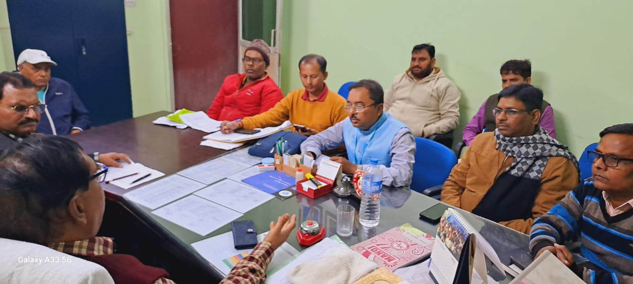
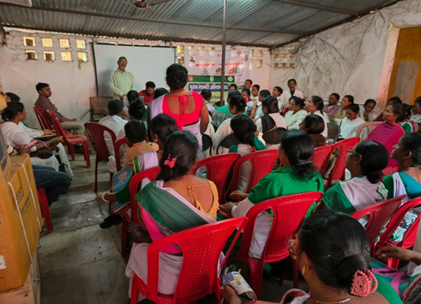
Actions taken
More than 100 coordination meetings, with District level officials – SBC actions/strategies refreshed
More than 600 vaccine hesitant areas identified, area specific plans prepared
About 150 community influencers, faith leaders, community elders oriented on routine immunization
Expansion of partners’ network - 16 NGOs and CBOs (Community Based Organizations included
System Side

Slide 8
Actions taken
System Side
Community based microplanning initiated in all 24 districts – community/religious leaders identified and added in microplans
Enlisting of hard-to-reach areas, vaccine hesitant/resistant areas, including those with low MR coverage (more than 1200 HRAs identified and tagged)
District level action plans (with budget) prepared - focused interventions planned for areas with vaccine hesitancy
Communication material developed in local languages

Slide 9
Key lessons
System Side
Community engagement in EPI microplanning is essential
Knowing is not enough and intentions are not actions – important to understand what it takes to get caregivers to act
Small is big – small variables may have an outsized impact
One size does not fit all - Differentiated approach

Slide 10
Thank you

