Slide 1
Vaccine-Preventable Disease Surveillance:
Why is it important?
Measles & Rubella Initiative Partners Meeting
Washington DC, 7 September 2017
Katrina Kretsinger, MD, MA
WHO, IVB/EPI
Cover

Slide 2
Why is VPD Surveillance Critical?
Understand disease epidemiology, monitor trends in disease burden over time →progress towards elimination/control goal
Identify outbreaks and inform response
Evaluate control measures
  Coverage fraught with problems
  Data to identify immunity gaps and target immunity
Inform public health planning and vaccination policy
Cover

Slide 3
Measles as the “Canary in the coalmine”
Measles is extremely infectious
  One measles case can cause infections in 12 – 18 susceptible persons
Measles cases and measles outbreaks are often the first to appear in situations with low population immunity from vaccine-preventable diseases
Vaccination coverage data often incomplete or unreliable
Thus, measles cases serve as an indicator for weaknesses in vaccine coverage and general weaknesses in vaccine system strength
Importance of surveillance to triangulate data sources
MTR recommendation: Disease incidence most important indicator of progress
Cover
Notes:
Not as vertical as previously accused

Slide 4
Goals that Rely on VPD Surveillance
Global Vaccine Action Plan
  Measles elimination in 5 regions by 2020
  Rubella elimination in 5 regions by 2020
  VPD surveillance
    Objective 4: strong immunization systems are an integral part of a well-functioning health system
    Indicator: Number of countries with case-based surveillance for IBD/Rotavirus
  Maternal and Neonatal Tetanus Elimination in all regions
Regional Goals
  JE control in WPR
Sustainable Development Goal 3
  By 2030, end preventable deaths of newborns and children under 5 years of age
Cover

Slide 5
Goals that Rely on VPD Surveillance
Global Health Security Agenda
  Strengthen capacity to prevent, detect, and respond to infectious disease threats, in order to achieve the goals of the International Health Regulations (IHR)
  In 2014, only 30% of countries were fully prepared to detect/respond to an outbreak!
Cover
Notes:
One such initiative, the Global Health Security Agenda (GHSA) pursues a multilateral and multisectoral approach to strengthen both the global capacity and nations’ capacities to prevent, detect, and respond to human and animal infectious diseases threats [18], in order to achieve the goals of the International Health Regulations (IHR) (2005), a framework for the containment of global public health risks (to which all WHO member states are committed). GHSA is composed of 11 lines of effort (so-called “action packages”) in support of tangible, measurable steps required to prevent outbreaks, detect threats in real time, and rapidly respond to infectious
disease threats. Two of these 11 action packages are relevant to this discussion, “Real-Time Surveillance and Reporting” and “Immunization,” both highlight the critical importance of strong disease surveillance (including VPD surveillance) to the success of GHSA. GHSA strives to strengthen national surveillance systems that are able to detect events of significance for public health. By 2012, fewer than 20% of countries were prepared to respond to health threats, as indicated by having met
IHR goals. By 2014, about 30% of countries were fully prepared to detect and respond to an outbreak [19]

Slide 6
Overview of Surveillance
Different types of surveillance systems have been built based on objectives
National surveillance: usually rare diseases, outbreak diseases, diseases with targets
  Acute Flaccid Paralysis (AFP), Measles/rubella, Japanese Encephalitis, Maternal/neonatal tetanus, Yellow Fever
Sentinel-site surveillance: common diseases
  Invasive bacterial disease, rotavirus, influenza
Combination
  N. meningitides
Cover

Slide 7
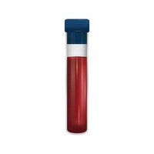
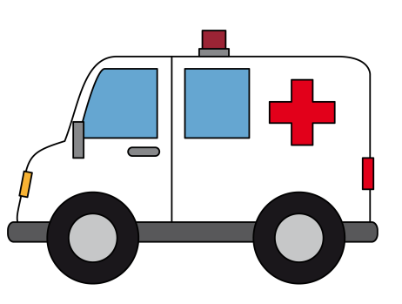
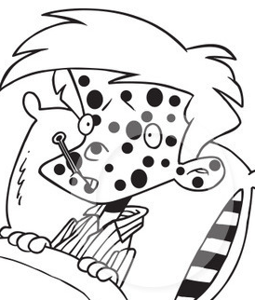
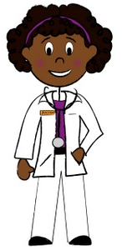

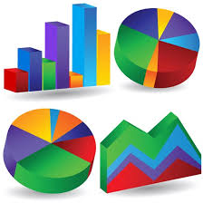


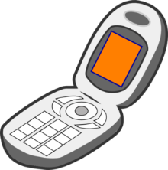

How does surveillance work?
Sample sent to WHO accredited lab
Person develops an illness
Clinician suspects VPD under surveillance
Local Surveillance Officer
Enter data
Analyze data
Respond to data
Investigate case
Collect sample
Report findings to next level
Cover
Notes:
Nsubuga P, McDonnell S, Perkins B, et al. Polio eradication initiative in Africa: influence
on other infectious disease surveillance development. BMC Pub Health 2002;
2:27–32. http://www.biomedcentral.com/1471–2458/2/27. Accessed day mo yr
According to a survey of staff in the WHO African Region
office and personnel in ministries of health of member states
in the region conducted in 2000, 26 (81%) of the 32 countries
who participated reported using AFP surveillance resources
for the surveillance of other infectious diseases, including
measles, neonatal tetanus, cholera, meningitis, and yellow
fever [5]. As of the end of 2003, 131 (66%) of 198 countries
globally had adapted their AFP surveillance systems for surveillance
of measles and other VPDs, such as yellow fever
[6]. This trend has continued so that currently, the majority
of countries are conducting AFP surveillance in conjunction
with at least some other VPDs. Surveillance for additional
VPDs has been added, depending on a country’s immunization
schedule and disease burden, including surveillance for
meningitis and encephalitis to track Japanese encephalitis and
bacterial meningitis [7].
Centers for Disease Control and Prevention. Acute flaccid paralysis surveillance
systems for expansion to other diseases, 2003–2004. Morb Mortal Wkly Rep 2004;
53:1113–6. Centers for Disease Control and Prevention. Expanding poliomyelitis and measles
surveillance networks to establish surveillance for acute meningitis and encephalitis
syndromes—Bangladesh, China and India, 2006–2008. Morb Mortal Wkly Rep
2012; 61:1008–11.

Slide 8
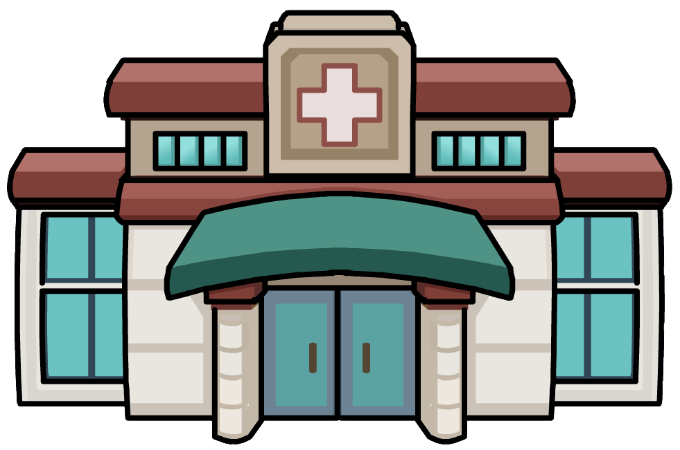

How does surveillance work?
Meetings: training, data review
Active case finding
Supervisory visits
Training/feedback
Health Facility
Local Surveillance Officer
Cover

Slide 9

Surveillance Officer: Responsibilities
Cover

Slide 10

Hypothetical: 100,000 person catchment
Polio
AFP: 2 cases/year

Slide 11

Hypothetical: 100,000 person catchment
Polio
Suspect Measles/Rubella:
Range 2-100s of cases/year
M/R

Slide 12

Hypothetical: 100,000 person catchment
Polio
Other VPDs:
Neonatal tetanus
Meningitis
Acute encephalitis syndrome
Diphtheria
Cholera
Yellow Fever
Pertussis
…and so on
M/R
Other VPDs

Slide 13
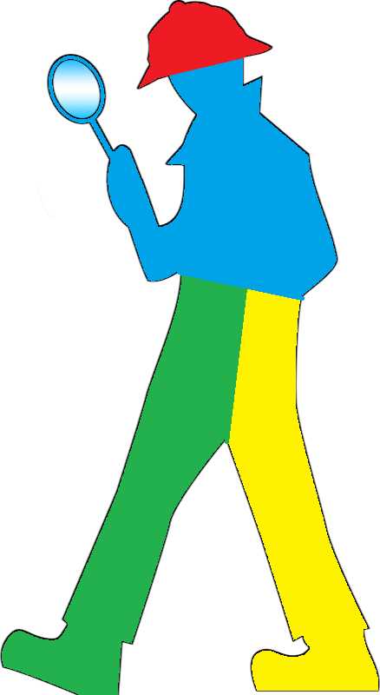
Hypothetical: 100,000 person catchment
Polio
Other Communicable Diseases:
Bloody diarrhea
Neglected tropical dzs
Dengue
Rabies
Malaria
Tb
HIV
….and so on
M/R
Other VPDs
Other
Notes:
Africa tB (new) incidence in 2015: 275 cases/100k/year, HIV 272/100K
SEARO tb incidence in 2015: 246 cases/yr, HIV 16/yr

Slide 14
Hypothetical: 100,000 person catchment
Polio
Trained by polio in
Surveillance
Outbreak Investigation
Data management, analysis, use
Outbreak response
Does many jobs-paid for by polio!
M/R
Other VPDs
Other

Slide 15
So What Does Polio Pay For?
Sample sent to WHO accredited lab
Person develops an illness
Clinician suspects VPD under surveillance
Local Surveillance Officer
Enter data
Analyze data
Respond to data
Investigate case
Collect sample
Report findings to next level
Cover
Notes:
Nsubuga P, McDonnell S, Perkins B, et al. Polio eradication initiative in Africa: influence on other infectious disease surveillance development. BMC Pub Health 2002;
2:27–32. http://www.biomedcentral.com/1471–2458/2/27.
According to a survey of staff in the WHO African Region office and personnel in ministries of health of member states in the region conducted in 2000, 26 (81%) of the 32 countries who participated reported using AFP surveillance resources for the surveillance of other infectious diseases, including measles, neonatal tetanus, cholera, meningitis, and yellow fever [5]. As of the end of 2003, 131 (66%) of 198 countries globally had adapted their AFP surveillance systems for surveillance
of measles and other VPDs, such as yellow fever [6]. This trend has continued so that currently, the majority of countries are conducting AFP surveillance in conjunction with at least some other VPDs. Surveillance for additional VPDs has been added, depending on a country’s immunization schedule and disease burden, including surveillance for meningitis and encephalitis to track Japanese encephalitis and bacterial meningitis [7].
Centers for Disease Control and Prevention. Acute flaccid paralysis surveillance systems for expansion to other diseases, 2003–2004. Morb Mortal Wkly Rep 2004;
53:1113–6. Centers for Disease Control and Prevention. Expanding poliomyelitis and measles surveillance networks to establish surveillance for acute meningitis and encephalitis syndromes—Bangladesh, China and India, 2006–2008. Morb Mortal Wkly Rep 2012; 61:1008–11.
investigated by government officers, as opposed to WHO surveillance officers, increased from 35% in 2009 to 79% in 2014 [12].

Slide 16
Relationship between Polio and other VPDs
Meetings: training, data review
Active case finding
Supervisory visits
Training/feedback
Health Facility
Local Surveillance Officer
Cover
Notes:
In Nepal, WHO’s Immunization Preventable Diseases (IPD) Network that is largely financed from polio resources has a staff of 61, situated in the central level and 11 district offices, and who support all 75 districts in the country. On a weekly basis this network actively monitors priority sites, and receives reports on various VPDs from 800 surveillance sites, and 1,100 informers. This is the only active surveillance network in the whole country

Slide 17
Outbreak Capacity
Same surveillance officer
Same skill set required
  Thorough investigations identifying person, place, time
  Contact tracing
  Responding to data rapidly
  Vaccination response
  Management structure/Coordination committees
Recent examples
  Yellow fever in Angola, DRC, Uganda
  Seasonal outbreaks of meningitis
  Ebola in Nigeria
  Cholera in Somalia
Cover

Slide 18
Case Study: Measles and Rubella Elimination
5 strategies of MR elimination
  Achieving and maintaining high coverage with 2 doses
  Performing effective disease surveillance
  Developing/maintaining outbreak preparedness/response
  Communicating with and engaging stakeholders
  Implementing research and innovations to improve the program
Similar to polio→need to transfer lessons learnt
  Methods and systems for collecting/reporting data
  Methods to better use surveillance and coverage data→identify areas of the unimmunized→data driving action to ↑ coverage and equity
  Establishing/operating a high quality lab network
Cover
Notes:
India: from NVC report. The proportion of surveillance units reporting Measles and Rubella data to the national level and on time increased between 2011 and 2014, but has shown decline in the next two years i.e. 2015 and 2016. The surveillance of AFP and MR are based on the same format. This overall decline is owing to the transition of the surveillance system from the National Polio Surveillance Project to the state and district authorities.
Thailand: joint strategic plan to maintain polio free status and eliminate measles: strengthen quality of disease surveillance, increase vaccination coverage and enhance capacity of laboratories

Slide 19
Disease burden
16 priority countries: 95% of polio assets/infrastructure
  Estimated measles cases (2015): 7.3 million (75%) of 9.7 million
  Measles deaths (2015): 118K (88%) of 134K
  Recently with sizeable measles outbreaks
    Afghanistan, Bangladesh, DRC, Myanmar, Nigeria, Pakistan, Somalia, Sudan, South Sudan
Cover
Notes:
The 16 countries with 95% of polio
assets and infrastructure are Afghanistan, Angola, Bangladesh,
Cameroon, Chad, the Democratic Republic of the Congo
(DRC), Ethiopia, India, Indonesia, Myanmar, Nepal, Nigeria,
Pakistan, Somalia, Sudan, and South Sudan.

Slide 20
Resource Dependence
Financial
  Polio FRR: surveillance/lab costs 102 million, excluding technical support like NPSP (2016)
  $111 million needed for MR surveillance to be maintained at status quo (excluding operational costs at country)
    $77 million (70%) coming from polio $
Human
  Over 2500 polio-funded staff are supporting MR surveillance
Cover

Slide 21
Key Messages
Polio is the foundation for much of VPD surveillance in many developing countries
Polio funds a significant amount of the VPD surveillance --human resources and infrastructure
  Even with polio support, insufficient to achieve various global/regional goals
Careful planning and consideration needs to be undertaken to ensure all the gains in VPD surveillance are not destroyed during polio transition
Polio needs VPD surveillance as much as VPD surveillance needs polio
Cover
Notes:
Not as vertical as previously accused

Slide 22
Thank You

