Slide 1
Sustaining the gains and reaching milestones on the way towards elimination of measles and rubella
15 September 2015
Dr Peter Strebel, WHO, IVB/EPI

Slide 2
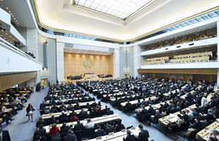
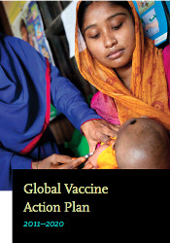
Measles and Rubella Targets
Global: World Health Assembly, 2010
By 2015:
MCV1 coverage ≥ 90% national and
≥ 80% in every district
Measles reported incidence <5 cases/million
Measles mortality reduction of 95% vs. 2000
Regional:
By 2015:
  Elimination of measles in 4 WHO Regions
  Elimination of rubella in 2 WHO Regions
By 2020:
  Elimination of measles & rubella in 5 WHO Regions

Slide 3
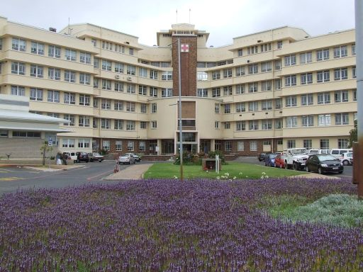

Slide 4
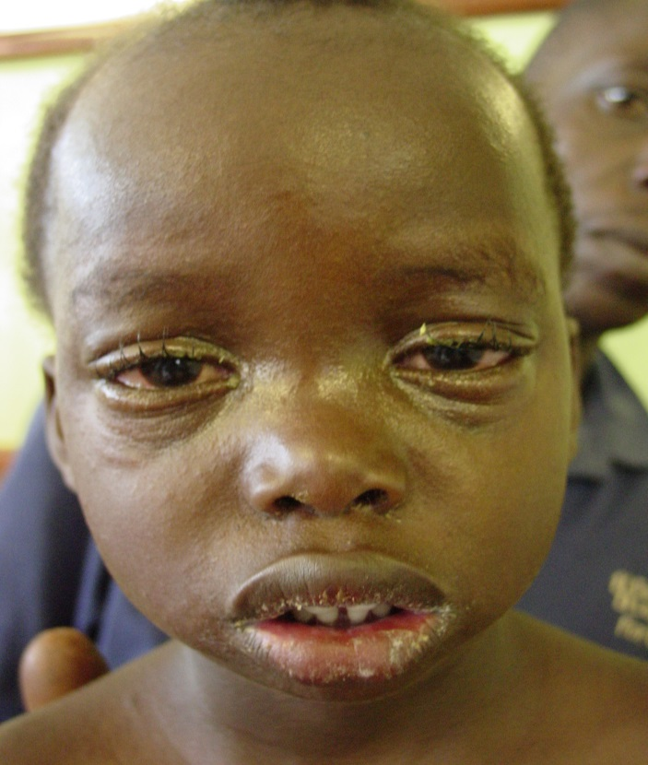
The Global Burden of
Measles & Rubella
146,000 measles deaths
in 2013
100,000 babies with
CRS each year

Slide 5
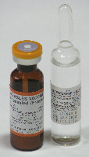
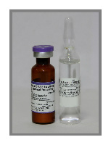
Vaccines are Safe, Effective and Inexpensive
UNICEF Awarded Prices*, 2015
Measles vaccine
10 dose vial
0.27 USD per dose
Measles-rubella vaccine
10 dose vial
0.58 USD per dose
Prices shown are for vaccines produced by Serum Institute India

Slide 6
Milestone #1:
90% MCV1 Vaccination Coverage in Every Country
<50% (4 countries or 2%)
50-79% (33 countries or 17%)
80-89% (35 countries or 18%)
90-94% (46 countries or 24%)
>=95% (76 countries or 39%)
The boundaries and names shown and the designations used on this map do not imply the expression of any opinion whatsoever on the part of the World Health Organization concerning the legal status of any country, territory, city or area or of its authorities, or concerning the delimitation of its frontiers or boundaries. Dotted lines on maps represent approximate border lines for which there may not yet be full agreement. © WHO 2015. All rights reserved
Not available
Not applicable
Immunization coverage with 1st dose of measles
containing vaccines in infants, 2014

Slide 7
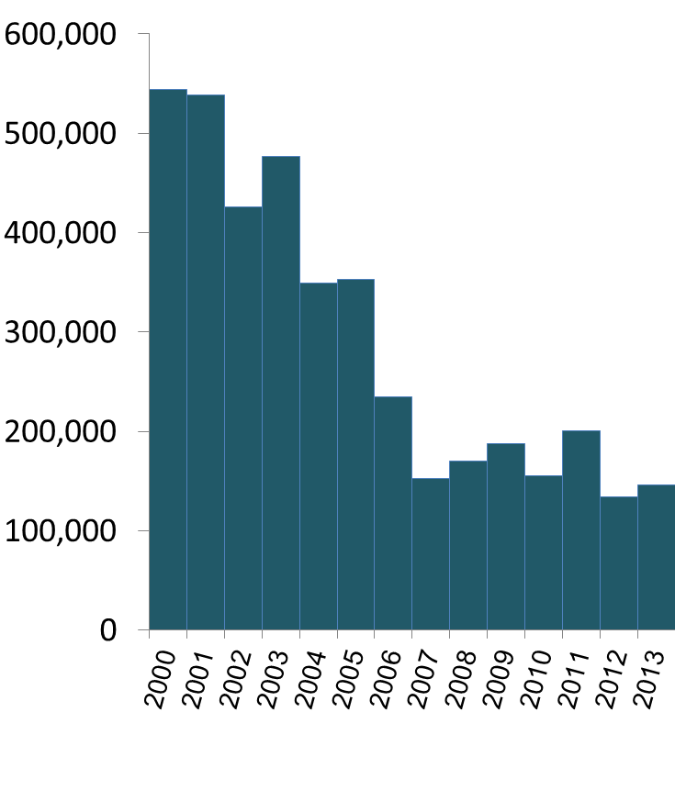

Milestone #2 Milestone #3
Measles Incidence <5 cases/million 95% Reduction in Measles Deaths
Measles incidence
down by 71%
42 per million, 2014
Measles deaths down by 75%
Estimated deaths
Reported cases in 1,000

Slide 8
We still have a way to go to reach our 2015 Milestones

Slide 9
Why are we missing our targets?
Age and Vaccination Status of Confirmed* Measles Cases, 2010-2014 (n=356,632)
41%
2/3 of all cases are children who should have been vaccinated;
Most had <2 doses
25%
Percent of confirmed cases
13%
11%
10%
*Lab-confirmed or epi-linked.

Slide 10
Big Gaps in Routine Coverage
Global immunization coverage with MCV1, MCV2, RCV, 2000-2014
Percent
~50% global birth cohort

Slide 11
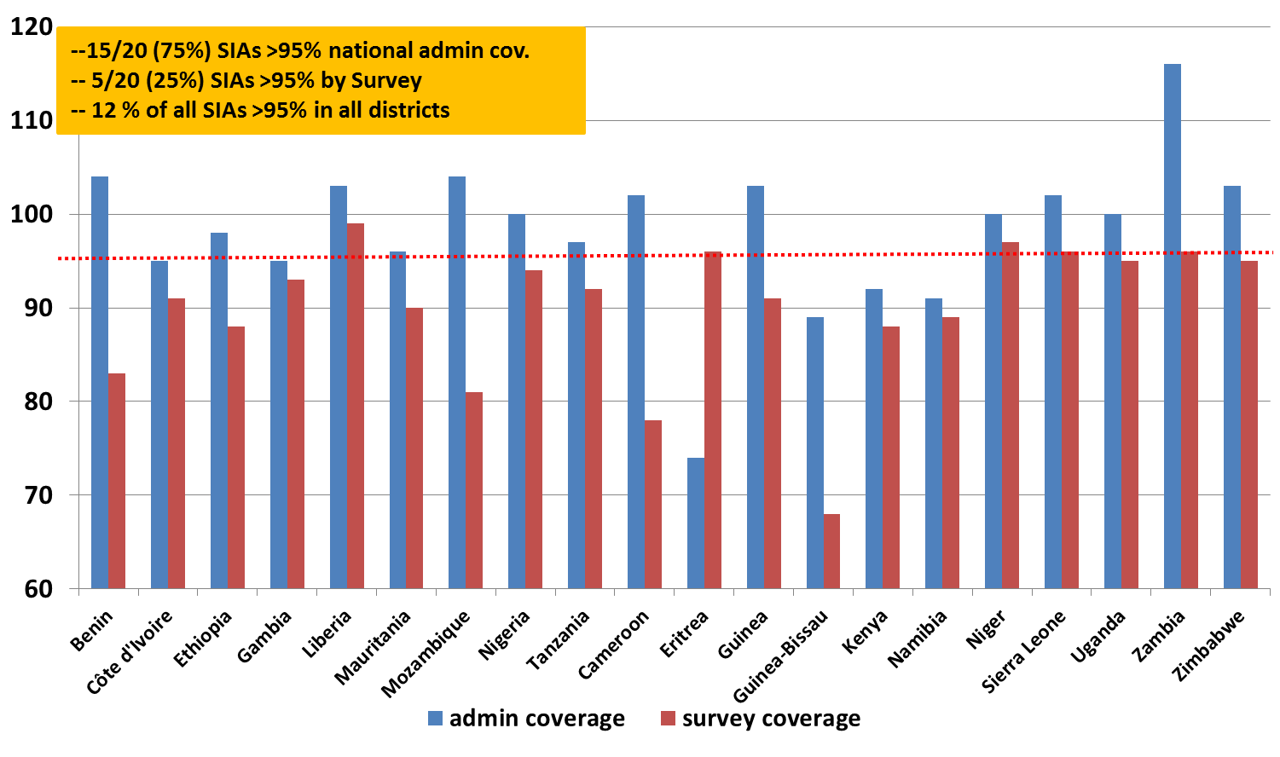
Too many SIAs are not achieving >95% coverage

Slide 12
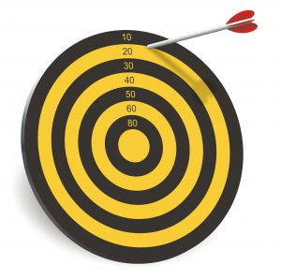
We Need a Midterm Review
Global Measles and Rubella Strategic Plan, 2012-2020

Slide 13
Where to focus with new ways of working…
71% of all measles deaths
MCV1 coverage
under 80%
No rubella vaccine
DRC India
Nigeria
Ethiopia Pakistan Indonesia
+ 21 countries
11
countries
27 countries

Slide 14
Rationale for our vaccination strategy
Consider 130 million babies born each year…
…all will be susceptible by 9 months of age.
Cost effectiveness
High
FIRST LINE OF DEFENSE:
Routine vaccination with MCV1 and MCV2
Medium
SECOND LINE OF DEFENSE:
SIAs to reach those missed by routine
Low
LAST RESORT…
Outbreak response vaccination

Slide 15
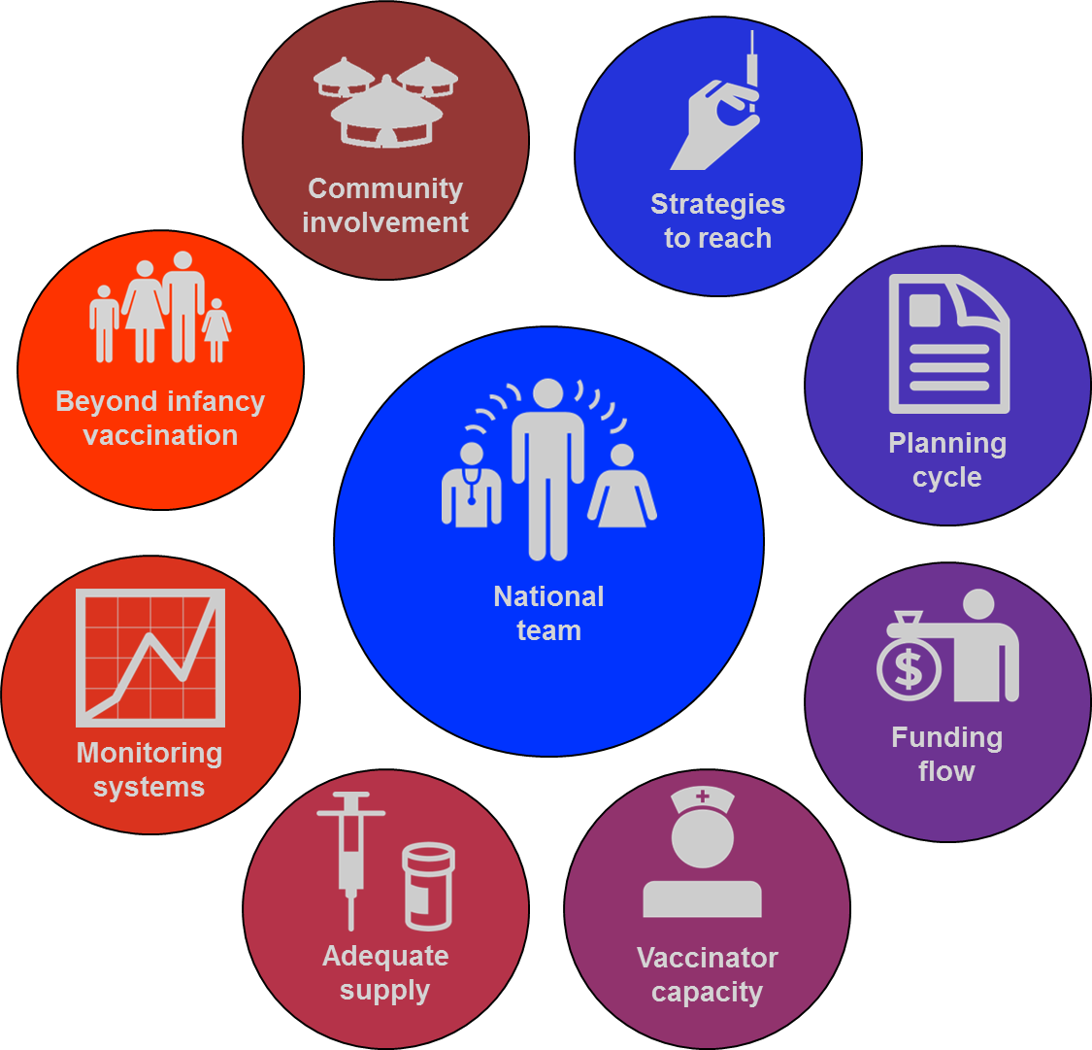
Global Routine Immunization Strategies and Practices
A Call to Invest in 8 Core Areas

Slide 16
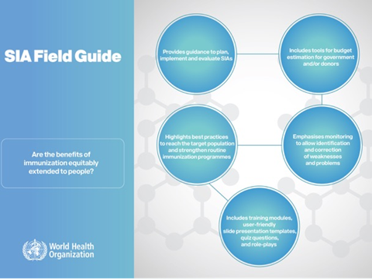
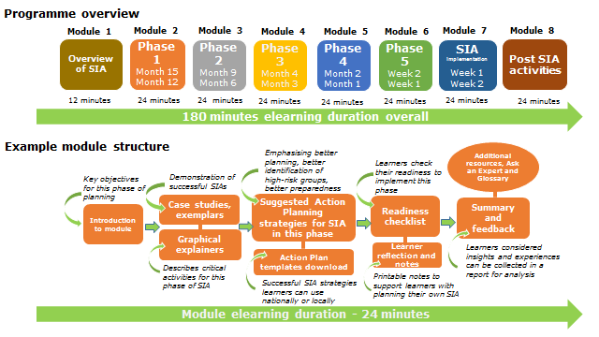
Improve the Quality of SIAs
Advance planning
Focus on hard to reach
Including them in the routine services
Monitoring performance
eLearning modules…

Slide 17
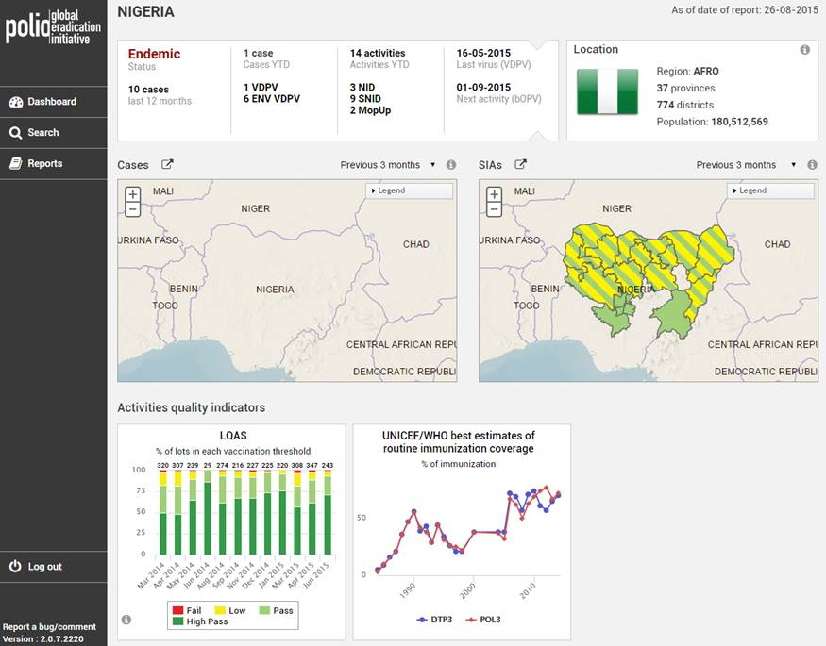
Invest in Better Information

Slide 18
An Example of good data analysis:
Genotypes of Measles Detected in the Last 10 Years
Genotype | 2005 | 2006 | 2007 | 2008 | 2009 | 2010 | 2011 | 2012 | 2013 | 2014
B2
B3
D11
D4
D5
D6
D7
D8
D9
G3
H1
Source: Dr Paul Rota, CDC and Global MR Laboratory Network
Solid color: Genotypes with ongoing transmission; stippled: genotypes with no detections in the last 3 years

Slide 19
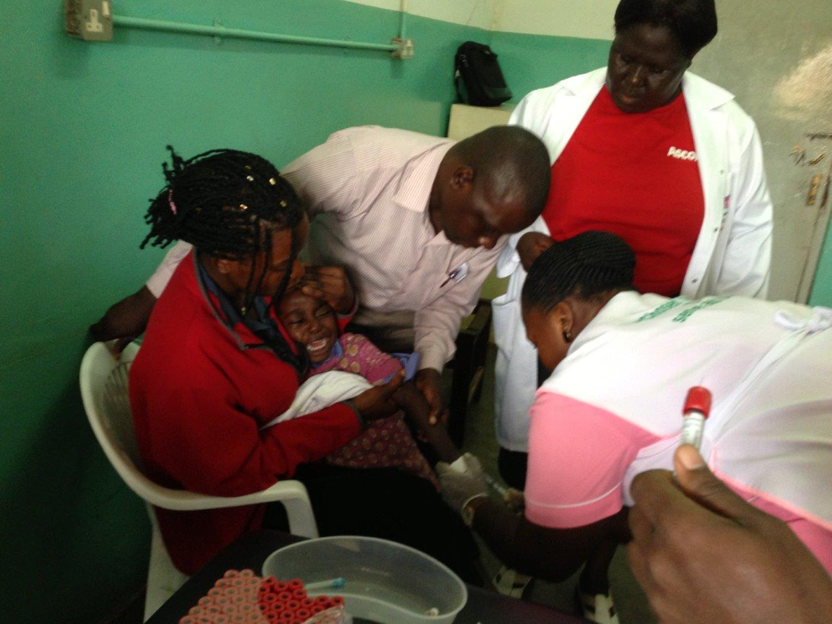
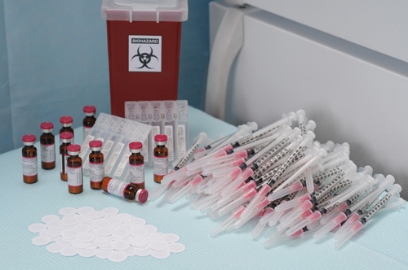
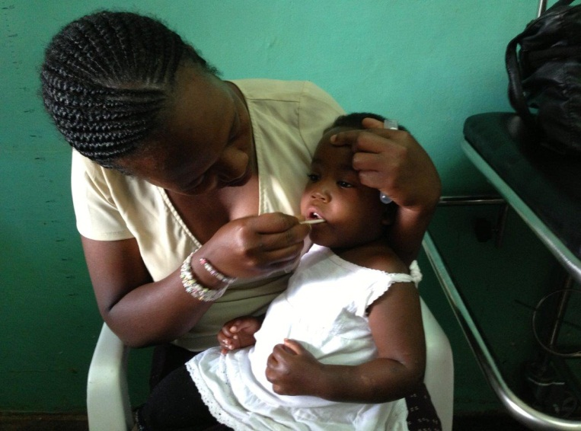
New tools
Diagnosis
Vaccination
100 micro-needle patches

Slide 20
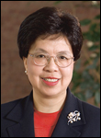
Conclusion
“We face a pivotal moment in the fight against measles and rubella.
We must:
  redouble our efforts,
  build the fundamental health infrastructure,
  focus on those who are being missed,
  … and never lose sight of the fact that the goal of eliminating these two diseases is entirely feasible.”

Slide 21

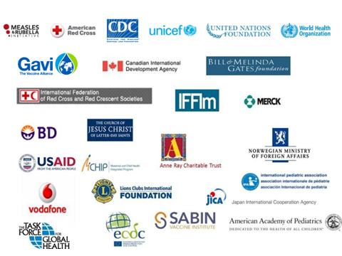
Acknowledgements
Country programs
Partners:
Thank You

