Slide 1
Contribution of Pediatricians and National Pediatric Societies to the M&RI
Louis Z Cooper, MD
for the
American Academy of Pediatrics Joint Project with
Centers for Disease Prevention and Prevention
and
International Pediatric Association
No conflict of interest
lzcooper@verizon.net

Slide 2

M&RI: PUBLIC/PRIVATE PARTNERSHIP STARTED 2001
IPA & AAP JOINED 2012

Slide 3
FRAME OF REFERENCE:
What is the IPA?
Who are we?
Why are we here?
What do we want to tell you about today?
Building, scaling and sustaining stronger relationships with you at the global, regional, national and local levels!

Slide 4
IPA MEMBERSHIP Includes:
147 National Pediatric Societies (NPS) = A society of societies
7 Regional Societies
14 International Pediatric Subspecialty Societies
1 Committee for pediatric academic chairs
1 Voice for children representing 1,000,000 pediatricians

Slide 5
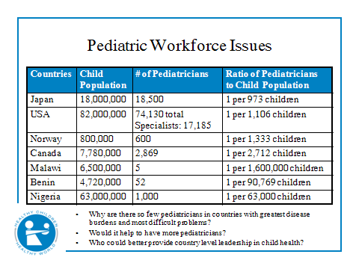
Pediatrician Direct Roles in Immunization Are Variable-Often Modest

Slide 6
CHALLENGES FOR GVAP-MRI
Goal unprecedentedly high (90-95% coverage)
Each country and pediatric society UNIQUE, but
common themes exist
Political will defines success in immunization
All politics is LOCAL
Historic silos: public/private/civil society organizations
Attitudes: ignorance to hostility and distrust
Heterogeneous communities
Real + perceived conflicts of interest
Conflicting values & priorities
MRI Model of Public/Private Partnerships
Notes:
Why do I say that? Becaise I have experienced that difference in my own country and others worldwide. We share common challenges in GVAP and MRI.

Slide 7
Value NPS Can Add to GVAP &
Measles & Rubella Initiative
Global Immunization Policy is science-based
  But must be tailored to local circumstances
POLITICAL WILL:
  is the common denominator for sustained success
    CREDIBILITY & TRUST are keys to education of publics and professionals. Pediatricians are still trusted!
Independence in Advocacy – for resources, equity & sustainability
Delivery of vaccines and surveillance: private and public
Capacity for Partnerships - transparency, accountability, respect, humility, inclusivity with reach-out to all for shared goal: health for all

Slide 8
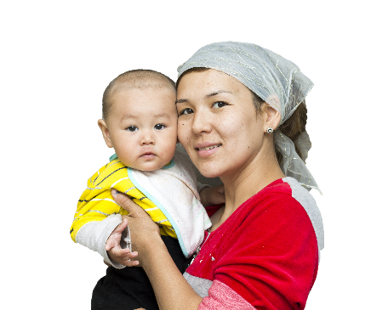
Review of Project Goals and Progress to Date

Slide 9
IPA AND CONTINUOUS MEDICAL EDUCATION
Workshops
Focused on elimination/eradication of measles and rubella
in Nepal February 2013
in Milan - ESPID congress May 2013
in Glasgow - Europaediatrics Congress June 2013
in Istanbul - Balkan Congress June 2013
in Melbourne - IPA Congress August 2013
In Vancover August 2016

Slide 10
Goal:
Strengthen National Pediatric Societies' ability to strategically support their country's health system through optimal and appropriate immunization policies and recommendations at the country level.
Objective 1:
Educate and strengthen capacity for pediatric leaders to be immunization advocates
Objective 2:
Support country partners to appropriately respond to immunization priorities
Objective 3:
Foster streamlined approaches to working with pediatric professionals in-country to meet global goals
Notes:
Revised objectives from our original proposal in terms of tighten the language and also that Objective 3 is new

Slide 11
AAP-CDC Program Approach includes:
Assess:
Understand NPS’ organizational and IZ advocacy capacity and experience
Train:
Hold advocacy workshop to train IZ champions and identify priorities
Implement:
Activities to implement advocacy priorities
Learn & Sustain:
Share learning with CDC, AAP, in-country partners, and other societies, and promote institutionalization
PHASE 1
PHASE 2
PHASE 3
Notes:
Phase 3 is new
How do we build longstanding capacity in an NPS in order to strengthen even more their abilities to meet immunization goals

Slide 12
Highlights from Years 1 & 2
Cross-stakeholder commitment to including and engaging higher-level providers in immunization training and service delivery in Kenya
Increased ownership and understanding of pediatric role in bridging public/private divide in Philippines and Indonesia
Strengthened institutional linkages in organizational structure to respond to immunization priorities and emergencies in Nigeria
Notes:
We will discuss these in a little more detail as we move forward

Slide 13
Kenya
Kenya Pediatric Association Identified Priorities:
Managing vaccine hesitancy issues
Improving communication activities, strategies, and techniques
Collaborating with other organizations around advocacy
Understanding the breadth of possible advocacy activities
Professional association strengthening
Becoming a more recognizable resource for information/education (for the public and providers) on child health topics
Identifying potential partners for disseminating information
Introducing new vaccines
Benefits of advocacy for members
Notes:
Needs assessment

Slide 14
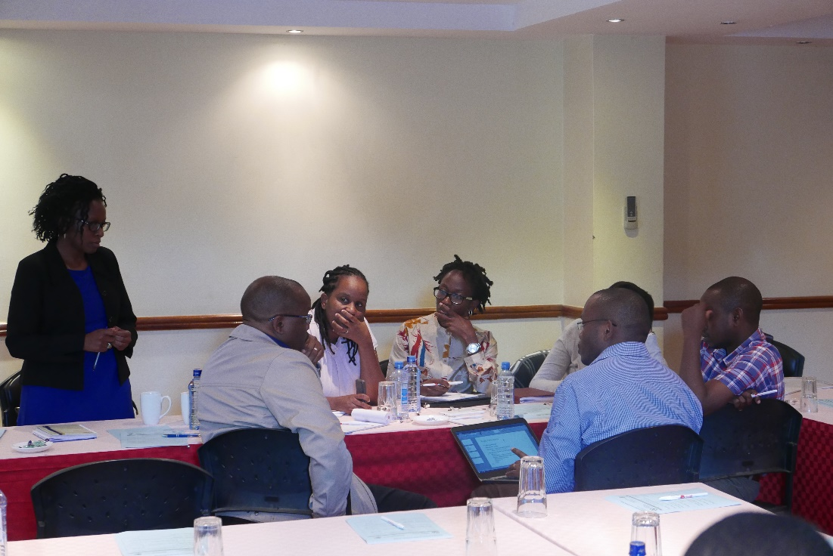
KPA Activity Results
Held faculty curriculum review to identify gaps in existing immunization curriculum
Coordinated immunization stakeholders buy-in for revised training curriculum
Developed outline for increased engagement of medical professionals in immunization service delivery
Notes:
May 2016
24 champions trained
*No curriculums for physicians
*Curriculums are based around EPI vaccines and do not include information beyond
*Curriculums are based in service delivery and do not provide significant information for improving uptake of vaccines for Providers
*Attended by MOH and EPI
*Developed outline agreed on by MOH
*Dissemination plan will include Pharmacy technicians, Pediatricians, Information Officers, in addition to nurses, Clinical and Medical Officers
*KPA and MOH will be certifying bodies
Ask Jim to comment
-MOH told AAP that KPA has become their initial resource for child health
-A core group of child health stakeholders agreed and committed to reframing immunization service delivery to include higher-level providers. This shows a national-level commitment to the importance of pediatricians as immunization partners and a continuum of care.

Slide 15
Nigeria
Pediatric Association of Nigeria Identified Priorities:
Immunization financing
Human resources for immunization
Access to routine immunization

Slide 16
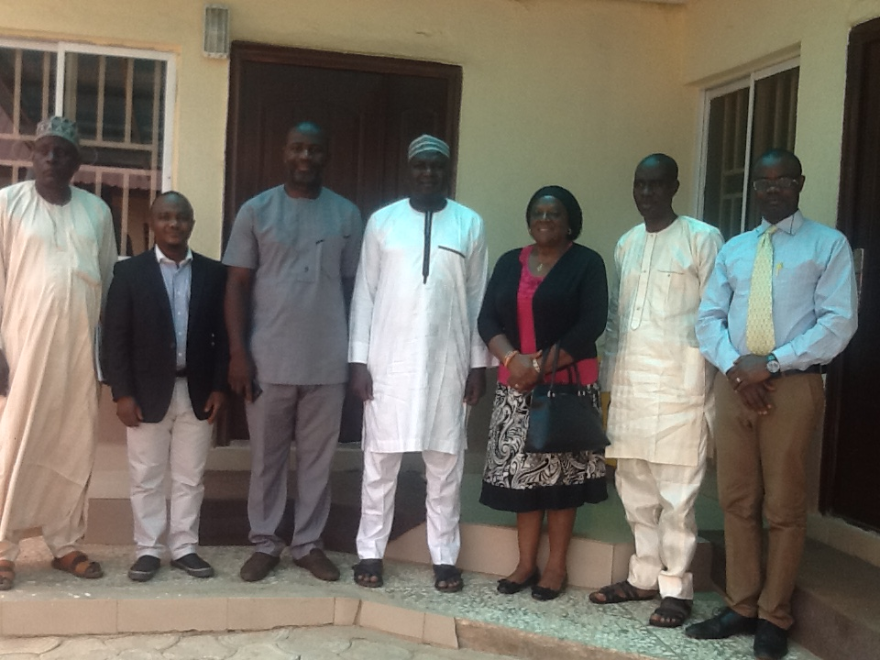
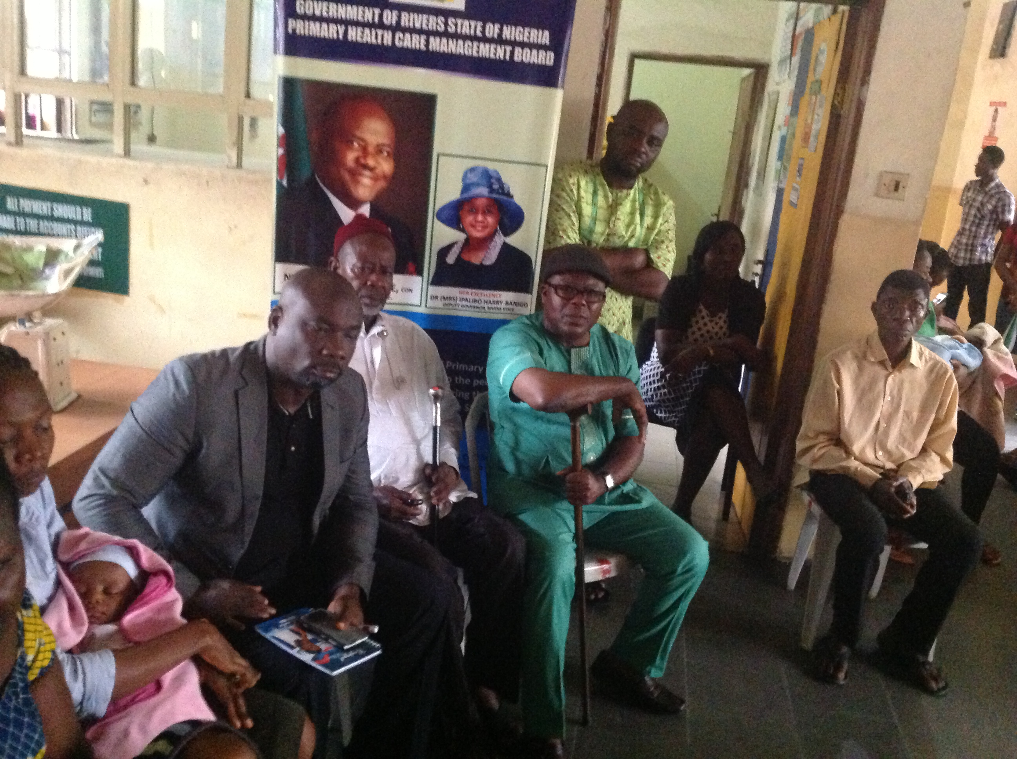
PAN Activity Results
*Final report due July 30th
Held advocacy meetings with Permanent Secretaries for Health in six states
  Importance of state budget for immunization human resources
  Routine immunization
  Polio eradication, even in non-Polio outbreak areas
Trained vaccinators in 6 states
Addressed misinformation and hesitancy with caregivers in 6 states
Notes:
April 2016
15 champions trained
*Obtained written letters of support from each PS
*Developed stronger relationships between regional leaders, regional PAN members, and national members
Trained vaccinators on up to date Immunization information
Held town hall meetings with caregivers
*Discussed immunization safety
*Messages around misconceptions of vaccines
*Importance of routine immunization
Comments from Meg
-Polio eradication was raised as a key issue across all regions in Nigeria, and regional leaders were informed and committed to their role
-PAN linked society leadership with more junior membership, beginning to build sustainability within their membership towards immunization advocacy institutionally and their ability to leverage expertise and knowledge to national-level bodies, such as the NTAG

Slide 17
Philippines
Philippine Pediatric Society Identified Priorities:
Professional Education to health workers
Immunization knowledge at community level
Improve relationship with faith-based organizations
Improve relationship with local/regional Department of Health
Data loss around immunizations given by private providers

Slide 18
PPS Activity Results
*Final report due July 30th
Highlighted immunization advocacy efforts at national conference
Completed 13 trainings (1 per chapter/region) using the newly developed immunization education modules for health workers
Developed new immunization data reporting structure
  New form developed with MOH
  Chapters → PPS National → MOH
Notes:
Nov 2016
14 Champions trained
Regional and Chapter trainings were done by a trained champion
In 1 region they are actually training the public sector vaccine program managers and PPS wants them to do that in each region, but so far the others are really focused on their own members
*Champions are training their chapters to collect data and will submit quarterly reports to the national PPS office. These data will be given to the MOH for programming and used by the Immunization Committee to guide future advocacy efforts.
Ask Bonnie to comment
-Through PPS advocacy, the Department of Health will now begin including private level data for EPI vaccines in national coverage, which will lead to more accurate coverage rates
-The reporting system developed through the project creates a system for the Immunization Committee to analyze service delivery data and provide the data and associated directly to the DOH

Slide 19

Year 2 Country Progress

Slide 20
Ethiopia
Ethiopia Pediatric Society Identified Priorities:
Routine immunization strengthening
Measles and Rubella activities
Introduction of new vaccines
Creating an Immunization Committee and providing standardized society recommendations to the government/NITAG
Improve vaccine coverage by reducing drop-out rates in 1 specific district
Decrease VPD disease burden by 10-20% in 1 specific district
Increase accessibility of immunization services

Slide 21
EPS Planned Activities
Target Afar and Somali states which have lowest coverage rates
Advocacy workshop targeting immunization stakeholders and state government personnel
  2 Position Papers calling for commitment of regional leadership to immunization
Awareness/demand creation workshop targeting clan leaders using TOT approach
Notes:
May 2017 was training
Planned activities, because of delays
Let Meg comment

Slide 22
Indonesia
Indonesia Pediatric Society Identified Priorities:
-Importance of data to vaccine system in Indonesia
-Integrating public and private vaccine service delivery data
-Combatting vaccine hesitancy
  Significant concerns raised with ‘pork product’ packaging
-Patient and community communication

Slide 23
IPS Activity Results
Trained an additional 150 champions in 3 districts
  Focused on data collection and data for decision making
Hosted Immunization Week stakeholder’s meeting to discuss MMR and Dtap shortages and recent disease outbreaks
Additional member outreach activities planned for July
  Report due August 31st
Notes:
Feb 2017
Press and MOH at the Immunization Week Stakeholder’s meeting.

Slide 24
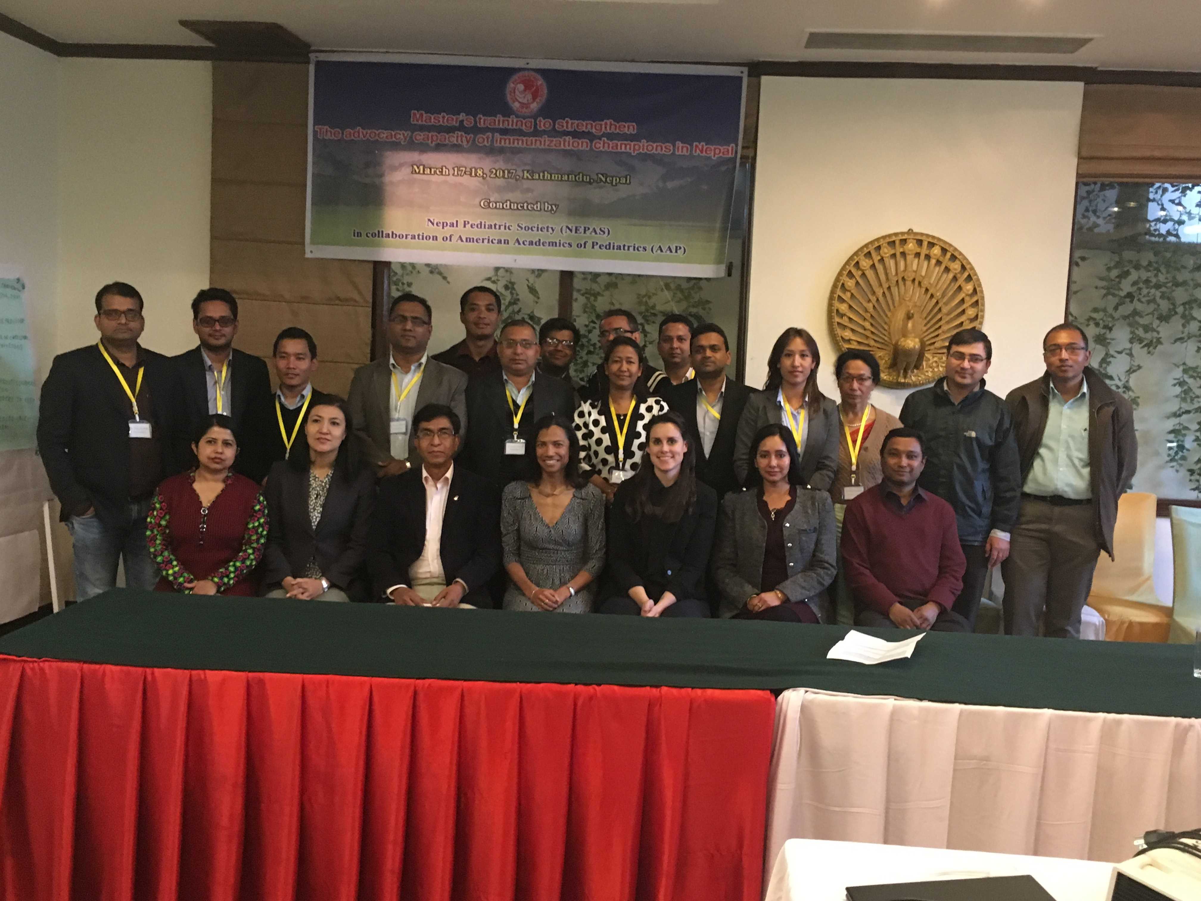
Nepal
Nepal Pediatric Society Identified Priorities:
Strengthening routine immunization and linkage to non-EPI vaccines/private sector care
Improve capacity of vaccinators to provide appropriate immunization messages
Improve linkages between providers and WHO measles surveillance
Strengthen NEPAS’ role within NCIP

Slide 25
NEPAS Planned Activities
Advocacy trainings to 4 Chapters expanding ‘Immunization Advocacy Champions’ to regional level
Training of vaccinators in 4 Chapters
  Improved counseling and knowledge of both EPI and non-EPI vaccines
  4 government meetings (with WHO, District Health Teams)
Linking frontline health workers to pediatricians, and dissemination of results to national audience, including government
Notes:
In-depth needs assessment interviewing vaccinators
Trained 16 champions Agreed to facilitate the sharing of information to other health workers and front line vaccinators
Ask Kristin to explain needs assessment.
Facilitators of the training included NEPAS executives, NEPAS immunization subcommittee, Child health division, Ministry of health and experts from the American Academics of Pediatrics.
and covered topics related to being an immunization champion, the role of the media and communication, catch-up immunization, and the results of the needs assessment.
• In coordination with the NEPAS chapter we will have meeting with CDO, DPHO, local WHO surveillance officers, regarding possibilities of involvement of the frontline health workers.
• Meeting with CHD and head of immunization about the II phase of activities and the need of the support of MOH.
• Specific material will be developed with the help of local coordinators
• Get help from the local coordinators for the training

Slide 26
Kenya- CDC and GVAP Priorities
Measles eradication
Routine Immunization strengthening/decentralization
Vaccine financing [CDC agreement with Sabin]

Slide 27
Philippines—CDC and GVAP Priorities
NITAG strengthening
Private sector data loss
Measles elimination
Routine immunization coverage/drop-out [GVAP]

Slide 28
Nigeria—CDC and GVAP Priorities
Polio eradication
Measles elimination
Data management
Training immunizers at ward level [WHO]
Maternal TT [GVAP]
Routine immunization/loss to follow-up [GVAP]

Slide 29
Ethiopia– CDC and GVAP Priorities
Measles elimination
Gavi transition/vaccine financing
Introduction of new/underused vaccines
  Hib
  IPV
  MR
  Meningitis
  Yellow Fever
  HPV & Td for girls 9-13 years
Routine immunization/drop out

Slide 30
Indonesia—CDC and GVAP Priorities
Measles elimination
Rubella elimination
Immunization surveillance strengthening
Introduction of new vaccines
  Hib
  JE
  Rota
  Influenza
Routine immunization/drop out

Slide 31
Nepal—CDC and GVAP Priorities
Routine immunization strengthening
Measles and rubella elimination
Polio eradication
Improve coverage in rural, poorer communities [GVAP]
School-age vaccines [GVAP]

Slide 32
the challenge
SUCCESS DEPENDS ON POLITICAL WILL
For Region of Europe
Asia-African Regions
Additional Factors
COMPLACENCY
(multiple factors)
INADEQUATE POLITICAL WILL
VICTIMS OF SUCCESS
NO OR LITTLE ADVOCACY
COMPETING PRIORITIES
LOSS OF PUBLIC TRUST
BELIEF ISSUES
CIVIL STRIFE
ARMED CONFLICT
POVERTY
INFRASTRUCTURE
CORRUPTION
Modified From Mark Muscat-WHO EURO

Slide 33
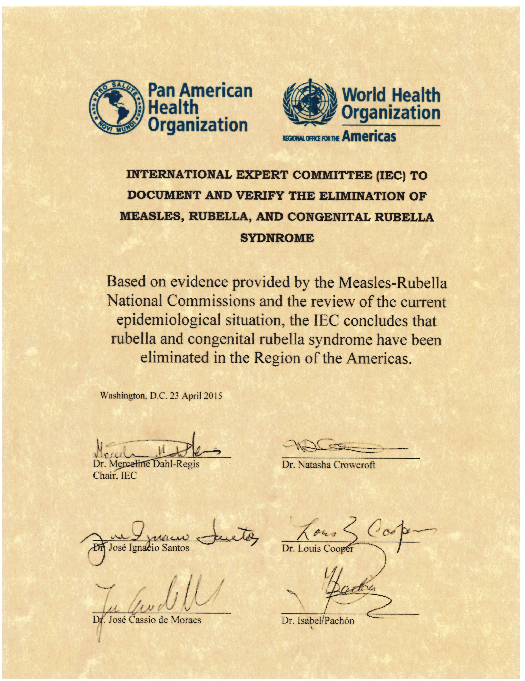
PAHO-THE AMERICAS
Success-Yes
Rubella- 2015
Measles- 2016
Sustainability-?
Complacency-No
NPS COMMITMENT
TO HEALTH:
DEMANDS SUSTAINED SUPPORT
FOR GVAP AND MRI

