Slide 1


Accelerating Progress towards Measles and Rubella Elimination
WHO Western Pacific Region
UNICEF East Asia and Pacific Region
21 June 2016
Geneva, Switzerland

Slide 2
Regional Measles and Rubella Goals
2003: Measles elimination to be used to strengthen routine immunization
2005: By 2012, the Region should aim to eliminate measles;
2010: Reaffirms the 2012 measles elimination goal and calls to accelerate control of rubella and the prevention of congenital rubella syndrome;
2012: Reaffirms the commitment to eliminate measles and accelerate rubella control;
2014: Regional Framework to implement GVAP endorsed including measles and rubella elimination and prevention of CRS

Slide 3
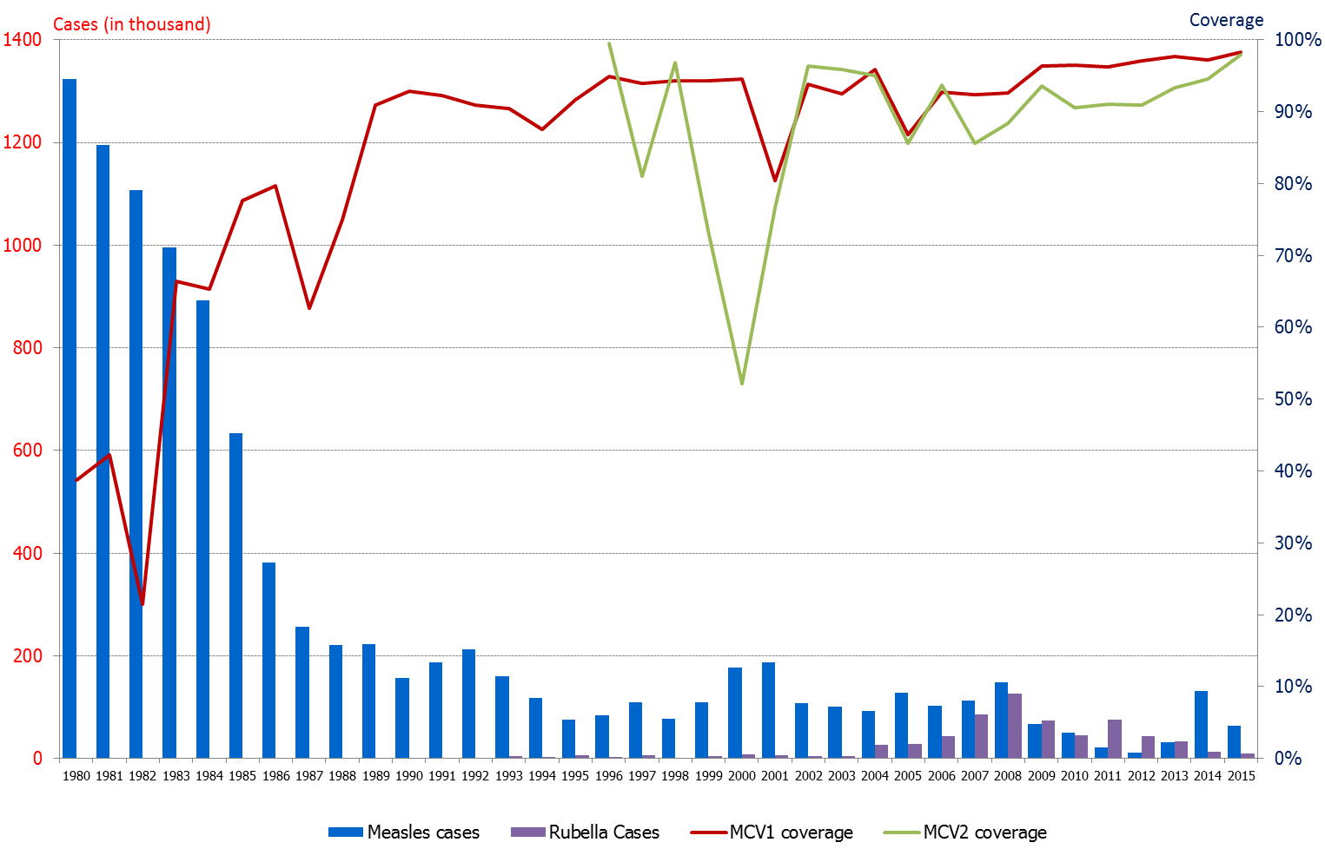
Measles and rubella reported cases and coverage of MCV1 and MCV2, 1980-2015
Source: WHO UNICEF Joint Reporting Forms

Slide 4
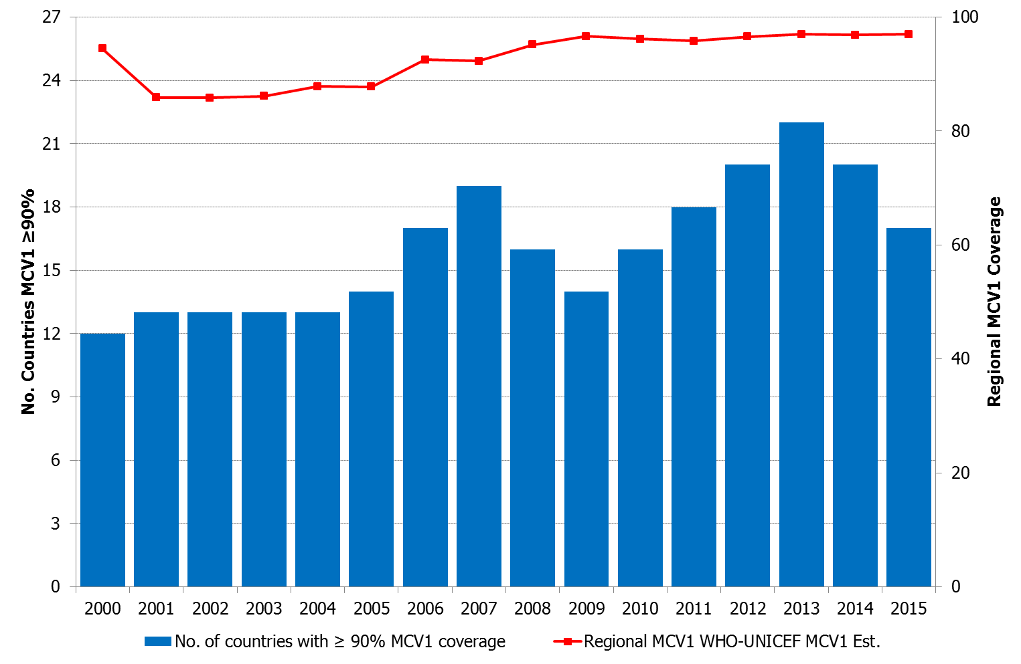
WHO UNICEF MCV1 coverage estimates, and number of countries reaching >90% coverage. 2000 – 2015. (N=27)
* For 2015, draft estimates are used

Slide 5
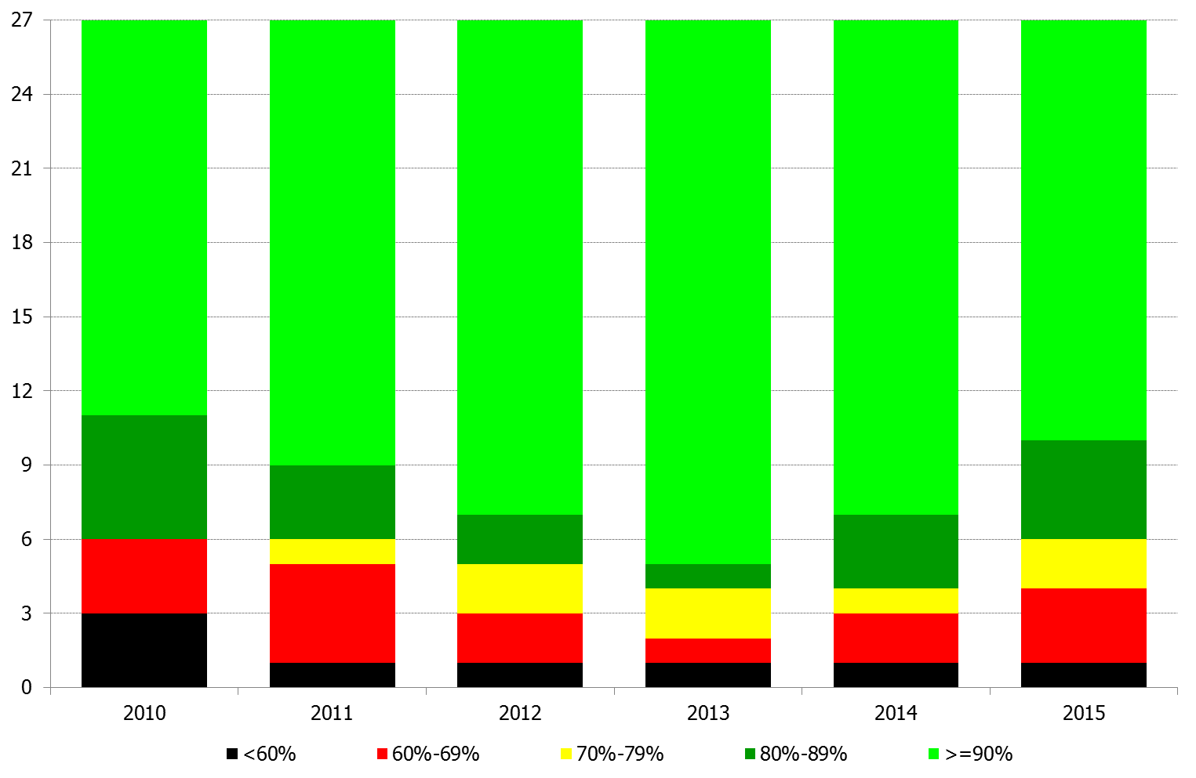
WHO UNICEF MCV1 coverage estimates in WPRO countries, 2010 – 2014
* For 2015, draft estimates are used
Notes:
Suggest to revise the title, something like: number/proportion of countries under different categories of MCV1 coverage
Data source; WHO/UNICEF coverage estimates.

Slide 6
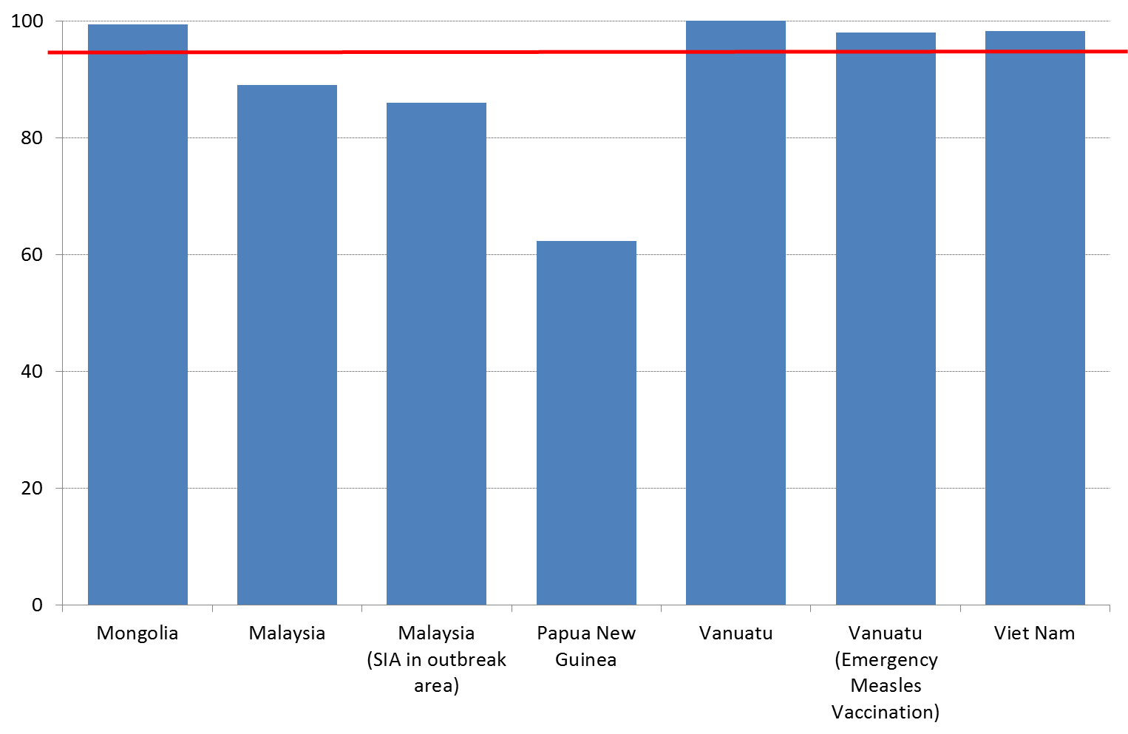
SIA coverage vs 95% coverage target (2015)
Source: WHO UNICEF Joint Reporting Forms (data for 2015)

Slide 7
SIAs done or planned during 2015-2016 in WPRO
Country | Vaccine | Target age | Dates | Admin coverage | Other interventions
Mongolia | Measles | children | May 2015 | 99% | Vitamin A
Malaysia (subnational) | Measles/ MMR | 6-12m/1-17y | Jan - Sep 2015 | 89%
Malaysia (subnational) | Measles/ MMR | 6-12m/1-15y | Jun 2015 | 86%
Papua New Guinea | MR | 6m-15y | Aug - Dec 2015 | 62% (ongoing) | All antigens, albendazole, IPV, OPV, vitamin A
Vanuatu (outbreak response) | Measles | 6-59m | Apr - May 2015 | 98%
Vanuatu | MR | 1-15y | Sep - Oct 2015 | 100% | Albendazole, OPV, vitamin A
Viet Nam | MR | 1-14y | Sep 2014 – May 2015 | 98%
Cambodia | MR | 9-59m | Mar 2016 | 91% | JE
Mongolia | MR | 18-30y | May 2016 | >85% (ongoing)
Lao PDR | MR | 9m-5y | Dec 2016 | Planned | OPV
Federated States of Micronesia (subnational) | MMR | TBD | TBD | Planned
Source: WHO UNICEF Joint Reporting Forms (data for 2015)

Slide 8
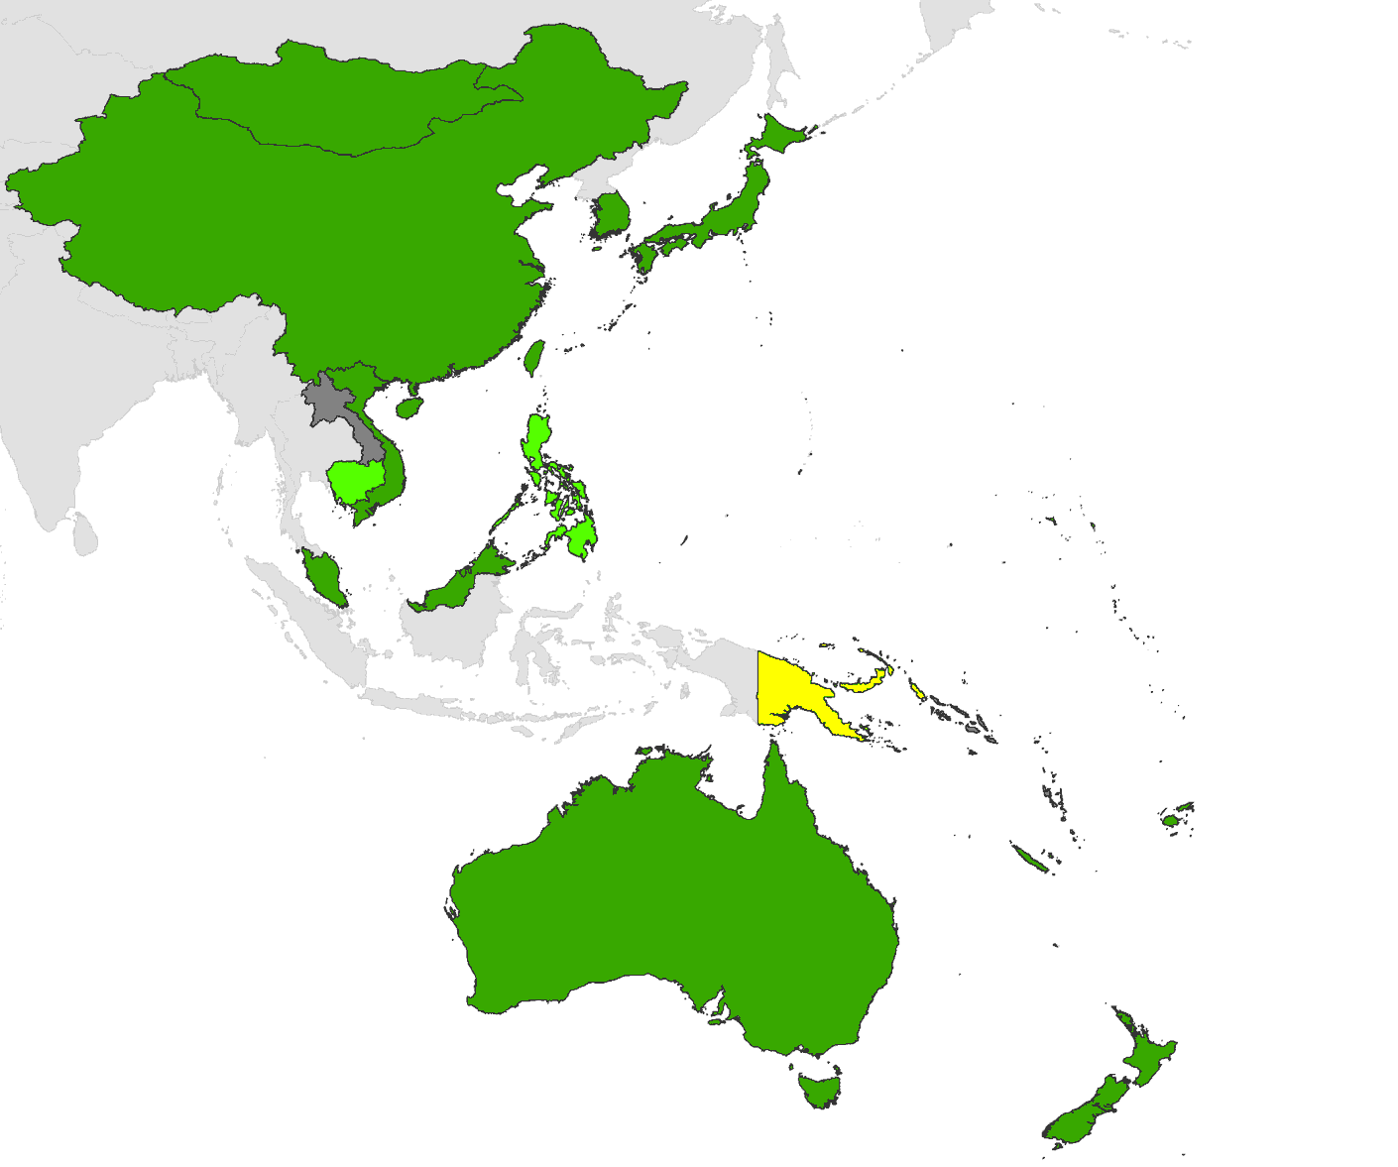
MCV2 introduction into routine EPI in WPRO 2015-2016
MCV2 already in EPI schedule
Introduced 2007-2014
Introduced in 2015
Introduced in 2016
No MCV2 (LAO, SLB, VUT)

Slide 9
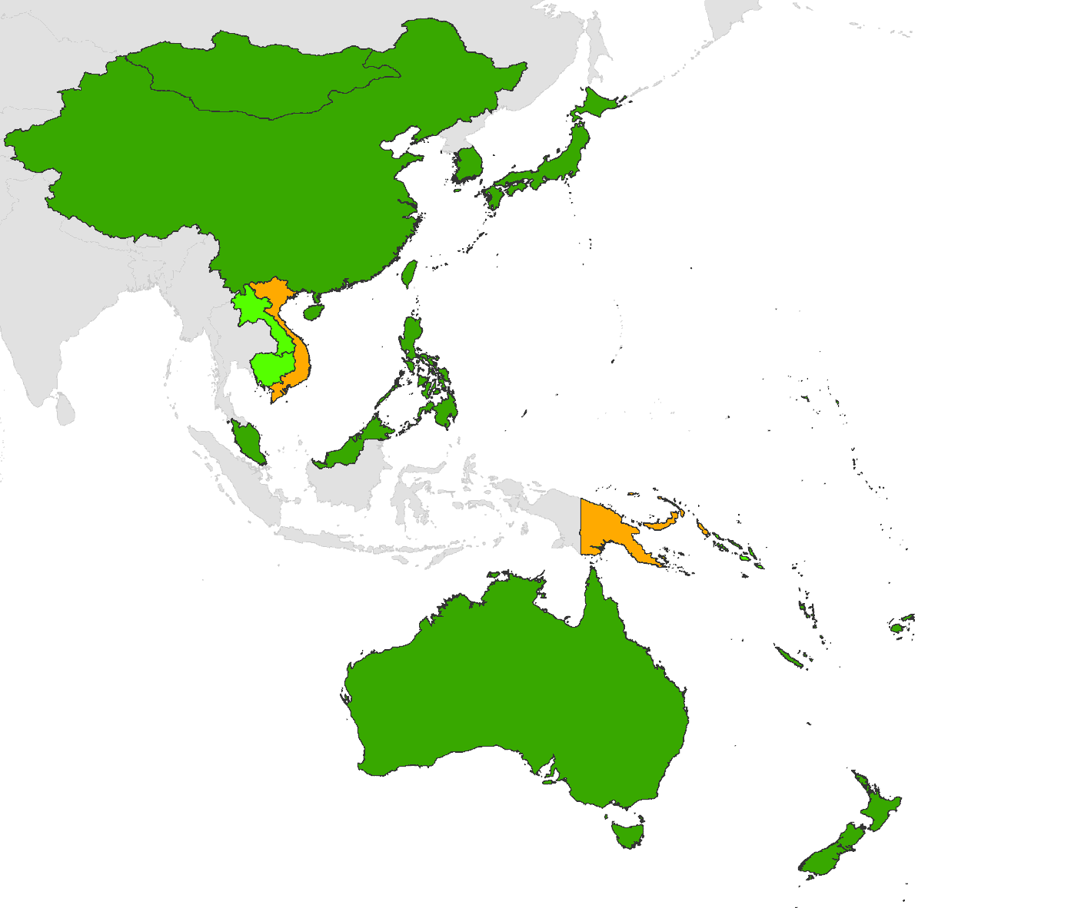
Rubella-containing vaccine introduction in WPRO 2015-2016
RCV already in EPI schedule
Introduced 2011-2014
Introduced in 2015
Introduction planned for 2016
No RCV plans currently
By end 2015, all countries and areas include RCV in the national programme.

Slide 10
Indicators of Progress Towards Measles (and Rubella) Elimination WPRO Region 2000-2016*
Category | Target | 2016* | 2015 | 2014 | 2013 | 2012 | 2011
Incidence (% countries < 5 per million population) | - | 65% | 47% | 29% | 53% | 59% | 41%
Incidence of confirmed measles (confirmed by lab, or epidemiologic link) per million population | - | 19.1 | 24.2 | 48.3 | 17.7 | 5.9 | 11.7
High Quality Surveillance
National reporting of discarded measles cases (goal: ≥2 per 100,000 population) | >2.0 | 2.0 | 3.9 | 4.2 | 3.6 | 2.4 | 2.8
% of 2nd level admin units reporting ≥ 2/100 000 discarded measles cases | >80% | 28.3 | 44.3 | 52.0 | 40.9 | 35.1 | 52.3
% of suspected cases with adequate blood specimens | >80% | 52.6 | 73.8 | 84.2 | 89.9 | 90.5 | 77.8
High Population Immunity
% countries with MCV1 >90% | >95% |  | 67% | 74% | 84% | 76% | 68%
% countries with MCV1 >80% in all dist | >90% |  | 57% | 41% | 45% | 63% | 41%
* Data as of May 2016
Notes:
Adapt to regional targets as necessary
suggested shading for incidence:
% countries: 90% or higher, yellow = 70-90%, red =<70%
reg incidence: green <5, yellow 5-50, red >50
surveillance quality:
green = 80% or higher, yellow = 70-80%, red = <70%
coverage:
green = 90% or higher, yellow = 70-90%, red =<70%

Slide 11
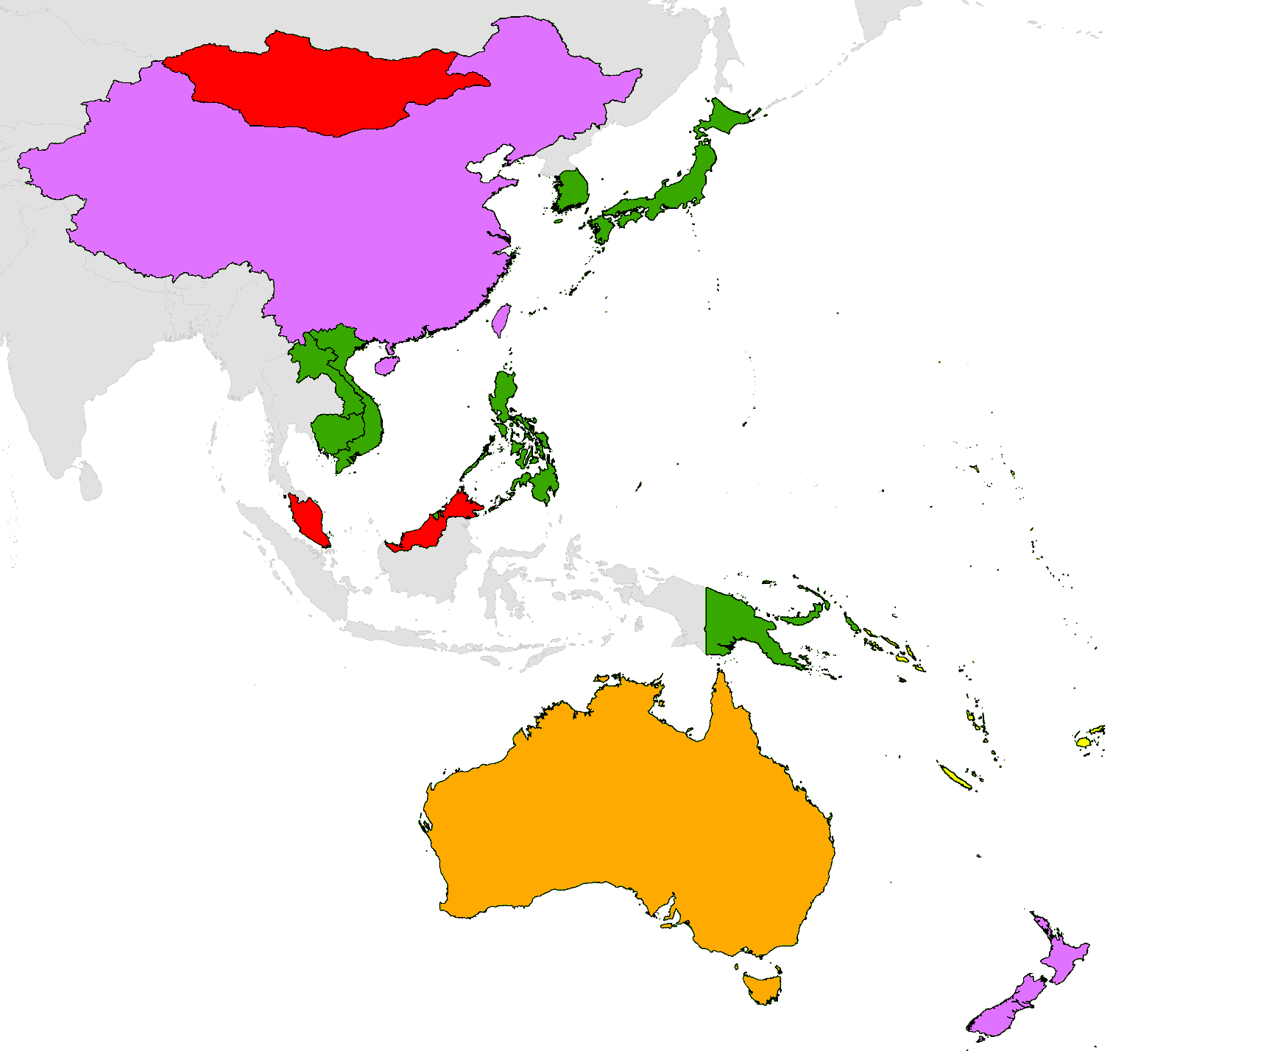
Measles incidence rate, WPRO, 2016
Legend:
< 1 per million population
1.0–4.9 per million population
5.0–9.9 per million population
10.0–49.9 per million population
>50 per million population
Source: National measles and rubella monthly reports as of 20 May 2016
*Incidence rate is annualized

Slide 12
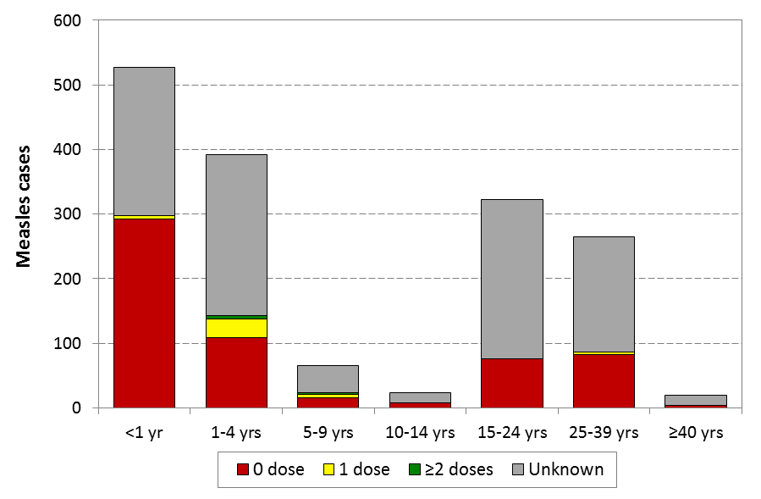
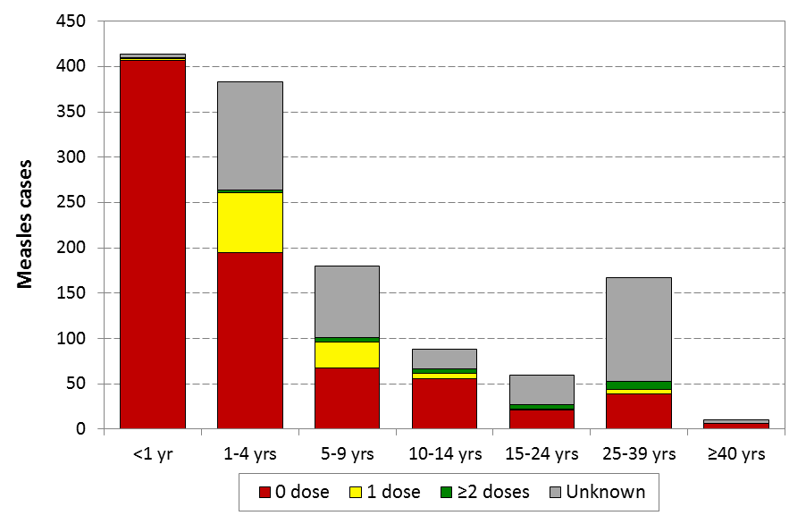
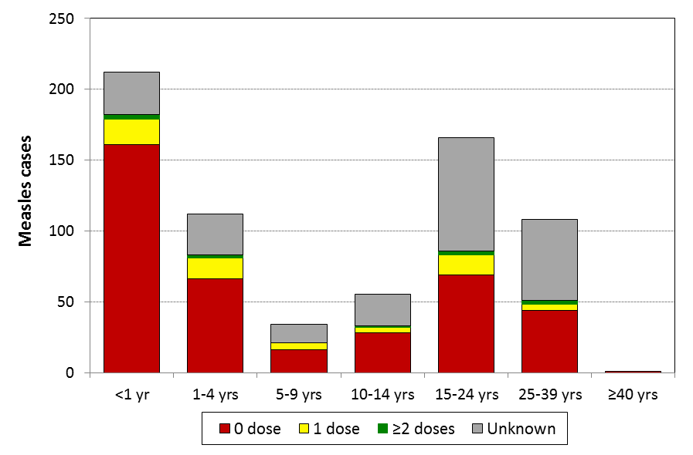
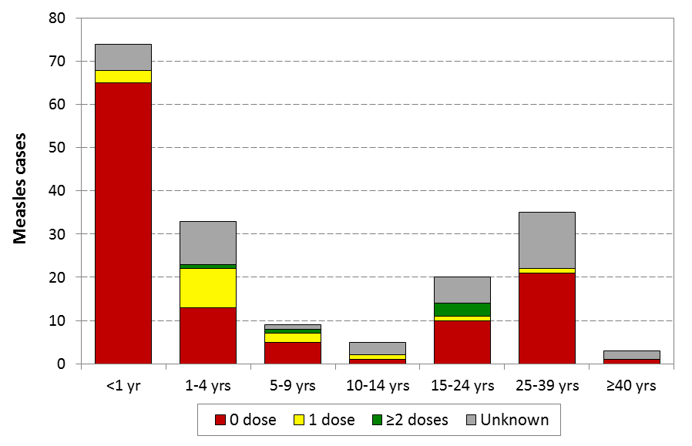
Distribution by age and vaccination status, selected large measles outbreaks, WPRO, 2015-2016
Confirmed measles, MNG, 2015 (N= 1616 )
Confirmed measles, MYS, 2015 (N= 1302 )
Confirmed measles, PHL, 2015 (N= 688)
Confirmed measles, VNM, 2015 (N= 183)

Slide 13
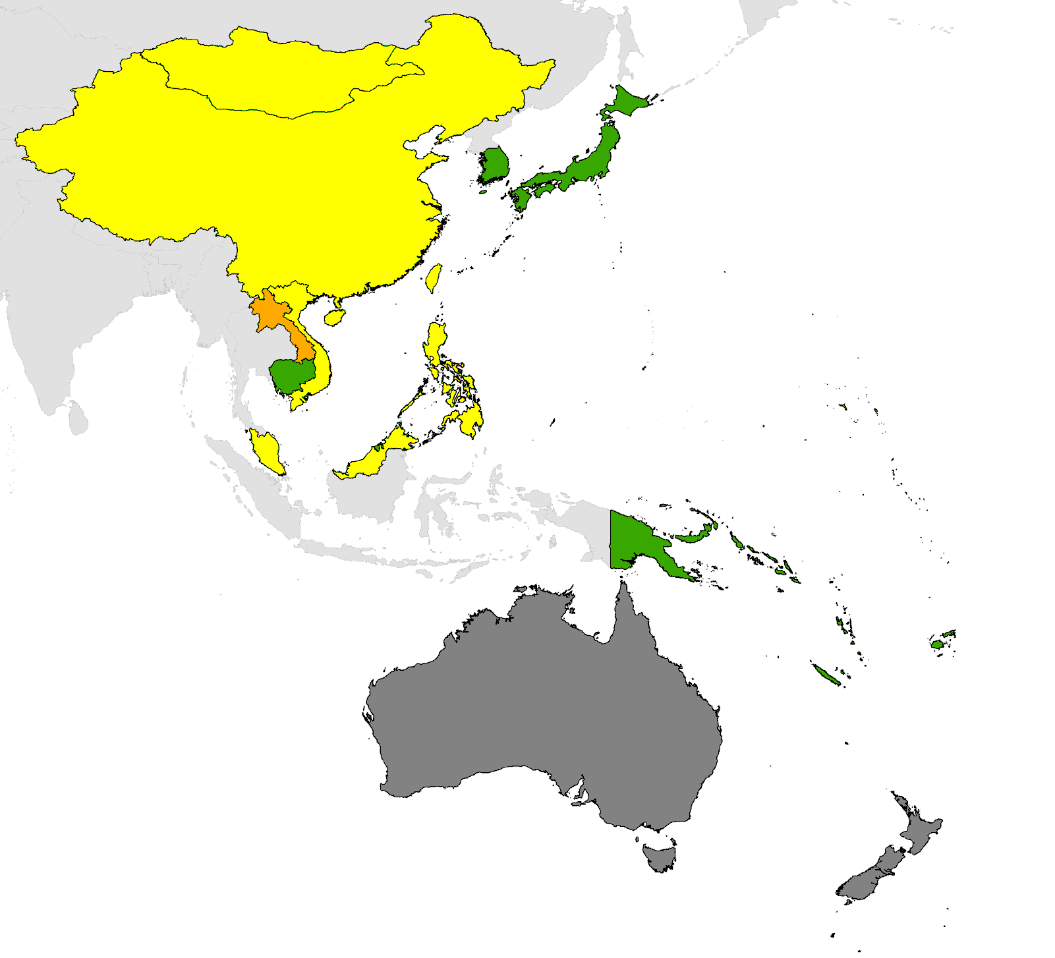
Rubella incidence rate, WPRO, 2016
Legend:
< 1 per million population
1.0–4.9 per million population
5.0–9.9 per million population
10.0–49.9 per million population
>50 per million population
No data
Source: National measles and rubella monthly reports as of 20 May 2016
*Incidence rate is annualized

Slide 14
Regional and National Verification
Status of RVC
  4th RVC meeting 24-27 March 2015
  5th RVC meeting 19-23 September 2016
Status of NVC
  All countries and areas have an NVC (21 Pacific islands with Sub Regional Verification Committee or SRVC)
  7 countries and areas verified as having achieved elimination [Australia, Brunei Darussalam, Cambodia, Japan, Macao SAR (China), Mongolia, and Republic of Korea]
  3 NVCs are expected to request verification in 2016

Slide 15
Challenges to achieving regional goals
Major challenge in the region
  Gaps in population immunity among persons not ordinarily targeted during routine and supplemental immunization including infants too young to be vaccinated as well as adolescents and young adults
Barriers to achieving the goals
  Population size and density
  Ongoing endemic transmission among countries/areas in the region and nearby regions
  Commitment and financial resources to close specific population immunity gaps
  Emerging and growing immunization inequities in urban setting following rapid urbanization in many WPR countries

Slide 16
Programme Plans
2017-2018

Slide 17
2017-2018 SIA plans and budget
Country | Vaccine | Target Age | Dates | Geographic Extent | Other intervent | Funding source | If Gavi, JA dates
Cambodia | MR | 9m-4y | Q4 2017 | National | TBD | Gavi? | TBD
Fiji | MR | 1-11y | 2017 | National | TBD | MRI
Kiribati | MR | 1-8y | 2017 | National | TBD | MRI
Lao PDR | MR | 9m-4y | 2018 | National | TBD | Gavi | Aug 2016
Papua New Guinea | MR | 9m-4y | 2018/2019 | National | TBD | Govt
Philippines | MR | 9m-3y | 2017 | 1-4a, CAR, NCR | TBD | Govt
Philippines | MR | 15-39y | 2018 | 6-8 | TBD | Govt
Samoa | MMR | 1-8y | 2017 | National | TBD | MRI
Solomon Islands | MR | 1-4y | 2018 | National | TBD | Gavi | TBD
Viet Nam | MR | 1-4y | 2018/2019 | National | TBD | Govt

Slide 18
2017-2018 GAVI application and introduction plans for MSD, MR, measles
Country | Vaccine (MSD, MR, M) | Year of Intro (or Measles SIA) | MCV1 coverage (2014) | Year of planned GAVI application | Budget
Lao PDR | MSD | 2017 | 87% | Sep 2016
Solomon Islands | MSD | 2017 | 93% | Sep 2016

Slide 19
Technical Assistance needs 2017-2018
Strengthening routine immunization services
  Pilot urban strategy in Philippines
  Develop MCV2 improvement strategy
Technical and financial support for SIA planning, implementation and monitoring in Fiji, Kiribati, and Samoa
GAVI applications:
  Possible MR SIA applications for Cambodia, Laos, and Solomon Islands
MSD introductions: Laos, Solomon Islands, Vanuatu
MSD + RCV PIE in Papua New Guinea (to be confirmed)
Surveillance reviews:
  Viet Nam: 2017
  Papua New Guinea: 2018
Notes:
XJ: tackling immunity gaps through routine immunization services
Pilot urban strategy in Philippines
Develop MCV2 improvement strategy: suggest to use MCV2 part of fully immunize child, building/strengthening second year platform to improve MCv2 & using MCV2 opportunity to catch up other missed doses of EPI vaccines.

Slide 20
Thank you

